Slide 1

InGen Dynamics Midpoint Review
Phase A–B: Market Opportunity, Cost Economics, and KPI Framework
Ruiyuan Yin
Business Analyst Internship
August 1, 2026

Slide 2
Each platform needs a different business case and one clear outcome metric
Platform | Main setting | Useful outcome metric | Main business driver
Fari | Nursing and senior care facilities | Cost per completed resident session | Software, support, privacy, and adoption
Senpai | K–8 education | Cost per completed student session | Curriculum, training, support, and classroom use
Sentinel Prime AI | Enterprise security | Cost per monitored hour or validated alert | Integration, monitoring, storage, and false alerts
Aido Rover | Outdoor patrol and inspection | Cost per completed patrol or inspection | Maintenance, downtime, and recovery
Aido Humanoid | Structured operations | Cost per accepted work cycle | Task engineering, supervision, and safety
Electricity matters, but it is usually smaller than software, integration, maintenance, downtime, and human support.

Slide 3
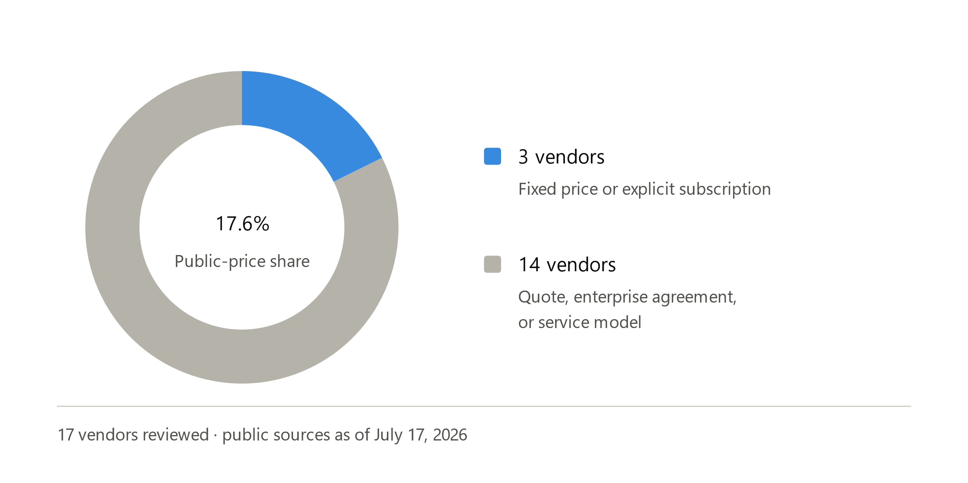
Only 3 of 17 vendors publish a fixed price
Four gaps InGen can test
Pilot economics
Publish a standard 90-day pilot range and a short TCO worksheet.
Security evidence
Track validated alerts, response time, and manual patrol reduction.
Outdoor packaging
Combine two recurring Rover workflows in one pilot.
Humanoid value
Compete on task results and deployment effort, not hardware price alone.
Pricing transparency and Sentinel security evidence should be tested first because they do not require new hardware.

Slide 4
Sentinel has the largest modeled three-year SOM revenue at $17.25M
Platform | TAM | SAM | Three-year SOM | Modeled SOM revenue
Fari | 14,695 facilities | 7,395 larger facilities | 74 facilities | $1.11M
Senpai | 100,237 schools | 28,218 target schools | 141 schools | $2.40M
Sentinel Prime AI | 1,283,470 deployment opportunities | 919,750 target-industry opportunities | 276 deployments | $17.25M
The market models use public institutional and employment data rather than a general robotics-market percentage.
Notes:
Fari: CMS nursing facility data
Senpai: NCES public school data
Sentinel Prime AI: BLS security guard employment data

Slide 5
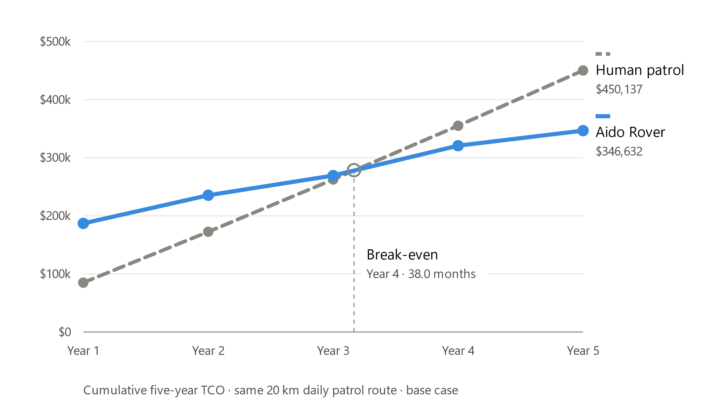
Rover lowers patrol cost by 23%, but breaks even in Year 4
Rover five-year TCO: $346,632
Human patrol five-year TCO: $450,137
Five-year savings: $103,505
Rover cost per km: $9.50
Human patrol cost per km: $12.33
Estimated payback: 38.0 months
Base case: both options cover the same 20 km daily patrol route. Labor hours and wage levels drive the result, while electricity has little effect.

Slide 6
A Sentinel deployment delivers $561,511 in NPV with a 7.6-month payback
Initial investment per deployment: $98,125
Discount rate: 7.75%
NPV per deployment: $561,511
IRR: 158.7%
Payback: 7.6 months
The model places the initial investment in Year 0 and discounts operating savings in Years 1–5.
Base case: one 24/7 security post, 25% human oversight, and 2% downtime backup.
Under the base case, one deployment is already NPV-positive, so the customer model does not imply a larger minimum contract size.

Slide 7
A three-year useful life is the largest downside risk
Scenario | Change vs. base | IRR | Payback
Base case | — | 158.7% | 7.6 mo.
Hardware cost +20% | −$21,420 | 131.3% | 9.2 mo.
Useful life: 3 years | −$243,864 | 149.8% | 7.6 mo.
All three scenarios remain NPV-positive. A three-year useful life reduces NPV by $243,864 because the model removes Years 4–5 savings.

Slide 8
Recommended KPI Framework and Next Steps
Platform | Deployment target | Operational target | Energy and customer economics | Business-health target
Fari | 74 paid facilities by Year 3 | ≥90% resident-session completion | Freeze kWh/session and cost/session baselines after pilot Day 30 | $13.5k–$16.5k revenue per facility-year
Senpai | 141 paid schools by Year 3 | ≥90% student-session completion | Freeze kWh/session and cost/session baselines after pilot Day 30 | $15.3k–$18.7k revenue per school-year
Sentinel Prime AI | 184–920 deployments, base 276 | ≥98% monitoring availability | ≤0.125 kWh per monitored hour and ≤$11.63 cost per hour, compared with $28.23 for human security | $11.25k–$13.75k recurring revenue per deployment-year
Next steps
Set Fari and Senpai baselines during the first 30 pilot days.
Test Sentinel cost and performance assumptions with pilot data.
Review operations monthly and business results quarterly.

