Slide 1
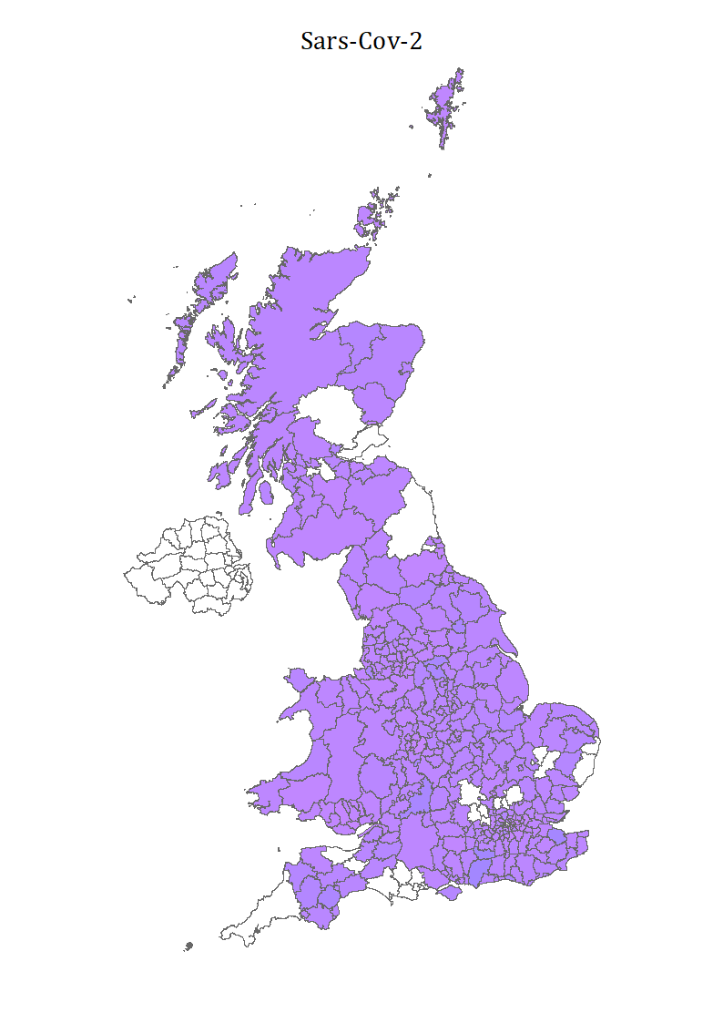
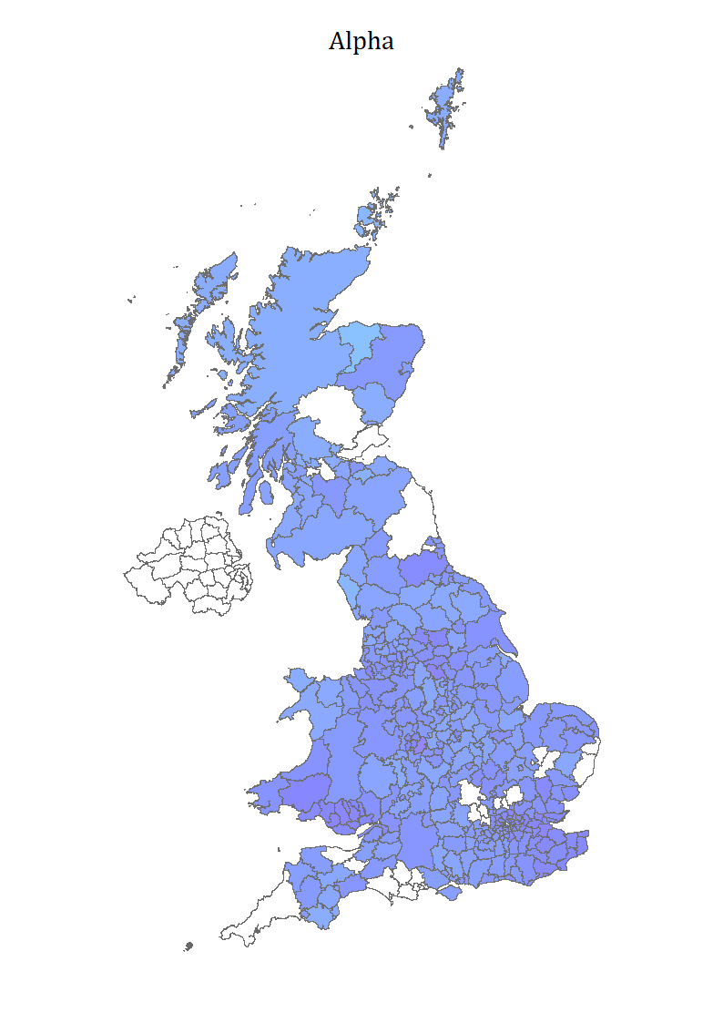

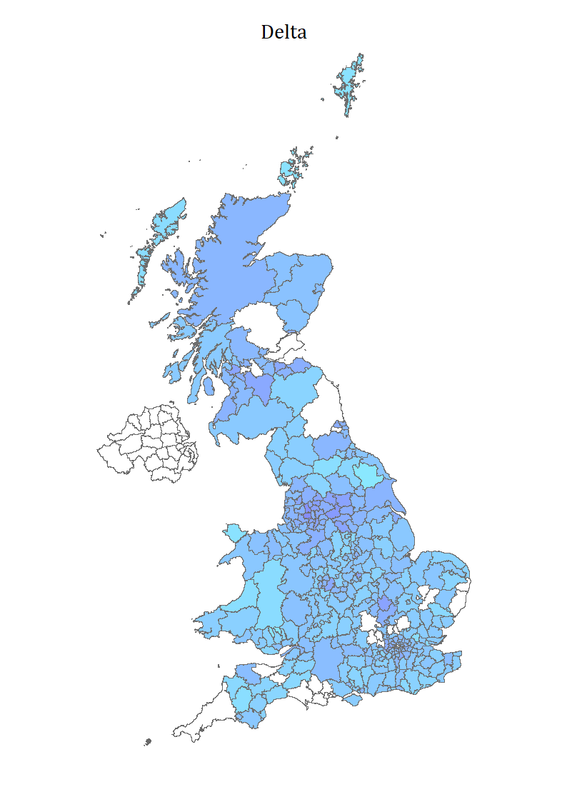
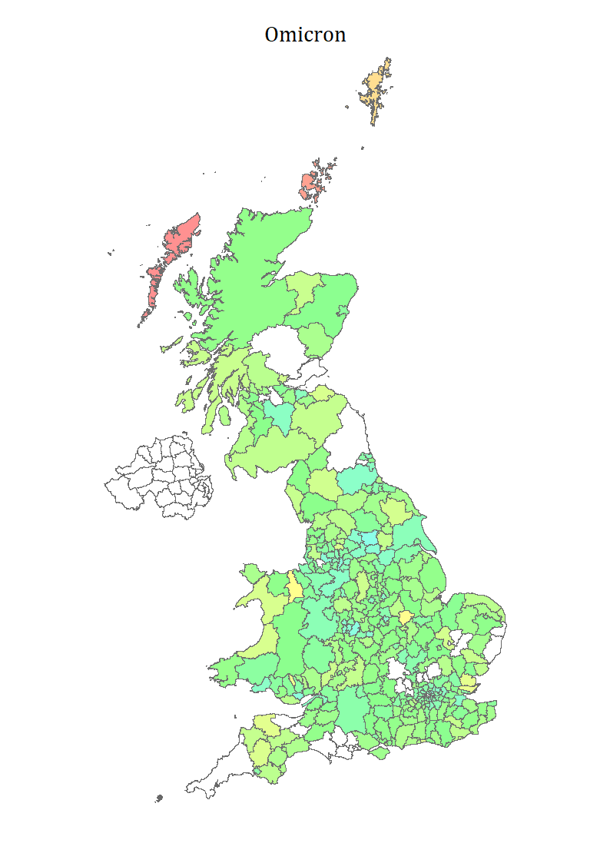
A)
B)
Moray
Birmingham
Birmingham
Chichester
C)
D)
Eilean Siar
Ryedale
Bolton
Leeds

