Slide 1


Lending Club Case Study
1

Slide 2
Contents
Business Objective
Problem Solving Approach
Top View of Profit & Loss
Conclusion Summary & Recommendation
Data Analysis Slides
Univariate Analysis
Segmented Univariate Analysis
Bivariate Analysis
2

Slide 3




Business Objective
Company
Business Challenge
Historical Data
Client’s Ask
The largest online loan marketplace
Lending loans to ‘risky’ applicants is the largest source of financial loss (called credit loss)
Not approving loans to the clients who are likely to repay, results in loss of business
The complete loan data of the time period 2007 to 2011
Identify driving factors behind loan default
It can be used for portfolio and risk assessment for reducing defaulters (credit loss)

Slide 4
Problem Solving Approach
Clean Data
Univariate Analysis
Segmented Univariate Analysis
Bivariate Analysis
Summarize Data Insights
Dropped columns with all NA values, conversion to appropriate data types
Derived columns like income buckets, loan amt buckets, P&L etc
1 page view captured to depict key drivers for defaulters
Each column is reviewed to understand frequency, unique values etc
2 or more columns/variables are reviewed together to analyse impact

Slide 5
Top View on Profit & Loss
Loan Data | Planned Recovery | Actual Recovery | Planned Profit | Actual Profit
Overall | 528730306 | 457792116 | 24% | 7%
Fully Paid | 439321840 | 419314516 |  | 17%
Charged Off | 89408466 | 38477600 |  | -44%
44% Loss in defaulter cases which drastically reducing overall profit to the company and urgent need to take corrective/preventive actions

Slide 6
Defaulters - Driving factors & Recommendation
Loan Amount
DTI
Interest Rate
Employee Length
Purpose
Public Records Bankruptcies
Bank Accounts
Grade
Term
Home Ownership
Verification Status
Income
Term: Offer 36 months term more as with positive trend compare to 60 months
Loan Amount: Reject loan amount > 15% of annual income for income < 200K
Home Ownership: Reduce loan request for Rent category or reduce loan amount
Employee length: < 2 yrs or 10+ yrs with highest defaulter risks. Apply further stringent steps
Interest Rate: Instead of keeping flat interest rate, apply more for boarder approval cases when higher DTI/Public Records/ Bank Accounts
Purpose: reduce loan sanction for ‘Small Business’ & ‘Renewable Energy’ or scrutinize deep
Verification Status: Mandate source verification as no major loss when income source was verified
Grade: Lower Grades/Sub Grades with higher defaulter risks
Note: Use slide navigator to see detailed analysis for each driving factor mentioned above

Slide 7
Univariate Analysis
Individual column was reviewed for values, unique categories, with frequency like below
Home Ownership:
Rent (18899)
Mortgage (17659)
Own (3058)
Other (98)
Not Specified (3)
Loan status:
Fully Paid (32950)
Charged Off (5627)
Current (1140) this column dropped off as not relevant
Term: 36 & 60 months
Interest Rate:
14.65% (39707 loan cases)
7 other different rates (10 loan cases)
Verification Status:
Not Verified ()
Verified
Source Verified
Pub Rec Bankruptcies:
0 (37339)
1 (1674)
2 (7)
Grade:
A(10085), B(12020), C(8098), D(5307), E(2842), F(1049), G(316)
DTI:
count(39717), mean(13.31), std(6.67),
min(0), 25%(8.17), 50%(13.40), 75%(18.60), max(29.99)

Slide 8
Segmented Univariate Analysis
Income Buckets
50 15389
100 17707
200 4911
300 399
400 81
600 66
500 24
Below columns are derived and analysed individually
Annual income bucket (50 K – 400K)
Loan Amount Bucket (5 K – 40K)
P&L: (Total Payment – Loan Amount)/ Loan Amount
Expected Recoveries: Installment * Term
P_L (Profit & Loss)
count 38577
mean 7.80
std 27.30
min -100
25% 6.96
50% 13.90
75% 21.04
max 68.84
Expected Recoveries
count 38577
mean 13705
std 9904
min 564
25% 6422
50% 11199
75% 18225
max 60303
Loan Amount Buckets
5 9472
10 12802
20 12032
30 3536
40 735

Slide 9
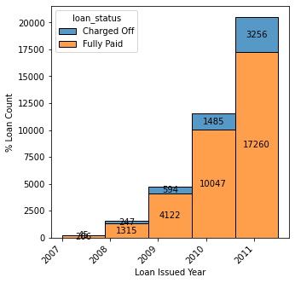
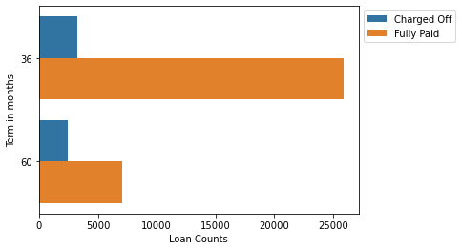
Bivariate Analysis – Year & Term
Loan count is trending up but defaulter rate is consistent between 15% - 18% for last 3 years
36 months loan term with better results than 60 months
Better to offer more 36 months Term loans
Go Back

Slide 10
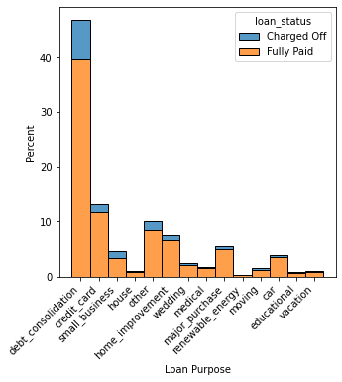
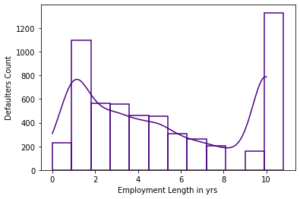
Bivariate Analysis – Employee Length & Purpose
Employment length < 2 yrs & 10+ years to be watched as deflater peaks
Below loan purpose categories to be handled cautiously as % defaulters are higher side
Dept Consolidation
Credit Card
Small Business
Highest % defaulters are in Small Business Category
Go Back

Slide 11
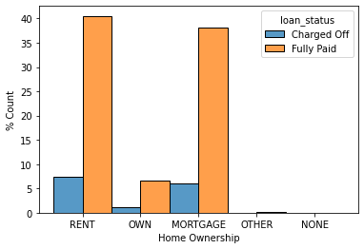
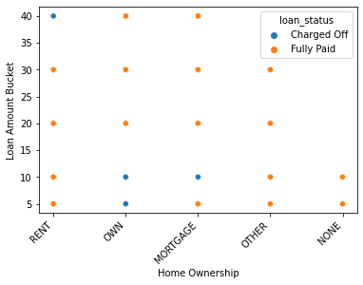
Bivariate Analysis – Home Ownership
% Defaulters high in case of Rent & Mortgage
In case of Rent, defaulters with top loan amount bucket
Reduce providing loans as well as reduce loan amount for Rent category
Go Back
11

Slide 12
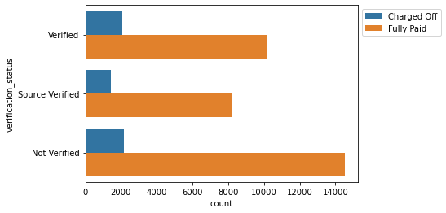
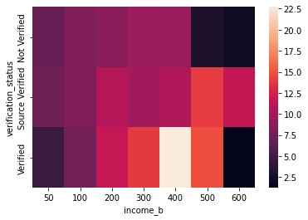
Bivariate Analysis – Verification Status
Surprisingly defaulter rate is lower in 'Not Verified' state compare to 'Verified' & 'Source Verified’
But, no major losses when source was verified. Better to mandate verification & source verification process
Go Back
12

Slide 13
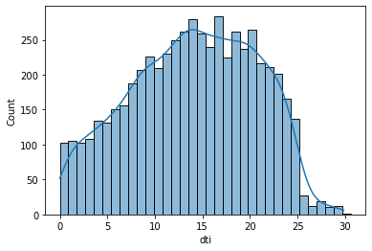
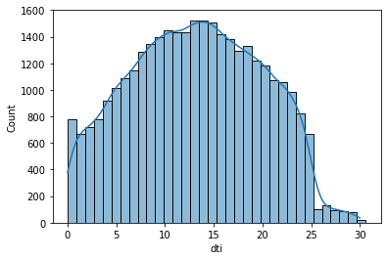
Bivariate Analysis – DTI Vs Loan Status
Defaulter (loan status = “Charged Off”) count is trending up with DTI value
Peaks observed DTI > 14; securitize deep for these loan requests
Defaulters
Non defaulters
Go Back

Slide 14
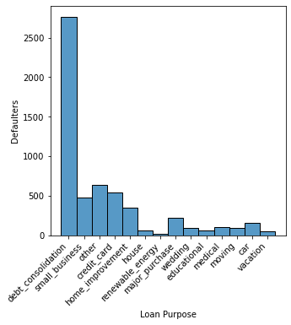
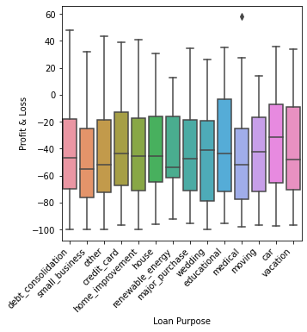
Bivariate Analysis – Loan Purpose & P&L
2 loan purpose categories – ‘Debt Consolidation’ & ‘Small Business’ with highest defaulters
2 industries – ‘Small Business’ & ‘’Renewable Energy’ with maximum average loss
Go Back

Slide 15
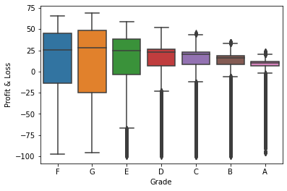
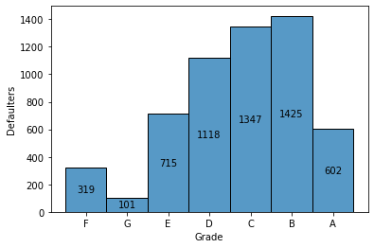
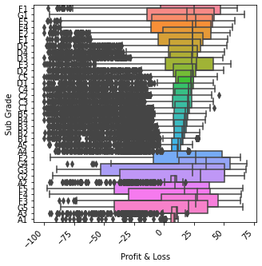
Bivariate Analysis – Profit & Loss across Grades
Grade: profit improves as grade upscale, but high risk with lower grades
Sub Grade: heavy loss making cases for middle sub grades though major cases are profit making
Initial sub grades are with wide spread across loss and profit scale and to be reviewed closely
Go Back

Slide 16
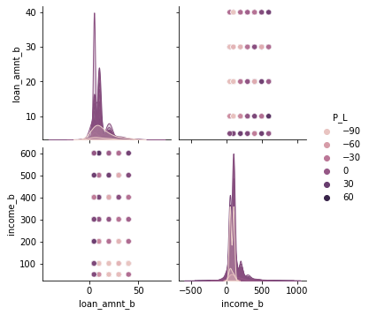
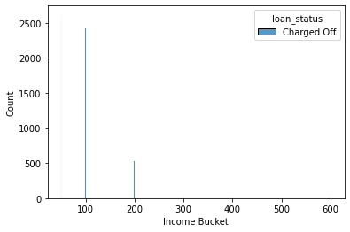
Bivariate Analysis – Profit & Loss, Income, Loan Amount
Income < 200K & loan amount between 15K to 40K to be scrutinized to mitigate loss risks or increase interest rate to have better recovery
Income < 200K, sanction loan up to 15% of annual income
Go Back

Slide 17
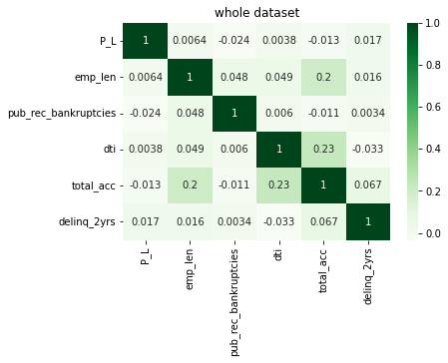
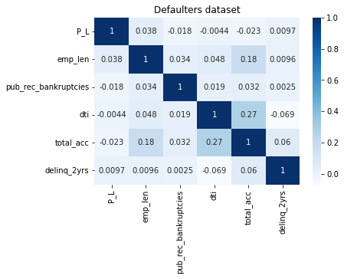
Bivariate Analysis – Watch Profit & Loss across key variables
Overall not very strong corelation but certainly employee length is positively impacting whereas below 3 drivers for loss making
Public Records (Bankruptcies)
DTI
Number of Bank Accounts
Go Back

Slide 18

The Goal was to turn data into information
and information into insights

