Slide 1

Lending Club Case Study
Exploratory Data Analysis

Slide 2




Business Objective
Company
Business Challenge
Historical Data
Client’s Ask
The largest online loan marketplace
lending loans to ‘risky’ applicants is the largest source of financial loss (called credit loss)
The complete loan data of the time period 2007 to 2011
Identify driving factors behind loan default
It can be used for portfolio and risk assessment for reducing defaulters (credit loss)

Slide 3
Problem Solving Approach
Clean Data
Univariate Analysis
Segmented Univariate Analysis
Bivariate Analysis
Summarize Data Insights
Dropped columns with NA values, conversion to appropriate data types
Dropped columns with all NA values, conversion to appropriate data types
Dropped columns with NA values, conversion to appropriate data types
Dropped columns with NA values, conversion to appropriate data types
Dropped columns with NA values, conversion to appropriate data types

Slide 4
Data Insights Summary
Loan Amount
Reject if loan amount > 30% of annual income
Interest Rate
Purpose
RLUR
Public Records

Slide 6
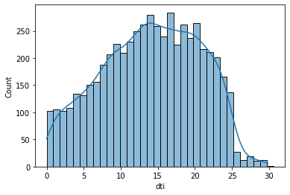
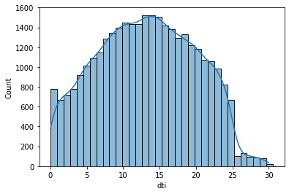
Data Insights 1/10
Bivariate Analysis – DTI Vs Loan Status
Defaulter (loan status = “Charged Oss”) count is trending up with DTI value
Peaks observed DTI > 14; securitize deep for these loan requests
Defaulters
Non defaulters

Slide 7
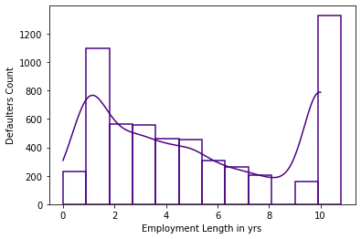
Data Insights 1/10
Bivariate Analysis – Employment Vs Defaulter Count
Employment length < 2 yrs & 10+ years to be watched as deflater peaks

Slide 8
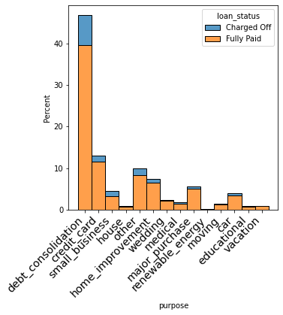
Data Insights 1/10
Bivariate Analysis – Loan Purpose Vs Defaulters
Below purpose categories to be handled cautiously as % defaulters are higher side
Dept Consolidation
Credit Card
Small Business
Highest % defaulters are in Small Business Category

Slide 9
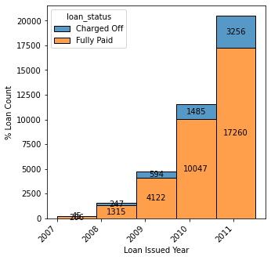
Data Insights 1/10
Bivariate Analysis – year wise trend
Loan count is trending up but defaulter rate is consistent ~18% for last 3 years

Slide 10
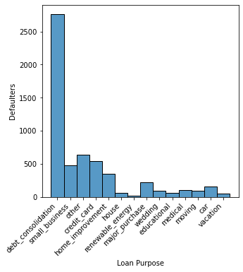
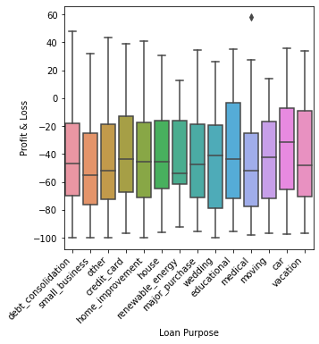
Loan Purpose

Slide 11
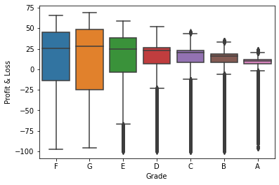
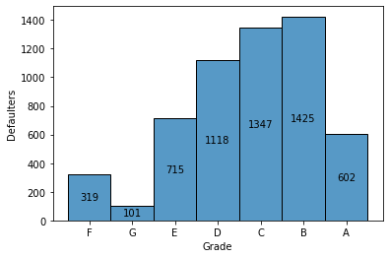
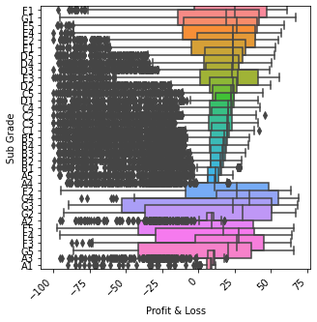
Data Insights 1/10
Bivariate Analysis – Profit & Loss across Grades & Sub Grades
Grade: profit improves as grade upscale, but lower grades are risky
Sub Grade: heavy loss making cases for middle sub grades though major cases are profit making. Initial sub grades are with wide spread across loss and profit scale and to be watched closely

Slide 12
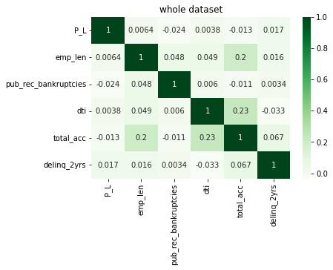
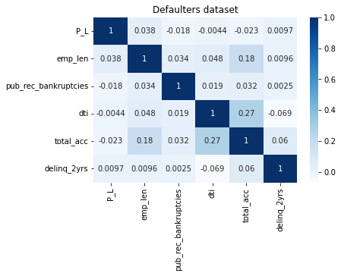
Data Insights 1/10
Bivariate Analysis – Watch Profit & Loss across key variables
Overall not very strong corelation but certainly employee length is positively impacting whereas below 3 drivers for loss making
Public Records (Bankruptcies)
DTI
Number of Bank Accounts

