Slide 1

T05 • OPD FLOW
OPD RAQ AIA
T05
OPD Risk-Aware Queue AI Agent
OPD Flow
Clinical urgency matters,
not just parcha numbers.
Working prototype
Problem Statement ID: T05
Theme: AI-enabled healthcare
Problem Title: OPD Flow
Team: Rujal Raj Singh
PS Category: Software
Team ID: AAYU-J9F7
01 / 10
Live Groq integration • Synthetic data • Clinical validation pending
Notes:
OPD RAQ AIA is our working hackathon prototype for T05, OPD Flow. It registers synthetic patients, suggests urgency and reorders a fixed-token queue. Groq is enabled, using the pretrained OpenAI GPT-OSS 120B model; we did not train or fine-tune it. Staff remain able to change the priority and request doctor review. This is not clinically validated and is not for real patient care. Team ID AAYU-J9F7. The application was developed iteratively with Codex/ChatGPT assistance across preparation and hackathon changes; do not claim that all work was written manually or completed in an eight-hour window. Sources: repository README and verification history; supplied Aayu T05 problem and presentation template. Live demo: https://opd-raq-aia.onrender.com . Repository: https://github.com/RujalRaj/OPD-RAQ-AIA .

Slide 2
THE OPD PROBLEM
Same token. A queue that responds to urgency.
Illustrative T05 scenario • original token numbers stay fixed
CURRENT TOKEN ORDER
OPD RAQ AIA SUGGESTS
23
Routine thyroid refill
87
IMMEDIATE
Chest tightness
+ sweating
Chest tightness with sweating.
87
Prompt clinical staff to assess now.
60-year-old man
23
ROUTINE after review
Symptoms + recorded vitals → priority + a short reason
02 / 10
Notes:
Use the problem statement story to explain the need, not as evidence of a tested medical decision: token 87 is a 60-year-old man with chest tightness and sweating, while token 23 is attending for a routine thyroid refill. The prototype can surface urgency without replacing either token. The story is illustrative and adapted from the supplied Aayu 2026 T05 brief; it is not a patient dataset or a measured clinical outcome. The routine label shown is conditional on the assessed context. The screenshot/demo queue is a separate synthetic set. Source: supplied T05 OPD Flow problem statement and original presentation.

Slide 3
CURRENT WORKFLOW
From registration to doctor.
3 STAFF DASHBOARD
1 REGISTRATION
2 ASSESSMENT
Language → About you
→ Staff-recorded vitals
Temp • SpO₂ • pulse
Supplied safety
rules run first.
IMMEDIATE
SOON
Then symptoms → Review
Voice / text / checkboxes
Staff emergency shortcut:
Immediate + token
No Immediate rule?
Groq suggests a priority
and a short reason.
ROUTINE
Reasoned override
Unresolved → Doctor
Validate → fixed token
Nurse / Intern / JR: reason + new measurement → audited priority change
03 / 10
React + Vite • FastAPI • SQLite • Groq
Notes:
Begin with language, About You and staff sign-in/vitals. Temperature, SpO2 and pulse are required; temperature and pulse permit a numeric value or High/Low, while SpO2 must be numeric. Other vitals may remain unknown. High/Low does not invent a number or automatically make the priority Immediate. Staff-assessed emergency creates an audited Immediate decision and a token, skipping symptoms and AI. Otherwise the patient contributes symptoms through voice, text or the eight grouped checkbox sections, then staff review before submission. The backend applies the supplied source rules. An Immediate rule bypasses the model; otherwise Groq may propose Immediate, Soon or Routine, subject to response validation and source safety limits. The receipt handles pending AI; priority updates do not change the token. The dashboard defaults to Immediate and switches groups via a dropdown. Nurses, interns and JRs need a reason and at least one new numeric measurement to override; doctors need a reason. Any permitted staff member can request doctor review with a reason. Only a doctor resolves an Unresolved review with a note. Sources: frontend/Intake, RegistrationVitals and PatientDetail; backend/main.py, schemas and services; README.

Slide 4
INNOVATION
A practical workflow around the existing queue.
DESIGN CHOICE
WHAT IT ADDS
Fixed tokens
Urgency changes the order; parcha stays the same.
Hindi + English
Original report and translation shown side by side.
Fast intake
Voice, text or eight grouped checkbox sections.
Rules + live AI
Source guardrails constrain model suggestions.
Staff authority
Emergency shortcut, overrides and doctor review.
Our contribution: OPD workflow, integration and accountable staff decisions.
04 / 10
Notes:
The innovation is the integration and workflow: urgency-aware sorting without changing registration identity; short, grouped multilingual intake; original wording alongside a translation; and clear staff authority with records of changes. We do not claim to have invented triage or a new foundation model. Eight checkbox groups contain the team-supplied symptom options and expand on demand. Live Groq suggestions are bounded by source safety checks. A staff emergency shortcut bypasses lengthy symptom collection only after the three required vitals. The third-party libraries, model, source matrix and presentation template are credited in the README and dependency notices. Sources: implementation, PROJECT_HANDOFF.md, Planout.xlsx, subsequent team requirements.

Slide 5
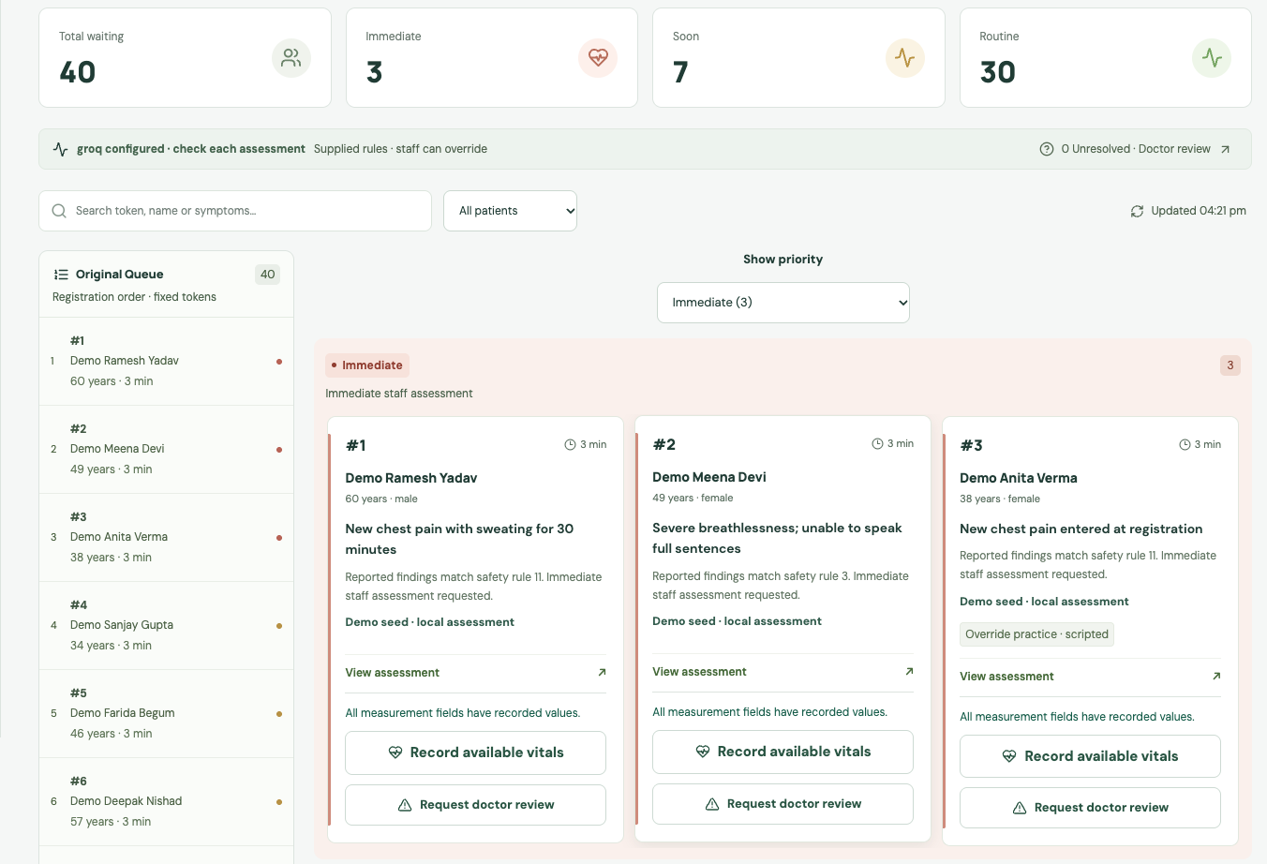
WORKING PROTOTYPE
Live app. A complete staff review loop.
40 synthetic patients • 3 Immediate / 7 Soon / 30 Routine
1 Show live assessment
Priority + reason, with original
and translated symptoms.
2 Demonstrate staff control
Anita: add reason + pulse,
change priority, keep the token.
Then show the audit history.
195 backend + 9 frontend tests
7 affected browser scenarios
05 / 10
opd-raq-aia.onrender.com
Notes:
Demo sequence: open the live URL and use Fill credentials to sign in as Nurse. The prepared queue starts at 3 Immediate, 7 Soon and 30 Routine; these seeded priorities are explicitly labelled local demo assessments. Eligible new registrations and reassessments use live Groq. Show the priority dropdown and open Demo Anita Verma, the scripted registration-error practice case. Choose Routine, enter the clarification in the reason box, add a numeric pulse measurement such as the synthetic value 82, then apply the override. Her original token and original report remain unchanged, while the queue and audit history reflect the change. The practice case is not evidence of a measured AI mistake. Show Original / Translated boxes, then Request doctor review and the Unresolved filter if time allows. Sign in as Doctor to resolve with a note. Current recorded checks: 195 backend tests; 9 frontend tests; 7 affected browser scenarios; production build and hosted smoke checks. A live synthetic Groq reassessment and two live translation calls succeeded. This is software/connectivity verification, not clinical validation. Screenshot: docs/assets/live-dashboard.png captured from this project on 13 October 2026. Evidence: docs/verification.md. Shared free Render demo may start slowly after inactivity; its SQLite data may reset on restart. Live: https://opd-raq-aia.onrender.com ; code: https://github.com/RujalRaj/OPD-RAQ-AIA .

Slide 6
HEALTHCARE EXPERIENCE
Clinical and engineering backgrounds.
Designed for a government general OPD in Gorakhpur, Uttar Pradesh.
Prof. Raj Kishore Singh
Dr. Aradhana Singh
Medicine • BRD Medical College
OBG • AIIMS Gorakhpur
CSE–AIML member
CSE–AIML developer • TCS
AI development
Software development
Early vitals • Hindi/English intake • Staff control • Doctor escalation
06 / 10
Notes:
The supplied team slide lists Prof. Raj Kishore Singh, Medicine, BRD Medical College; Dr. Aradhana Singh, OBG, AIIMS Gorakhpur; a CSE–AIML member; and a CSE–AIML developer associated with TCS. Engineering names were not supplied for those roles, so none are invented here. These are the backgrounds stated by the team, not endorsements from their institutions. No years of experience or formal clinical validation are claimed. Explain the healthcare-oriented workflow choices requested by the team: staff-led entry, early mandatory vitals, patient participation only for symptom reporting when appropriate, preservation of the parcha number and escalation of an unresolved case to the doctor. Describe specific clinician review or field testing only if the team can substantiate it. Formal clinical evaluation remains pending. Source: the supplied final presentation, slide 7, and the team’s implementation requirements.

Slide 7
SAFETY AND IMPLEMENTATION
Checks around every AI suggestion.
AREA
CURRENT IMPLEMENTATION
Live model
Groq GPT-OSS 120B; no training or fine-tuning.
Response checks
Structured JSON + validation + safety limits.
Unknown values
Missing numbers stay unknown, never normal.
Staff decisions
AI reassessment preserves a staff override.
Model failure
Rule fallback is labelled; staff review requested.
Synthetic demo only. No diagnosis, prescription or clinical validation.
07 / 10
Notes:
The live provider is Groq using model ID openai/gpt-oss-120b through the OpenAI Python SDK and a Groq API base URL. The model is pretrained and no training dataset or fine-tuning was created. The FastAPI backend supplies structured context and a constrained schema, validates model output, and prevents the AI result from lowering a source-derived safety floor or replacing a staff decision. Prompt and JSON structure alone do not prove clinical safety. The source Safety Matrix is the proximate rule source; its unresolved example mismatches are documented in docs/source-gaps.md. Temperature/pulse High or Low are qualitative observations with null numeric values. The source numeric rules cannot invent thresholds from them; the model is told not to fabricate numbers. If a response is unavailable or invalid, the labelled source-rule result and staff-review request remain visible. Role checks, version checks and append-only audit records are enforced server-side. Doctors must give a reason to override; nurses/interns/JRs additionally need a new numeric measurement. This is a synthetic hackathon prototype, not a clinical device or a treatment system. Sources: backend/services/ai.py and triage rules, schemas, tests, README, docs/source-gaps.md. Model documentation: https://console.groq.com/docs/model/openai/gpt-oss-120b .

Slide 8
IMPACT
Make urgency visible at registration.
PATIENTS
NURSES
DOCTORS
Report symptoms
in their language.
See priorities;
record a correction.
Review symptoms,
vitals and changes.
MEASURE IN A SUPERVISED EVALUATION
Time to staff
assessment
Missed urgent cases
and disagreements
Intake time and
translation errors
08 / 10
Intended benefits; no measured clinical outcomes.
Notes:
The intended benefit is earlier visibility of urgent concerns and less effort communicating across language or literacy barriers, with staff able to correct the result. We have demonstrated the mechanics with synthetic data, not a reduction in waiting time, mortality or workload. A future supervised evaluation should measure registration-to-staff-assessment time, missed urgent cases, unnecessary escalations/disagreements, intake completion time, assistance required and translation errors. Measures shown here are a proposed evaluation plan, not measured statistics. Clinical review, ethics/governance and local workflow approval would be needed before a real-patient evaluation. The current 195 tests are software checks, not diagnostic or triage accuracy. Source: current project scope and limitations; responsible oversight background https://www.who.int/publications/i/item/9789240029200 .

Slide 9
FUTURE PROSPECT
Next steps after the prototype.
1
Connect records and extend clinician support
ABDM/ABHA; diagnostic assistance; doctor-approved prescription + leaflet.
2
Support follow-up and improve reliability
Follow-up and emergency alerts; better models; broader reviewed rules.
3
Prepare for limited connectivity
Local inference and local-network operation, with battery or backup power.
Planned features. Clinical evaluation is required before patient use.
09 / 10
Notes:
These are the seven future directions approved by the team and listed in the README: ABDM/ABHA integration; clinician assistance in diagnosis from symptoms, vitals, history and doctor conversation; prescription drafts approved by the doctor with a patient leaflet in the patient’s language; follow-up reminders and patient emergency alerts with a defined response process; comparison/integration of better models; a more comprehensive clinician-reviewed safety matrix; and offline inference/local-network operation for poor connectivity. Diagnosis support and prescriptions are not implemented in the current demo. ABHA is currently a placeholder and has no record-fetch integration. Present local operation still requires electricity; battery or UPS would be needed during an outage. Offline model inference is planned, while local forms/database/audio and source-rule fallback already work without hosted inference. Source: README Future prospect, exactly the user-approved scope.

Slide 10
ACKNOWLEDGEMENTS
What we used and adapted.
1
Problem, template and clinical references
Aayu T05 + template; team handoff/matrix; WHO IITT and AI governance.
2
AI assistance and existing models
Codex/ChatGPT-assisted build; Groq + OpenAI GPT-OSS 120B + SDK.
3
Software, voice and visual assets
React/Vite, FastAPI/SQLite; Edge voices; Lucide; Fontsource; Render.
github.com/RujalRaj/OPD-RAQ-AIA
Full source, tool and dependency credits are in README + THIRD_PARTY_NOTICES.
10 / 10
Notes:
Acknowledgements and provenance: Aayu 2026 / DevAarambh supplied the T05 OPD Flow problem and the visual template retained here. The template background and logos were not created by this project. PROJECT_HANDOFF.md and Planout.xlsx (originally Updated_PRANA_Hackathon_Battle_Plan.xlsx) supplied starting requirements, example cases and the Safety Matrix. Team-provided symptom text and later instructions shaped the implementation. The source material cites WHO/ICRC/MSF IITT and NEWS2-informed guardrails; this app is not an independently validated implementation of those protocols. IITT source: https://www.who.int/tools/triage . WHO Ethics and governance of artificial intelligence for health (2021): https://www.who.int/publications/i/item/9789240029200 . OpenAI Codex/ChatGPT assisted coding, debugging, tests, synthetic data, wording, documentation and presentation preparation. The team supplied workflow choices and corrections. Groq hosts the existing OpenAI GPT-OSS 120B model; model source documentation https://console.groq.com/docs/model/openai/gpt-oss-120b ; SDK https://github.com/openai/openai-python . No training or fine-tuning was performed. React, Vite, TypeScript, FastAPI, Pydantic, SQLAlchemy, SQLite and their dependencies underpin the app. Lucide icons and Fontsource DM Sans, Manrope and Noto Sans Devanagari are credited with notices. Fixed audio was generated with edge-tts and Microsoft Edge Swara/Neerja voices, using PyAV/NumPy; a legacy asset used gTTS/Google Translate TTS. Local faster-whisper checked generated speech and is not the runtime speech-input provider. Optional browser speech recognition uses the Web Speech API. pytest/Vitest/Playwright/Testing Library/axe-core/Ruff/Prettier support verification. Git/GitHub/VS Code/Docker/Render support development and hosting. Screenshots and the current 40-case queue contain synthetic demo data. AI model/voice services remain governed by their own terms. Full exact dependency inventory and preserved font/icon licences: https://github.com/RujalRaj/OPD-RAQ-AIA/blob/main/THIRD_PARTY_NOTICES.md . No WHO or institutional endorsement is claimed.

