Slide 1
Signals and Systems
Project Based Learning
Project Title:
EMG-Based Assistive Device for Enhanced Human Computer Interaction
Rujul Rumale 23EG104B51
Sai Vignesh 23EG104B49
Supervisor
Dr. Raghu Indrakanti
Assistant Professor
Dept. of ECE
Branch and Section: ECE-B
Dept. of Electronics and Communication Engineering

Slide 2
Problem Statements:
There is a growing need for assistive technology that enables individuals with limited mobility to interact with computers more effectively.
Existing Human-Computer Interaction (HCI) systems often rely on fine motor skills, which may not be suitable for users with muscular impairments.
People with disabilities like amputated wrist or arms have a difficult time interacting with electronic devices which primarily use touch or mouse input.
They lack the motor function to properly use the devices to the full extent

Slide 3
Solution:
Make a interface which can use muscles from different parts of the body as an input to an electronic device
Objectives
To develop a system that uses EMG signals to control a computer mouse.
To implement techniques for signal processing, including noise filtering and thresholding, to ensure accuracy of the input signal
To test and validate the system’s usability in real-world scenarios.

Slide 4
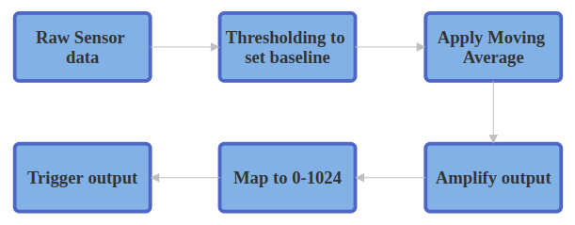
Process
Acquire EMG Signal.
Perform signal processing, Bandpass, Filtration, Amplification, etc.
Send data to computer and process mouse movement.

Slide 5
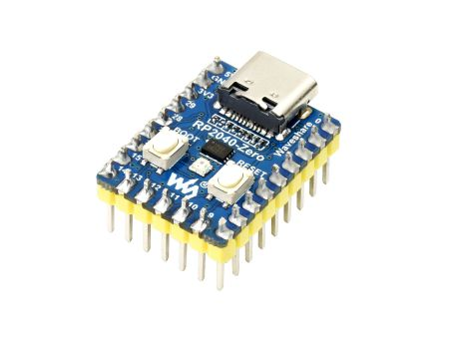
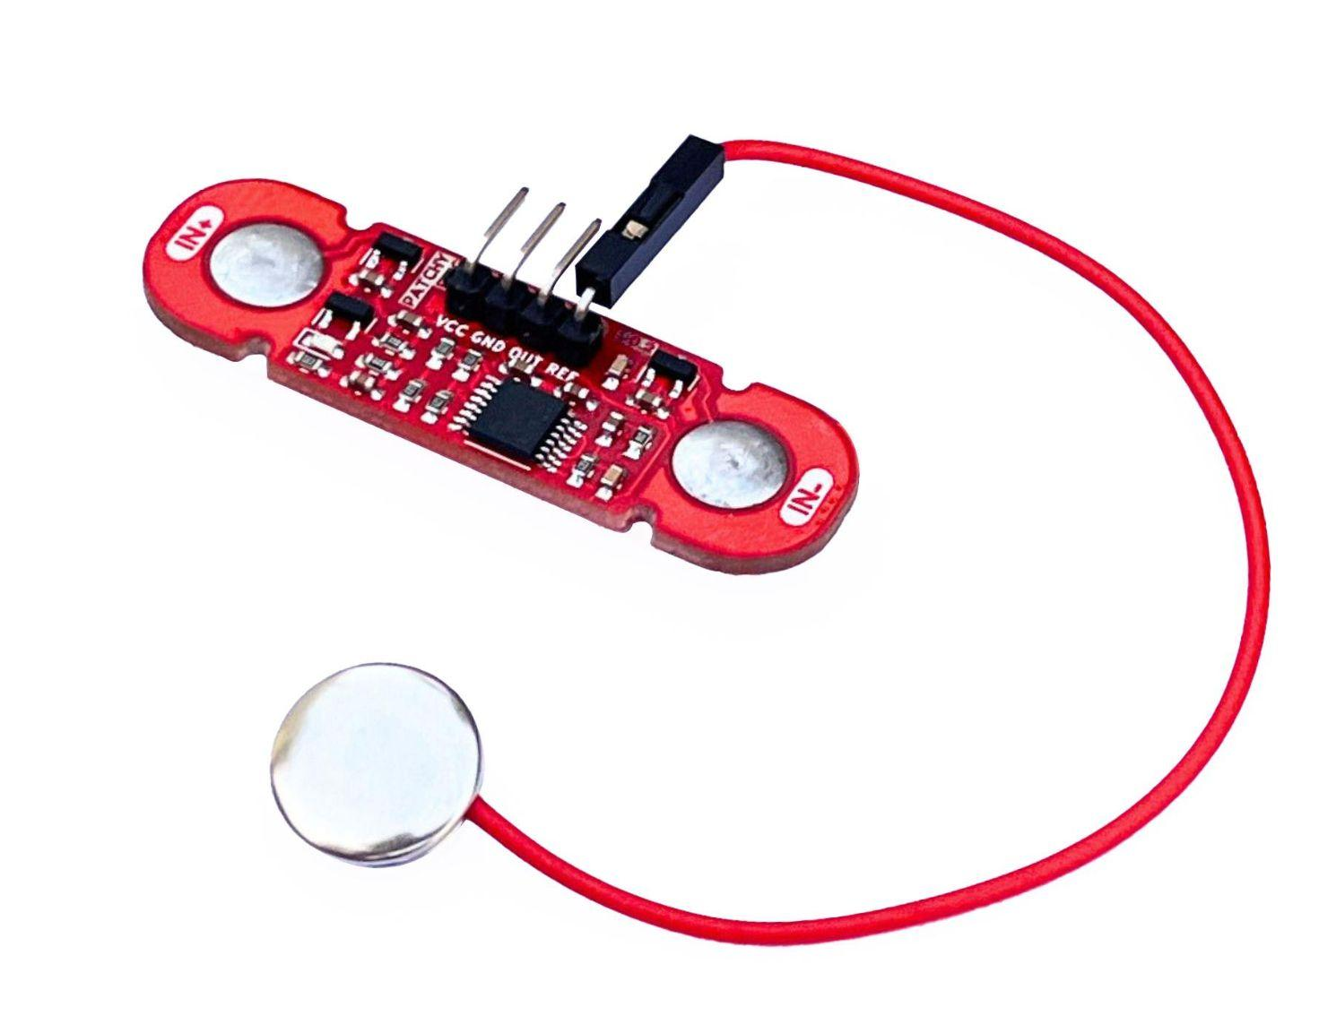
Implementation: Hardware
Components:
Waveshare RP2040 zero- Low cost, low power, small
form factor micro controller with powerful
Arm Cortex M0+ cores at 133Mhz and 12 bit ADC for
higher resolution analog signal processing
Upside down labs Muscle Bioamp Patchy-
2 wearable EMG sensors
with an integrated band pass filter 72-720Hz

Slide 6
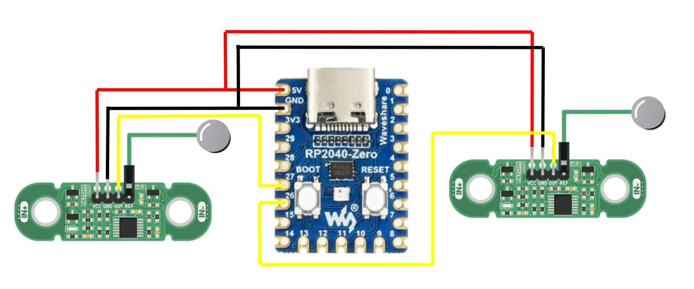

Slide 7
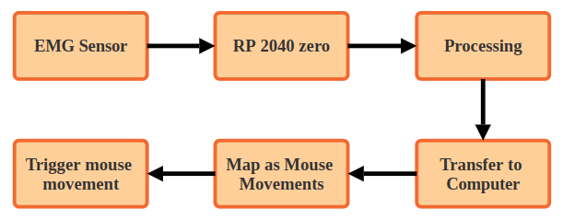

Slide 8


Implementation: Software
Arduino IDE- Simple and easy to use, wide support
for multiple libraries for microcontrollers
Python 1.12-
Powerful programming language with libraries for
extended control on microcontrollers and computers
Libraries used:
serial
pyautogui
time, csv

Slide 9
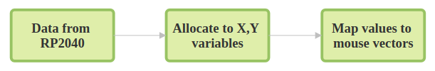

Slide 10
Implementation: Signal Processing
Thresholding: Only strong signals (indicating deliberate muscle activity) were passed to control the mouse.
Noise Filtering and smoothing: Moving average filter was applied to smooth out the EMG signal and reduce artifacts.
Signal Amplification: As EMG sensor signals are weak(~3.3v), they were amplified before processing to make sure muscle movements were detected accurately.
Real-time Processing: Signal processing was done in real-time to ensure immediate feedback and smooth mouse control.

Slide 12
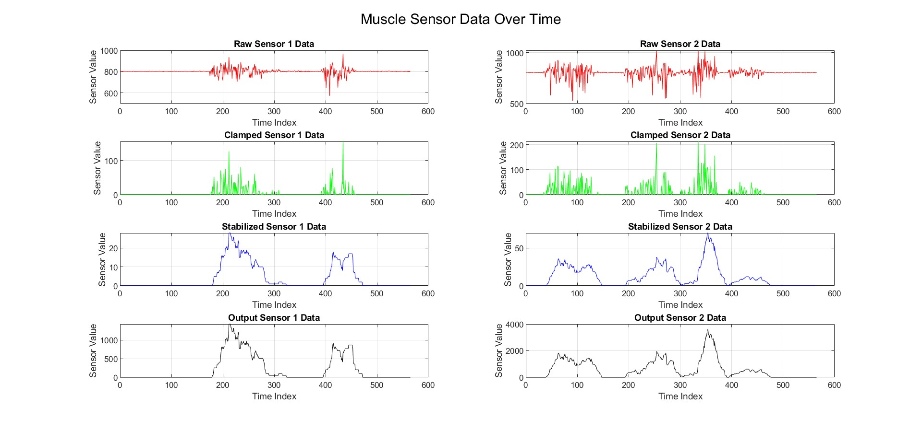
Implementation: Signal Processing

Slide 13
Testing & Validation:
EMG signal processing was verified by using the serial plotter available in Arduino IDE
Serial communication was tested using python serial library and data was saved to a csv file and hence verified
EMG signals were sent through serial communication and verified by plotting rhe resulting CSV file in MATLAB
mouse movement was tested by using a python script with the pyautogui
library

Slide 14
Final Report & Analysis
Key Takeaways
EMG signals can be used to provide computer inputs without using traditional methods
signals accuracy and responsiveness are good but still can be improved
They can also be used for applications other than the computer control like robotics mechanical arm control etc

Slide 15
Future Upgrades/Possibilities
More sensors for multi channel control, making more advanced control available
Simplifying the program and algorithms for efficient and faster execution
Getting better signals by testing different filters like boxcar and gaussian smoothing
Adding on the go adjustable sensitivity for user’s ease of use
Implementing a mouse mapping algorithm for control without extreme muscle contraction.

Slide 16
Conclusion
Successfully Acquired EMG sensor data and applied signal processing like amplification and Filtering.
Achieved EMG to mouse movement by mappint the processed output to mouse vector
Found potential for improvement and learnt about different algorithms and methods for signal processing

Slide 17
Thank You

