Slide 1
Stimulus Checks and Consumer Spending
Aaron Davis, Navya Sonti, Rujula Nadipi, Swapnil Sethi, and Ujas Shah

Slide 2
Do stimulus checks help the economy?
(using high customer spending as a proxy for economic health)

Slide 3
Why Should YOU Care How Healthy the US Economy Is?
Healthy Economy –> More Jobs
&
Healthy Economy –> Better-Paying Jobs

Slide 4
Data Source & Associated Paper
https://github.com/OpportunityInsights/EconomicTracker
“The Economic Impacts of COVID-19: Evidence from a New Public Database Built Using Private Sector Data”, by Raj Chetty, John Friedman, Nathaniel Hendren, Michael Stepner, and the Opportunity Insights Team. November 2020. Available at: https://opportunityinsights.org/wp-content/uploads/2020/05/tracker_paper.pdf

Slide 5
Replace NA values with 0
# https://stackoverflow.com/questions/45576805/how-to-replace-all-na-in-a-dataframe-using-tidyrreplace-na df <- df %>% replace(is.na(.), 0) df <- df %>% filter(spend_all != 0)

Slide 6
Combine Weekly and Daily Data
df_weekly <- df %>% group_by(year, week, stateabbrev) %>% summarize(spend_all = mean(spend_all), contclaims_rate_combined = mean(contclaims_rate_combined), bg_posts = mean(bg_posts), emp = mean(emp), gps_retail_and_recreation = mean(gps_retail_and_recreation), gps_grocery_and_pharmacy = mean(gps_grocery_and_pharmacy), gps_parks = mean(gps_parks), gps_transit_stations = mean(gps_transit_stations), gps_workplaces = mean(gps_workplaces), gps_residential = mean(gps_residential), gps_away_from_home = mean(gps_away_from_home), new_case_count = sum(new_case_count), new_death_count = sum(new_death_count), case_count = max(case_count), death_count = max(death_count), date = max(date))
## `summarise()` has grouped output by 'year', 'week'. You can override using the `.groups` argument.
df_weekly <- left_join(df_weekly, state_id, by = c("stateabbrev"))

Slide 7
Adding Stimulus Check Data
df_weekly <- df_weekly %>% mutate( first_check = (if (date < ymd("2020-04-15")) { 0 } else { 1 }), second_check = (if (date < ymd("2021-01-04")) { 0 } else { 1 }), third_check = (if (date < ymd("2021-03-18")) { 0 } else { 1 }) )

Slide 8
Plotting spending over time for all states and categories
(The dates for the stimulus checks were approximated from this article.)

Slide 9
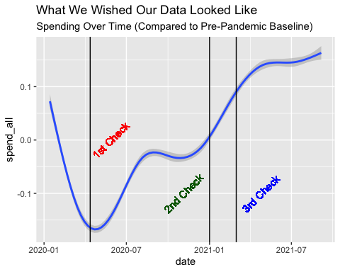

Slide 10
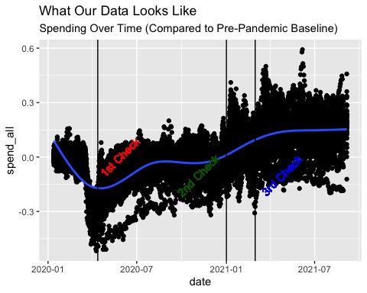

Slide 11
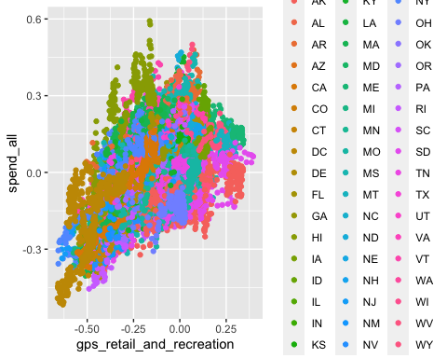

Slide 12
Training a Linear Model
## ## Call: ## lm(formula = spend_all ~ gps_retail_and_recreation + emp + first_check + ## second_check + third_check, data = df_weekly) ## ## Residuals: ## Min 1Q Median ## -0.34163 -0.04494 0.00693 ## 3Q Max ## 0.04757 0.41405 ## ## Coefficients: ## Estimate ## (Intercept) -0.041870 ## gps_retail_and_recreation 0.308678 ## emp 0.185988 ## first_check 0.044965 ## second_check 0.133771 ## third_check 0.013451 ## Std. Error ## (Intercept) 0.003174 ## gps_retail_and_recreation 0.012020 ## emp 0.025534 ## first_check 0.003733 ## second_check 0.004405 ## third_check 0.004700 ## t value ## (Intercept) -13.190 ## gps_retail_and_recreation 25.681 ## emp 7.284 ## first_check 12.045 ## second_check 30.367 ## third_check 2.862 ## Pr(>|t|) ## (Intercept) < 2e-16 ## gps_retail_and_recreation < 2e-16 ## emp 3.81e-13 ## first_check < 2e-16 ## second_check < 2e-16 ## third_check 0.00423 ## ## (Intercept) *** ## gps_retail_and_recreation *** ## emp *** ## first_check *** ## second_check *** ## third_check ** ## --- ## Signif. codes: ## 0 '***' 0.001 '**' 0.01 ## '*' 0.05 '.' 0.1 ' ' 1 ## ## Residual standard error: 0.08172 on 4482 degrees of freedom ## Multiple R-squared: 0.6325, Adjusted R-squared: 0.6321 ## F-statistic: 1543 on 5 and 4482 DF, p-value: < 2.2e-16

Slide 13
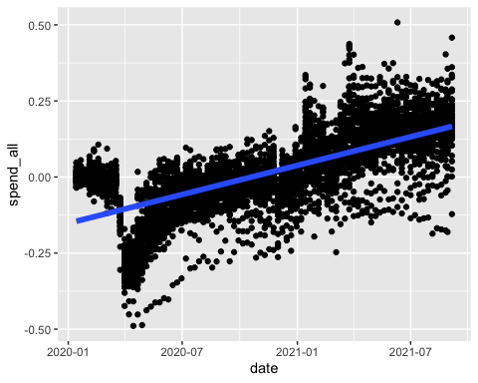

Slide 14
Summarize the Model
It’s really bad, to be blunt.
Possible Better Models
Neural Networks
Decision Trees
Time Series Models (LSTM, RNN, etc.)

Slide 15
Some Possible Biases
Movement data only comes from Google
Effect of stimulus checks won’t fade, because of the way we encoded the data.

Slide 16
Conclusion
Stimulus checks seem to encourage consumer spending, unsurprisingly. Assuming that high consumer spending attributes to a healthier economy, we can conclude that stimulus checks will encourage more new job openings that offer higher wages.

