Slide 1
Stimulus Checks and Consumer Spending
Aaron Davis, Navya Sonti, Rujula Nadipi, Swapnil Sethi, and Ujas Shah

Slide 2
Do stimulus checks help the economy?
(using high customer spending as a proxy for economic health)

Slide 3
Why Should YOU Care How Healthy the US Economy Is?
Healthy Economy –> More Jobs
&
Healthy Economy –> Better-Paying Jobs

Slide 4
Data Source & Associated Paper
https://github.com/OpportunityInsights/EconomicTracker
“The Economic Impacts of COVID-19: Evidence from a New Public Database Built Using Private Sector Data”, by Raj Chetty, John Friedman, Nathaniel Hendren, Michael Stepner, and the Opportunity Insights Team. November 2020. Available at: https://opportunityinsights.org/wp-content/uploads/2020/05/tracker_paper.pdf

Slide 5
Replace NA values with 0
# https://stackoverflow.com/questions/45576805/how-to-replace-all-na-in-a-dataframe-using-tidyrreplace-na df <- df %>% replace(is.na(.), 0) df <- df %>% filter(spend_all != 0)

Slide 6
Combine Weekly and Daily Data
df_weekly <- df %>% group_by(year, week, stateabbrev) %>% summarize(spend_all = mean(spend_all), contclaims_rate_combined = mean(contclaims_rate_combined), bg_posts = mean(bg_posts), emp = mean(emp), gps_retail_and_recreation = mean(gps_retail_and_recreation), gps_grocery_and_pharmacy = mean(gps_grocery_and_pharmacy), gps_parks = mean(gps_parks), gps_transit_stations = mean(gps_transit_stations), gps_workplaces = mean(gps_workplaces), gps_residential = mean(gps_residential), gps_away_from_home = mean(gps_away_from_home), new_case_count = sum(new_case_count), new_death_count = sum(new_death_count), case_count = max(case_count), death_count = max(death_count), date = max(date))
## `summarise()` has grouped output by 'year', 'week'. You can override using the `.groups` argument.
df_weekly <- left_join(df_weekly, state_id, by = c("stateabbrev"))

Slide 7
Adding Stimulus Check Data
df_weekly <- df_weekly %>% mutate( first_check = (if (date < ymd("2020-04-15")) { 0 } else { 1 }), second_check = (if (date < ymd("2021-01-04")) { 0 } else { 1 }), third_check = (if (date < ymd("2021-03-18")) { 0 } else { 1 }) )

Slide 8
Plotting spending over time for all states and categories
(The dates for the stimulus checks were approximated from this article.)
## Warning in x:y: numerical expression has 2 elements: only the first used ## Warning in x:y: numerical expression has 2 elements: only the first used
## Warning in mask$eval_all_mutate(quo): NAs introduced by coercion ## Warning in mask$eval_all_mutate(quo): NAs introduced by coercion ## Warning in mask$eval_all_mutate(quo): NAs introduced by coercion

Slide 9
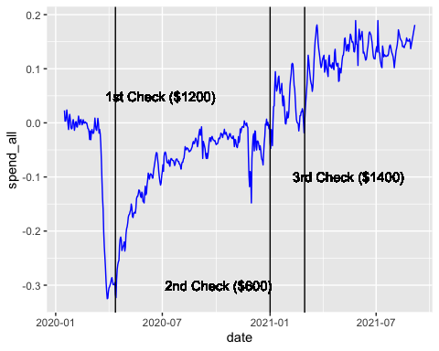

Slide 10
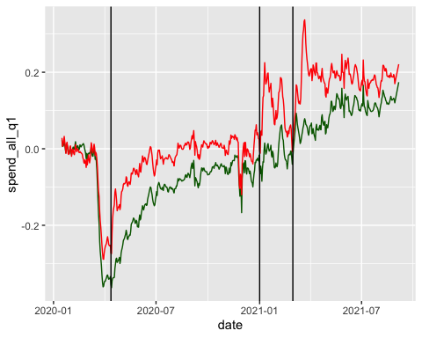

Slide 11
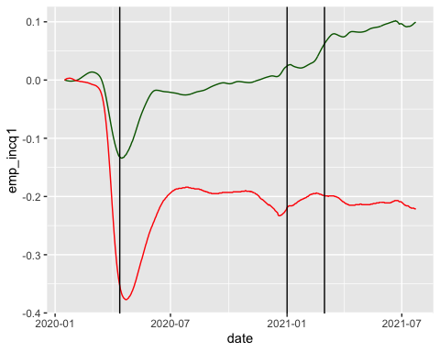

Slide 12
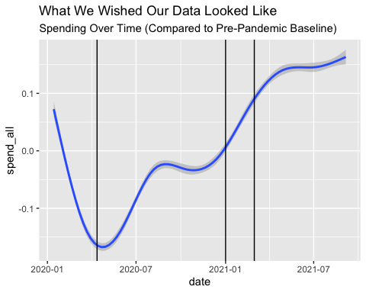

Slide 13
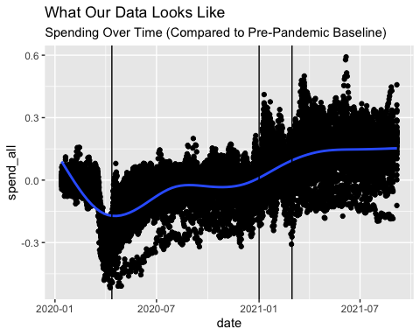

Slide 14
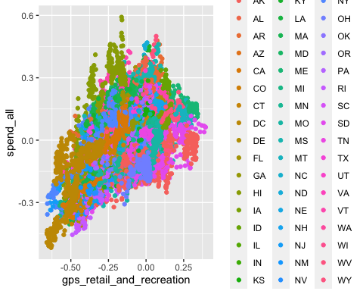

Slide 15
Training a Linear Model
## ## Call: ## lm(formula = spend_all ~ gps_retail_and_recreation + emp + first_check + ## second_check + third_check, data = df_weekly) ## ## Residuals: ## Min 1Q Median 3Q Max ## -0.34163 -0.04494 0.00693 0.04757 0.41405 ## ## Coefficients: ## Estimate Std. Error t value Pr(>|t|) ## (Intercept) -0.041870 0.003174 -13.190 < 2e-16 *** ## gps_retail_and_recreation 0.308678 0.012020 25.681 < 2e-16 *** ## emp 0.185988 0.025534 7.284 3.81e-13 *** ## first_check 0.044965 0.003733 12.045 < 2e-16 *** ## second_check 0.133771 0.004405 30.367 < 2e-16 *** ## third_check 0.013451 0.004700 2.862 0.00423 ** ## --- ## Signif. codes: 0 '***' 0.001 '**' 0.01 '*' 0.05 '.' 0.1 ' ' 1 ## ## Residual standard error: 0.08172 on 4482 degrees of freedom ## Multiple R-squared: 0.6325, Adjusted R-squared: 0.6321 ## F-statistic: 1543 on 5 and 4482 DF, p-value: < 2.2e-16

Slide 16
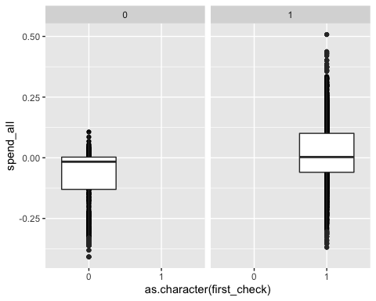

Slide 17
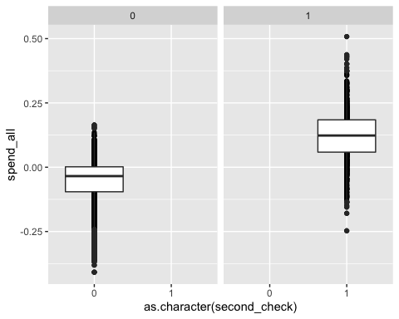

Slide 18
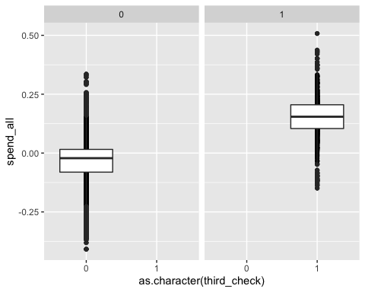

Slide 19
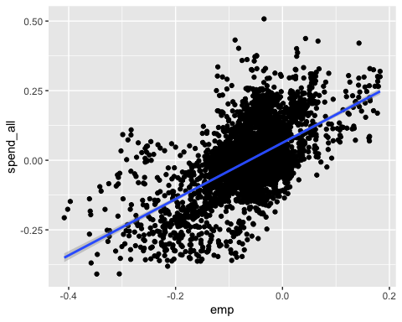

Slide 20
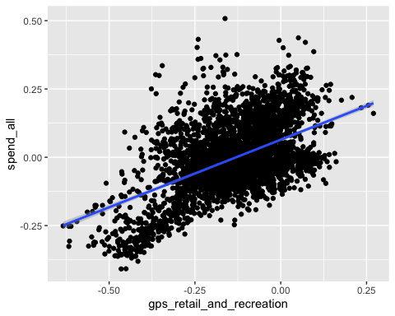

Slide 21
Summarize the Model
It’s not great, to be blunt.
Possible Better Models
Neural Networks
Decision Trees
Time Series Models (LSTM, RNN, etc.)

Slide 22
Some Possible Biases
Movement data only comes from Google
Effect of stimulus checks won’t fade, because of the way we encoded the data.

Slide 23
Conclusion
Stimulus checks -> Higher Consumer Spending
Therefore,
IF Higher Consumer Spending -> Healthier Economy (needs separate analysis)
THEN Stimulus Checks -> More Jobs and Better Jobs

