Slide 1
Stimulus Checks and Consumer Spending
Aaron Davis, Navya Sonti, Rujula Nadipi, Swapnil Sethi, and Ujas Shah
9/19/2021

Slide 2

Data Source
https://github.com/OpportunityInsights/EconomicTracker

Slide 3
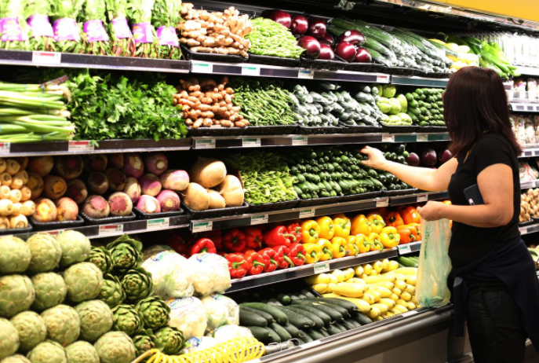
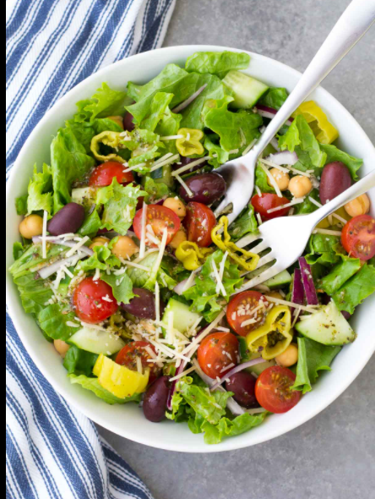


Slide 4


Slide 5
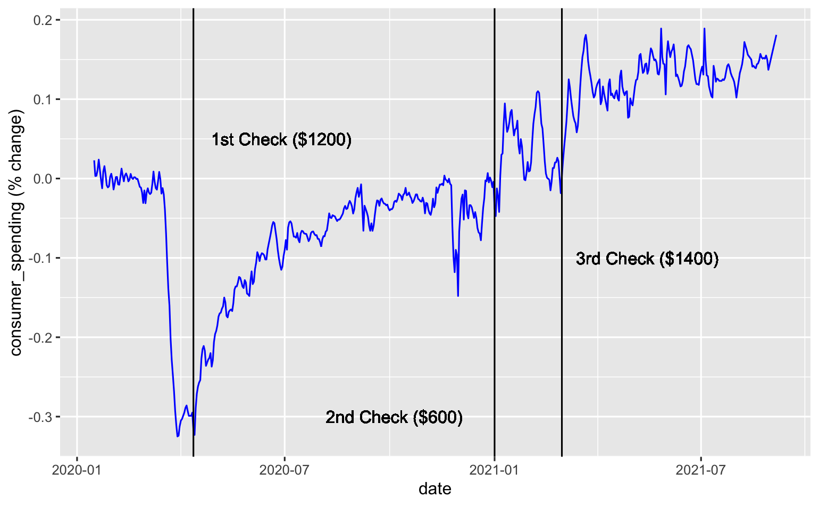
Chart showing change in consumer spending over time

Slide 6
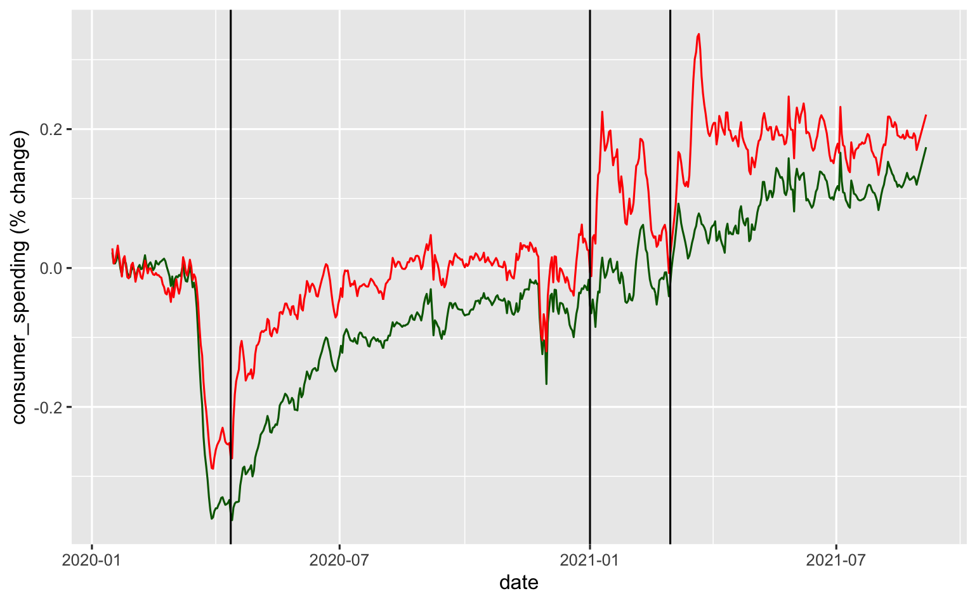
Change in consumer spending by low income households (RED) and high income households (GREEN)

Slide 7
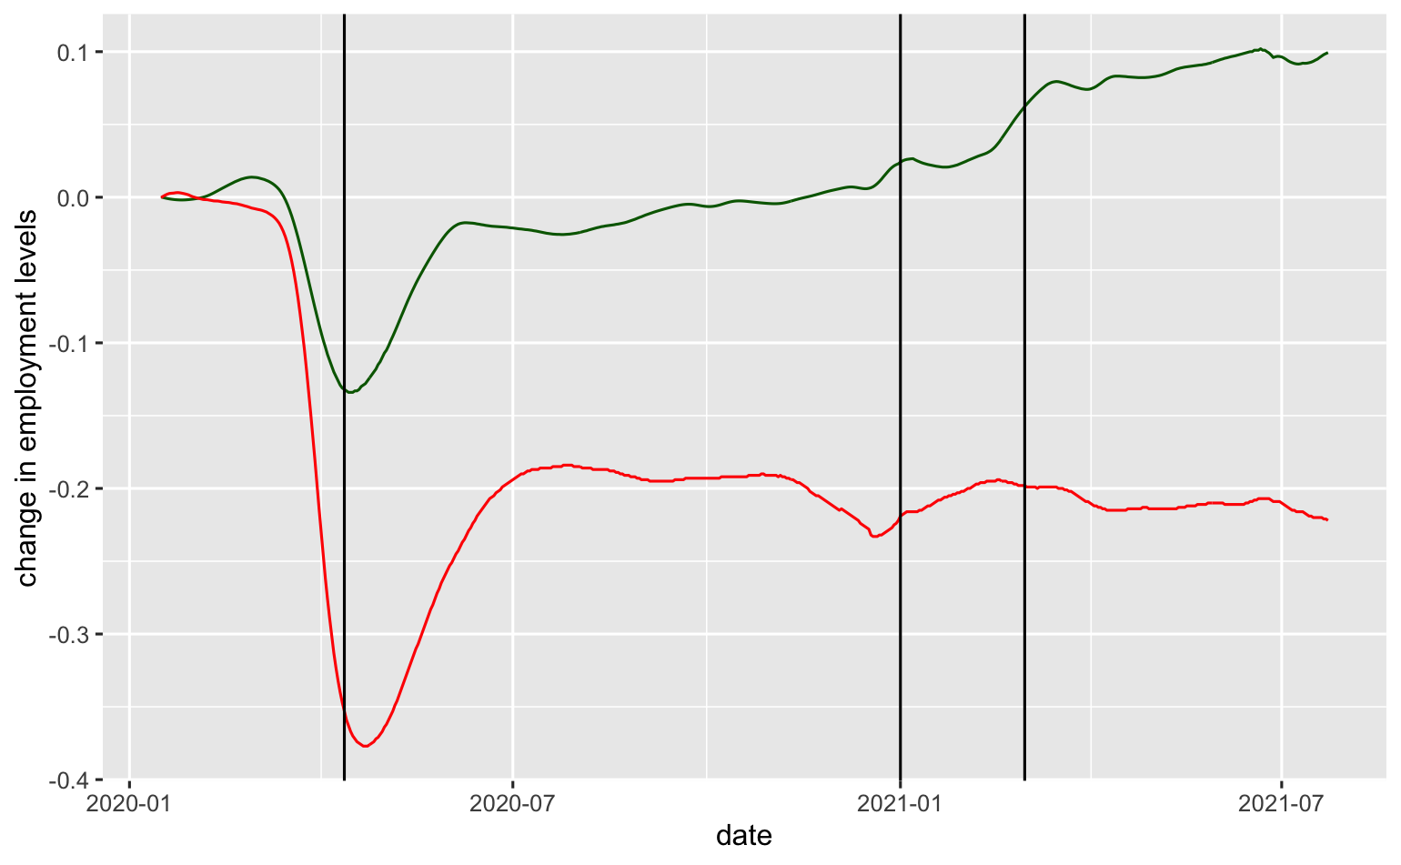
Change in employment levels for low income households (RED) and high income households (GREEN)

Slide 8
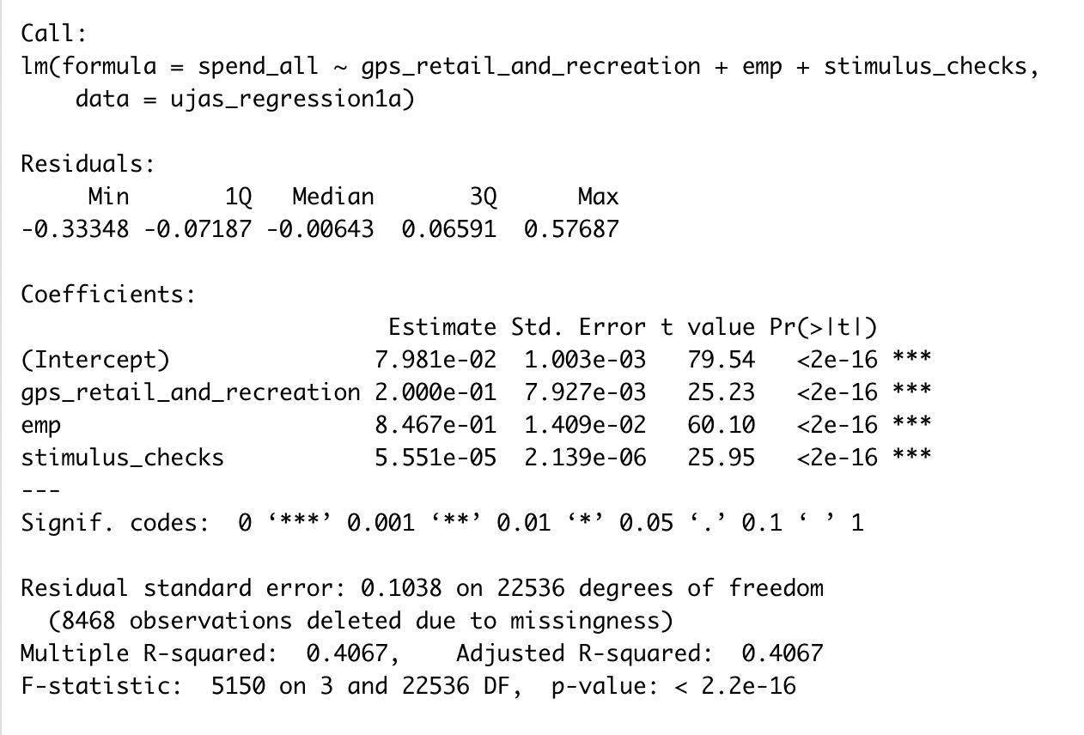
Training a Linear Model

Slide 9
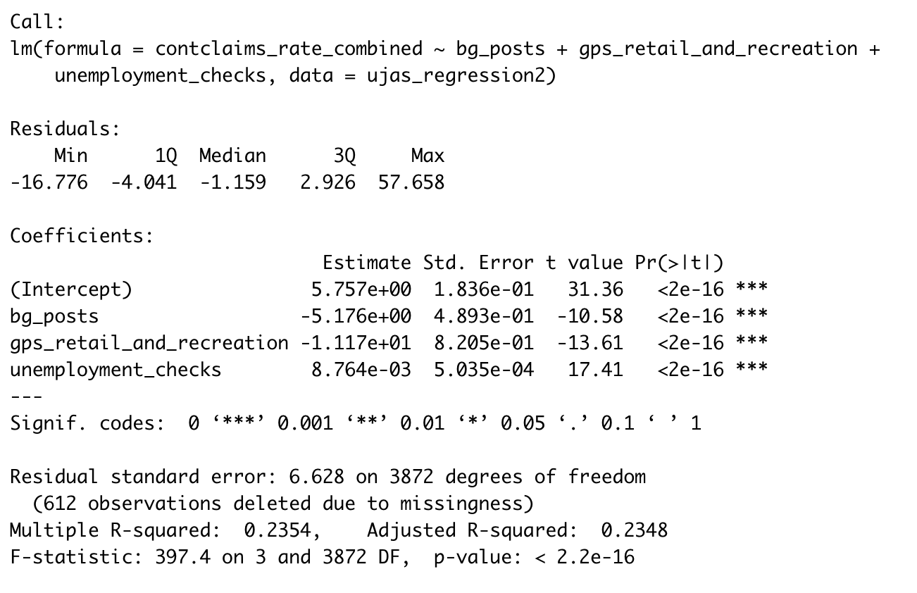
Training a Second Model

Slide 10
Summarize the Model
It’s really bad, to be blunt.
Possible Better Models
Neural Networks
Decision Trees
Time Series Models (LSTM, RNN, etc.)

Slide 11
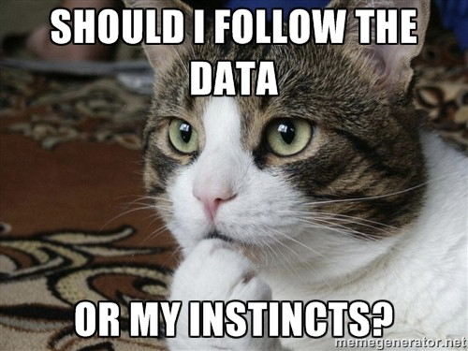
Biases

Slide 12
Some Possible Biases
Human Reporting bias -
Human Mobility data includes all data like morning walk, running, etc.
Selection bias - Algorithm selection
Interpretation bias - Result interpretation
Data Bias -
Movement data only comes from Google
Effect of stimulus checks won’t fade, because of the way we encoded the data.

Slide 13
Conclusion
Stimulus checks seem to encourage consumer spending, unsurprisingly. Assuming that high consumer spending attributes to a healthier economy, we can conclude that stimulus checks will encourage more new job openings that offer higher wages.
Thank you!

