Slide 1
INTERNSHIP PROJECT PRESENTATION
Student Risk Prediction
& Academic Performance
Analytics Dashboard
Presented by Rujuta Patil
Python
Pandas
Machine Learning
Tableau

Slide 2



ABOUT THE INTERNSHIP
ORGANIZATION
DOMAIN
DURATION
Paarsh Infotech
Data Analytics
February 2026 – July 2026
TECHNOLOGIES LEARNED
Python
Pandas
NumPy
Machine Learning
Tableau

Slide 3




PROBLEM STATEMENT
Identification Gap
Manual Overhead
Difficulty identifying academically at-risk students early enough for intervention
Traditional monitoring is time-consuming and lacks scalability
No Analytics System
Visualization Void
Need for data-driven, analytics-based academic monitoring tools
Lack of an interactive visualization and prediction system for educators

Slide 4
PROJECT OBJECTIVES
01
04
Analyze student academic data
Build interactive Tableau dashboard
02
05
Predict student risk levels
Generate meaningful academic insights
03
Identify attendance and study patterns

Slide 5
TECHNOLOGIES USED
Python
Pandas
NumPy
Scikit-learn
Tableau
Data Processing & Scripting
Data Analysis & Manipulation
Numerical Operations
Machine Learning Models
Dashboard Visualization

Slide 6
DATASET OVERVIEW
1,100
11
3
Total Records
Features
Risk Categories
Student data points
Input variables
Low · Medium · High
RISK DISTRIBUTION CATEGORIES
LOW RISK
MEDIUM RISK
HIGH RISK

Slide 7
PROJECT WORKFLOW
1
2
3
4
Data Collection
Data Cleaning
Exploratory Data Analysis
Feature Engineering
5
6
7
Machine Learning Model
Risk Prediction
Tableau Dashboard

Slide 8
MACHINE LEARNING MODEL
Model Used
RISK CATEGORIES
Random Forest
Classifier
3
Low · Medium · High
Why Random Forest?
Handles non-linear relationships
Robust to overfitting
Works well with mixed feature types
Interpretable feature importance
MODEL ACCURACY
~89
Validated on test set

Slide 9
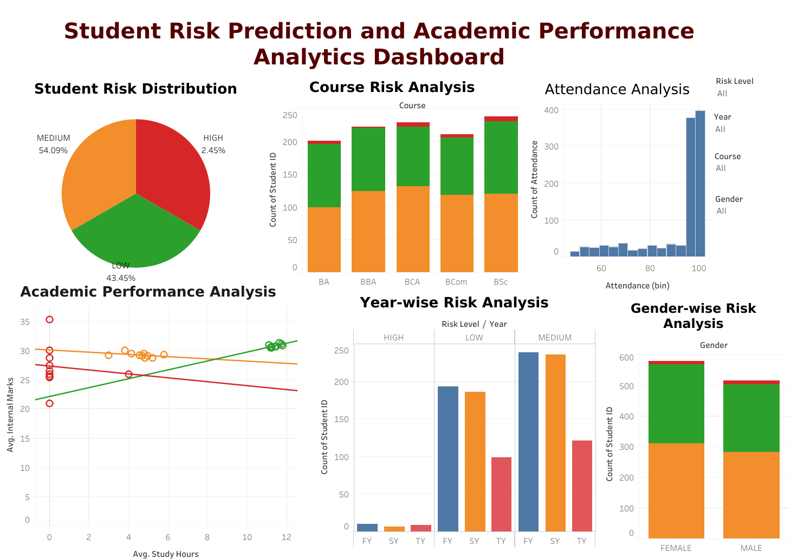
TABLEAU DASHBOARD
Student Risk Prediction & Academic Performance Analytics Dashboard
Student Risk Prediction & Academic Performance Analytics Dashboard

Slide 10




KEY INSIGHTS
Risk Distribution
Attendance Impact
Most students fall into the MEDIUM risk category, indicating a common performance cluster
Higher attendance rates are directly correlated with improved academic performance
Study Hours
High-Risk Students
Students dedicating more study hours consistently perform better across all risk categories
HIGH risk students are comparatively fewer, enabling targeted intervention strategies

Slide 11
CHALLENGES FACED
01
Handling Missing Values
Identifying and applying appropriate imputation strategies for incomplete student records
02
Preprocessing Categorical Data
Encoding and normalizing categorical variables for effective machine learning model training
03
Dashboard Layout Management
Designing clear, intuitive Tableau layouts that communicate insights effectively
04
Selecting Suitable ML Model
Evaluating multiple classifiers and tuning hyperparameters to achieve optimal prediction accuracy

Slide 12

FUTURE SCOPE
Real-time Monitoring
Faculty Alert System
Live student data integration for continuous risk assessment and alerts
Automated notifications to faculty for timely intervention with at-risk students
Mobile Dashboard
AI-based Recommendations
Responsive mobile app for access to analytics and insights on the go
Personalized academic recommendations driven by AI for each student profile

Slide 13


CONCLUSION
Successfully completed the full analytics workflow — from raw data collection to Tableau dashboard deployment
Significantly improved proficiency in Python, Pandas, NumPy, Scikit-learn, and ML concepts through hands-on project work
Built an interactive, multi-view Tableau dashboard enabling educators to monitor student risk levels at a glance

Slide 14
THANK YOU
Student Risk Prediction & Academic Performance Analytics Dashboard
Presented by Rujuta Patil | Paarsh Infotech | 2026

