Slide 1
Offensive image detection
By: Bathini Rukmini (20RH1A6708)
G. Meghana Reddy (20RH1A6723)
Sukasi Dhatrija (20RH1A6753)
T. Jahnavi Latha (20RH1A6755)
Major project-I, IV CSE-Ds

Slide 2

contents
abstract
Existing system
Proposed system
Algorithms used
UML diagrams
Results
conclusion

Slide 3
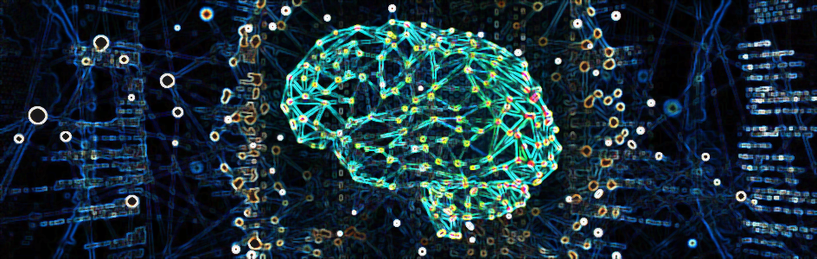
abstract
The widespread availability of offensive and semi-nude images on the internet has emerged as a significant societal challenge, necessitating effective content filtering and moderation solutions. This project addresses this pressing problem by proposing an advanced offensive image detection model based on Convolutional Neural Networks (CNN) employing the VGG architecture.
Our objective is to develop a robust system capable of accurately distinguishing between safe and unsafe images, providing users with precise safety percentages for uploaded content. This work builds upon and extends the findings of relevant IEEE papers, contributing to the ongoing research in content moderation.
The integration of this solution into online platforms and social media networks can significantly contribute to reducing the dissemination of harmful content, addressing an ongoing societal challenge while respecting ethical and privacy considerations.

Slide 4
Existing system
The current state of offensive image detection systems relies primarily on typical traditional computer vision techniques or shallow machine learning models, rule-based algorithms and basic image processing techniques, which often fall short in accurately identifying and classifying offensive and semi-nude images. These systems often employ keyword filtering, user reporting, and manual moderation, which have several significant disadvantages:
Limited Feature Extraction
Scalability Challenges
Subjectivity
Adaptability to Evolving Content

Slide 5
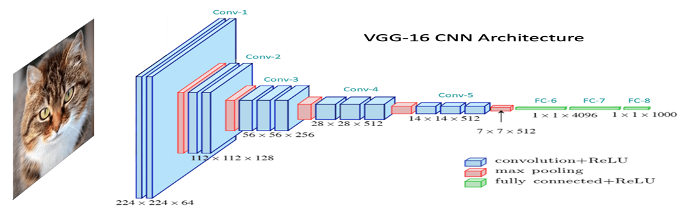
Proposed system
The proposed system is an advanced offensive image detection model based on Convolutional Neural Networks (CNN) utilizing the VGG architecture. This state-of-the-art system is designed to overcome the limitations of existing approaches.
The use of deep CNNs, particularly the VGG architecture, allows our system to automatically extract intricate features from images, capturing subtle visual cues that are crucial for accurately detecting offensive content.

Slide 6
ALGORITHMS USED
CONVOLUTIONAL NEURAL NETWORKS (CNN) WITH VGG
Convolutional Neural Networks (CNNs) with the VGG architecture are a powerful class of deep learning models primarily used for image classification and feature extraction tasks. Here’s an overview of how CNN with VGG works:
Input Layer
Convolutional Layers
Activation Functions
Pooling Layers
Fully Connected Layers
Output Layer
Loss Function and Optimization
Backpropagation
VGG Architecture
The hierarchical structure, convolutional layers, activation functions, and optimization techniques all work together to make CNNs highly effective at understanding and classifying visual data.

Slide 7
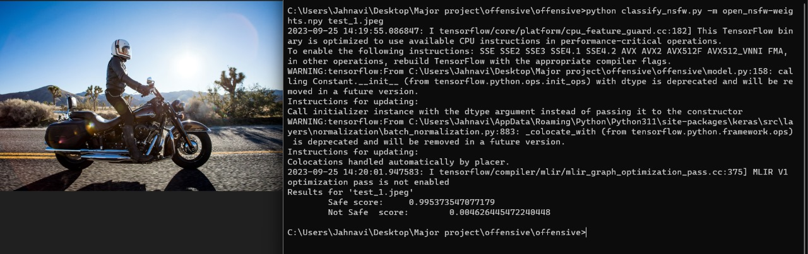
results

Slide 8
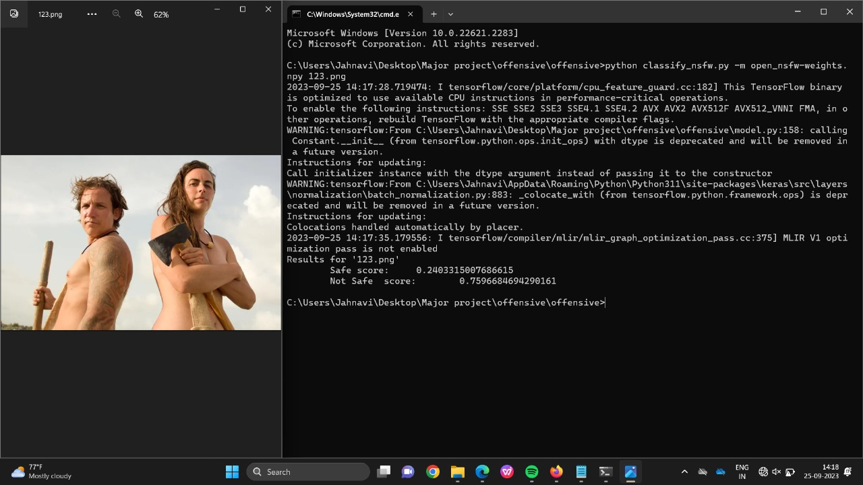




Slide 9

Future scope
The future scope of this project extends to several promising avenues.
Enhancing the model's interpretability to provide insights into why specific content is flagged as offensive can aid in transparency.
Refinements in the model's adaptability to recognize emerging content trends and evasion tactics will be crucial.
Integration with real-time reporting mechanisms and user feedback systems can also facilitate continuous model improvement.
Exploring multi-modal content analysis to detect offensive text in conjunction with images presents another opportunity.
Expanding its application to diverse content types beyond images, such as videos and audio, can enhance its utility in comprehensive content moderation across digital platforms.

Slide 10
conclusion
In summary, our offensive image detection project, employing CNNs with the VGG architecture, represents a significant leap in content moderation. It accurately identifies offensive images and offers precise safety percentages, addressing the shortcomings of traditional methods. Key advantages include improved accuracy, scalability, adaptability, granularity, and automation.
By harnessing deep learning, we elevate content moderation, promoting a safer online environment. In a constantly evolving digital landscape, our project highlights the potential of AI-driven solutions to tackle complex challenges, emphasizing the importance of research and innovation in creating a secure online space for users globally.

Slide 11


Thank you

