Slide 1

EXPLORATOTRY DATA ANALYSIS
ON AMCAT

Slide 2


About Me
Name: Rukmini Hatkar
Qualification: B.Com (Computers)
LinkedIn: linkedin.com/in/rukminihatkar

Slide 3
ABOUT DATASET
The dataset was released by Aspiring Minds from the Aspiring Mind Employment Outcome 2015 (AMEO). The study is primarily limited only to students with engineering disciplines. The dataset contains the employment outcomes of engineering graduates as dependent variables (Salary, Job Titles, and Job Locations) along with the standardized scores from three different areas – cognitive skills, technical skills and personality skills. The dataset also contains demographic features. The dataset contains around 40 independent variables and 4000 data points. The independent variables are both continuous and categorical in nature. The dataset contains a unique identifier for each candidate. Below mentioned table contains the details for the original dataset.
Objective:
Times of India article dated Jan 18, 2019 states that After doing the Computer Science and Engineering if you take up the jobs as Programming Analyst Software Engineer, Hardware Engineer and Associate Engineer . You can earn up to 2.5 to 3 lac
Is there a relationship between gender and specialization? (i.e. Does the preference of Specialization depend on the Gender?

Slide 4
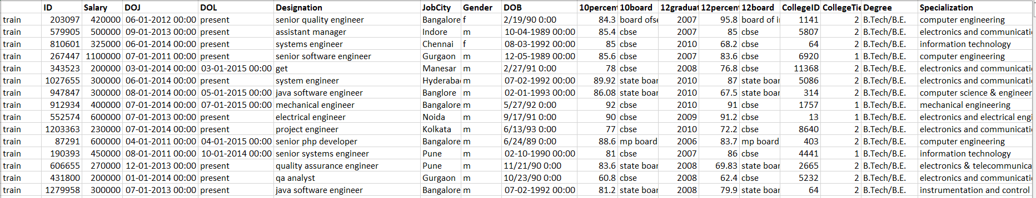
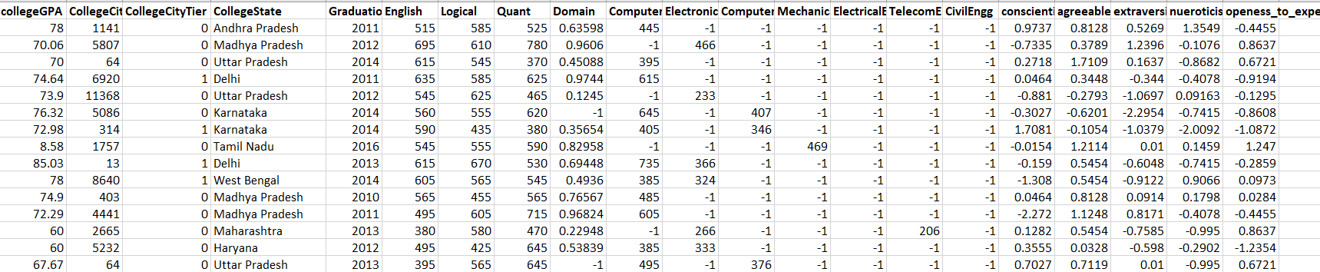
Raw Data :

Slide 5
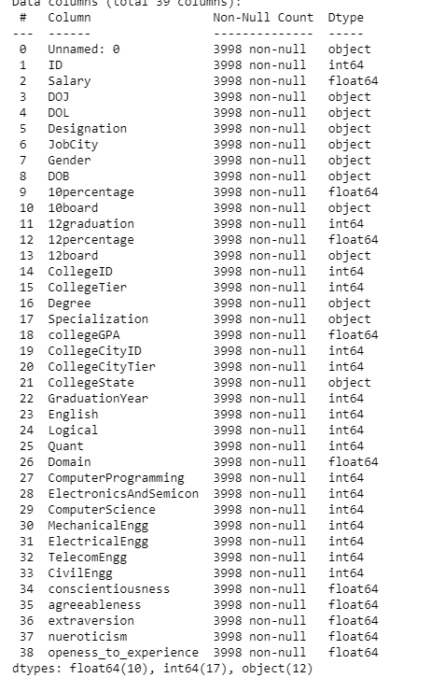
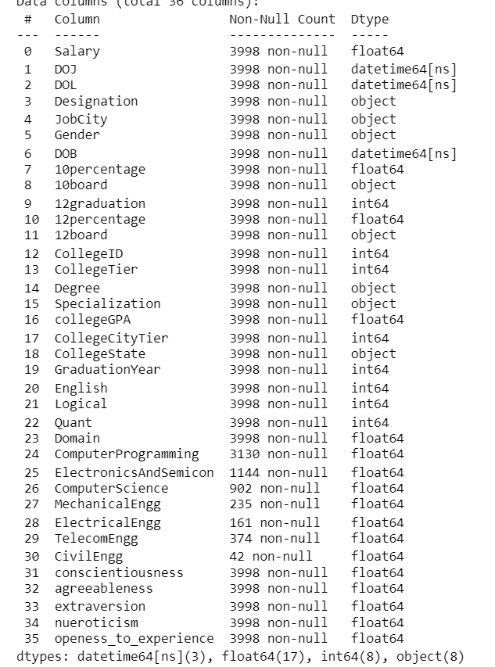

Slide 6
Exploratory Data Analysis
DATA CLEANING:
1. Standardization of Dates and Scores: Conversion of 'Date of joining' and 'Date of Birth' to DateTime format, and replacement of "-1" scores in technical subjects with NaN to accurately reflect students from non-related branches.
2. Column Optimization: Removal of unnecessary columns like 'Unnamed: 0', 'CollegeCityId', and 'Id', alongside updating 'Date of leaving' to current dates for ongoing positions, streamlining the dataset for analysis.
3. Normalization of Categorical Data: Standardized 'Jobcity' entries to 'Bangalore' for missing values, consolidated education board names to uniform categories ('state board', 'cbse', 'icse'), and simplified the 'Specialization' and 'Designation' fields to fewer, more general categories for clearer analysis.
4. Enhanced Data Integrity for Analysis: These steps collectively clean and prepare the dataset for more efficient and meaningful analysis by ensuring consistency, relevance, and clarity in the data presented, focusing on essential attributes and simplifying varied categories.

Slide 7
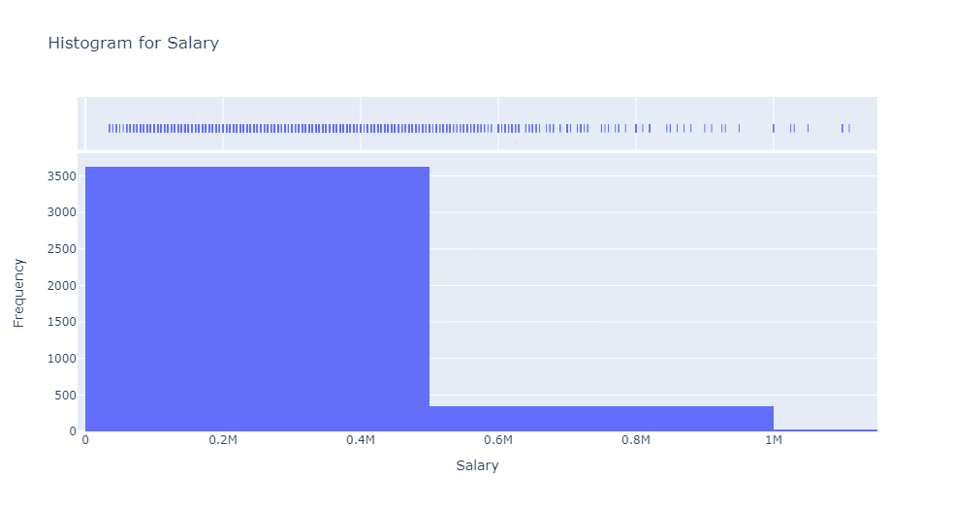
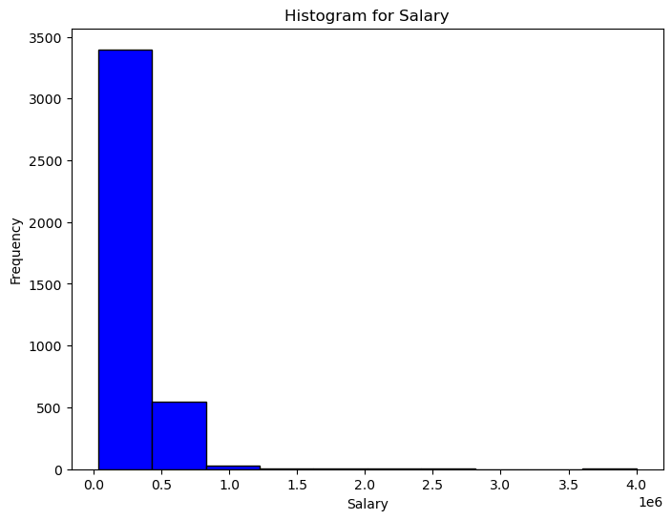
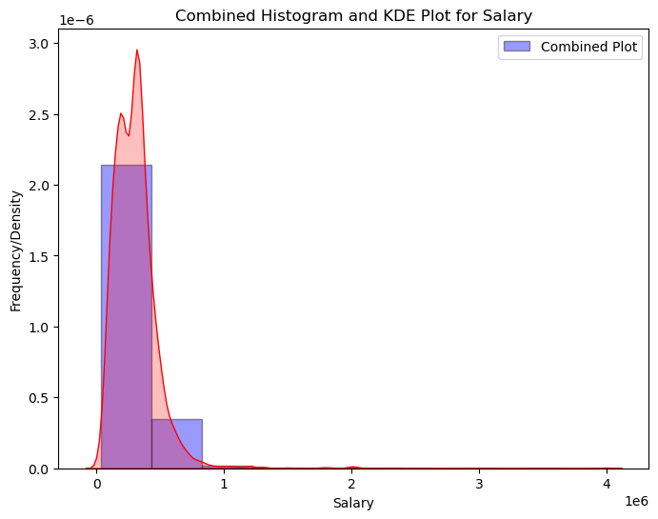
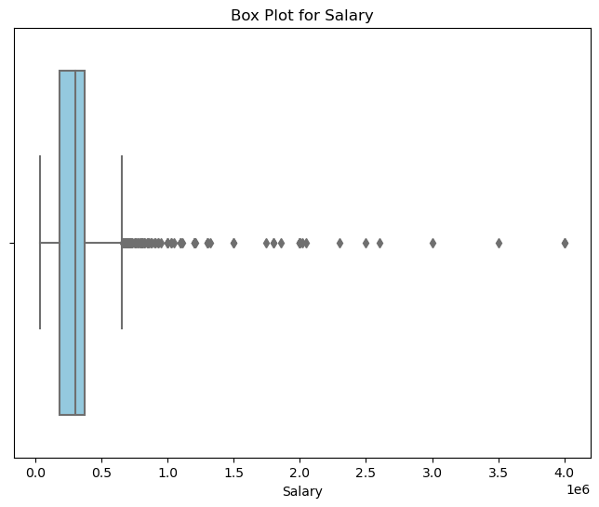
UNIVARIATE ANALYSIS ON THE NUMERICAL DATA SALARY DATA
Distribution of salaries: The histogram shows that the salary data is right-skewed, meaning that there are more people with lower salaries than there are people with higher salaries. The combined histogram and KDE plot confirms this, showing a density of data points at the lower end of the salary range and a long tail extending to the right and shown in box plot as well.
Central tendency: The box plot shows that the median salary is around 3,00,000 , while the mean salary is higher, around 3,07,000. This suggests that there are a few outliers with very high salaries that are pulling up the mean.
Spread of Salaries: More than the 75 % of the data of the salary falls around the 3,70,000 it is more than 75% and 50% of the data falls in 1,80,000 to 3,07,000

Slide 8
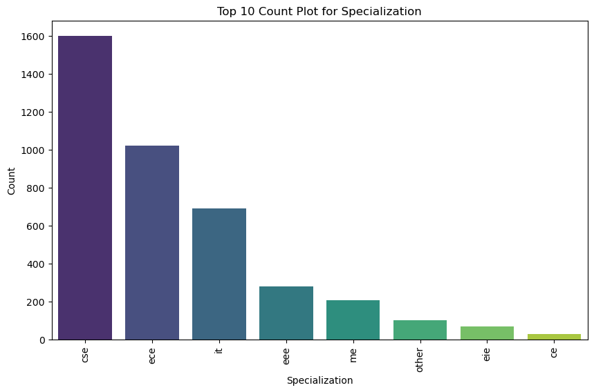
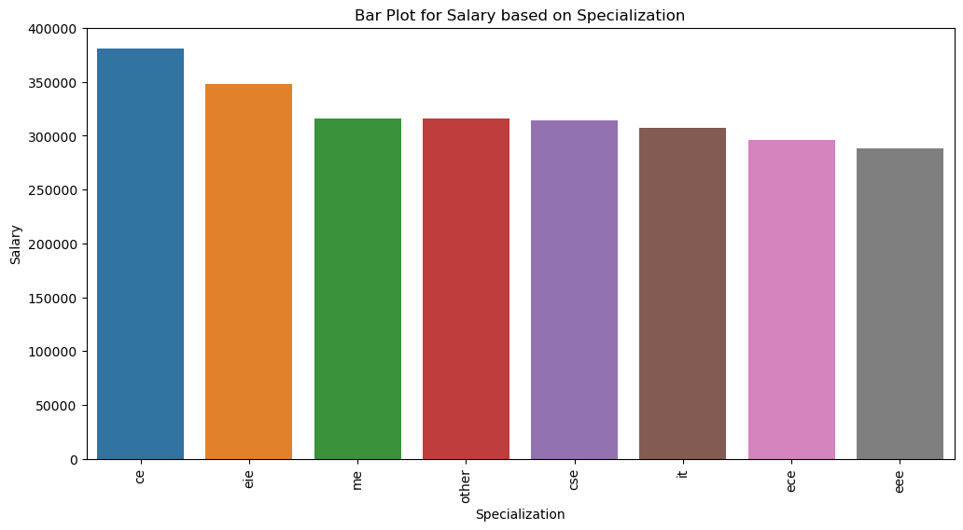
Top Specializations: The top 10 specializations are listed on the left side of the image, with “Computer science and Engneering“ that is cse.
Specialization Counts: The bar chart on the left shows the number of people with each specialization. “Computer Science and Engineering" has the most individuals. This aligns with the information in the top 10 specializations list.
Salary Distribution by Specialization: The bar chart on the right shows the average salary for each specialization. “Computer Science and Engineering" has the highest average salary, followed by “cse students". This suggests that there is a correlation between these specializations and higher salaries in the dataset.

Slide 9
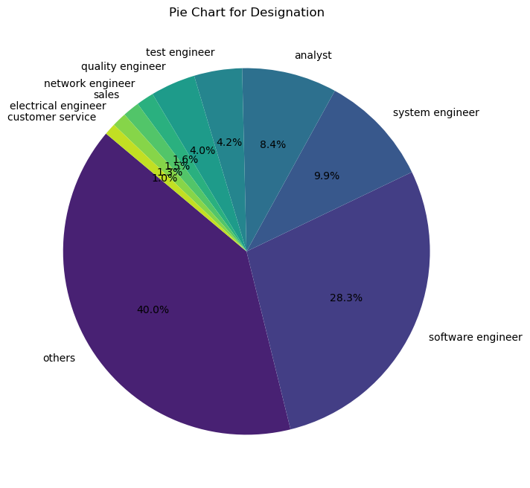
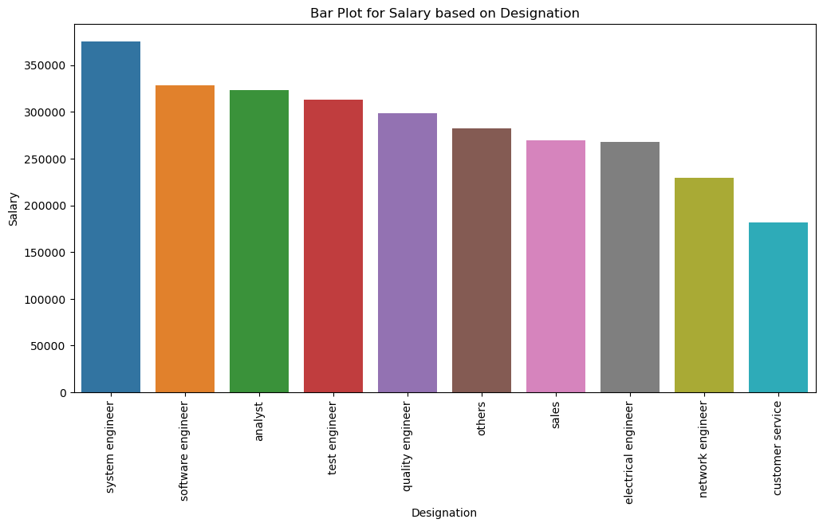
The left-hand side of the image is a pie chart that shows the distribution of job titles. The slices of the pie chart are labeled with different job titles, and the size of each slice is proportional to the number of people who have that job title
The right-hand side of the image is a bar chart that shows the average salary for each job title. The bars of the bar chart are labeled with the same job titles as the slices of the pie chart, and the height of each bar represents the salary for that job title average
There are a relatively small number of job titles represented in the dataset, with "Software Engineer" being the most common, followed by "Quality Engineer" and "Test Engineer."
There is a positive correlation between the number of people in a job title and the average salary for that job title. In other words, the job titles with more people tend to have higher average salaries.

Slide 10
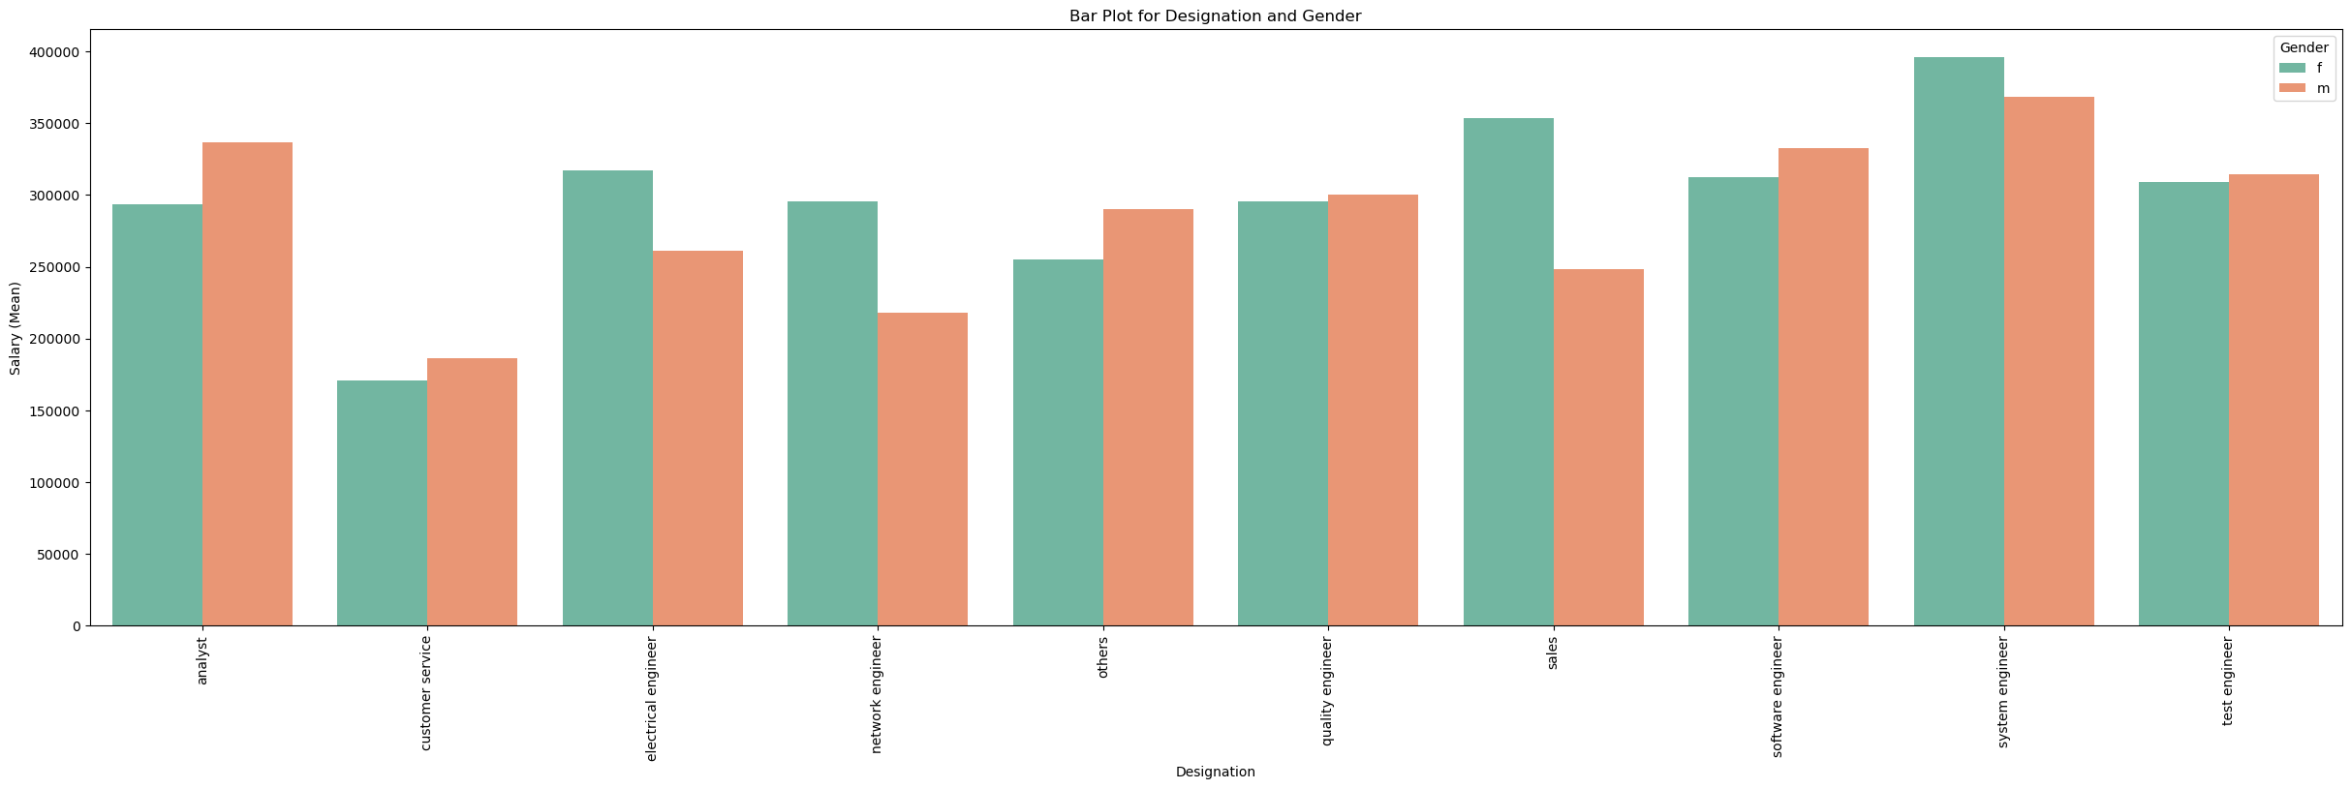
Number of employees by designation: The pie chart shows that the largest portion of employees are "Software Engineers," followed by "Quality Assurance" and "Business Development" roles. The remaining designations have smaller proportions of employees.
Average salary by designation: The bar graph shows that "Software Engineers" have the highest average salary, followed by "Data Scientists" and "Business Development" roles. The average salary for "Software Engineers" is almost double that of "Quality Assurance" and "Customer Support" roles.
Distribution of salaries: The salary distribution appears to be right-skewed, meaning there are more employees with lower salaries than there are with higher salaries. This is evident in the bar graph where the bars are shorter towards the higher salary range.
Relationship between designation and salary: There seems to be a positive correlation between job title and average salary. Designations with more employees tend to have higher average salaries. However,
it is important to note that this is just a general trend and there may be exceptions.

Slide 11
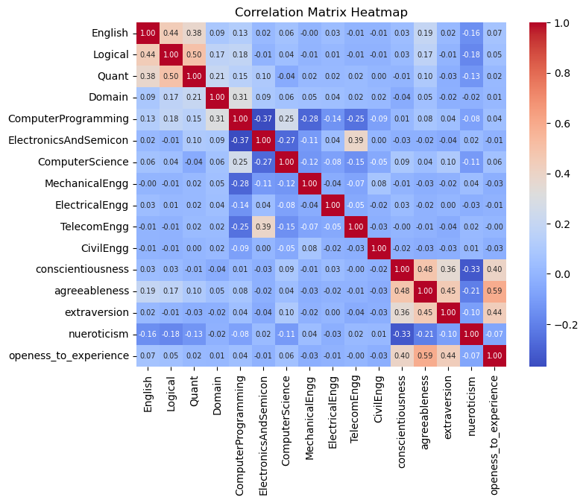
CORRELATION MATRIX
Subject Relationships: Strong positive correlations exist between English and Computer Programming, Computer Programming and Electronics and Semiconductors, and Conscientiousness and Agreeableness, indicating subject scores tend to align.
Domain-Specific Correlations: Electrical Engineering and Civil Engineering are positively correlated within engineering subjects, contrasting with Telecommunication Engineering's weaker correlations.
Personality and Academics: While Conscientiousness correlates positively with several subjects, Neuroticism's negative correlation is less pronounced, making the overall personality-academics relationships unclear.

Slide 12
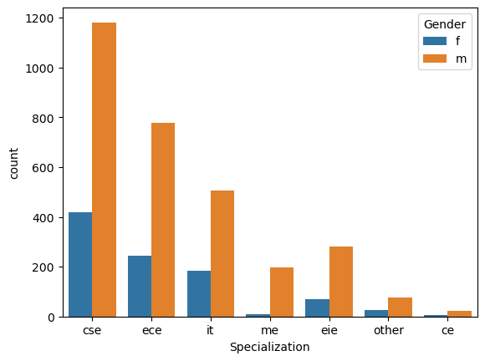
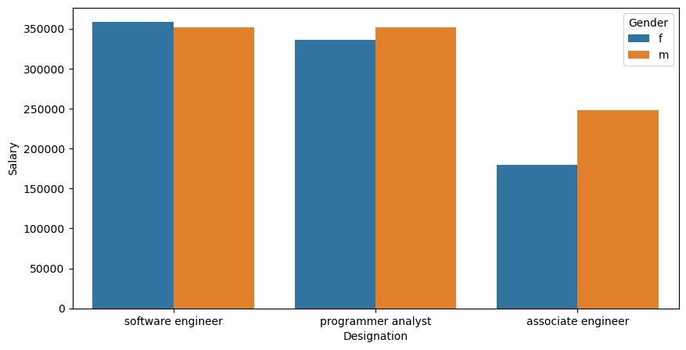
TIMES OF INDIA QUESTIONS
The left side of the image show the count plot of the gender with respect to the gender and we can see that there are more no of the people are tending towards the cse (Computer science and Engineering) it is more than 33% above than the electronics and communication engineering people
The right side image is with respect to the Salaries to the designation for the computer science and Engineering we can see that for the role of Software Engineer and Programmer Analyst has the highest salary it is satisfied in the terms of the Times of India they told that it is around 2.5 to 3 lakh’s but is around more than 10,000 extra

Slide 13
Conclusion
More than 75% of the salary data falls around ₹3,70,000, indicating that over three-quarters of the dataset is below this figure. Meanwhile, 50% of the data ranges from ₹1,80,000 to ₹3,07,000, highlighting a significant spread in salaries within the middle portion of the distribution.
The average salary for freshers is approximately ₹3,00,000 per annum, suggesting a starting benchmark for new entrants in the job market.
Both men and women show a preference for Computer Science and Engineering over other specializations, indicating a strong inclination towards this field across genders.
The average salaries for Software Engineering and Programming Analyst positions are almost identical, based on conclusions drawn from The Times of India. This similarity in earnings reflects the competitive compensation packages offered in these roles.
Within the Computer Science and Engineering specialization, there are no individuals positioned as Hardware Engineers, pointing to a concentration of talent in software-oriented roles rather than hardware.

Slide 14

THANK YOU

