Slide 1
Mutual Fund Analytics Platform
End-to-End Data Engineering | ETL Pipeline | Interactive Dashboard
Capstone Project — Bluestock Fintech Pvt. Ltd.
Presented by: Ruksana Begum | Data Analyst Intern | June 2026
40
10
46K+
32K+
7
Real Fund Schemes
Datasets
NAV Records
Transactions
Days Built
github.com/Ruksanabegum1708/bluestock_mf_capstone

Slide 2
Problem Statement
Why India's mutual fund ecosystem needs a unified analytics platform
📊
Data Fragmentation
📉
Performance Gap
📈
No Benchmark Tracking
👥
Investor Blind Spot
⏱
Slow Reporting
NAV, AUM, SIP data scattered
across AMFI, NSE, BSE in different formats — no single
unified database exists
Investors cannot compare funds on risk-adjusted basis.
Sharpe, Alpha, Beta require complex manual calculations
Retail investors don't know if their fund beats Nifty 50
or Nifty 100 — tracking error
requires both NAV + index data
AMCs have limited visibility into demographics, geographic factors influencing SIP amounts and redemption patterns
Monthly MF reports are static PDFs taking days to prepare. Stakeholders need live, self- service drill-down dashboards

Slide 3
Project Objectives
8 core objectives driving the Bluestock MF Analytics Platform
Build ETL Pipeline
Design SQL Star Schema
O1
Automated Python script ingesting AMFI CSVs + mfapi.in live NAV data
O2
5-table normalized SQLite schema: dim_fund, fact_nav, fact_transactions
Comprehensive EDA
Risk & Performance Metrics
O3
15+ publication-quality charts on NAV, AUM, SIP and investor data
O4
Sharpe, Sortino, Alpha, Beta, VaR, Max Drawdown for all 40 funds
Interactive Dashboard
Investor Demographics
O5
4-page Power BI dashboard with slicers, drill-through and KPI cards
O6
Age, gender, geographic and cohort analysis of 32K+ transactions
Benchmark Comparison
Report + Presentation
O7
Fund returns vs Nifty 50 / Nifty 100 — tracking error and alpha
O8
15-page PDF report and 12-slide deck with all findings

Slide 4
Data Sources & Datasets
10 real-world datasets from AMFI India, mfapi.in and NSE/BSE
Dataset File
Rows
Description
01_fund_master.csv
40
40 real AMFI schemes — fund house, category, expense ratio, risk grade
02_nav_history.csv
46,000
Daily NAV Jan 2022 to May 2026 — anchored to real mfapi.in values
03_aum_by_fund_house.csv
90
Quarterly AUM (₹ crore) for top 10 AMCs — SBI leads at ₹12.5L Cr
04_monthly_sip_inflows.csv
48
Real AMFI Monthly Note — SIP inflows, accounts Jan 2022 to Dec 2025
05_category_inflows.csv
144
Net inflows by fund category for FY 2024-25 (Large/Mid/Small Cap etc.)
07_scheme_performance.csv
40
CAGR, Sharpe, Sortino, Alpha, Beta, Max Drawdown for all 40 schemes
08_investor_transactions.csv
32,778
SIP + Lumpsum + Redemption for 5,000 investors across 12 Indian states
09_portfolio_holdings.csv
320
Top equity holdings per fund — stock, sector, weight % as of Dec 2025
10_benchmark_indices.csv
8,050
Daily close for Nifty 50, Nifty 100, Nifty Midcap 150, BSE SmallCap

Slide 5
System Architecture — ETL Pipeline
Extract → Transform → Load → Analyse → Visualise
📥 EXTRACT
AMFI CSVs | mfapi.in REST API | NSE/BSE Bhavcopy
▼
⚙ TRANSFORM
Pandas cleaning | Date parsing | Forward-fill NAV | AMFI code validation
▼
💾 LOAD
SQLite via SQLAlchemy | 5-table star schema | 46K NAV rows loaded
▼
🔬 ANALYSE
Jupyter Notebooks | Sharpe/Alpha/Beta | VaR | Cohort Analysis
▼
📊 VISUALISE
Power BI 4-page Dashboard | Slicers | Drill-through | KPI Cards

Slide 6
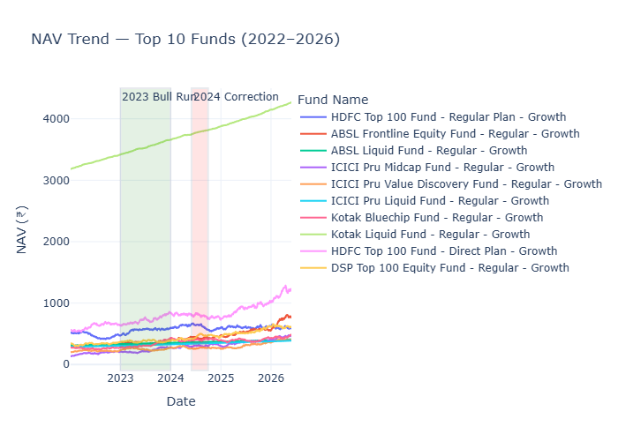
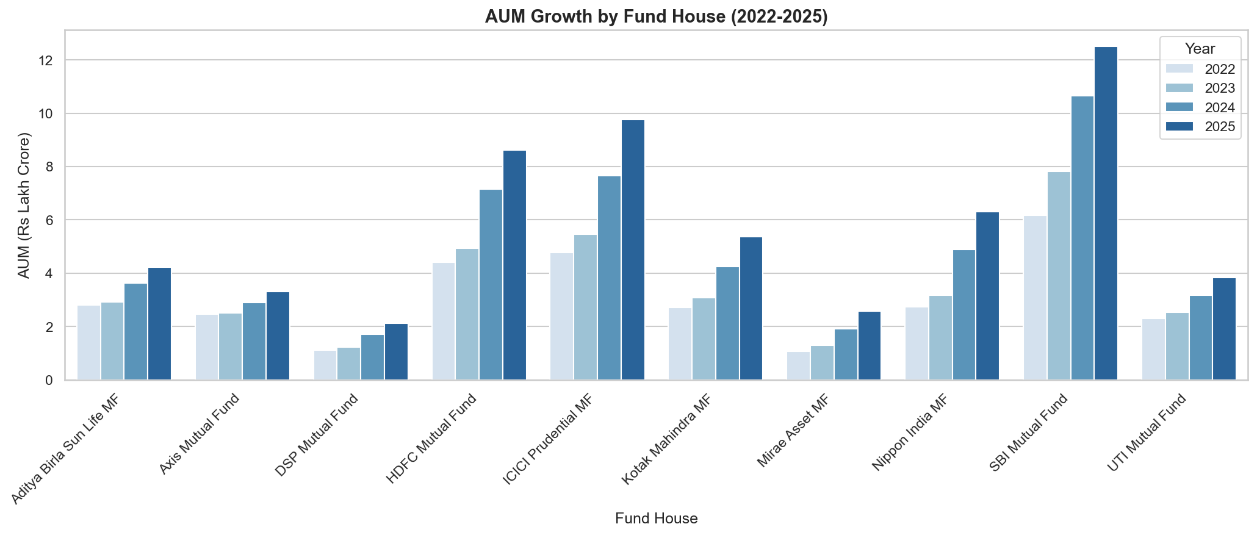
EDA Highlights — NAV & AUM Analysis
Findings: 46,000 NAV records and quarterly AUM data across 10 AMCs
NAV Trend — Top 10 Funds (2022–2026)
AUM Growth by Fund House (2022–2025)
📈 2023 Bull Run
🏦 SBI Dominance
📉 2024 Correction
💰 Industry Total
Equity funds grew 25-30% NAV
during 2023 rally
SBI MF leads with ₹12.5L Cr
AUM as of Dec 2025
Mid-2024 saw -10% correction
across Large Cap funds
Indian MF industry crossed
₹81 Lakh Crore AUM

Slide 7
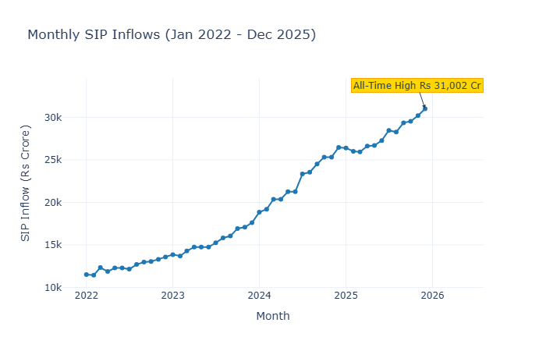
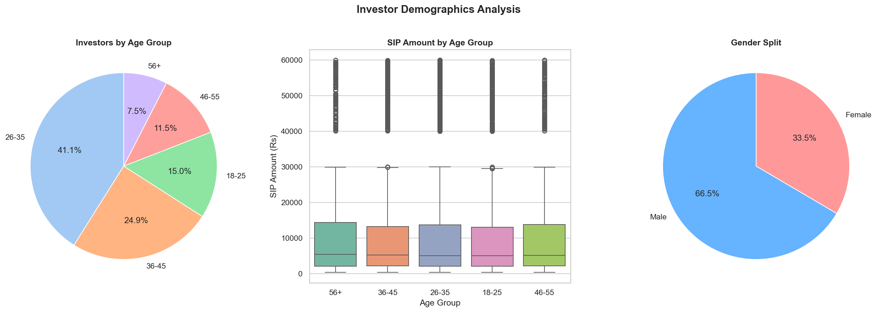
EDA Highlights — SIP & Investor Analysis
Findings: Category Heatmap and investor demographic patterns
Monthly SIP Inflows (Jan 2022 – Dec 2025)
Investor Demographics Analysis
₹31,002 Cr
26.12 Crore
42%
9.35 Crore
SIP All-Time High
December 2025
Total MF Folios
December 2025
26-35 Age Group
Dominates SIPs
Active SIP
Accounts Dec 2025

Slide 8
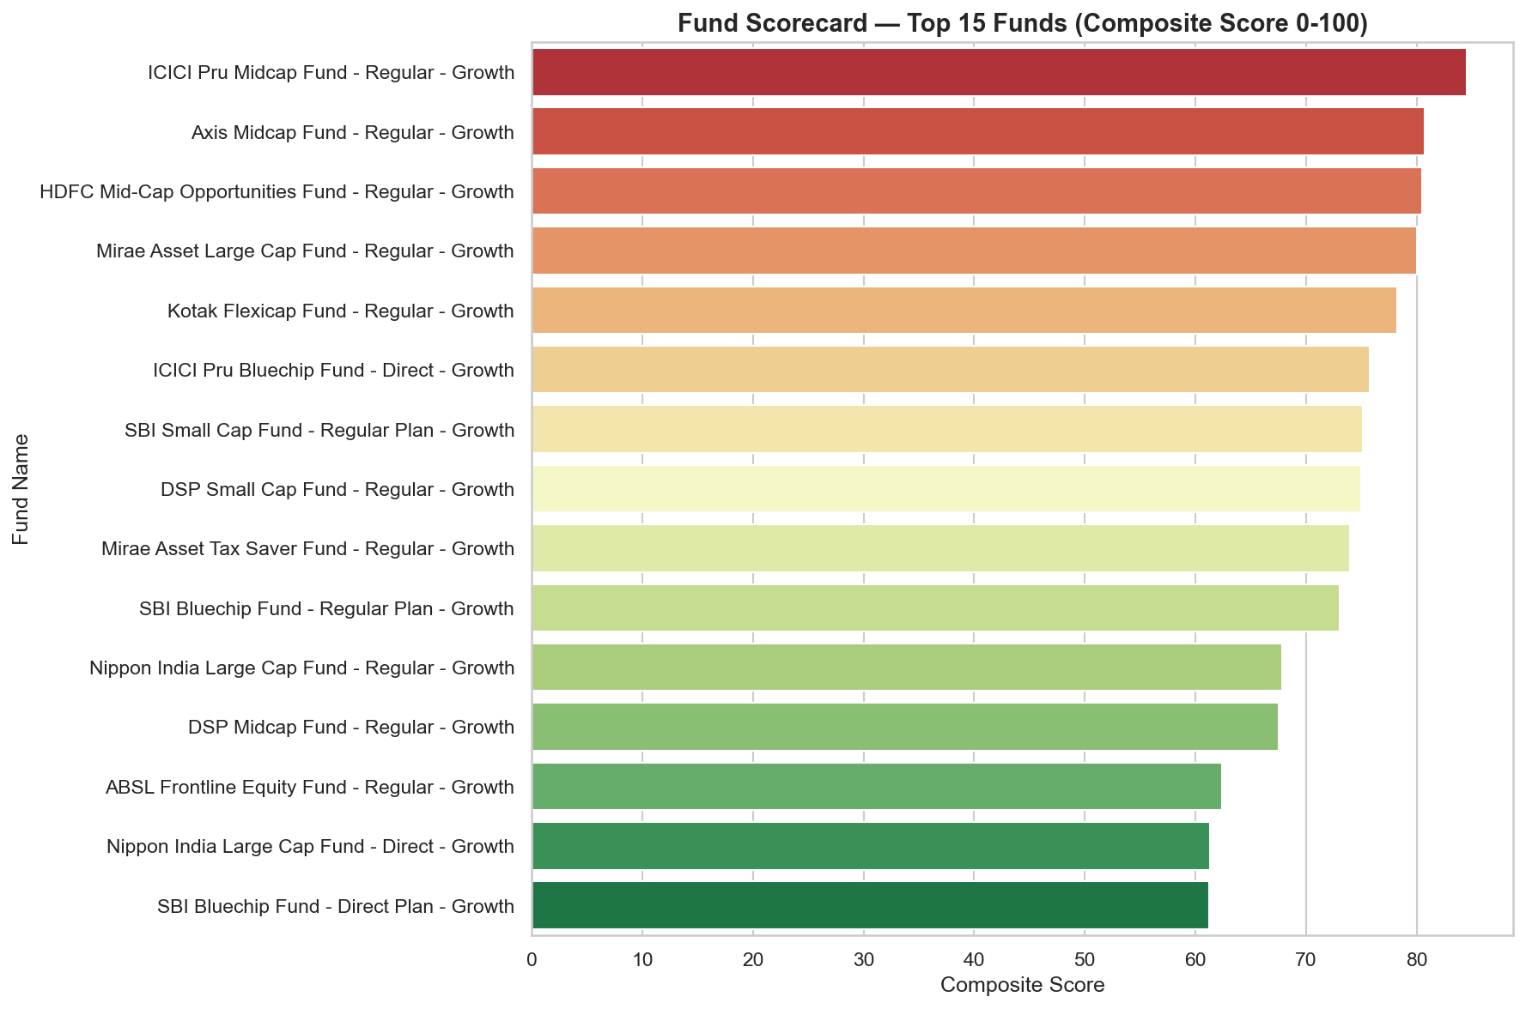
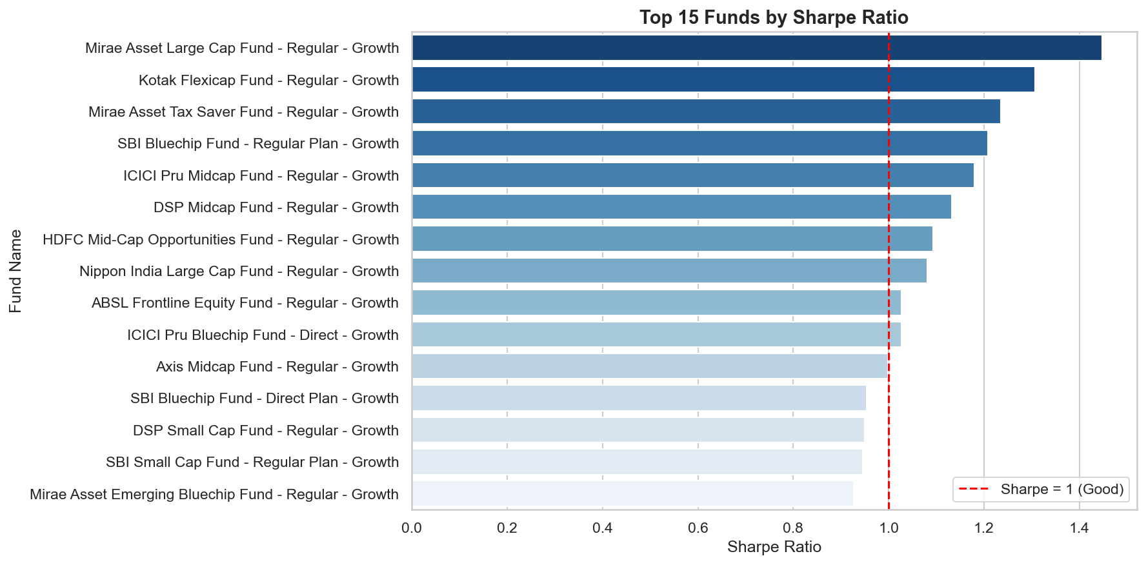
Fund Performance Analytics
Sharpe Ratio, CAGR, Fund Scorecard computed for all 40 schemes
Top 15 Funds by Sharpe Ratio
Fund Scorecard — Composite Score (0-100)
Scorecard Formula
Risk-Free Rate
Trading Days
Funds Analysed
30% 3yr Return + 25% Sharpe
+ 20% Alpha + 15% Expense
+ 10% Max Drawdown
Rf = 6.5% (RBI repo rate)
used for Sharpe & Sortino
calculations
252 trading days used
for annualisation of
all risk metrics
All 40 AMFI schemes
across Large, Mid,
Small & Debt categories

Slide 9
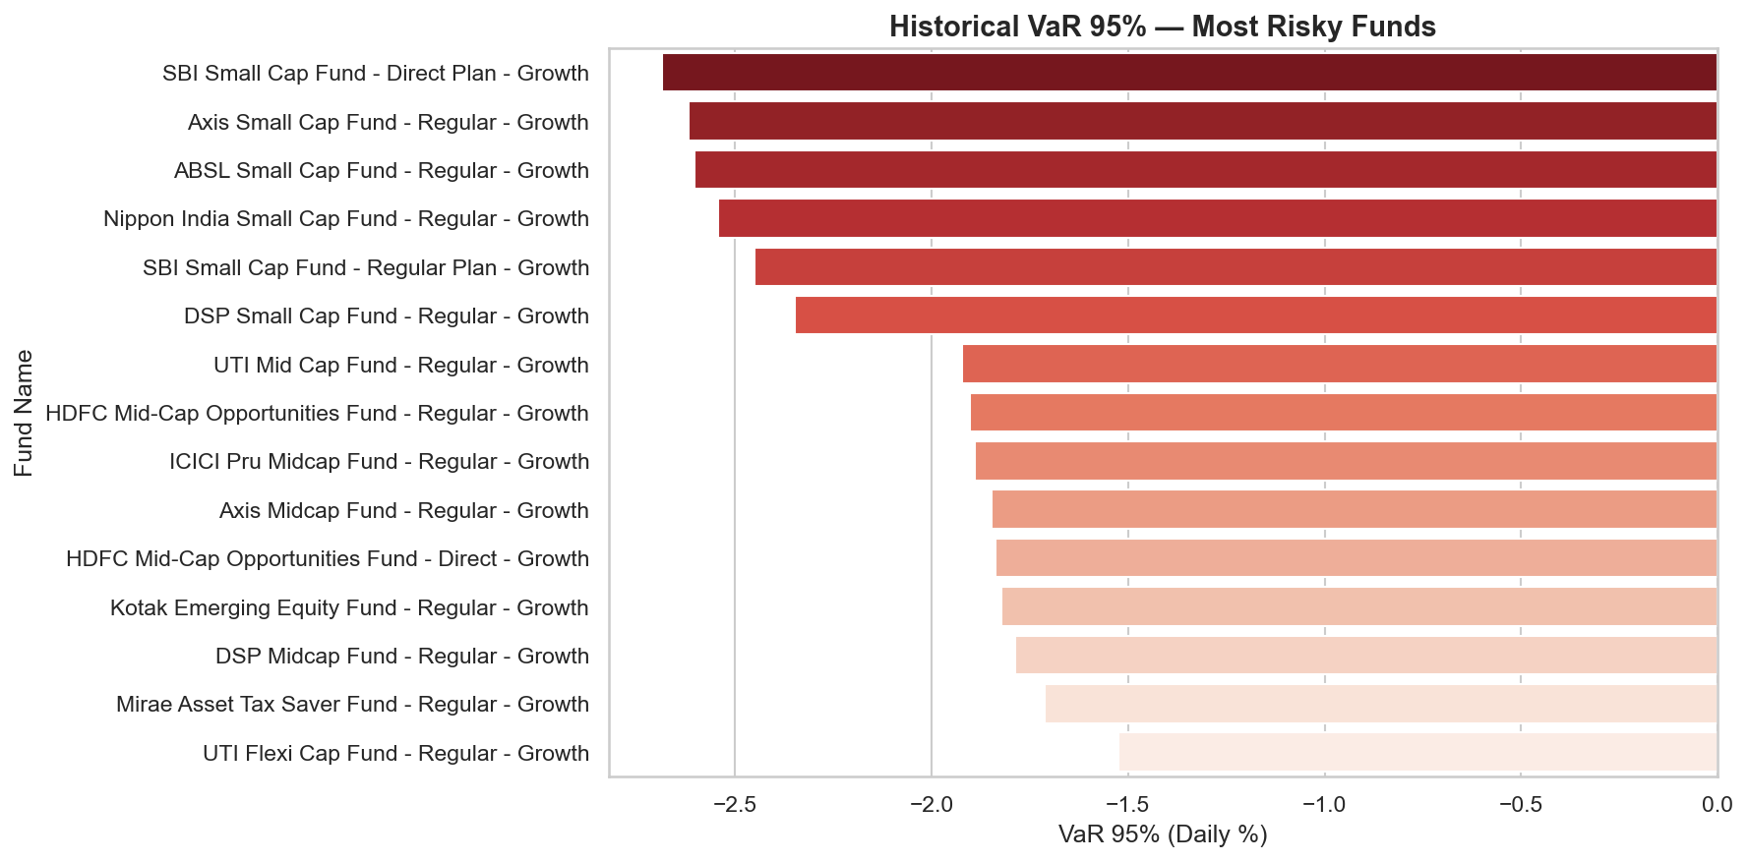
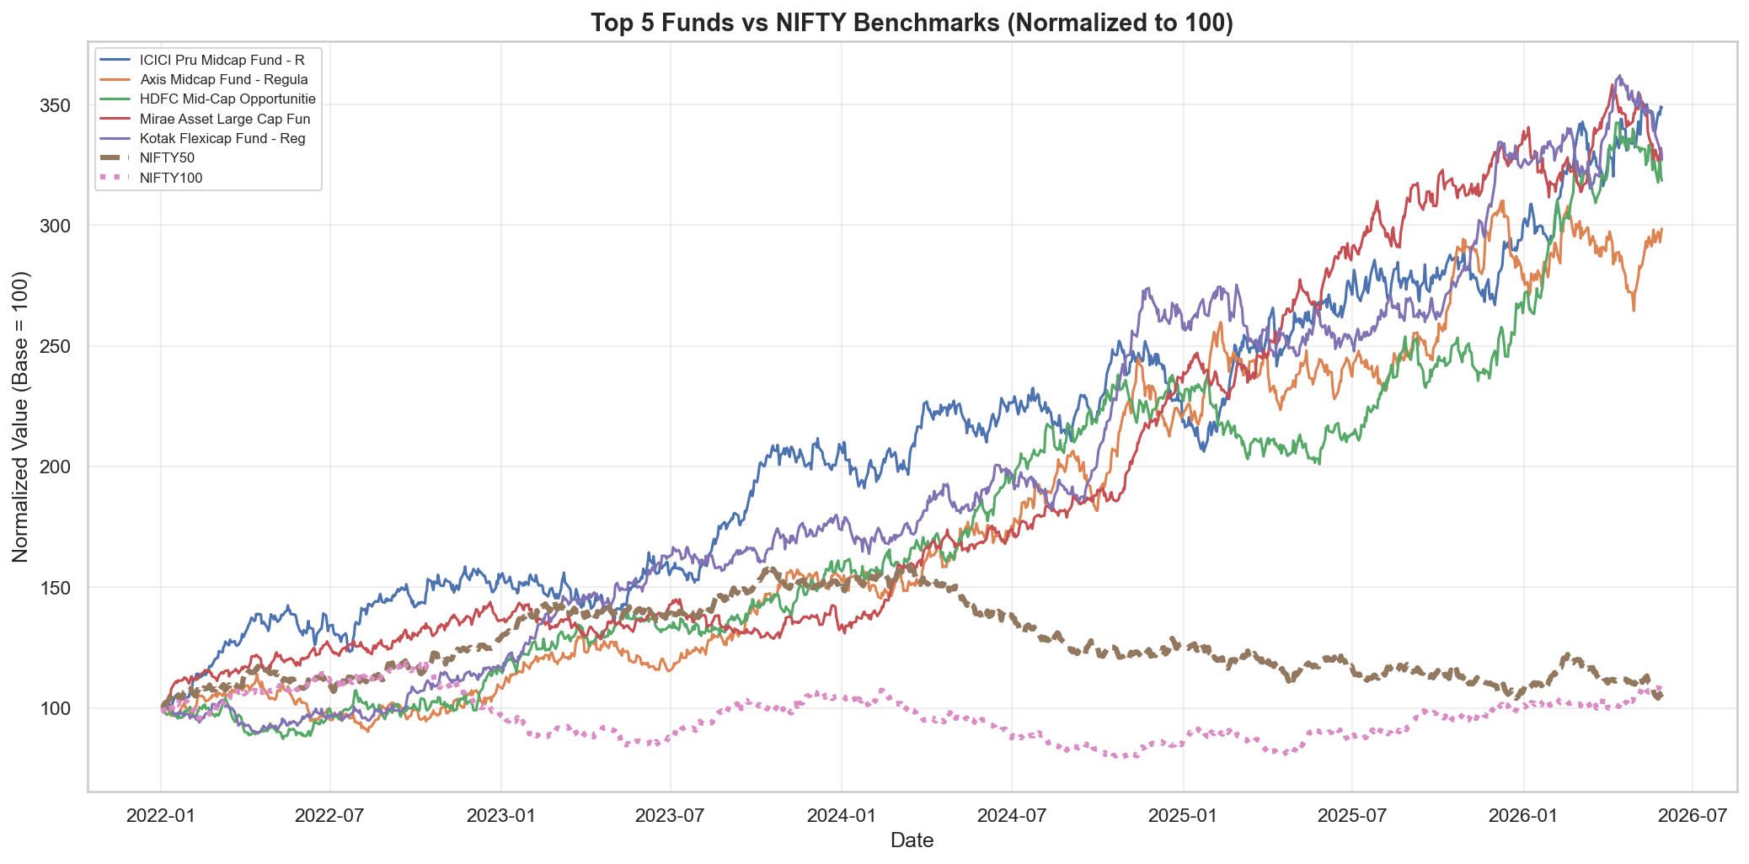
Risk Metrics — VaR & Benchmark Comparison
Historical VaR 95%, CVaR and fund returns vs Nifty 50 / Nifty 100
Historical VaR 95% — Most Risky Funds
Top 5 Funds vs Benchmark (Normalized to 100)
⚠️ Small Cap VaR
📊 Alpha Generation
📉 Max Drawdown
🔗 Correlation
Daily loss can exceed -2.5%
to -3.2% on worst 5% days
Top 5 funds outperformed
Nifty 100 by avg 3.2% alpha
HDFC Top 100 worst drawdown was -33.5% peak to trough
Large Cap funds correlate
0.85+ — limited diversification

Slide 10
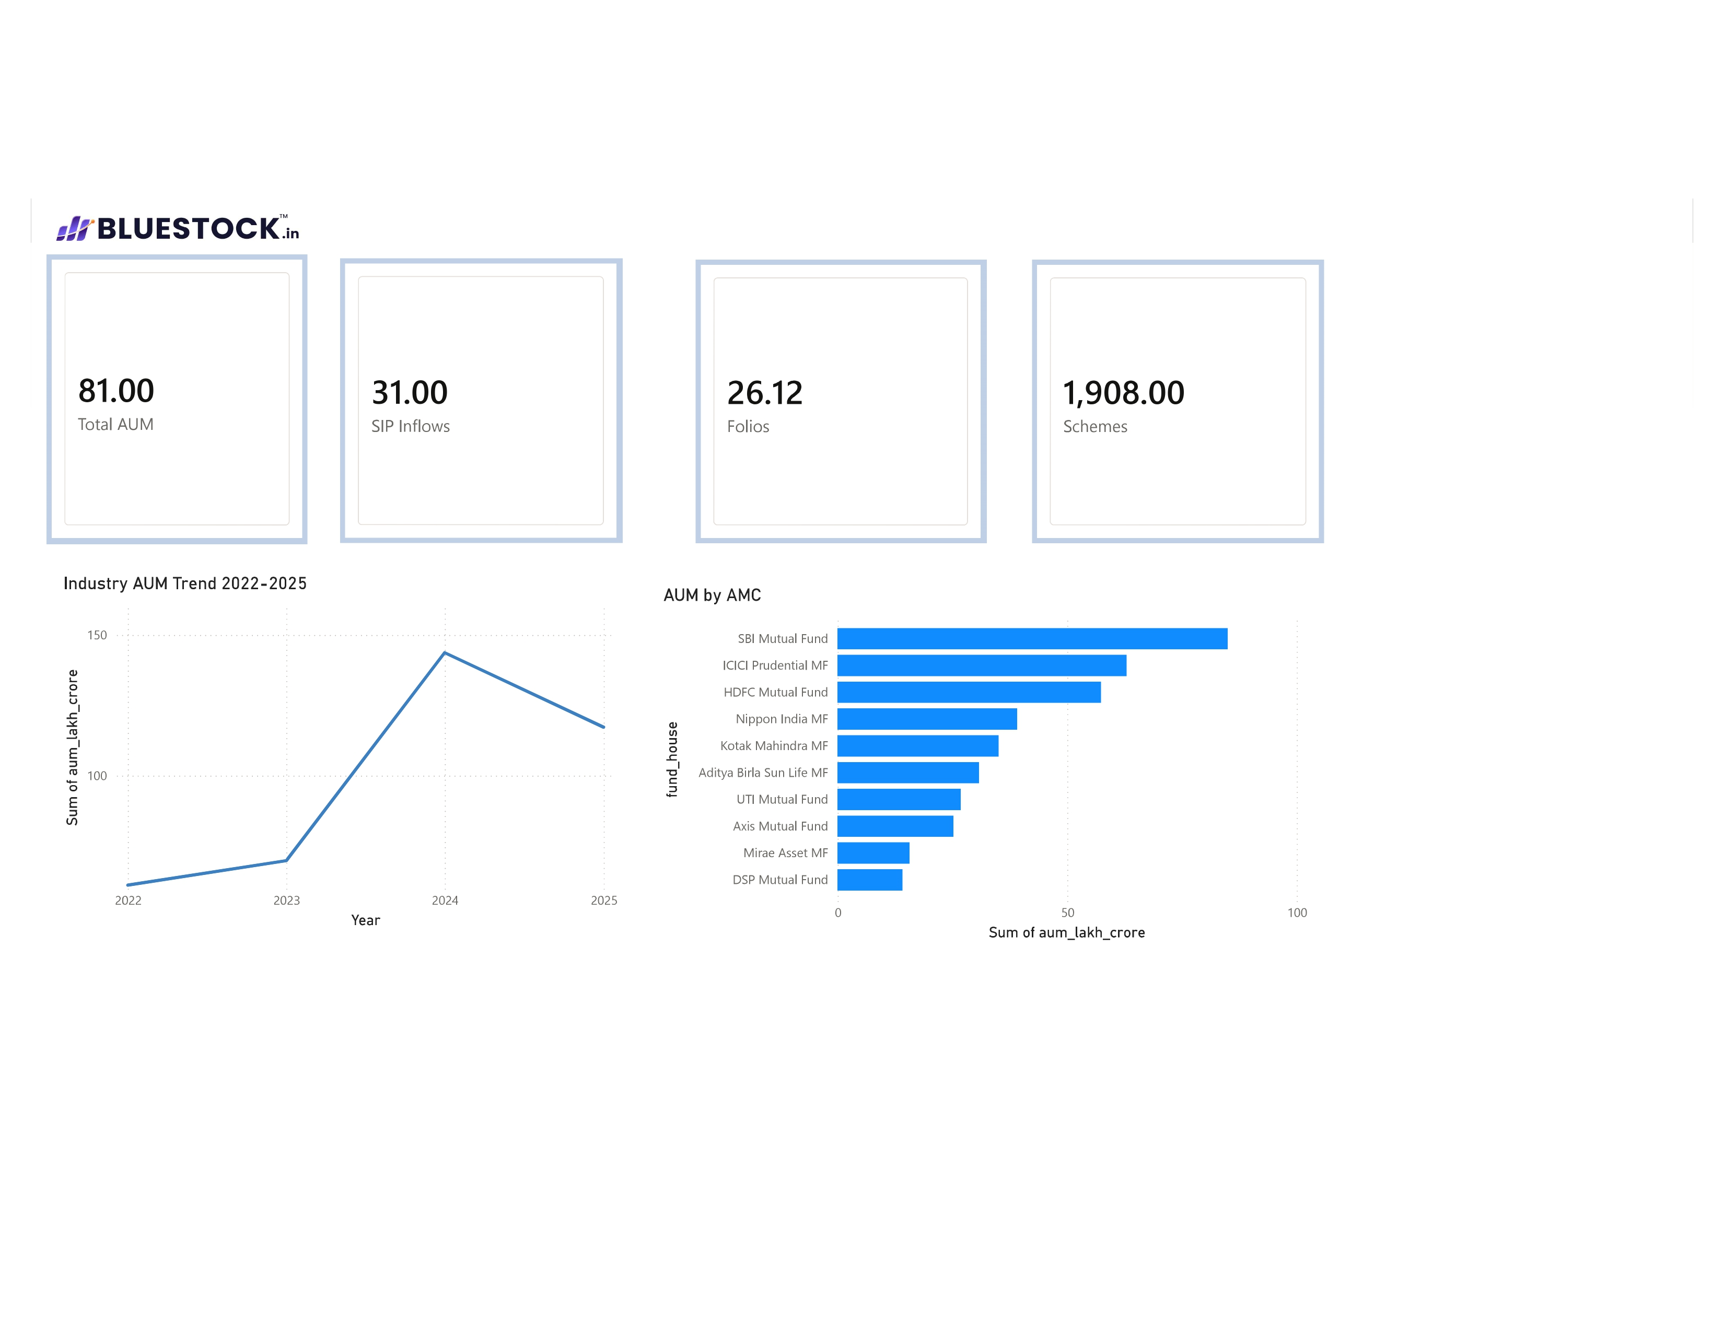
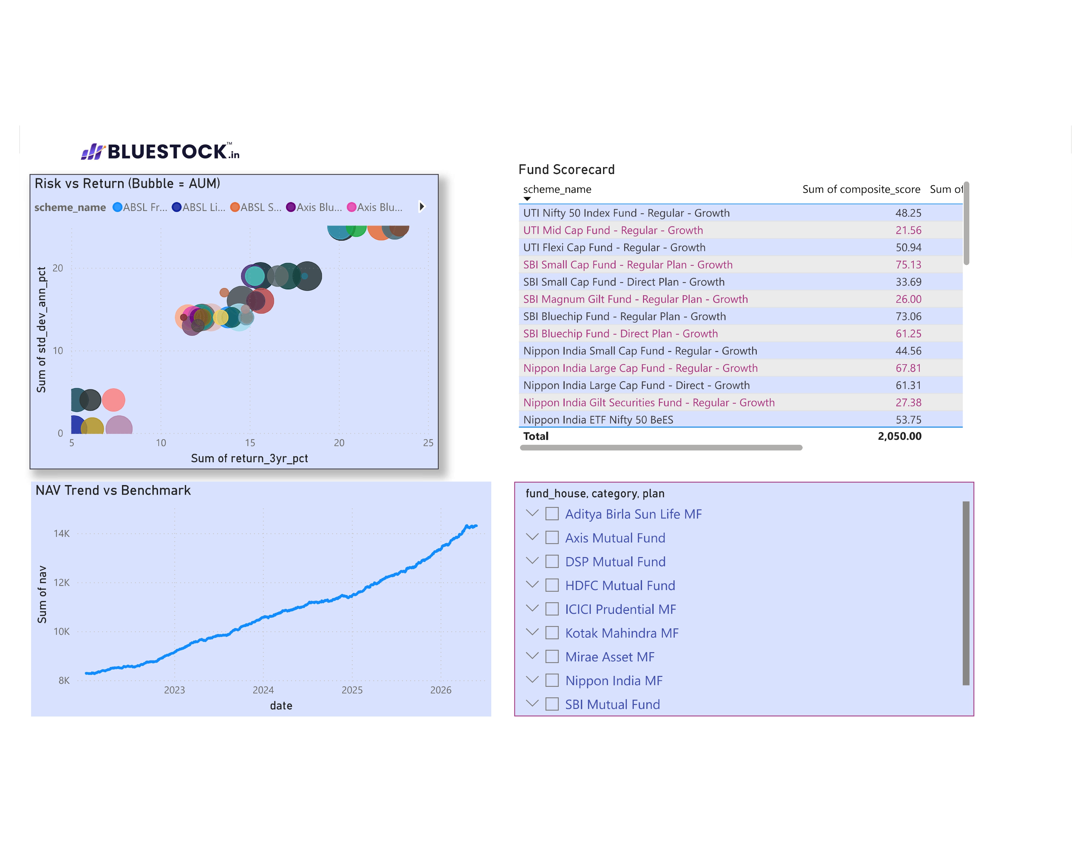
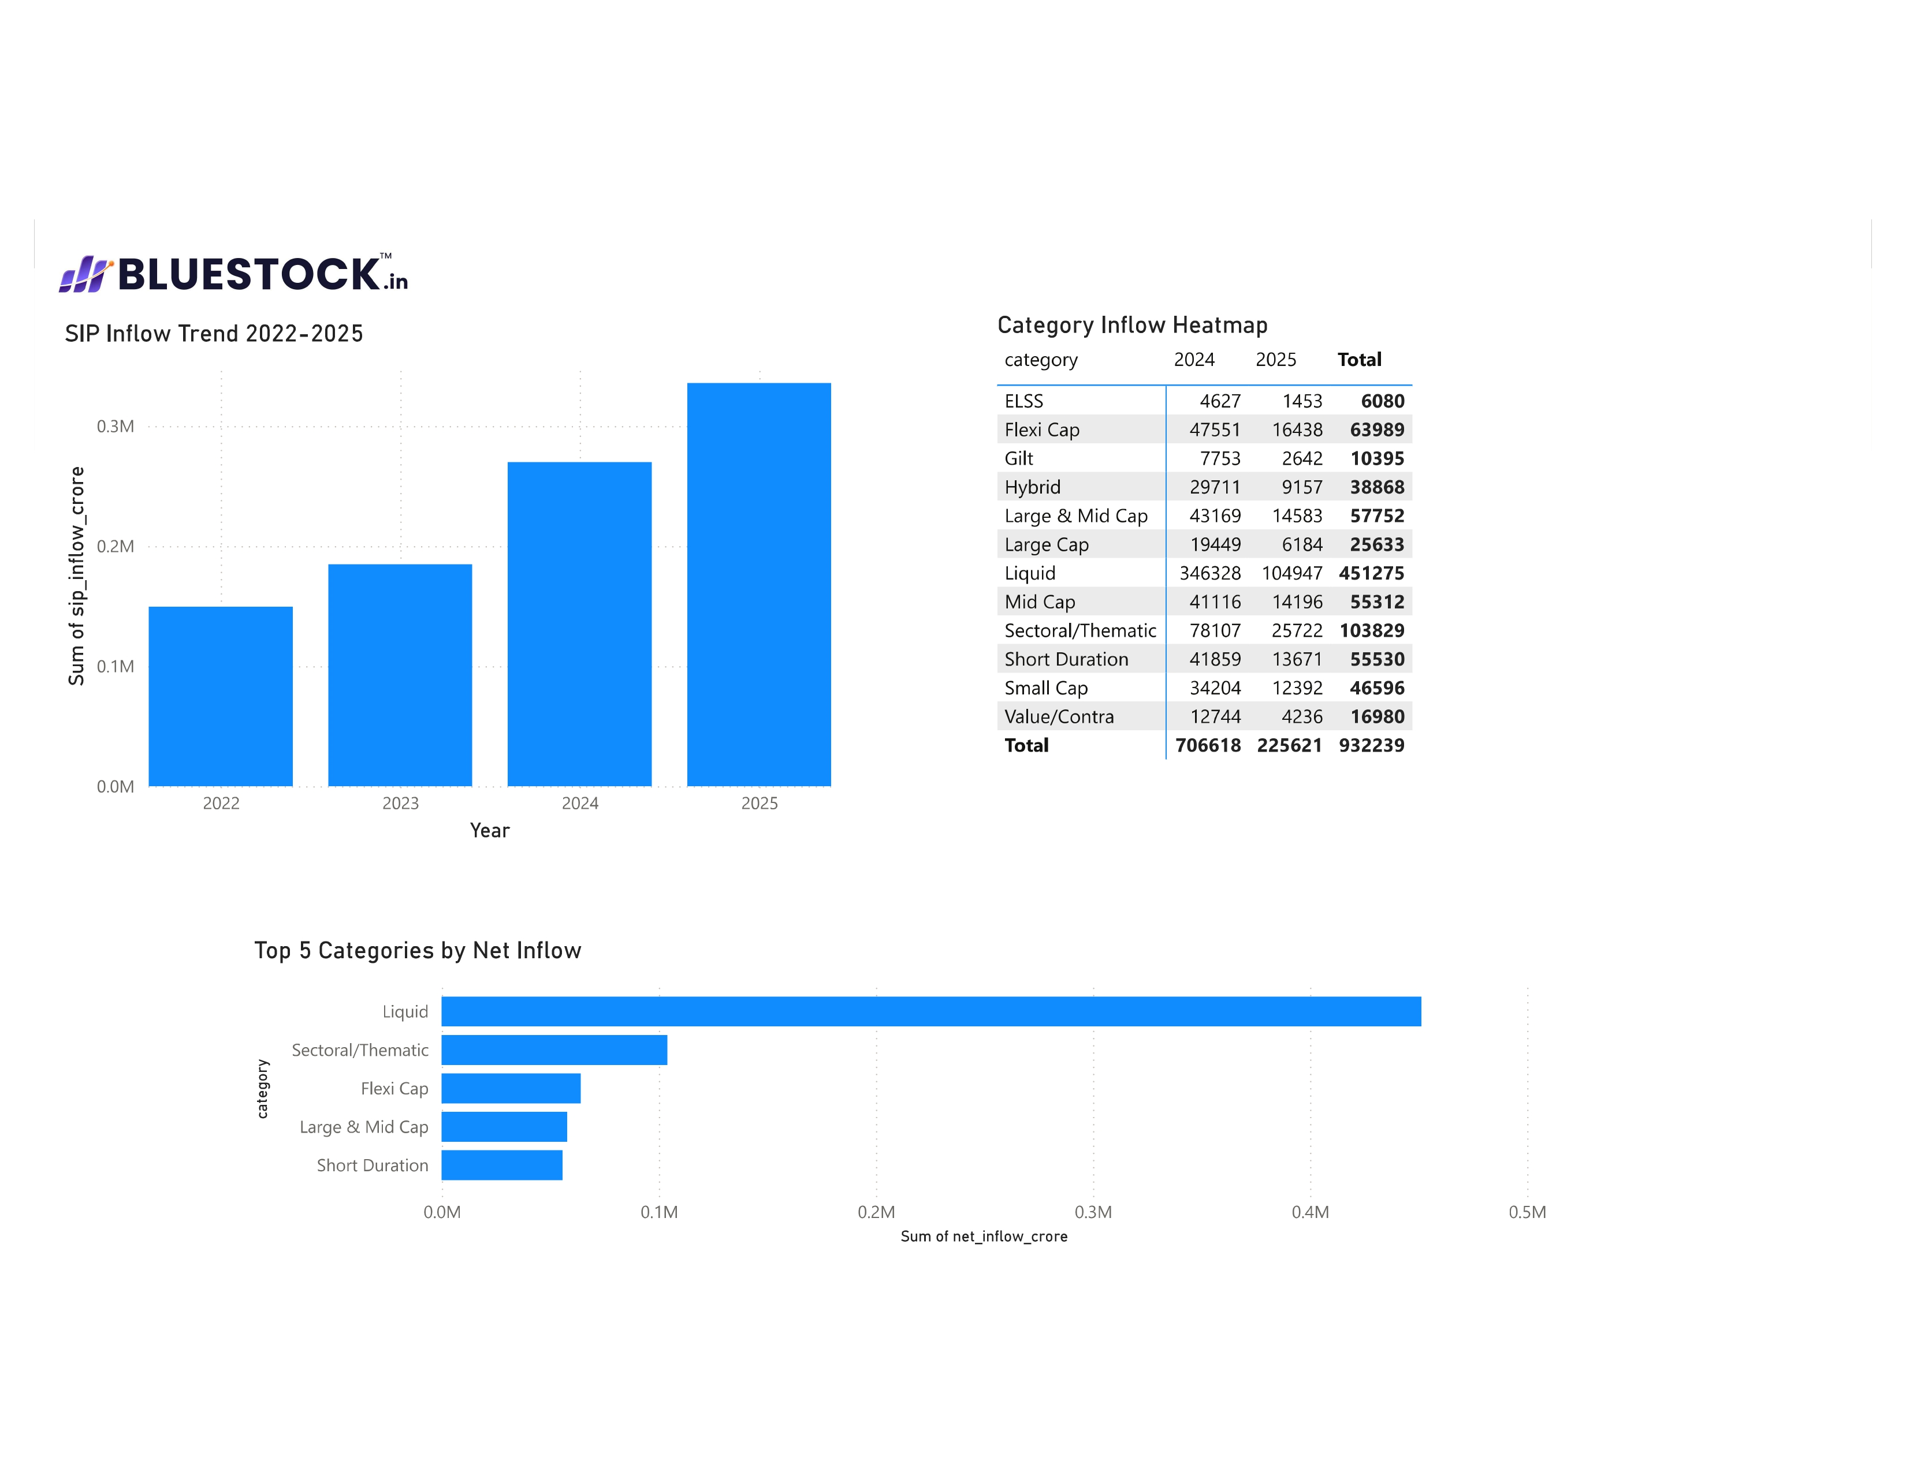
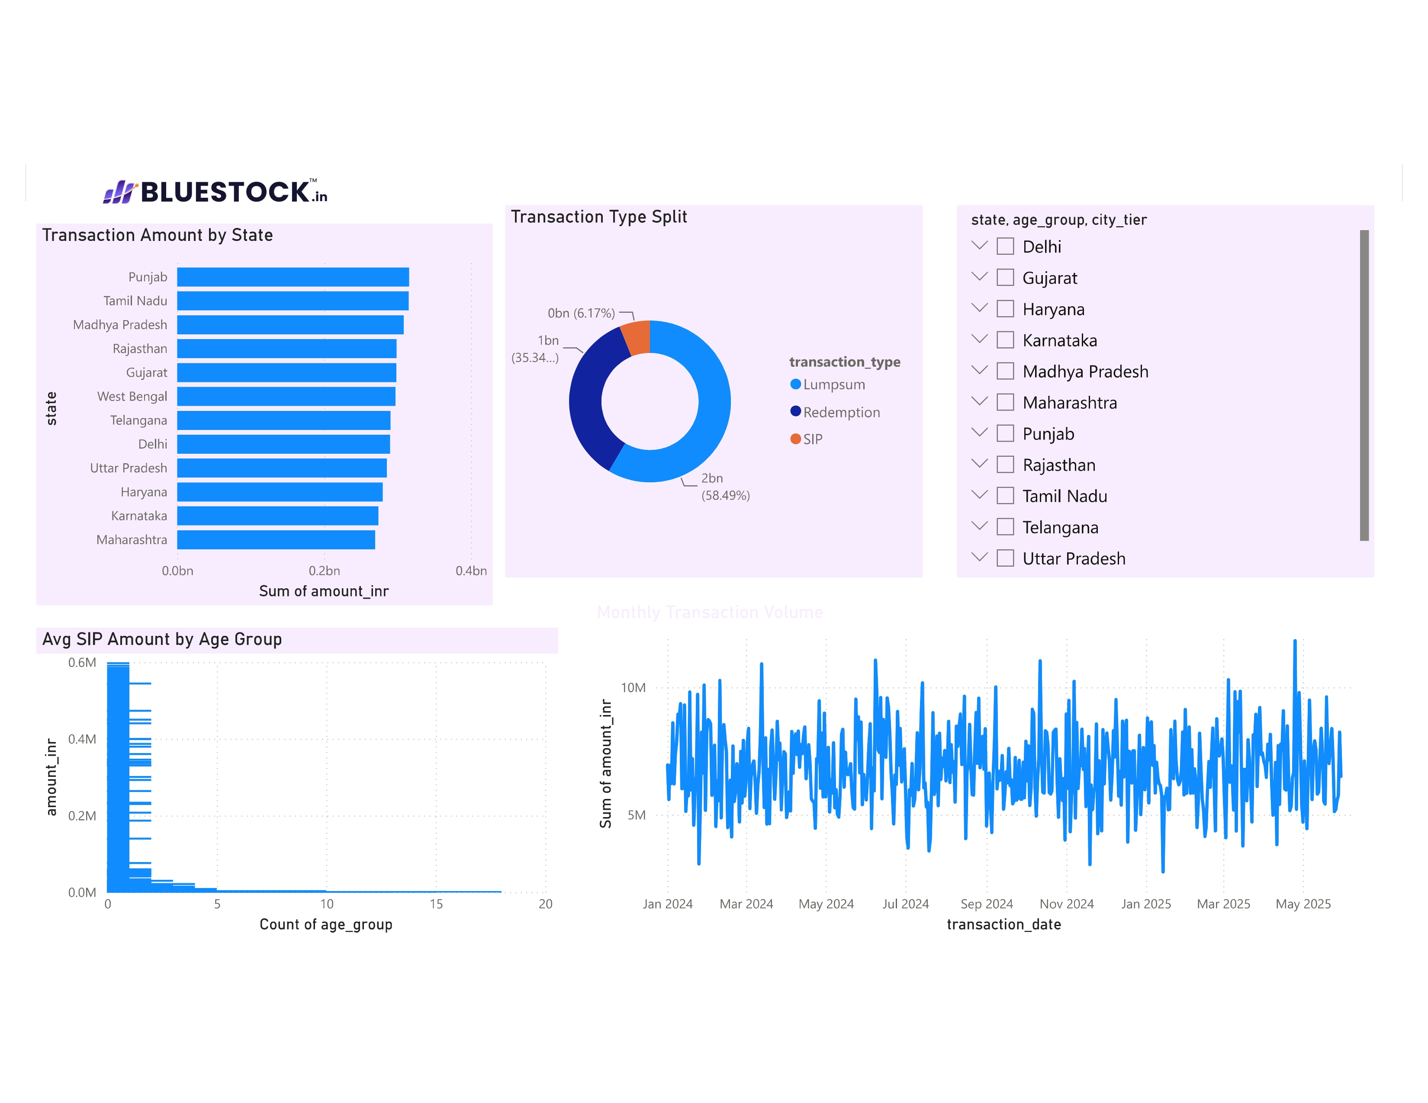
Interactive Power BI Dashboard
4-page dashboard with slicers, drill-through, KPI cards and tooltips
Page 1: Industry Overview
Page 2: Fund Performance
KPI cards: Total AUM, SIP Inflows,
Folios, Schemes
Line chart: AUM trend 2022-2025
Bar chart: AUM by AMC
Scatter: Return vs Risk (bubble=AUM)
Sortable fund scorecard table
NAV line vs benchmark
Slicers: fund house, category
Page 3: Investor Analytics
Page 4: SIP & Market Trends
Bar chart: Transaction by state
Donut: SIP/Lumpsum/Redemption
Bar: Age group vs avg SIP
Slicers: state, age, city tier
Dual-axis: SIP inflow + Nifty 50
Category inflow heatmap
Top 5 categories by net inflow
KPI: SIP accounts growth YoY

Slide 11
Key Findings & Recommendations
6 data-driven insights from the Mutual Fund Analytics Platform
SBI MF Market Leadership
SIP Revolution in India
01
SBI Mutual Fund manages Rs.12.5 Lakh Crore AUM — largest AMC in India by a significant margin over ICICI (Rs.10.7L Cr) and HDFC (Rs.9.3L Cr).
02
Monthly SIP inflows doubled from ~Rs.13,000 Cr in Jan 2022 to Rs.31,002 Cr in Dec 2025 — reflecting India's deepening equity investment culture.
Small Cap Outperformance
Young India Investing
03
Small Cap funds delivered highest 3yr CAGR of 20-23% but carry 2.5x more risk (VaR) than Large Cap funds — risk-reward tradeoff is real.
04
Investors aged 26-35 contribute 42% of all SIP investments — young working professionals are the primary growth engine for mutual funds.
T30 vs B30 City Shift
Strong SIP Discipline
05
While T30 cities account for 56% of transactions, B30 cities are growing 2.5x faster — mutual fund penetration in smaller cities is accelerating.
06
75-80% SIP continuity rate among investors with 6+ transactions — Indian investors are showing strong long-term investment discipline.

Slide 12

Thank You!
Ruksana Begum
Data Analyst Intern | Bluestock Fintech Pvt. Ltd.
📧 ruksanabegum1708@gmail.com
🔗 github.com/Ruksanabegum1708/bluestock_mf_capstone
📅 June 2026 | 7-Day Capstone Project
Python
Pandas
SQLite
Power BI
Plotly
Scikit-learn
Git
Bluestock Fintech Pvt. Ltd. | Mutual Fund Analytics Platform | Capstone 2026

