Slide 1
Online Food Delivery system
Food Villa Wish Box

Slide 2
Abstract
Food Villa Wish Box is a restaurant chain that delivers food items of different cuisines at affordable prices.
They have decided launch an online food delivery web application with a rich and user-friendly interface.
The system provides different functionalities for admin and non-admin users.
Admin user is able to manage products, while any registered user can view menu, select items and checkout the items added to the cart.

Slide 3
Introduction
It is a web portal that can be used by Admin user or a non-Admin user. As per the type of user, functionalities are made available to the user. An Admin user has added functionality to “Manage Products”, where in the admin can add/delete/edit/view products. All the user need to be first registered with the portal. Then on login both Admin and non-admin user can view “Menu” and place the order for food delivery.
All the functionalities are available on the navigation bar to the user. Also links for “Home” and “Log Out” are provided there.

Slide 4
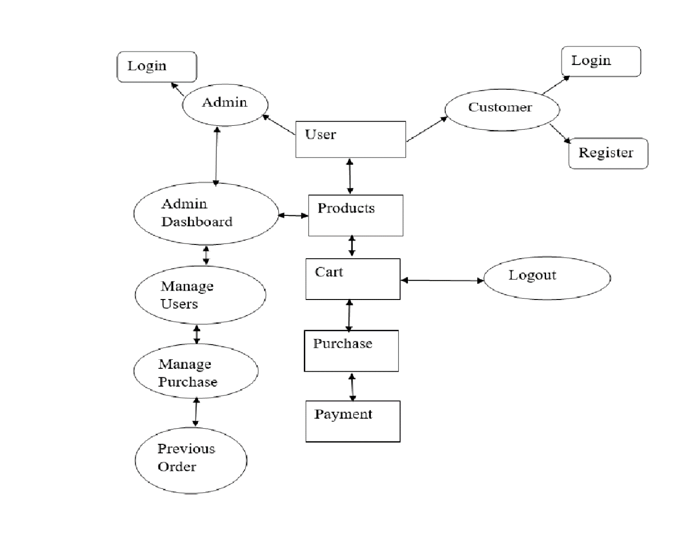
ER-Diagram

Slide 5
Technology Used
MySQL
Spring boot, JPA, Hibernate
Angular
Postman, J-Unit, Selenium

Slide 6
Modules
Admin
Customer
Products
Cart
Purchase
Payment
Testing

Slide 7
Advantages
Easy-to-use feature,
Easy, convenient and completely transparent,
It’s visually appealing and stimulating to ALL of the hungry customers

Slide 8
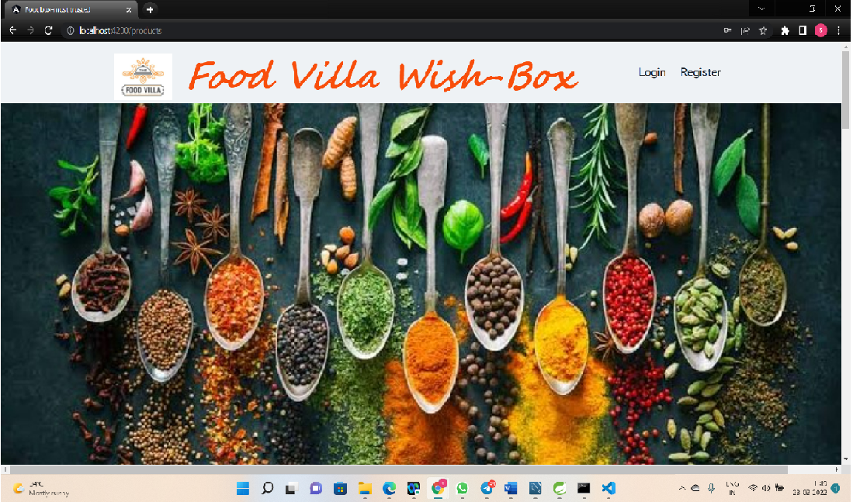
Homepage

Slide 9
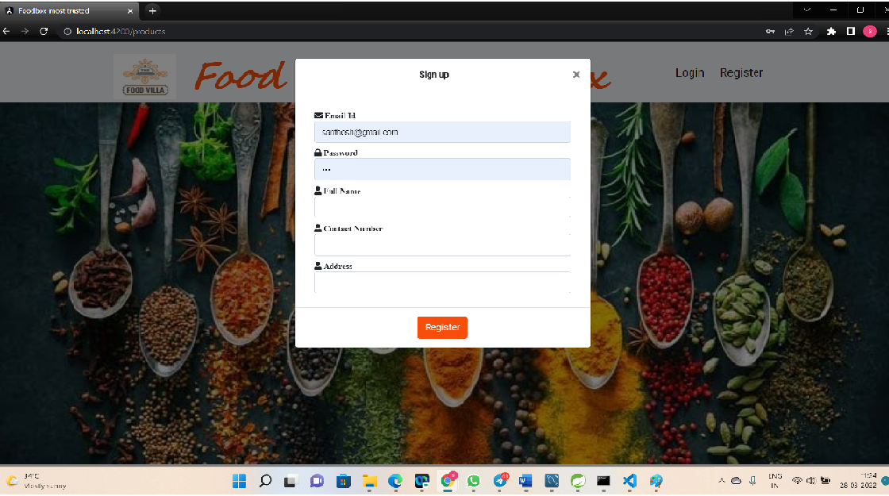
CustomerPage

Slide 10
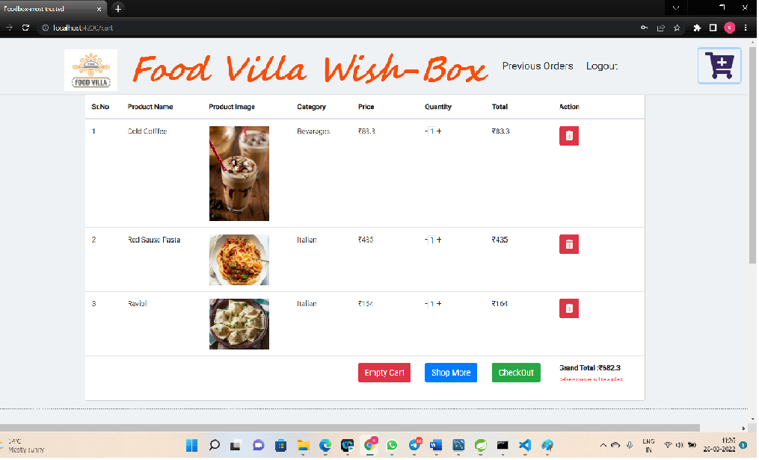
Cart page

Slide 11
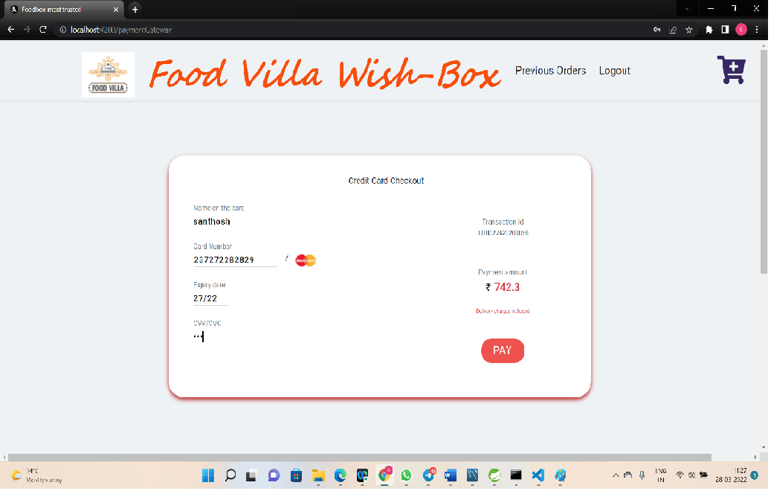
PaymentGateway

Slide 12
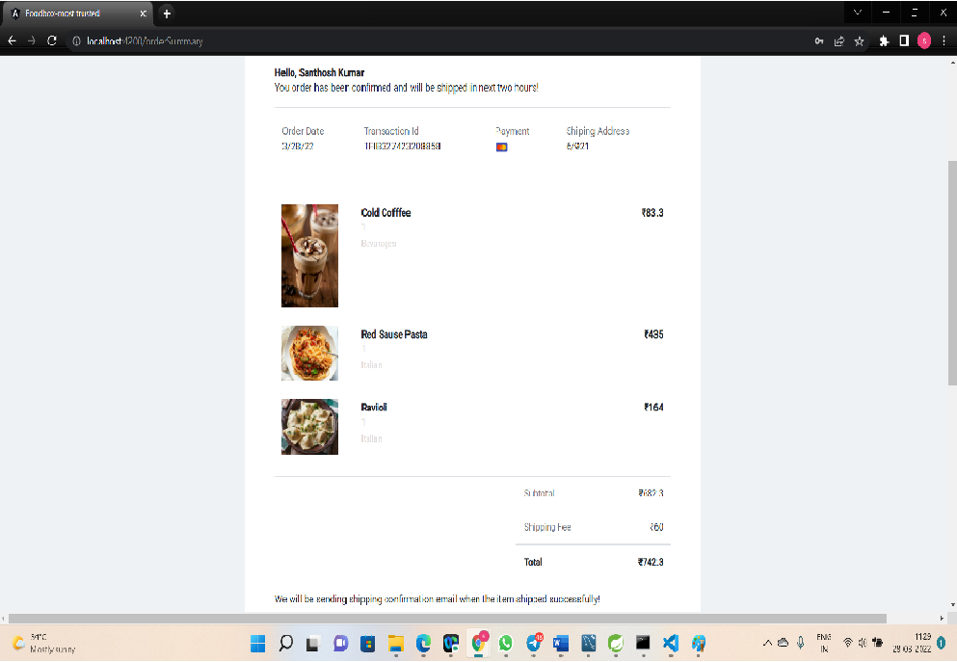
OrderSummary

Slide 13
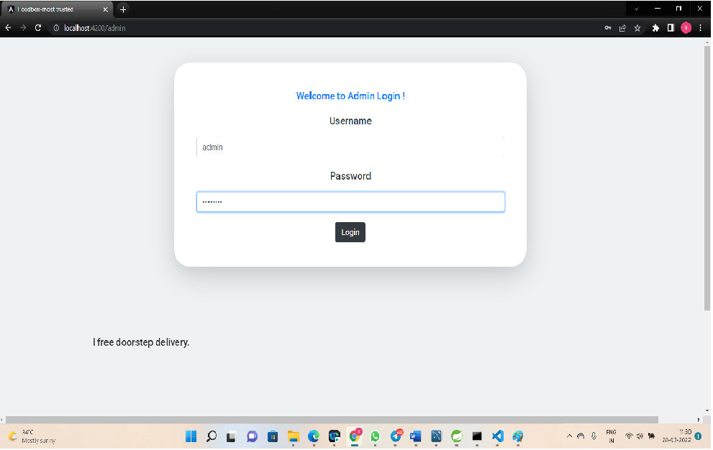
AdminLogin

Slide 14
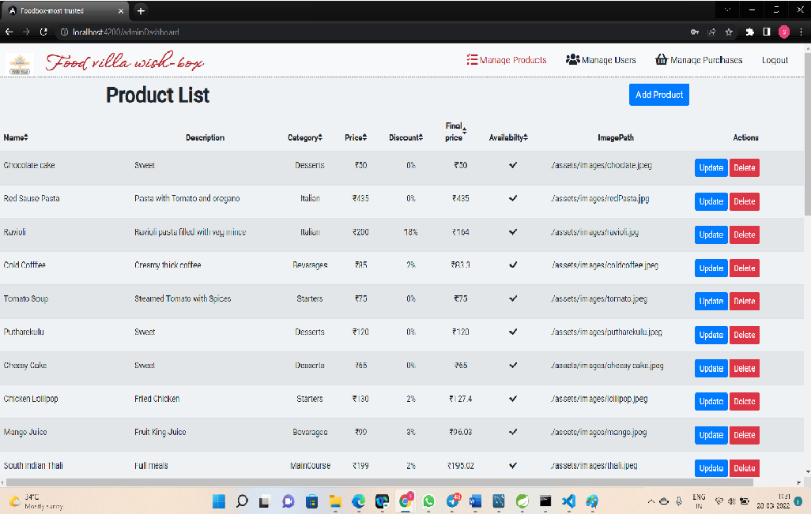
Admin Dashboard

Slide 15
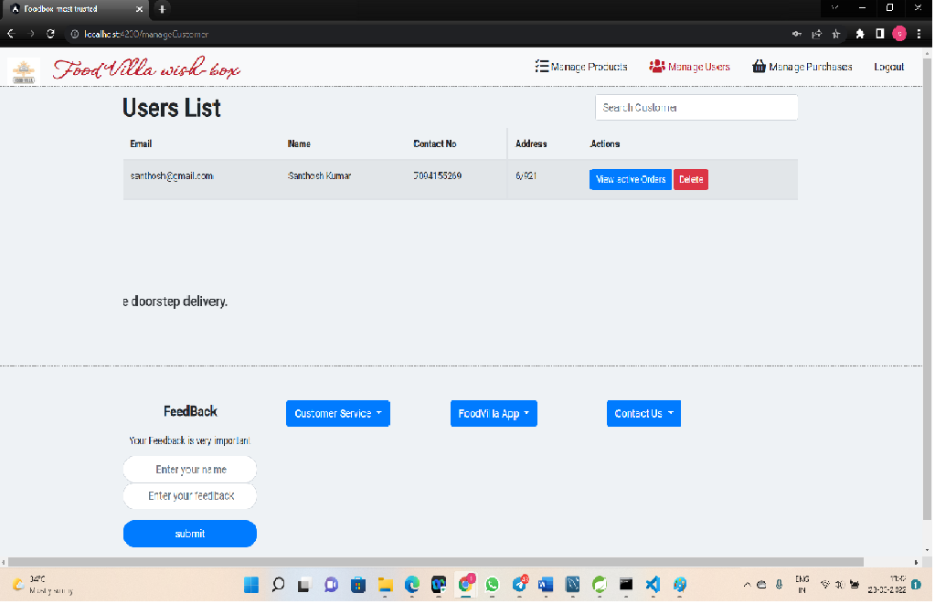
ManageUsers

Slide 16
Conclusion
This application provides interface for admin as well as non-admin users to manage the business data and/or view menu and checkout the order.

Slide 17
THANK YOU

