Slide 1

Authentication & Authentication Type

Slide 2
Content
Introduction
Authentication type
Password based Authentication
Token based Authentication
Biometric Authentication
Remote based Authentication
Conclusion

Slide 3

What is Authentication ?
Authentication is the process companies
use to ensure that only the right people,
services, and applications with the right permissions
have access to corporate resources.

Slide 4

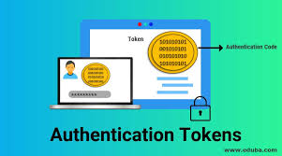

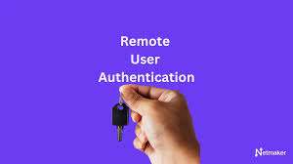
The main type of authentication
Password based Authentication
Token based Authentication
Biometric Authentication
Remote based Authentication

Slide 5
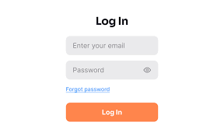
Password based Authentication
Password-based authentication is a common method for verifying a user's identity by requiring them to enter a username and a password.

Slide 6
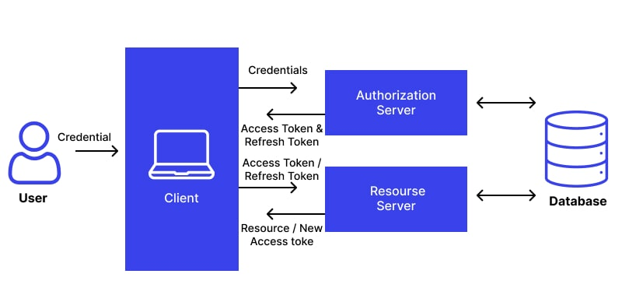
Token based Authentication
Token-based authentication is the process of verifying identity by checking a token. In access management, servers use token authentication to check the identity of a user, an API, a computer, or another server.
Various token-based verification processes
Eg :-
Verifying identity via a physical token.
Reconfirming identity via a web token.

Slide 7
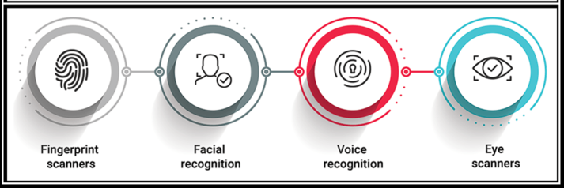
Biometric Authentication
Biometric authentication is a technology that uses biological characteristics to verify a person's identity and grant access to secure systems or locations.
Types of Authentication Methods
Facial recognition
Fingerprint Recognition
Eye Recognition
Voice Recognition
Retina/Iris Recognition
Gait Recognition
Vein Recognition

Slide 8
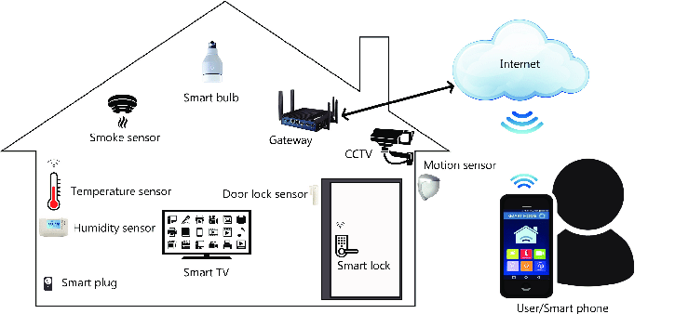
Remote based Authentication
Remote-based authentication refers to the methods and processes used to verify a user's identity when they are accessing a system or service from a remote location.
Types of Remote-Based Authentication
Password-Based Authentication
Multi-Factor Authentication (MFA)
Single Sign-On (SSO)
Token-Based Authentication
Certificate-Based Authentication

Slide 9
Conclusion
Authentication is crucial for organizations to verify identities and control access to resources. Its key advantages include enhanced security against unauthorized access, improved user trust, and compliance with regulations. By implementing robust authentication methods, companies can safeguard sensitive data while ensuring a seamless user experience.

Slide 10
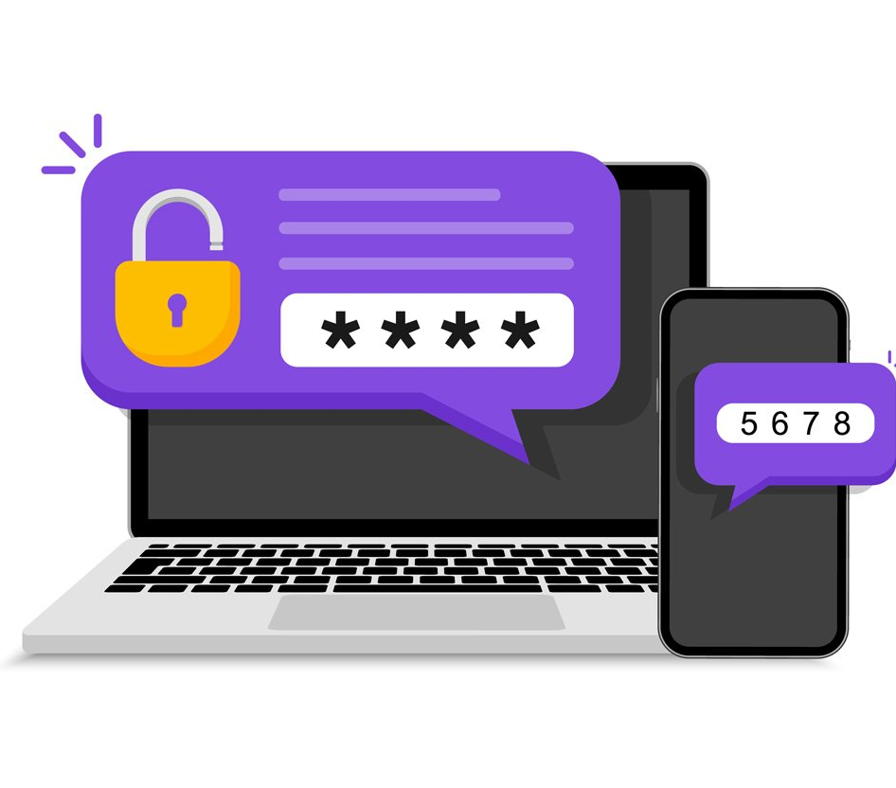


Thank you !

