Slide 1
Noun

Slide 2
Noun
A noun can be defined as a word used to name a person, place, or thing.
By a thing here, it means that it comprises something which can be perceived by human senses, or that which cannot be perceived but can be thought of.
Naming Word

Slide 3
Noun Classification
Kinds
Grammatical Nature
Number
Gender
Case

Slide 4
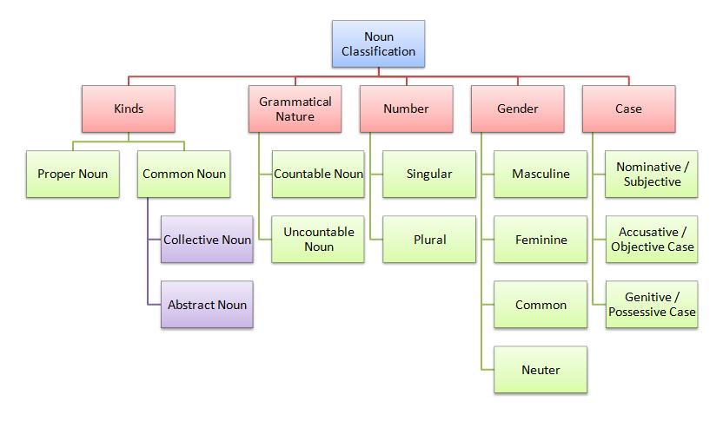

Slide 5
Noun Classification
Kinds
Proper Noun
Common Noun
Collective Noun
Abstract Noun

Slide 6
Noun Classification
Kinds
Proper Noun
A name of a particular, individual person, place, or thing who/which is usually unique
It is written is a capital letter
Examples:
Daniel
Islamabad
Punjab

Slide 7
Noun Classification
Kinds
Common Noun
A Common Noun is a name given in common to every person or thing of the same class or kind.
Boy
Girl
Chair
Types
Collective Noun
Abstract Noun

Slide 8
Noun Classification
Kinds
Types (Common Noun)
Collective Noun
A Collective Noun is the name of a number (or collection) of persons or things taken together and spoken of as one whole; as,
Crowd, mob, team, flock, herd, army, fleet, jury, family, nation, parliament, committee

Slide 9
Noun Classification
Kinds
Types (Common Noun)
Collective Noun
Crowd, mob, team, flock, herd, army, fleet, jury, family, nation, parliament, committee
A fleet = a collection of ships or vessels.
An army = a collection of soldiers.
A crowd = a collection of people.

Slide 10
Noun Classification
Kinds
Types (Common Noun)
Abstract Noun
An Abstract Noun is usually the name of a quality, action, or state considered apart from the object to which it belongs; as
Ideas / No physical Shapes
No Plural Possible
Grammar always treat them singular

Slide 11
Noun Classification
Kinds
Types (Common Noun)
Abstract Noun
Quality
Goodness, kindness, whiteness, darkness, hardness, brightness, honesty, wisdom, bravery
Action
Laughter, theft, movement, judgment, hatred
State
Childhood, boyhood, youth, slavery, sleep, sickness, death, poverty

Slide 12
Noun Classification
Kinds
Types (Common Noun)
Abstract Noun
The names of the Arts and Science (e.g., grammar, music, chemistry, etc.) are also Abstract Nouns

Slide 13
Exercises
Jones, money, rocket, actress, hatred, mob, conscience, State, University of Karachi, herd, team, the Himalayas, patriotism, town, pencil

Slide 17
Noun Classification
Grammatical Nature
Countable Noun
Uncountable Noun

Slide 18
Noun Classification
Number
Singular
Plural

Slide 19
Noun Classification
Gender
Masculine
Feminine
Common
Neuter

Slide 20
Noun Classification
Case
Nominative / Subjective
Accusative / Objective Case
Genitive / Possessive Case

Slide 21
Noun

