Slide 1



Slide 2
Group Members
PROGARM:BSEE A
SEMESTER:1st
Mubashir Ali (Reg No:F16-0207)
Asim Khan (Reg No:F16-0206)

Slide 3
Topic:Opreation Modes Of Bipolar Junction Transistor

Slide 4
Outline
Modes of Operations
BJT In saturation Mode
BJT in Cut off Mode
BJT in Active Region
BJT In Null Region
Mathematical Formulas for BJT
Summary
Truth Table of all Modes

Slide 5
Operation Modes of BJT
Transistor have four distinct modes of operation, which describe the current flowing through them. (When we talk about current flow through a transistor, we usually mean current flowing from collector to emitter of an NPN.)

Slide 6
Saturation Mode of BJT
Saturation :
The transistor acts like a short circuit. Current freely flows from collector to emitter.
Saturation is the on mode of a transistor. A transistor in saturation mode acts like a short circuit between collector and emitter.
In saturation mode both of the “diodes” in the transistor are forward biased
In reality VBE must be greater than a threshold voltage to enter saturation

Slide 7
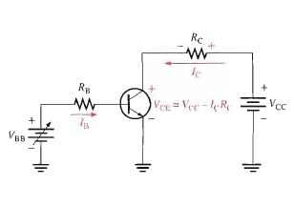
Base-emitter junction forward biased
Collector-base junction is forward biased
Ic reaches a maximum which is independent of IB and β.
No control.

Slide 8
Active Mode Of BJT
Active :
Collector-base junction is reverse biased
Base-emitter junction forward biased
Once Emitter based junction is reversed biased IC level off and remain constant for essinatlly value of IB as VCE continues to increase.

Slide 9
Cutoff Mode of BJT
When collector base junction is reversed and emitter base is also reversed than a BJT is in cutoff mode.
When BJT in cutoff mode base current is zero.
Collector leakage is extremely(Iceo) small and usually neglected
VCE=VCC

Slide 10
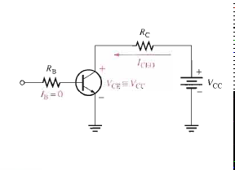
CONTT:

Slide 11
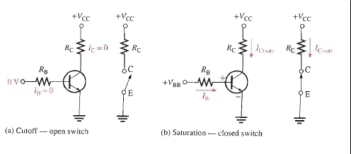
Transistor as a Switch
When transistor is in saturation as well in cutoff than transistor is behave like switch.
Switch is used for Turn and off LED.

Slide 12
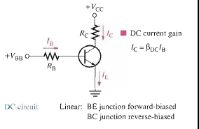
Transistor as a Amplifier
When Transistor is in Linear and active modes its behave as a current amplifier.
In other words “The amplification is the process of increasing current voltage by electronic means is called Amplification”.

Slide 13
BJTs Mathematical Formulas
IE=IC+IB(For Transistor current)
Betadc=IC/IB(current gain)
IB=VBB-VBE/RB(For Base To emitter voltage)
VCE=VC-IcRc (Common Emitter)
VCB=VCE-VBE(collector to base voltage)
IC=PD(MAX)/VCE(For Maximum ratting)
Av=Rc/re’(Approximate voltage gain)
Ic (sat)=vcc-vce(sat)/Rc(collector in saturation current)
Ib=ic(sat)/BetaDc(Maximun base current for saturation)

Slide 14
Truth Table

Slide 15
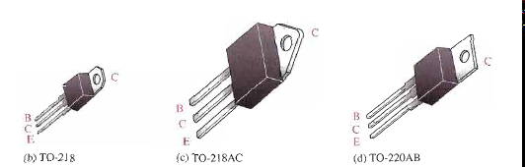
Summary
The BJT has three region named collector base and emitter.
By area base is very small and thin as compared to emitter and collector .
Collector is highly doped and bigger the other two one.
Emitter is the bigger than base and smaller than collector.
To operate as an amplifier collector based and emitter base are must be reversed biased.
To operate as an switch only when cutoff and saturation condition prove true.
Some BJTs are following:

Slide 16
THANK YOU

