Slide 1
Social Media Ad Performance Dashboard
Power BI Dashboard Analysis
Prepared By – Rul Amin
Student code – AF05013597

Slide 2
Agenda
Business Context & Objectives
Dashboard Overview
KPI Performance Analysis
Audience & Engagement Insights
Ad Type Analysis
Key Findings & Recommendations

Slide 3
Business Context
Digital advertising campaigns executed on Social Media platforms
Objective: Drive awareness, engagement, and conversions
Analysis performed using Power BI dashboard

Slide 4
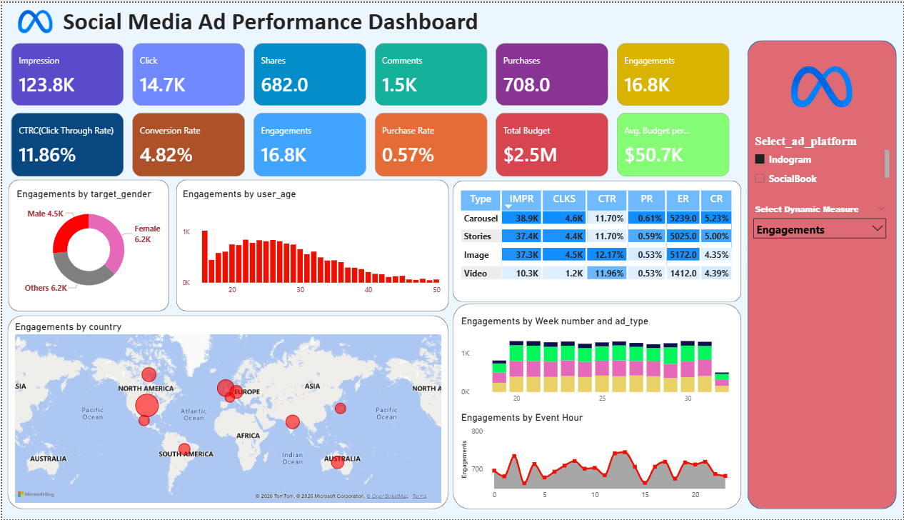
SOCIAL MEDIA Ad Performance Dashboard – Overview

Slide 5
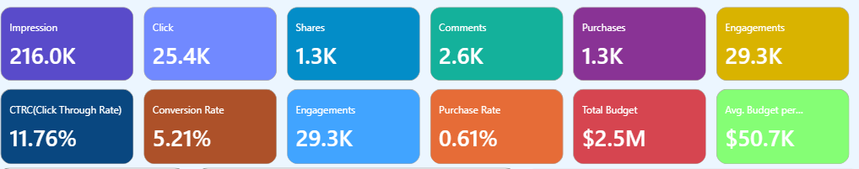
KPI Snapshot
Impressions: -Number of times ads were displayed - (Strong reach)
Clicks:- Number of times users clicked ads
Shares- Number of times ads were shared.
Comments - Number of user comments on ads.
Purchases (Conversions):Number of purchases made after seeing ads.
Engagement - Total interactions (Clicks + Shares + Comments).

Slide 6
Efficiency Metrics
CTR -% of impressions that resulted in clicks.- (Above industry benchmark)
Conversion Rate:- % of clicks that resulted in purchases.
Engagement - Total interactions.
Purchase Rate - % of impressions that resulted in purchases..
Total Budget - Total spend allocated to campaigns.
Avg. Budget per Campaign - Average budget allocation per campaign.

Slide 7
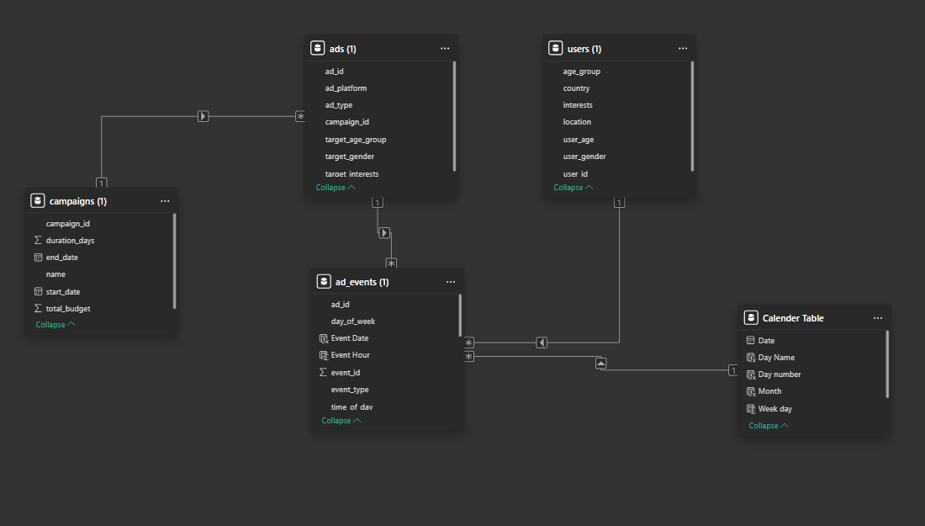
ER Diagram

Slide 8
Budget Overview
Total Ad Spend: 2.5M
Average Budget per Campaign: 50.7K
Multiple campaigns executed simultaneously

Slide 9
Marketing Funnel Performance
Strong awareness and interest (High CTR & Engagement)
Significant drop-off at purchase stage

Slide 10
Engagement by Gender
Female: 43% (Highest engagement)
Male: 22%
Other / Not Specified: 35%
Female audience shows stronger response

Slide 11
Engagement by Age Group
Highest engagement from
20–30 age group
Peak activity in early 20s
Engagement declines after age 35

Slide 12
Geographic Performance
Top countries: India, US, Brazil, Germany, UK
India & US drive volume and engagement
Germany & UK show higher purchasing power

Slide 13
Weekly Engagement Trends
Consistent engagement across weeks
No major volatility observed
Campaigns maintain steady audience interest

Slide 14
Hourly Engagement Trends
Peak engagement between 12PM – 8 PM
Low activity during early morning hours
Ad scheduling should prioritize evening slots

Slide 15
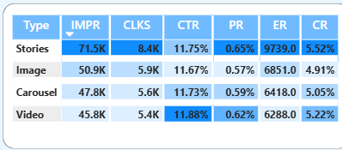
Ad Type Performance
Video & Story Ads: Highest CTR, Conversion & Engagement
Story Ads – Highest Purchase Rate
Carousel & Stories Ads: Strong impressions and reach.

Slide 16

Best Performing Formats
Video ads deliver best overall ROI
Stories ads effective for reach & visibility
Budget should prioritize these formats

Slide 17

Key Insights
Creatives and targeting are highly effective.
Audience engagement is strong.
Conversion efficiency needs improvement.

Slide 18

Strategic Recommendations
Optimize landing pages and checkout flow
Increase spend on Video & Stories ads
Focus on Females aged 18–30

Slide 19

Conclusion
Dashboard shows strong campaign awareness & engagement
Data-driven optimizations can improve ROI
Power BI enables actionable marketing insights

Slide 20
THANK YOU !!!

