Slide 1






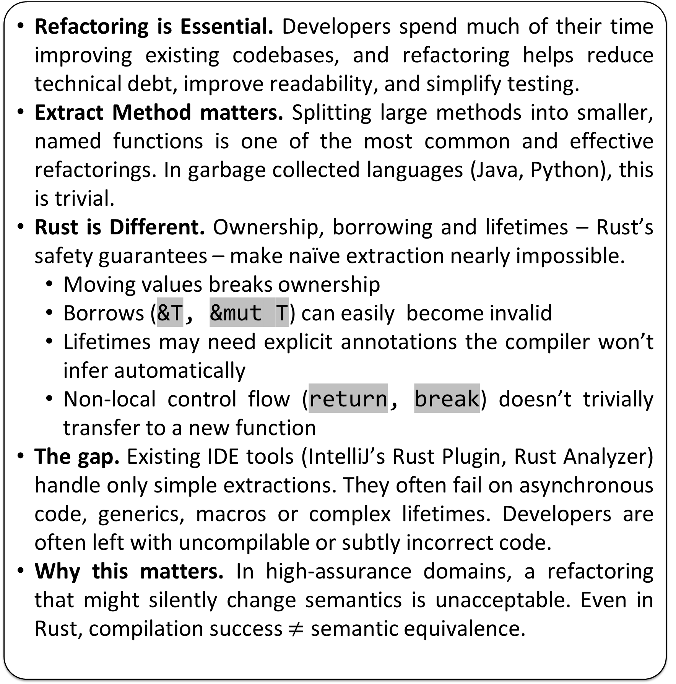
Motivation & Problem
Approach & Pipeline
Proof Mechanics & Obligations
Refactoring is Essential. Developers spend much of their time improving existing codebases, and refactoring helps reduce technical debt, improve readability, and simplify testing.
Extract Method matters. Splitting large methods into smaller, named functions is one of the most common and effective refactorings. In garbage collected languages (Java, Python), this is trivial.
Rust is Different. Ownership, borrowing and lifetimes – Rust’s safety guarantees – make naïve extraction nearly impossible.
Moving values breaks ownership
Borrows (&T, &mut T) can easily become invalid
Lifetimes may need explicit annotations the compiler won’t infer automatically
Non-local control flow (return, break) doesn’t trivially transfer to a new function
The gap. Existing IDE tools (IntelliJ’s Rust Plugin, Rust Analyzer) handle only simple extractions. They often fail on asynchronous code, generics, macros or complex lifetimes. Developers are often left with uncompilable or subtly incorrect code.
Why this matters. In high-assurance domains, a refactoring that might silently change semantics is unacceptable. Even in Rust, compilation success $≠$ semantic equivalence.
✂️ EXTRACTION
User selects code region
“Copy and Paste”
P
(Original)
P’ (Refactored)
Equivalence Obligation: For all inputs satisfying preconditions, extracted code and original return the same result and effects
Proof Generation: REMV auto-writes EquivCheck.v Coq file (imports + lemma skeleton)
Automation: Coq discharges proof via reflexivity after unfolding both sides
Guarantee: Trusted code without the need for user annotations
🛠️ REM
Repairs lifetimes
Infers borrows & ownership
Functionalised Semantics (AENEAS)
🔄 CHARON
Translates Rust to LLBC – a lambda calculus
Isolates rustc internals
Coq
(EquivCheck.v)
$$∀x.Φ\left(x \right)⟹\left(f_{P}\left(x\right)=f_{P^{′}}\left(x\right)∧obs\left(τ\right)=obs\left(τ^{′}\right)\right)$$
🧮 AENEAS
Functionalises LLBC
Prepares verification conditions
✔️ COQ
Generates observational equivalence proofs
Discharges correctness proofs
✔️ Same Results + Effects
Verifying Extract Method Refactoring in Rust
Matthew Britton, Alex Potanin, Sasha Pak
Preliminary Results
From Prototype to Production
GitHub
Standalone CLI: working tool outside of the research harness
Language Coverage: already supports async/await, generics, macros, etc.
IDE integration: VSCode extension provides proof – of – concept with live extract → fix → verify cycle.
Performance: ~2s proof cycles → feels interactive
Robustness: automated repair loop makes it work on real crates
We evaluated REM on a curated set of extraction sites adapted from the rust-analyzer test suite, selected to span diverse language features (loops, control flow, comments, etc.). Each site was automatically transformed and verified for observational equivalence. All 10/10 cases discharged successfully in Coq, with average verification time ≈ 2 s—fast enough for interactive IDE use. These results show REMV’s ability to scale beyond toy examples, and highlight opportunities for larger-scale evaluation on real-world crates.
VSCode
“Not just theory – A usable developer tool”
ID | Focus | Extracted Signature | LOC(P→P’) | Equiv
0 | break loop | n: i32 → Option<i32> | 11 → 18 | ✓
1 | Break with value | () → Option<i32> | 13 → 19 | ✓
2 | Comments in block | () → i32 | 9 → 10 | ✓
3 | Extract from nested loop | () -> i32 | 9 → 12 | ✓
4 | Extract from trait impl | &self -> i32 | 11 → 16 | ✓
5 | Extract mutable reference | y: &mut Foo | 14 → 17 | ✓
6 | Extract return statement | () → u32 | 5 → 8 | ✓
7 | Extract mutable method call | mut n: i32 | 12 → 15 | ✓
8 | No arguments if let else | () → i32 | 5 → 8 | ✓
9 | Try option with return | () → Option<i32> | 12 → 16 | ✓
Future Work
Scaling: whole-crate coverage via caching + incremental re-verification.
New features: unsafe code, concurrency, richer ownership patterns.
Diagnostics: friendlier failure messages when proofs don’t go through
Large-scale evaluation: across multiple community crates
Stronger guarantees: beyond observational equivalence!
“Towards real-world scale”
DOI

Slide 2
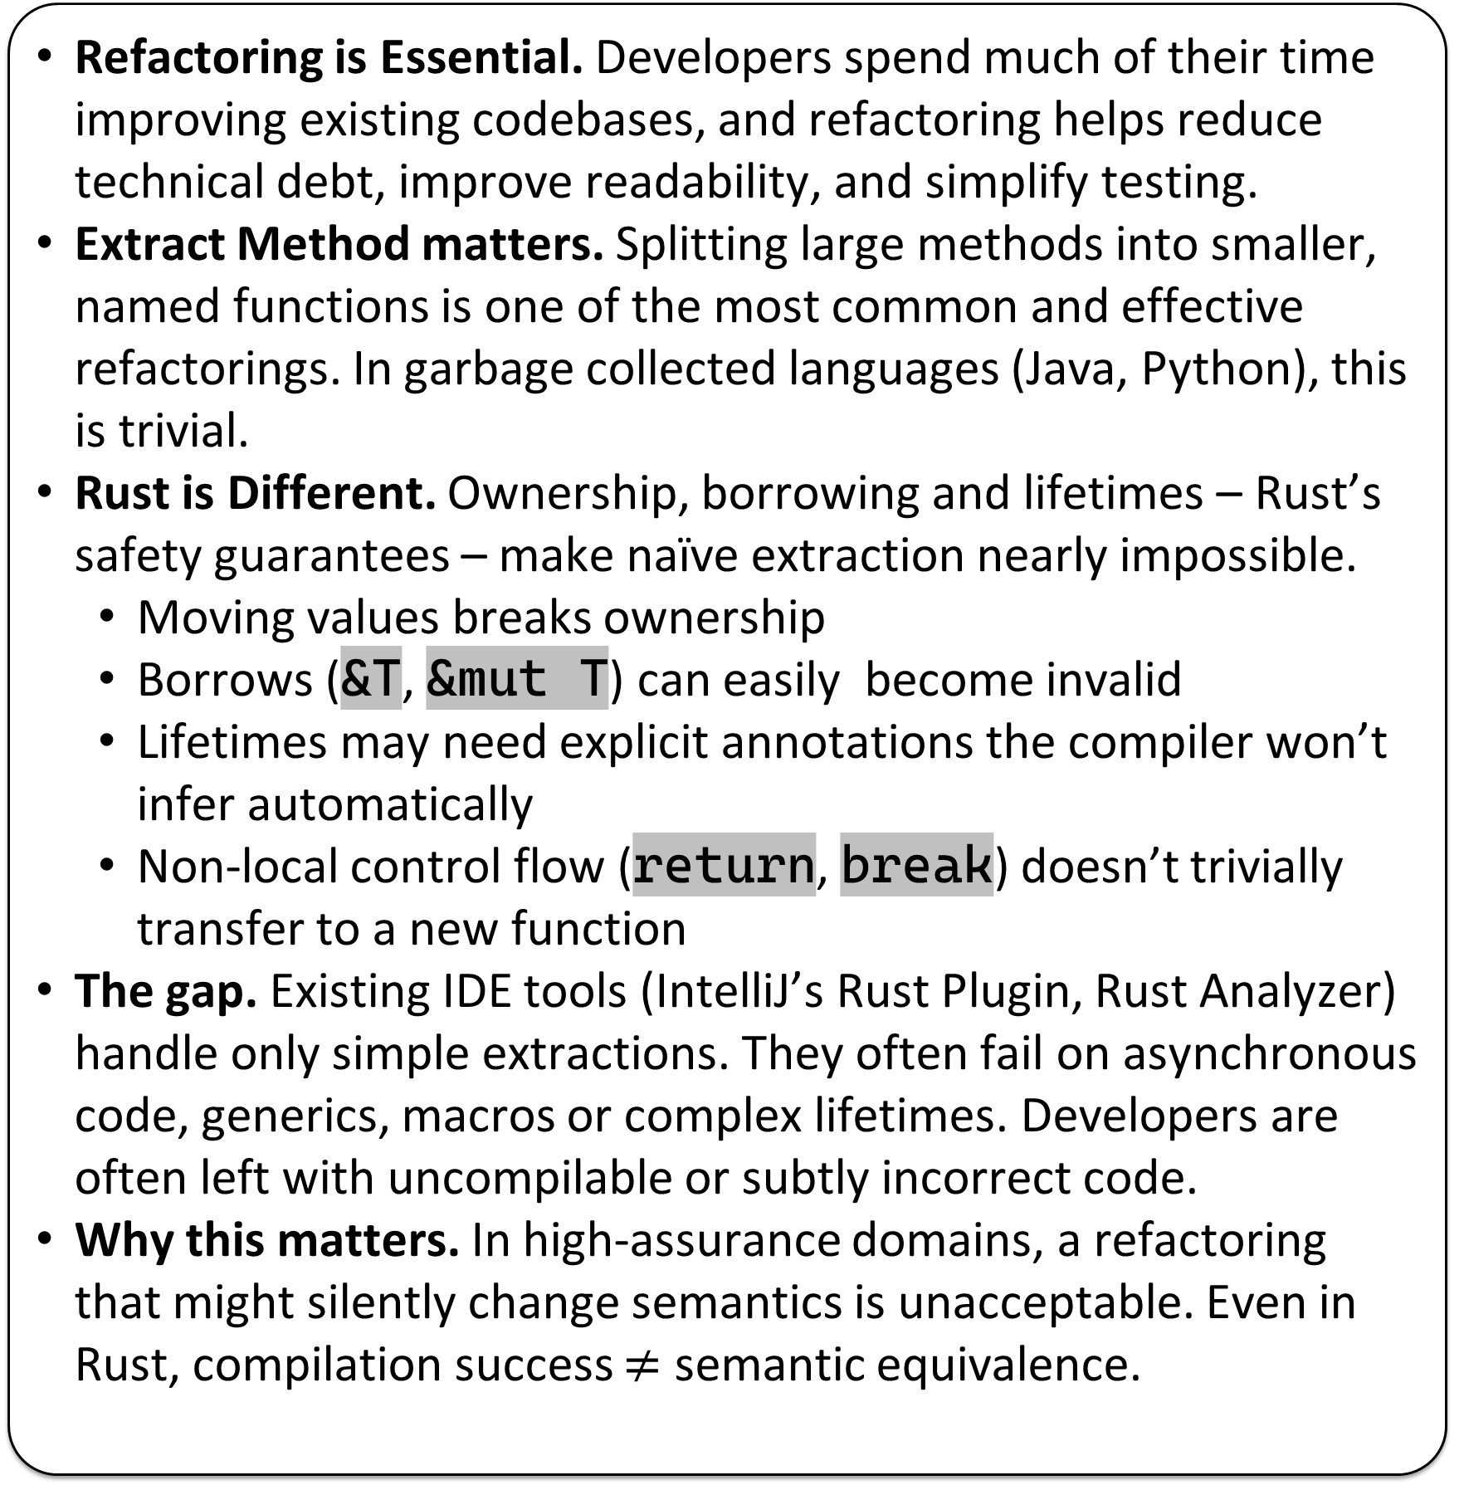
Motivation & Problem
Approach & Pipeline
Preliminary Results
Refactoring is Essential. Developers spend much of their time improving existing codebases, and refactoring helps reduce technical debt, improve readability, and simplify testing.
Extract Method matters. Splitting large methods into smaller, named functions is one of the most common and effective refactorings. In garbage collected languages (Java, Python), this is trivial.
Rust is Different. Ownership, borrowing and lifetimes – Rust’s safety guarantees – make naïve extraction nearly impossible.
Moving values breaks ownership
Borrows (&T, &mut T) can easily become invalid
Lifetimes may need explicit annotations the compiler won’t infer automatically
Non-local control flow (return, break) doesn’t trivially transfer to a new function
The gap. Existing IDE tools (IntelliJ’s Rust Plugin, Rust Analyzer) handle only simple extractions. They often fail on asynchronous code, generics, macros or complex lifetimes. Developers are often left with uncompilable or subtly incorrect code.
Why this matters. In high-assurance domains, a refactoring that might silently change semantics is unacceptable. Even in Rust, compilation success $≠$ semantic equivalence.
Extraction
User selects code region
“Copy and Paste”
REM
Repairs lifetimes
Infers borrows &
ownership
CHARON
Translates Rust to LLBC
(a Lambda Calculus)
Isolates rustc internals.
Allows for semantic analysis
Aeneas
Functionalises LLBC
Prepares verification conditions
Coq
Checks observational
equivalence proofs
Discharges correctness
automatically
- 10/10 cases discharged - Avg cycle: 2s (IDE-friendly) [Table/Graph Placeholder]
Verifying Extract Method Refactoring in Rust
Matthew Britton, Alex Potanin, Sasha Pak
From Prototype to Production-Ready REM
Future Work
GitHub
- Unsafe code - Concurrency - Large-scale evaluation - Better diagnostics - Scalable verification
VSCode
DOI

