Slide 1
SAFE, AUTOMATED REFACTORING FOR RUST: FROM EXTRACTION TO VERIFICATION
MATTHEW BRITTON WITH DR ALEX POTANIN AND SASHA PAK

Slide 2
AUTOMATING THE IMPOSSIBLE: VERIFIED EXTRACT METHOD REFACTORING IN RUST
MATTHEW BRITTON WITH DR ALEX POTANIN AND SASHA PAK

Slide 3
TABLE OF CONTENTS
01
WHAT IS EXTRACT METHOD REFACTORING?
04
VERIFICATION TOOLCHAIN: PROVING IT’S CORRECT
02
WHY IS IT SO HARD IN RUST? + HOW DID AoL AND REM TACKLE IT?
05
RESULTS AND ANALYSIS
03
MY CONTRIBUTIONS: EXPANDING REM
06
CONCLUSIONS AND FUTURE WORK

Slide 4
01
WHAT IS EXTRACT METHOD REFACTORING?
Breaking big problems into smaller, safer pieces of code

Slide 5
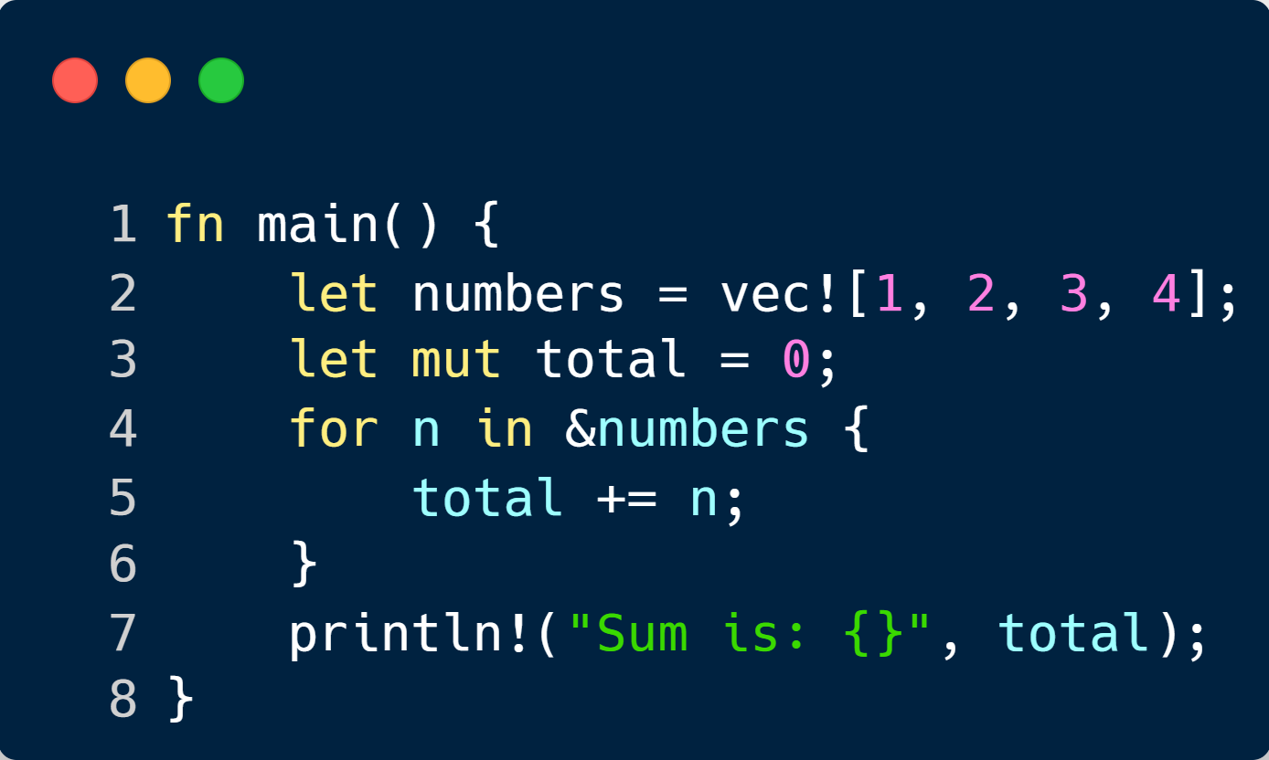
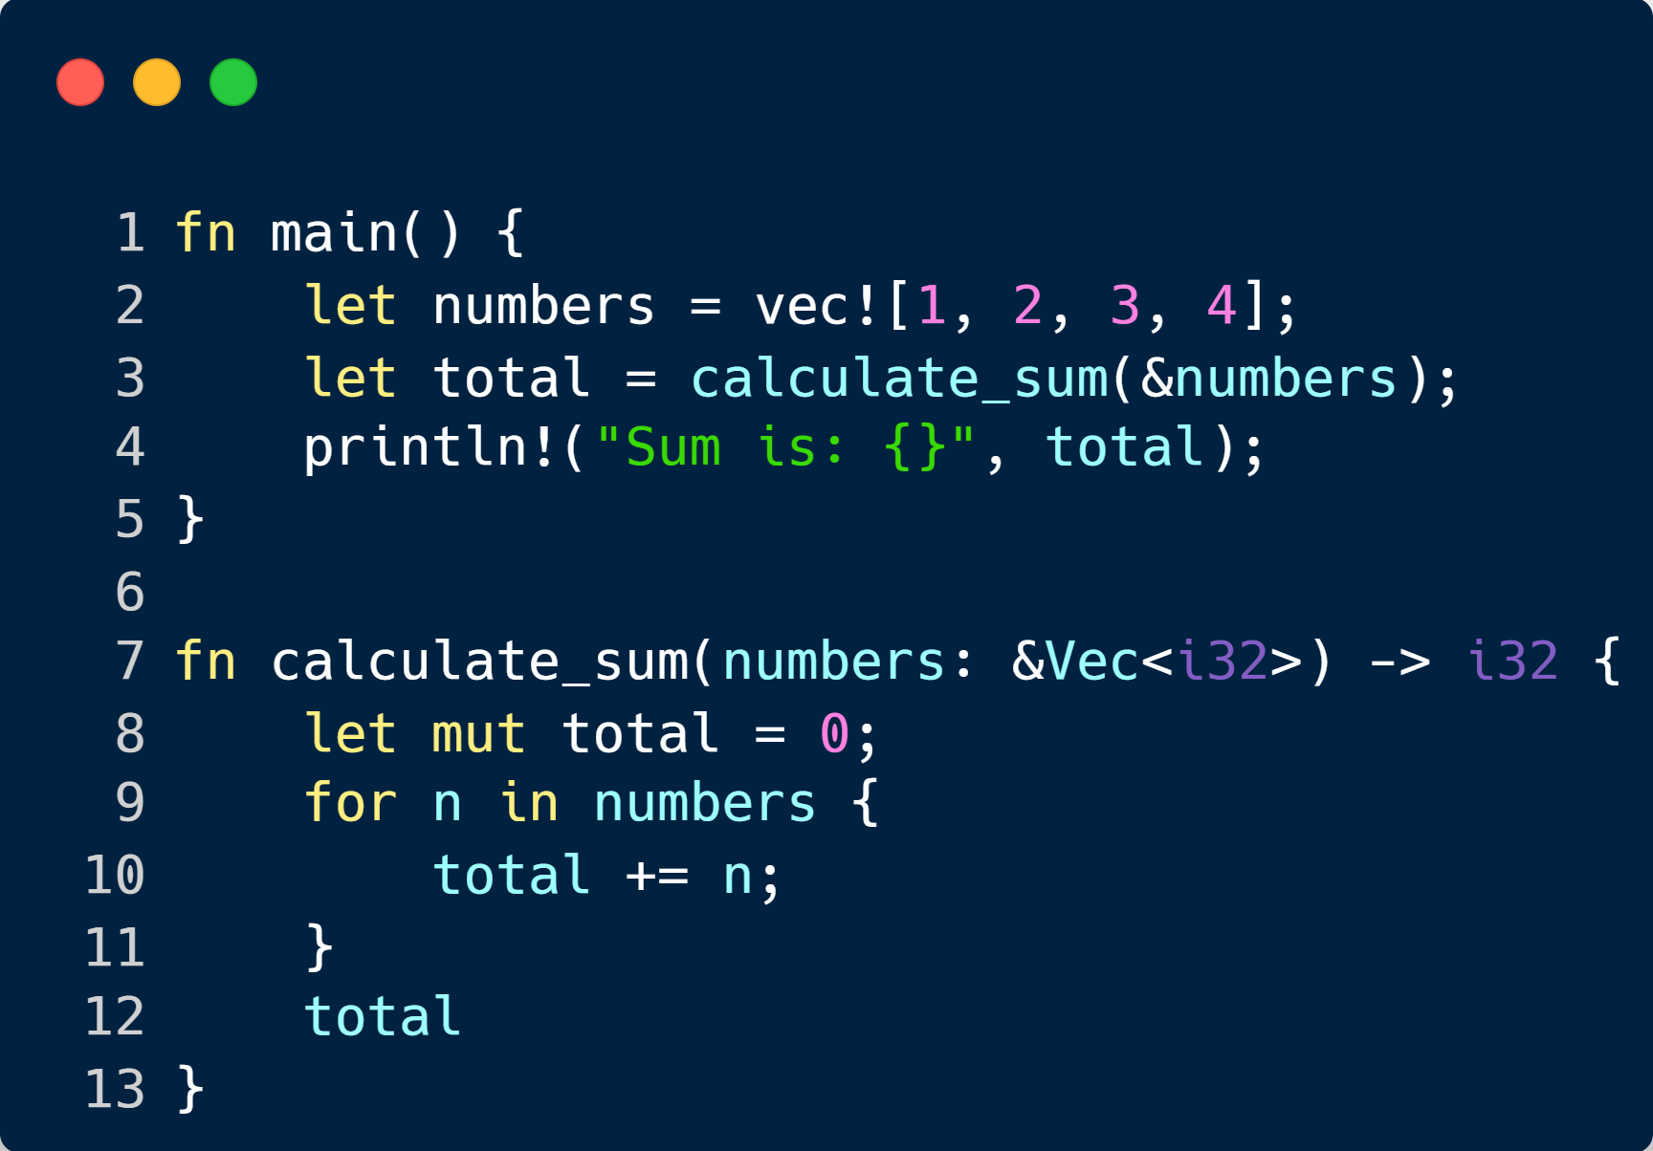
WHAT IS EXTRACT METHOD?
DO DEVELOPERS DO IT?
One Thousand and One Stories: A Large-Scale Survey of Software Refactoring (Jetbrains) – The answers to question 3: “In the past month, how
often have you performed any code refactoring?”
Notes:
2nd Column: yes developers do do it often, but manually for the most part.

Slide 6
02
WHY IS IT SO HARD IN RUST? + HOW DID AoL AND REM TACKLE IT?
When ownership and lifetimes make simple refactors anything but simple.

Slide 7
RUST’S SAFETY MODEL = COMPILER AS A BODYGUARD

Slide 8
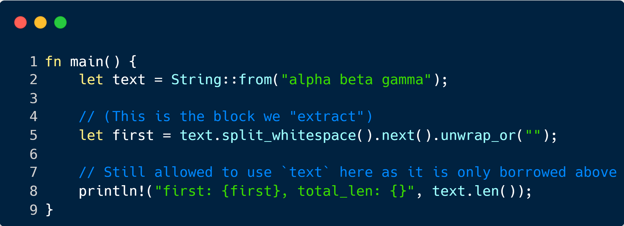
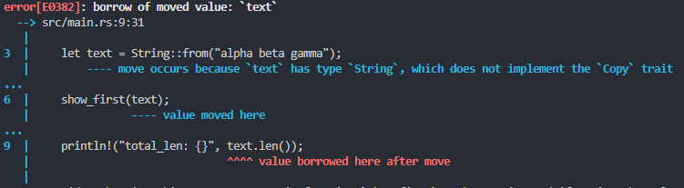
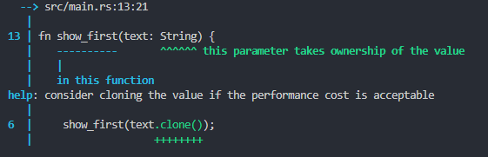
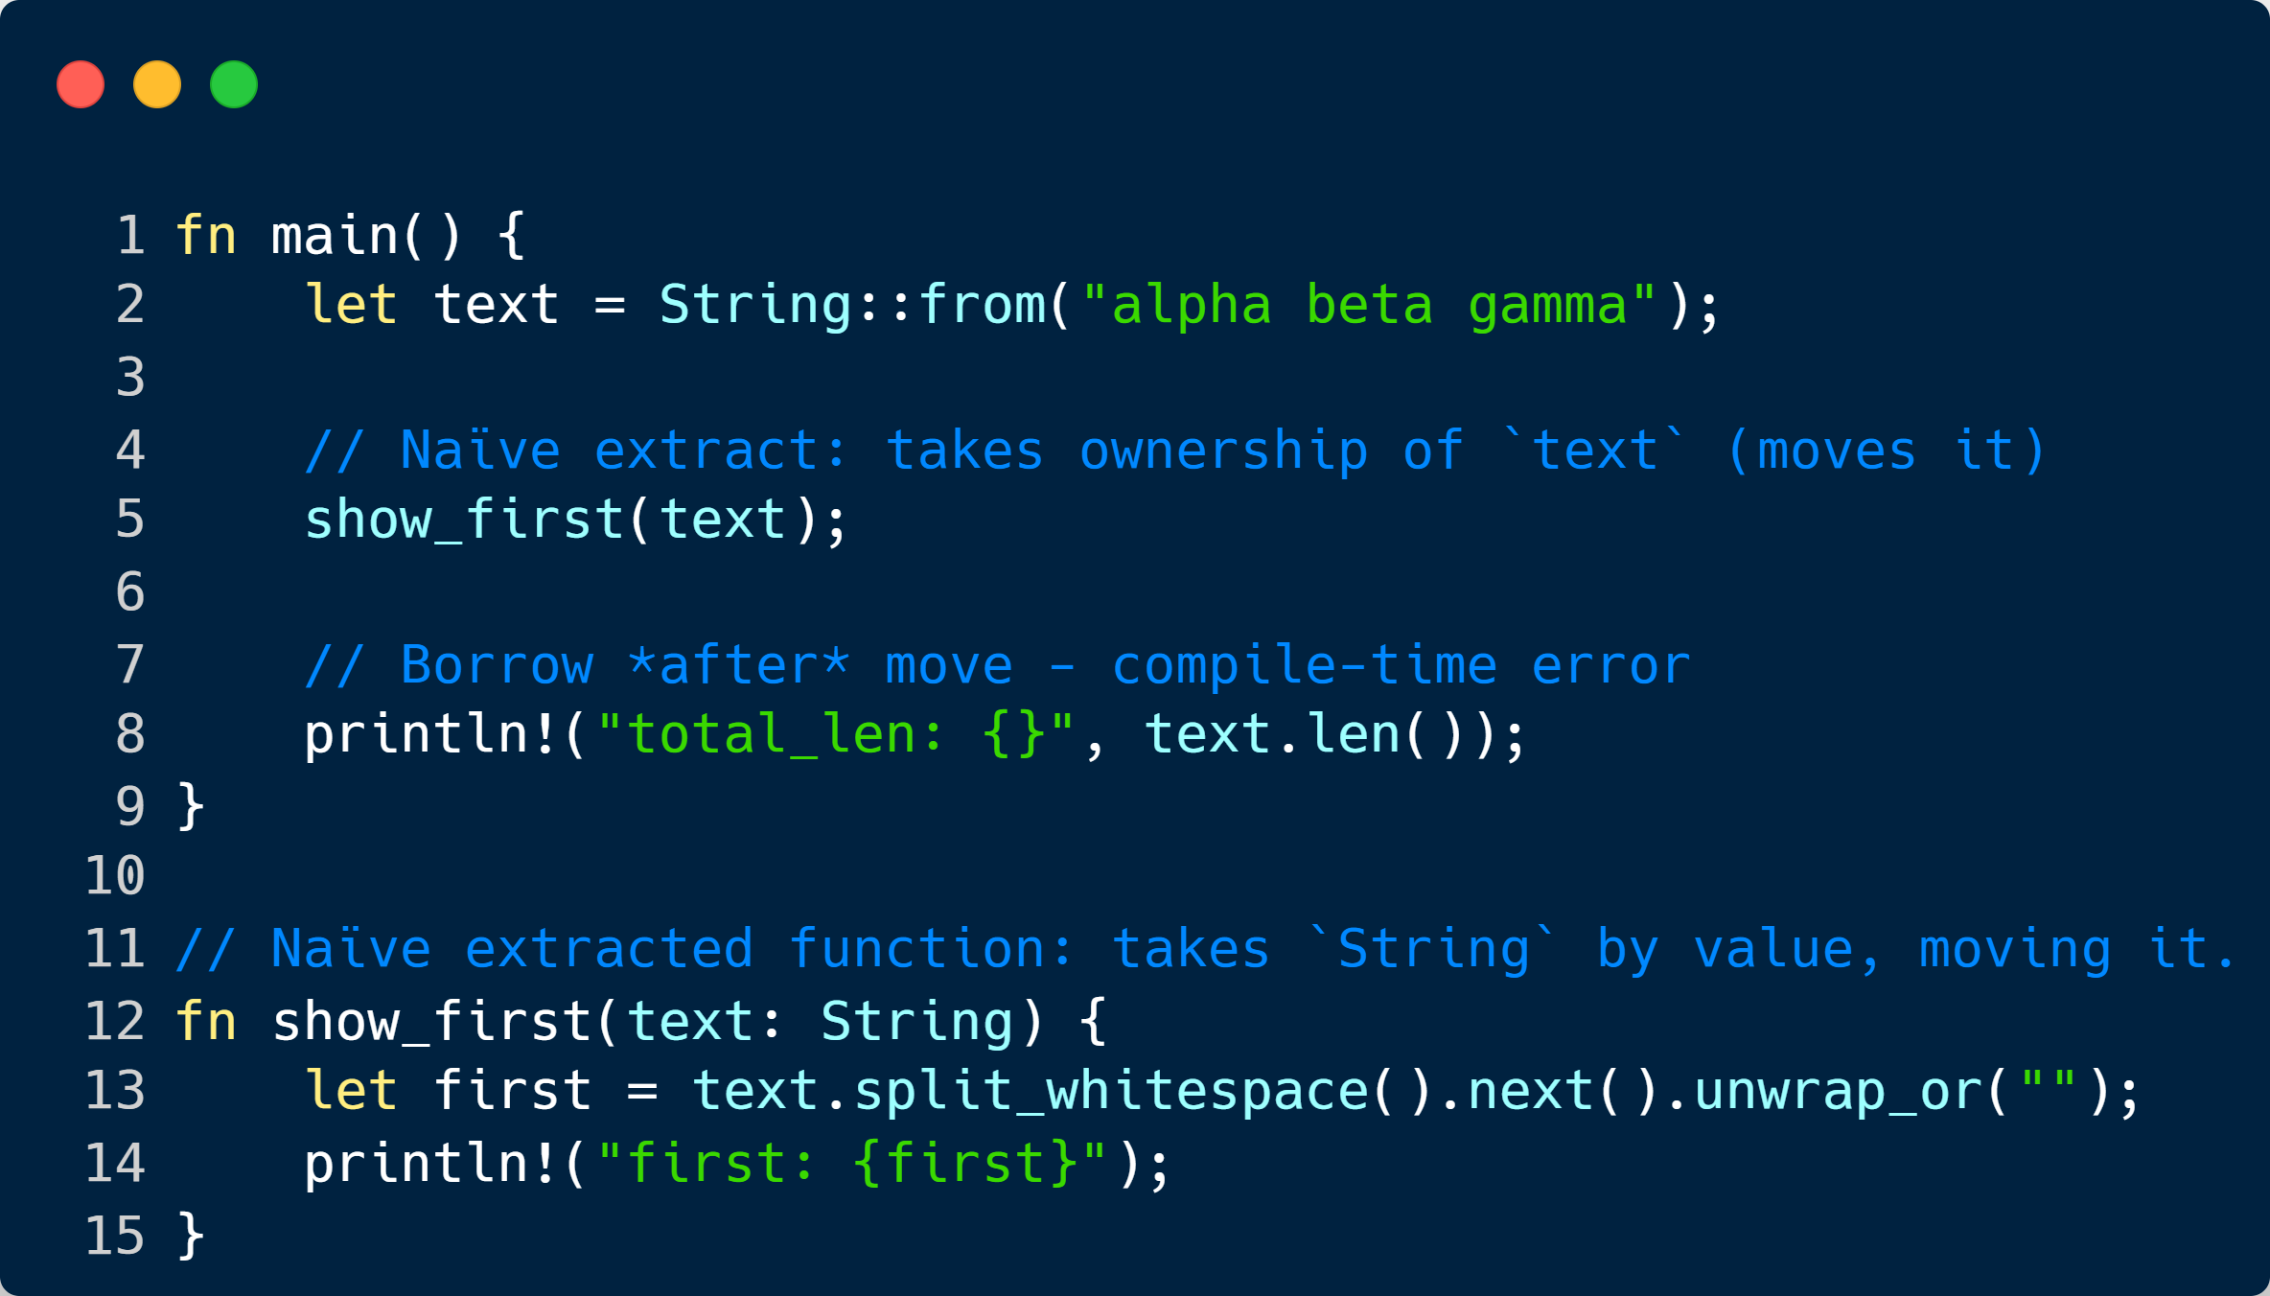
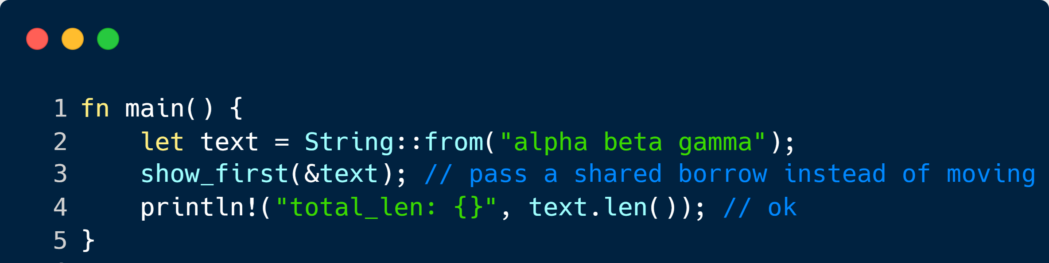
WHEN A NAIVE EXTRACTION FAILS
WE PERFORM THE EXTRACTION
WE GET AN ERROR – COMPILER HELPS US
↓ THE TOOL GIVES US THIS ↓
BUT WE ACTUALLY WANTED THIS…

Slide 9
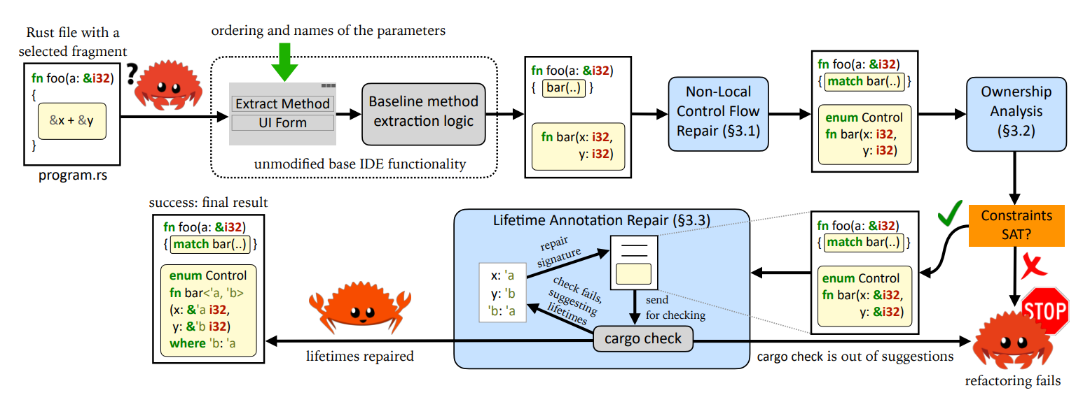
ADVENTURE OF A LIFETIME (2023) / BORROWING WITHOUT SORROWING (2023)
High level design of the original REM toolchain. Light-blue boxes are the stages of the refactoring contributed by this work. Grey boxes are the software components reused by us as-is. Figure from Adventure of a Lifetime (2023)

Slide 10
03
MY CONTRIBUTIONS: EXPANDING REM
Expanding REM to meet the demands of modern Rust — faster, smarter, and IDE-ready

Slide 11
A NEW CORE ARCHITECTURE
VENUS
MARS
Venus is the second planet from the Sun
Mars is actually a very cold place
1980
1998
2005
2022
SATURN
NEPTUNE
It’s composed of hydrogen and helium
It’s the farthest planet from the Sun
Notes:
Not a timeline so much as a presentation of the architecture and how code flows through it

Slide 12
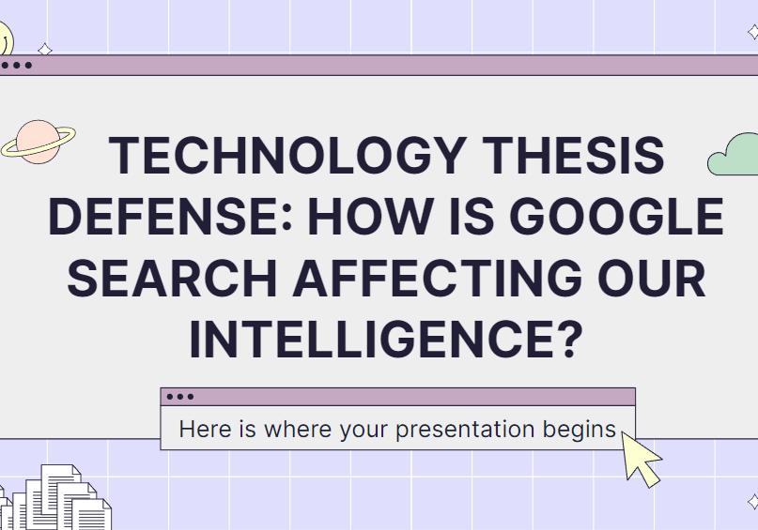
UNIFIED CLI INTO A VSCode EXTENSION
The “help” from the CLI, demonstrating all its subfunctions and how to use them
The VSCode Extension is available now for any developer to download and use

Slide 13
04
VERIFICATION TOOLCHAIN: PROVING IT’S CORRECT
Using formal methods and complex analysis to go from “it compiles” to “it’s correct.”

Slide 14
COMPILATION ≠ CORRECTNESS
WHAT WE PROVE
Notes:
2nd Column: yes developers do do it often, but manually for the most part.

Slide 15
THE VERIFICATION PIPELINE
VENUS
MARS
Venus is the second planet from the Sun
Mars is actually a very cold place
1980
1998
2005
2022
SATURN
NEPTUNE
It’s composed of hydrogen and helium
It’s the farthest planet from the Sun
Notes:
Not a timeline so much as a presentation of the architecture and how code flows through it

Slide 16
05
RESULTS AND ANALYSIS
Real-world performance and proof outcomes from the new toolchain.

Slide 17
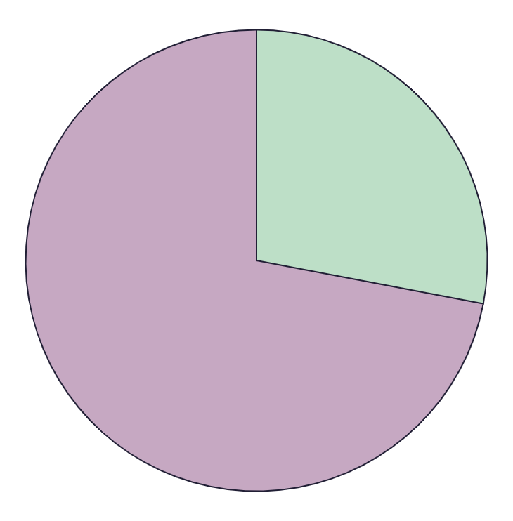
EXTRACTION EVALUATION
28
EARTH
72
VENUS
Earth is the planet with life
Venus has a beautiful name
MARS
50%
Despite being red, Mars is actually a cold place
Follow the link in the graph to modify its data and then paste the new one here. For more info, click here

Slide 18
VERIFICATION EVALUATION
28
EARTH
72
VENUS
Earth is the planet with life
Venus has a beautiful name
MARS
50%
Despite being red, Mars is actually a cold place
Follow the link in the graph to modify its data and then paste the new one here. For more info, click here

Slide 19
06
CONCLUSIONS AND FUTURE WORK
Towards trustworthy, automated refactoring for every Rust developer.

Slide 20
KEY TAKEAWAYS
TYPE OF DATA
Mercury is the smallest planet of them all
MOTIVES COLLECTION
Venus has a beautiful name, but also high temperatures
MERCURY
DATA COLLECTION
Despite being red, Mars is actually a cold place
SPECIFIC SAMPLING
Jupiter is the biggest planet in the Solar System

Slide 21
WHATS NEXT
MARS
VENUS
MERCURY
NEPTUNE
Despite being red, Mars is actually a cold place. It’s full of iron oxide dust
Venus has a very beautiful name and is the second planet from the Sun
Mercury is the closest planet to the Sun and the smallest of them all
Jupiter is a gas giant and the biggest planet in the Solar System.

