Slide 1






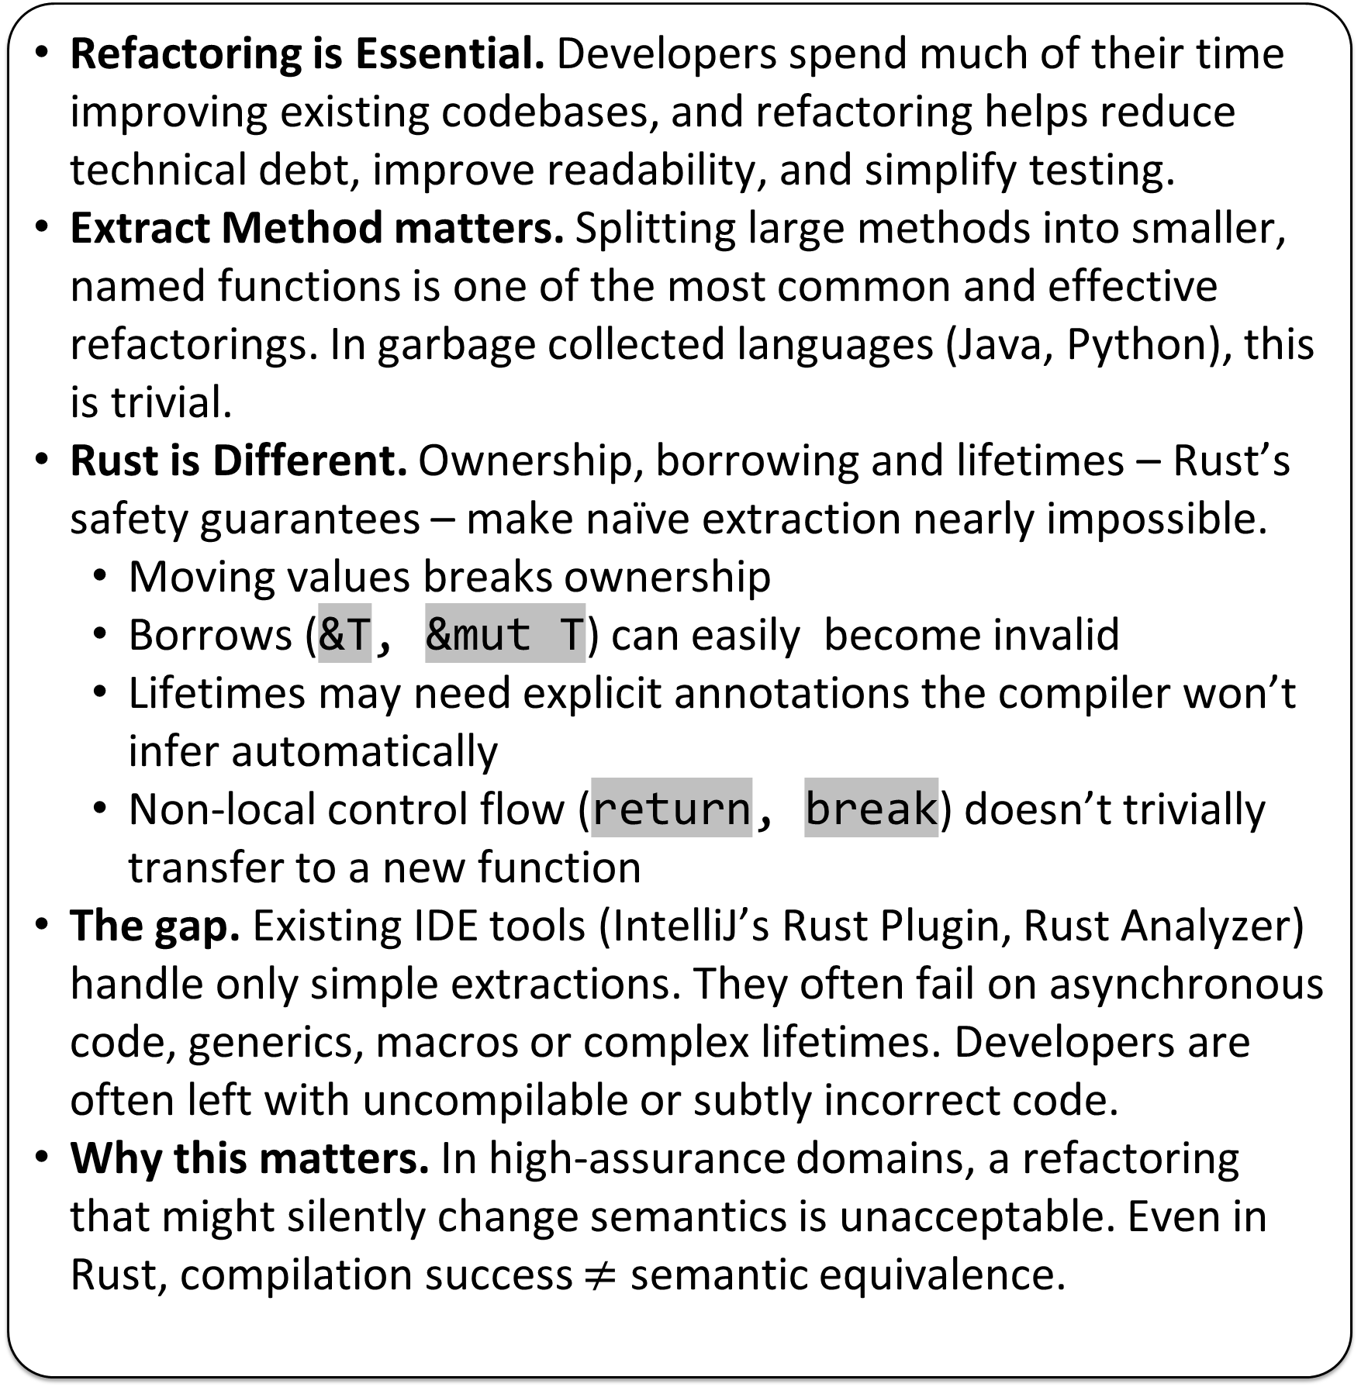
Motivation & Problem
Approach & Pipeline
Proof Mechanics & Obligations
Refactoring is Essential. Developers spend much of their time improving existing codebases, and refactoring helps reduce technical debt, improve readability, and simplify testing.
Extract Method matters. Splitting large methods into smaller, named functions is one of the most common and effective refactorings. In garbage collected languages (Java, Python), this is trivial.
Rust is Different. Ownership, borrowing and lifetimes – Rust’s safety guarantees – make naïve extraction nearly impossible.
Moving values breaks ownership
Borrows (&T, &mut T) can easily become invalid
Lifetimes may need explicit annotations the compiler won’t infer automatically
Non-local control flow (return, break) doesn’t trivially transfer to a new function
The gap. Existing IDE tools (IntelliJ’s Rust Plugin, Rust Analyzer) handle only simple extractions. They often fail on asynchronous code, generics, macros or complex lifetimes. Developers are often left with uncompilable or subtly incorrect code.
Why this matters. In high-assurance domains, a refactoring that might silently change semantics is unacceptable. Even in Rust, compilation success $≠$ semantic equivalence.
✂️ EXTRACTION
User selects code region
“Copy and Paste”
P
(Original)
P’ (Refactored)
Equivalence Obligation: For all inputs satisfying preconditions, extracted code and original return the same result and effects
Proof Generation: REM auto-writes an EquivCheck.v Coq file (imports + lemma skeleton)
Automation: Coq discharges proof via reflexivity after unfolding both sides
Guarantee: Trusted code without the need for user annotations
🛠️ REM
Repairs lifetimes
Infers borrows & ownership
Functionalised Semantics (AENEAS)
🔄 CHARON
Translates Rust to LLBC – a lambda calculus
Isolates rustc internals
Coq
(EquivCheck.v)
$$∀x.Φ\left(x \right)⟹\left(f_{P}\left(x\right)=f_{P^{′}}\left(x\right)∧obs\left(τ\right)=obs\left(τ^{′}\right)\right)$$
🧮 AENEAS
Functionalises LLBC
Prepares verification conditions
✔️ COQ
Generates observational equivalence proofs
Discharges correctness proofs
✔️ Same Results + Effects
Verifying Extract Method Refactoring in Rust
Matthew Britton, Alex Potanin, Sasha Pak
Preliminary Results
From Prototype to Production & Future Work
GitHub
- Standalone CLI - Async/await, generics, macros - VSCode extension
- Unsafe code - Concurrency - Large-scale evaluation - Better diagnostics - Scalable verification
VSCode
DOI

Slide 2
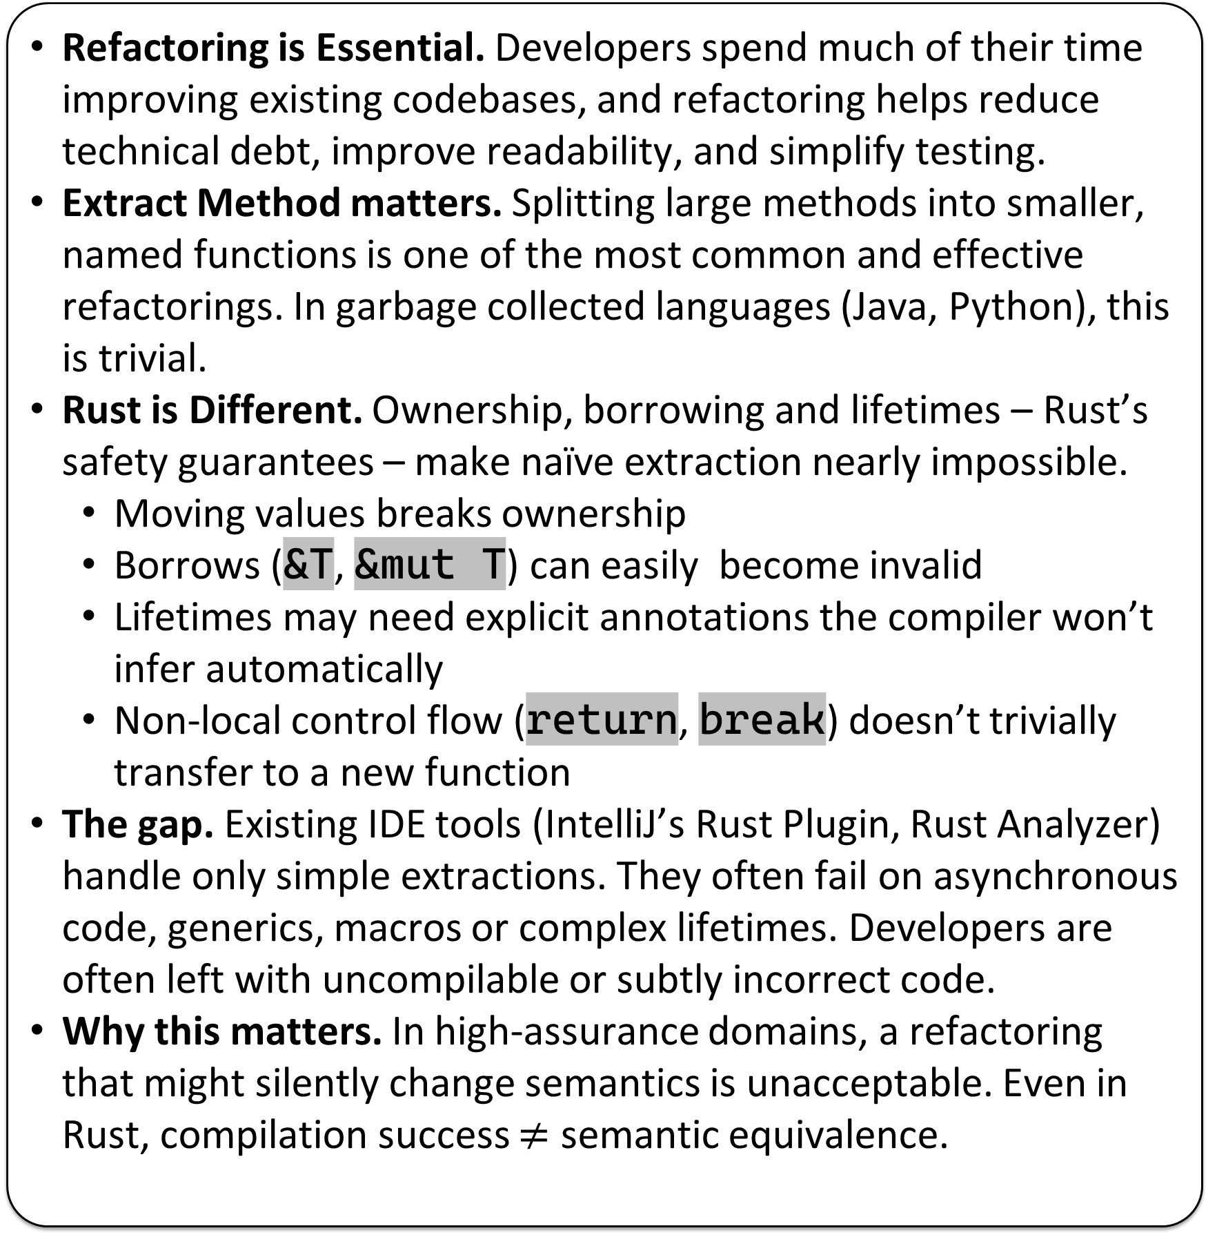
Motivation & Problem
Approach & Pipeline
Preliminary Results
Refactoring is Essential. Developers spend much of their time improving existing codebases, and refactoring helps reduce technical debt, improve readability, and simplify testing.
Extract Method matters. Splitting large methods into smaller, named functions is one of the most common and effective refactorings. In garbage collected languages (Java, Python), this is trivial.
Rust is Different. Ownership, borrowing and lifetimes – Rust’s safety guarantees – make naïve extraction nearly impossible.
Moving values breaks ownership
Borrows (&T, &mut T) can easily become invalid
Lifetimes may need explicit annotations the compiler won’t infer automatically
Non-local control flow (return, break) doesn’t trivially transfer to a new function
The gap. Existing IDE tools (IntelliJ’s Rust Plugin, Rust Analyzer) handle only simple extractions. They often fail on asynchronous code, generics, macros or complex lifetimes. Developers are often left with uncompilable or subtly incorrect code.
Why this matters. In high-assurance domains, a refactoring that might silently change semantics is unacceptable. Even in Rust, compilation success $≠$ semantic equivalence.
Extraction
User selects code region
“Copy and Paste”
REM
Repairs lifetimes
Infers borrows &
ownership
CHARON
Translates Rust to LLBC
(a Lambda Calculus)
Isolates rustc internals.
Allows for semantic analysis
Aeneas
Functionalises LLBC
Prepares verification conditions
Coq
Checks observational
equivalence proofs
Discharges correctness
automatically
- 10/10 cases discharged - Avg cycle: 2s (IDE-friendly) [Table/Graph Placeholder]
Verifying Extract Method Refactoring in Rust
Matthew Britton, Alex Potanin, Sasha Pak
From Prototype to Production-Ready REM
Future Work
GitHub
- Unsafe code - Concurrency - Large-scale evaluation - Better diagnostics - Scalable verification
VSCode
DOI

