Slide 1
SAFE, AUTOMATED REFACTORING FOR RUST: FROM EXTRACTION TO VERIFICATION
MATTHEW BRITTON WITH DR ALEX POTANIN AND SASHA PAK

Slide 2
AUTOMATING THE IMPOSSIBLE: VERIFIED EXTRACT METHOD REFACTORING IN RUST
MATTHEW BRITTON WITH DR ALEX POTANIN AND SASHA PAK

Slide 3
TABLE OF CONTENTS
01
WHAT IS EXTRACT METHOD REFACTORING?
04
VERIFICATION TOOLCHAIN: PROVING IT’S CORRECT
02
WHY IS IT SO HARD IN RUST? + HOW DID AoL AND REM TACKLE IT?
05
RESULTS AND ANALYSIS
03
MY CONTRIBUTIONS: EXPANDING REM
06
CONCLUSIONS AND FUTURE WORK

Slide 4
PURPOSE & RESEARCH GOALS
MODULAR ARCHITECTURE FOR EXTRACTION
BRIDGING RESEARCH AND PRACTICE
UNDERSTANDING RUST’S CHALLENGES
To build a system that enables experimental evaluation of automated refactoring in Rust — each component is isolated, testable, and composable.
Designing a usable developer tool that also functions as a research platform, enabling comparative studies of refactoring strategies and verification approaches in real environments.
Investigate how lifetimes, ownership, and control flow affect automated transformations, and develop new strategies for preserving correctness during extraction.
TOWARDS PROVABLY CORRECT TRANSFORMATIONS
Establish a methodology and framework for integrating formal verification into real-world development workflows — moving towards practical, provably correct refactoring.
“A system designed not just to refactor code — but to research how safe, automated refactoring can be achieved in Rust.”
Notes:
“Before I dive into what Extract Method refactoring is, I want to set the scene. This wasn’t just about building a tool — it’s about creating a research platform. I wanted something modular enough that we could experiment with different analyses, lifetimes, and verification strategies — and yet still make it usable for real developers.” “So what exactly are we trying to automate — and why is it so difficult in Rust?”

Slide 5
01
WHAT IS EXTRACT METHOD REFACTORING?
Breaking big problems into smaller, safer pieces of code

Slide 6
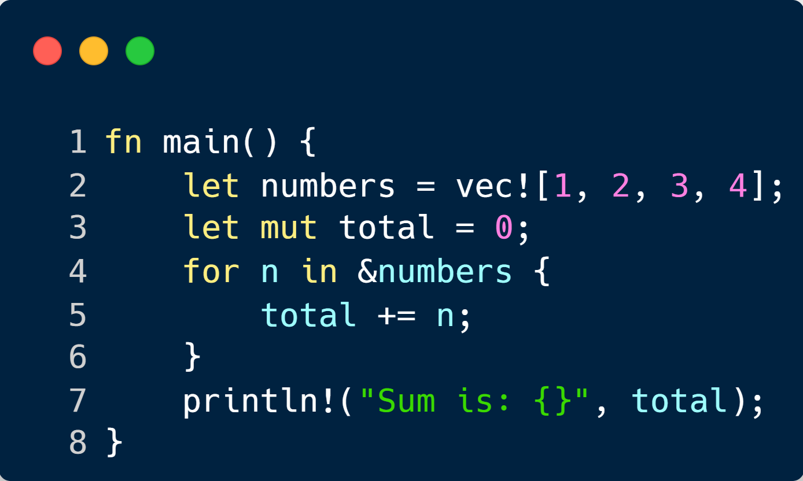
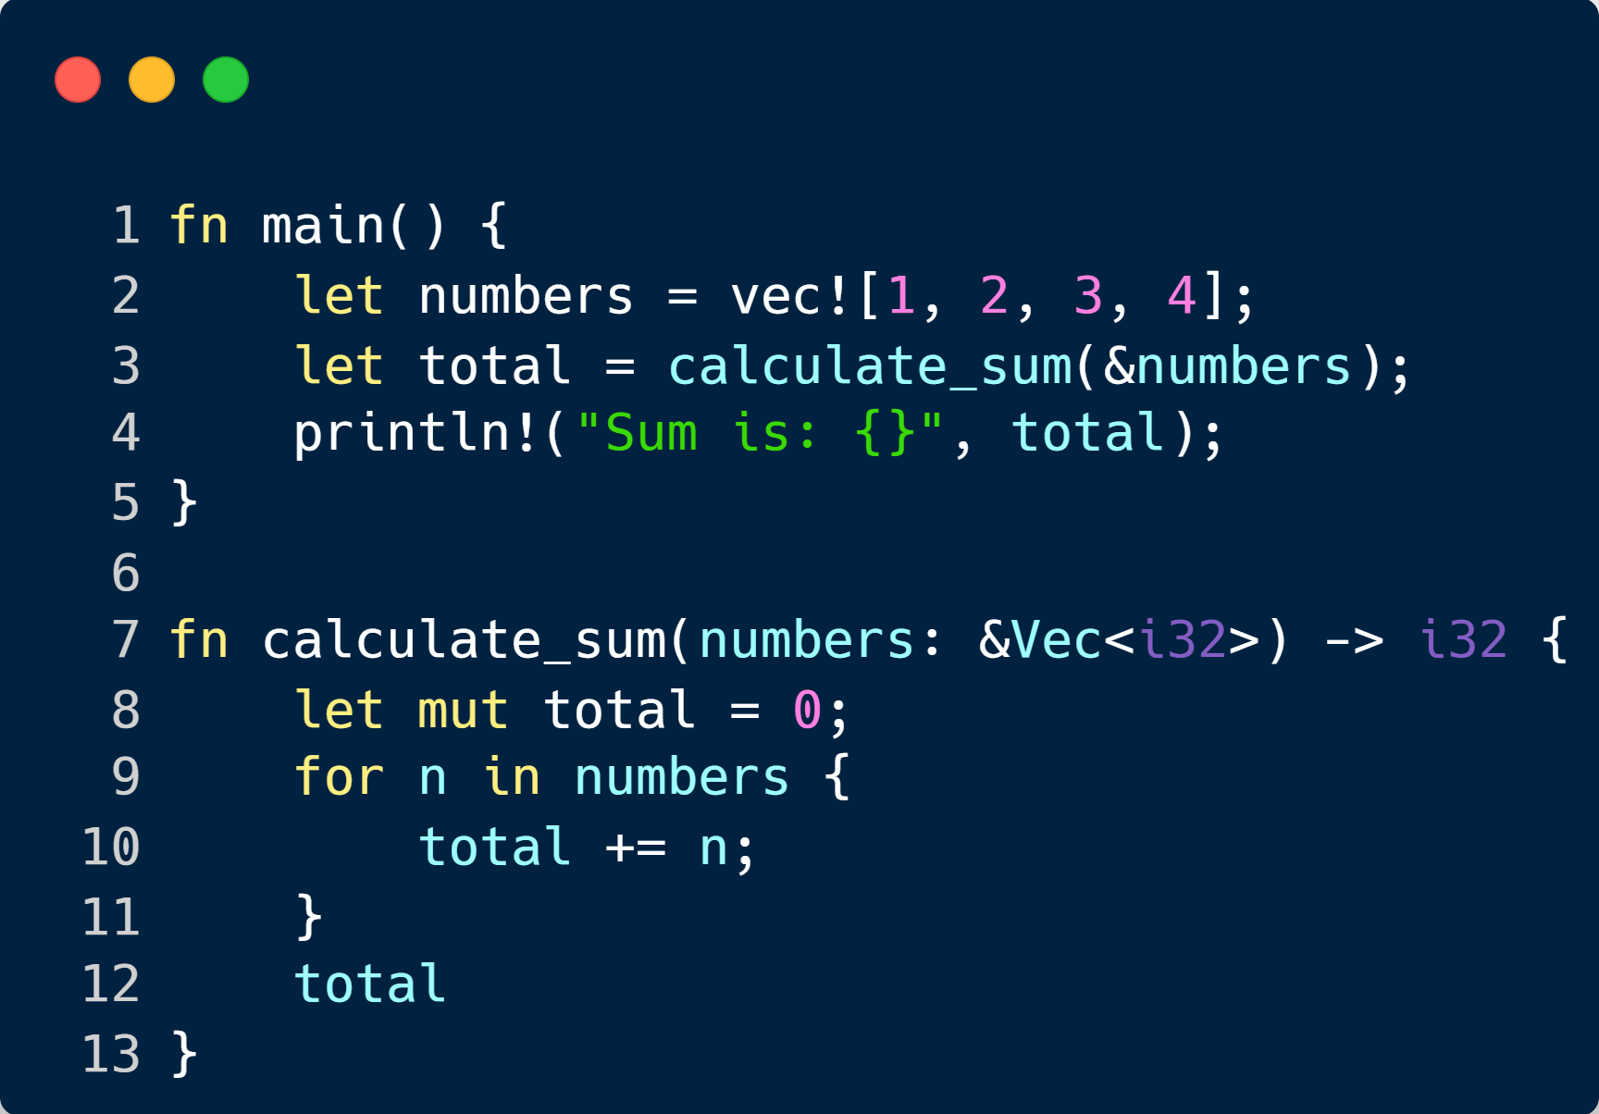
WHAT IS EXTRACT METHOD?
DO DEVELOPERS DO IT?
One Thousand and One Stories: A Large-Scale Survey of Software Refactoring (Jetbrains) – The answers to question 3: “In the past month, how
often have you performed any code refactoring?”
Notes:
2nd Column: yes developers do do it often, but manually for the most part.

Slide 7
02
WHY IS IT SO HARD IN RUST? + HOW DID AoL AND REM TACKLE IT?
When ownership and lifetimes make simple refactors anything but simple.

Slide 8
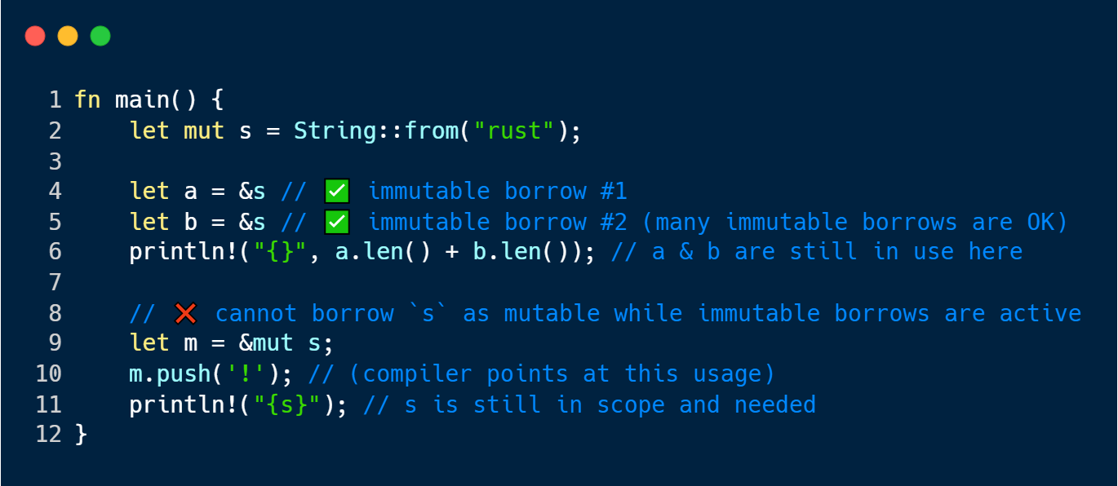
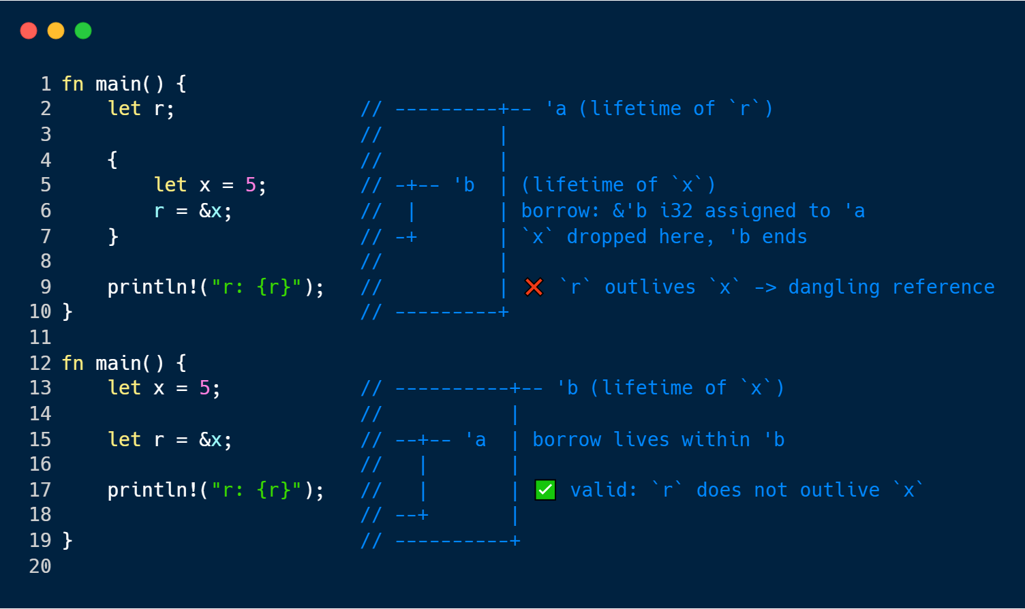
RUST’S SAFETY MODEL = COMPILER AS A BODYGUARD
OWNERSHIP & BORROWING
LIFETIMES
Every value has one owner
Ownership can move or be borrowed immutably (&) or mutably (&mut)
The compiler ensures that no two mutable borrows overlap and no invalid access occurs
Each reference has a lifetime – the span of code during which it’s valid
The compiler infers and checks that lifetimes never outlive the owed data
Violation cause compile-time errors instead of run-time crashes

Slide 9
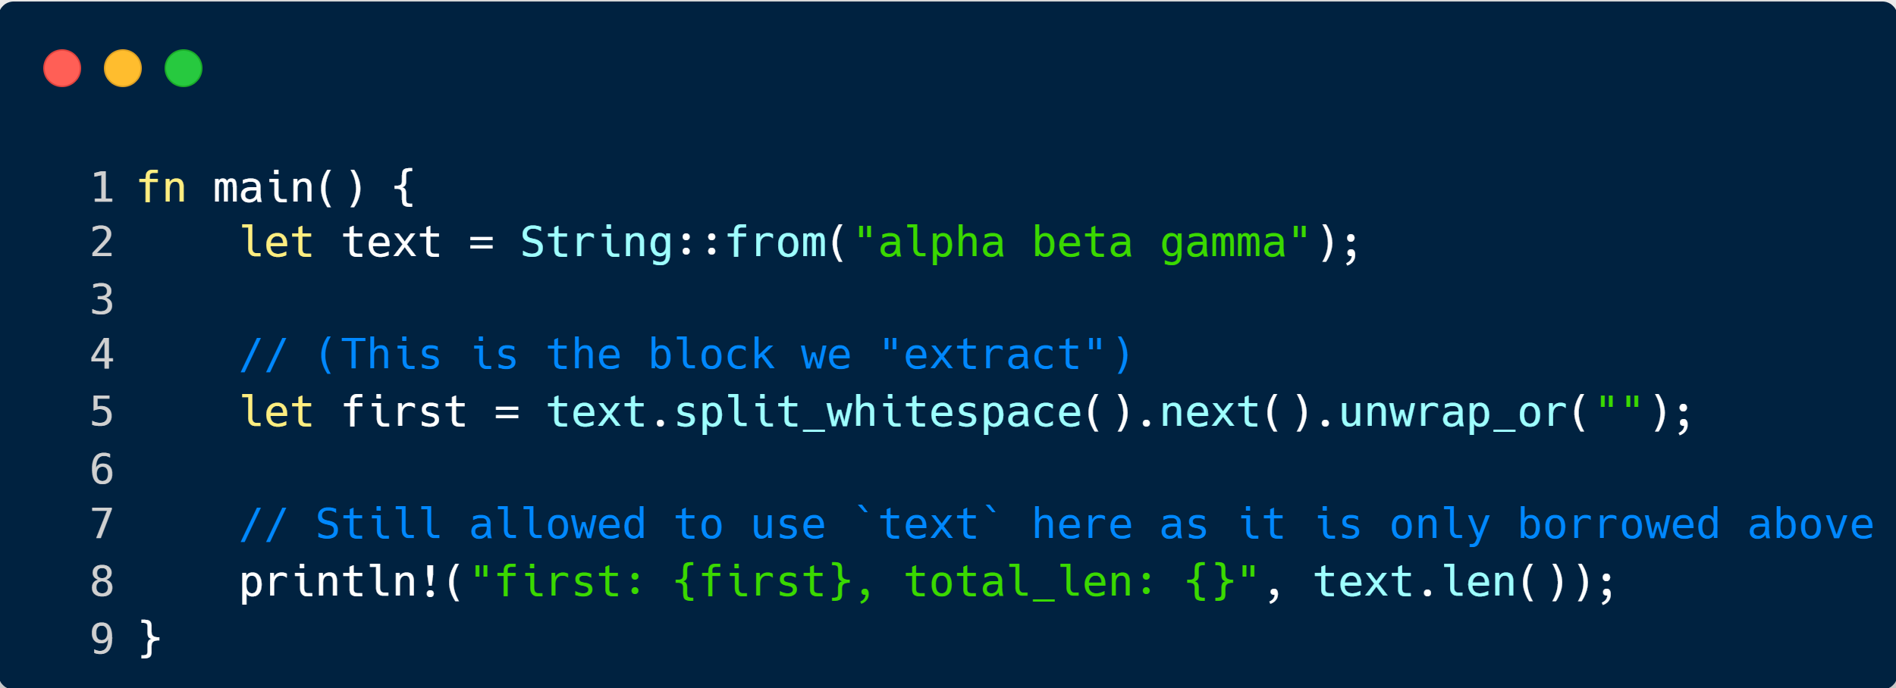
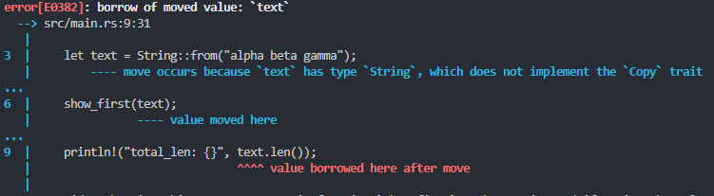
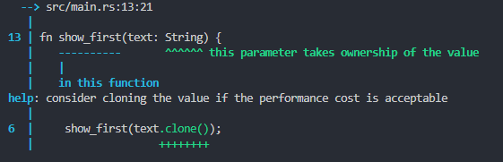
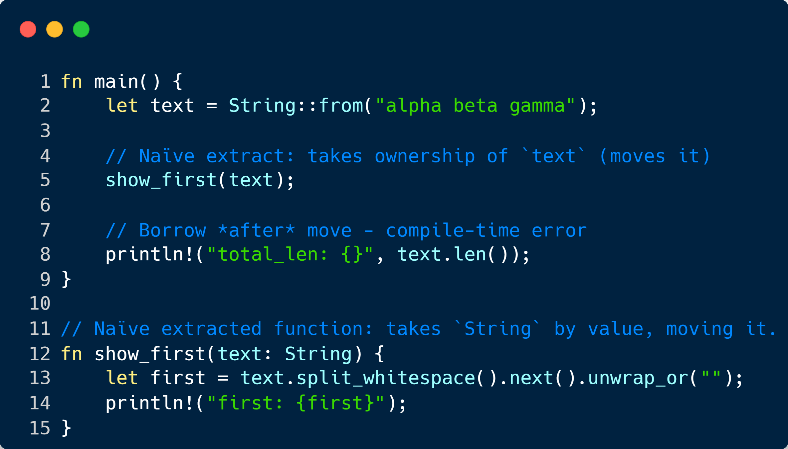
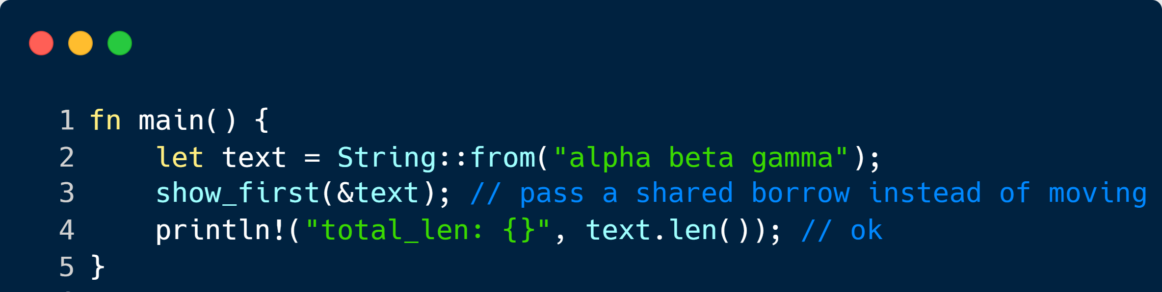
WHEN A NAIVE EXTRACTION FAILS
WE PERFORM THE EXTRACTION
WE GET AN ERROR – COMPILER HELPS US
↓ THE TOOL GIVES US THIS ↓
BUT WE ACTUALLY WANTED THIS…

Slide 10
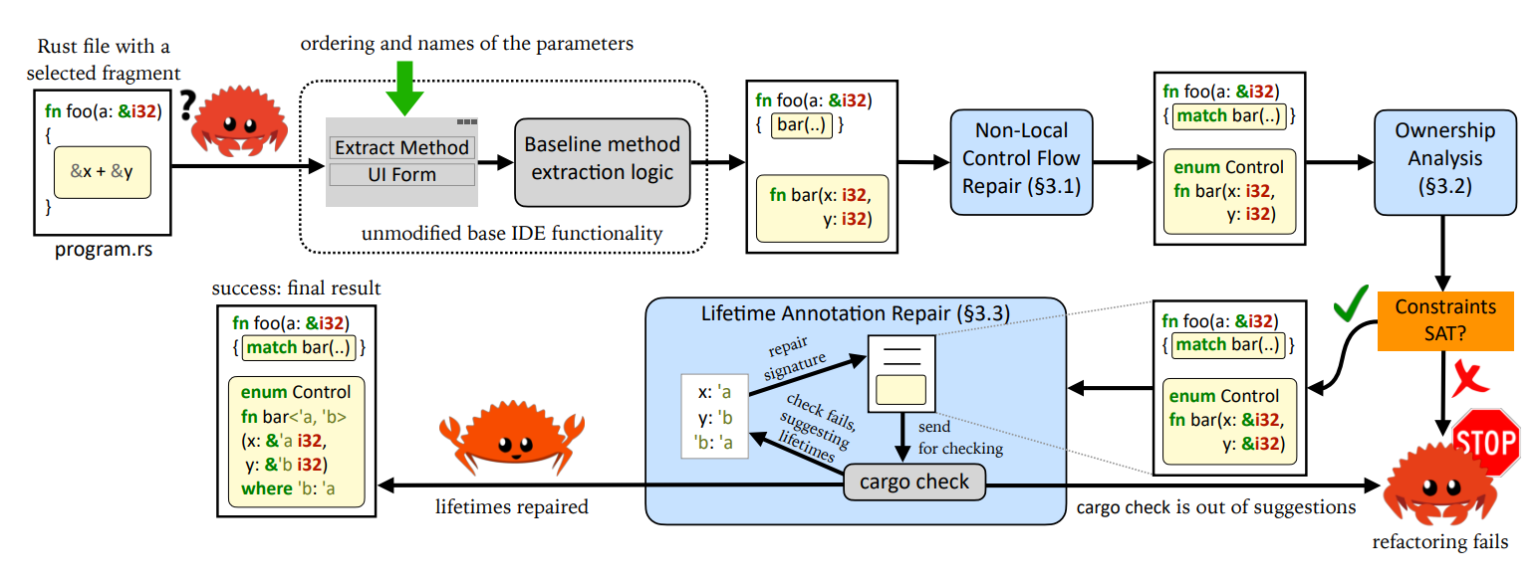
ADVENTURE OF A LIFETIME (2023) / BORROWING WITHOUT SORROWING (2023)
High level design of the original REM toolchain. Light-blue boxes are the stages of the refactoring contributed by this work. Grey boxes are the software components reused by us as-is. Figure from Adventure of a Lifetime (2023)

Slide 11
03
MY CONTRIBUTIONS: EXPANDING REM
Expanding REM to meet the demands of modern Rust — faster, smarter, and IDE-ready

Slide 12
A NEW CORE ARCHITECTURE
Incremental IR Server
REM
VSCode Extension
It’s all about caching, incremental updates, and responsiveness.
Secondary analytical pass. Rewrites code based on compiler suggestions
Presents results interactively and integrates with the IDE.
CACHE
ANALYSE
REWRITE
UNIFY
INTEGRATE
Extraction Engine
CLI Interface
Core analytical pass. Performs data-flow and ownership analysis.
It ties all components together — one command-line entry point.

Slide 13
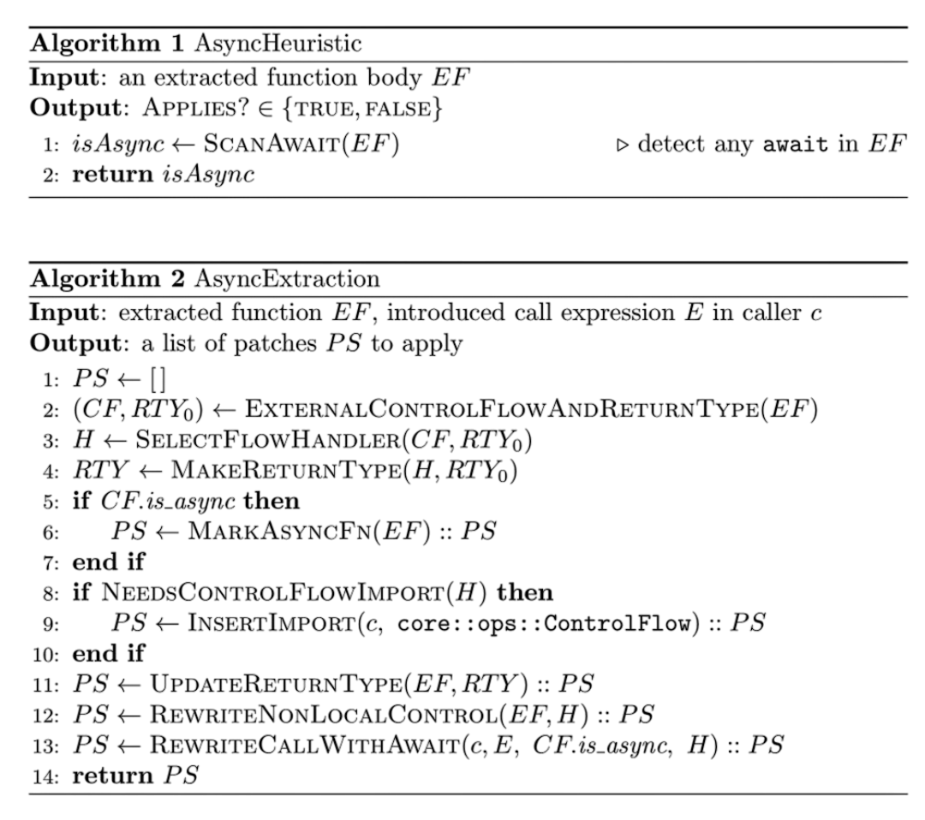
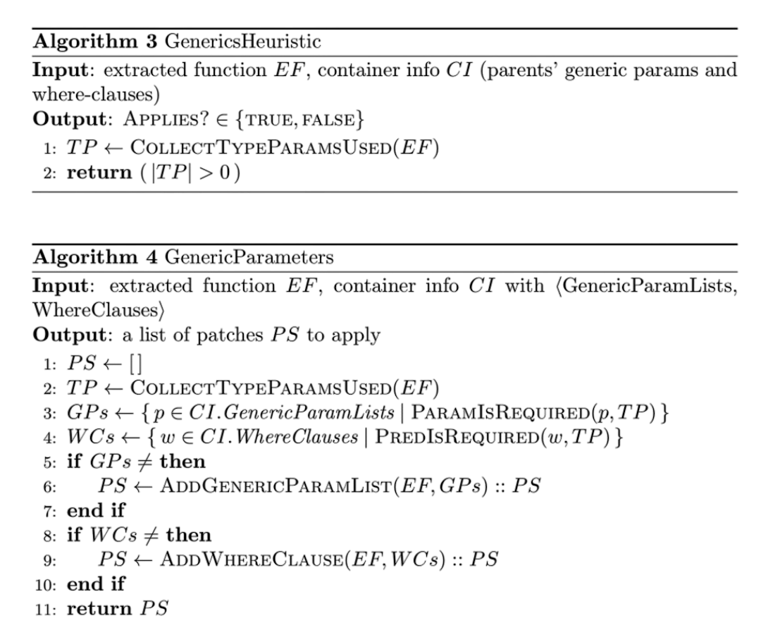
EXPERIMENTAL FRAMEWORK: INCREMENTAL IR AND COMPOSABLE EXTRACTION
File Watcher
Incremental IR Server
Generics Extraction Stage
Source Code
AST/MIR Cache
Incremental Rebuild Engine
Query Engine
Cached IR
Extraction Query
Extraction Engine
Asynchronous Extraction Stage
Analysis Component
Planning Component
Composable Extractions
New SRC
Execution

Slide 14
04
VERIFICATION TOOLCHAIN: PROVING IT’S CORRECT
Using formal methods and complex analysis to go from “it compiles” to “it’s correct.”

Slide 15
COMPILATION ≠ CORRECTNESS
WHAT WE PROVE
Notes:
2nd Column: yes developers do do it often, but manually for the most part.

Slide 16
THE VERIFICATION PIPELINE
Extraction Toolchain
LLBC Translation
Coq + Solver
Produces two working programs – the original P and refactored P′.
Converts Rust into a structured low-level byte code representation (LLBC) suitable for proof.
Automatically proves P ≡ P′ under the same observable behaviour; reports pass/fail.
EXTRACT
LIFETIME
CHARON
AENEAS
VERIFY
REM
Coq Code Generation
Fixes lifetimes on P’ using compiler driven feedback
Translates LLBC to Coq definitions; generates corresponding semantics for both versions.

Slide 17
05
RESULTS AND ANALYSIS
Real-world performance and proof outcomes from the new toolchain.

Slide 18
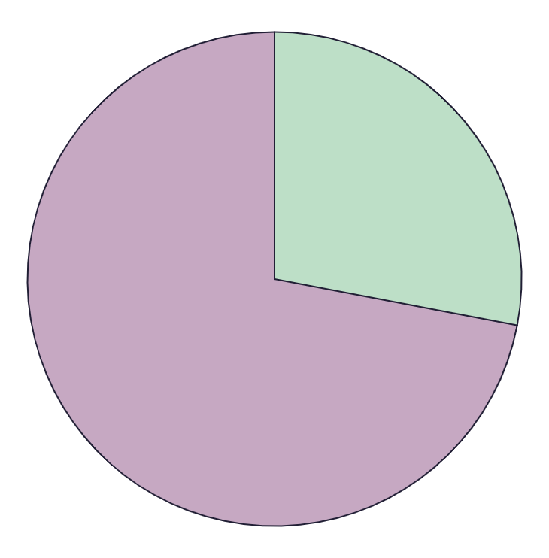
EXTRACTION EVALUATION
28
EARTH
72
VENUS
Earth is the planet with life
Venus has a beautiful name
MARS
50%
Despite being red, Mars is actually a cold place
Follow the link in the graph to modify its data and then paste the new one here. For more info, click here

Slide 19
VERIFICATION EVALUATION
28
EARTH
72
VENUS
Earth is the planet with life
Venus has a beautiful name
MARS
50%
Despite being red, Mars is actually a cold place
Follow the link in the graph to modify its data and then paste the new one here. For more info, click here

Slide 20
06
CONCLUSIONS AND FUTURE WORK
Towards trustworthy, automated refactoring for every Rust developer.

Slide 21
KEY TAKEAWAYS
SMARTER EXTRACTION
Supports async and generic Rust features - handles real-world complexity.
FAST & LIGHTWEIGHT
Incremental IR server + modular engine make extraction near-instant.
COMPOSABLE ARCHITECTURE
Modular passes enable targeted research and easy experimentation.
TRUSTWORTHY REFACTORING
PORTABLE TOOLCHAIN
Unified CLI + VS Code extension — cross-platform and IDE-agnostic.
FORMALLY VERIFIED
Integrated proof pipeline (CHARON -> AENEAS -> Coq) for semantic trust
RESEARCH PLATFORM
Enablers comparative evaluation of extraction algorithms and verification strategies

Slide 22
WHATS NEXT?
⚙️ INCREMENTAL LLBC COMPILATION
💬 DIAGNOSTICS & IMPROVED USABILITY
🧩 EXPANDED COVERAGE
🦀 MERGE WITH RUST ANALYZER
The biggest speed up to the verifier possible – bring it to near instant operation
Explain extraction / verification failures with actionable feedback
Handle unsafe code, concurrency primitives, and complex control flow
Long-term goal: merge with official tooling for production-ready adoption

