Slide 1
AUTOMATED AND VERIFIED EXTRACT METHOD REFACTORING IN RUST
MATTHEW BRITTON WITH DR ALEX POTANIN AND SASHA PAK

Slide 2
TABLE OF CONTENTS
01
WHAT IS EXTRACT METHOD REFACTORING?
04
VERIFICATION TOOLCHAIN: PROVING IT’S CORRECT
02
WHY IS IT SO HARD IN RUST? + HOW DID AoL AND REM TACKLE IT?
05
RESULTS AND ANALYSIS
03
MY CONTRIBUTIONS: EXPANDING REM
06
CONCLUSIONS AND FUTURE WORK

Slide 3
PURPOSE & RESEARCH GOALS
MODULAR ARCHITECTURE FOR EXTRACTION
BRIDGING RESEARCH AND PRACTICE
UNDERSTANDING RUST’S CHALLENGES
To build a system that enables experimental evaluation of automated refactoring in Rust — each component is isolated, testable, and composable.
Designing a usable developer tool that also functions as a research platform, enabling comparative studies of refactoring strategies and verification approaches in real environments.
Investigate how lifetimes, ownership, and control flow affect automated transformations, and develop new strategies for preserving correctness during extraction.
TOWARDS PROVABLY CORRECT TRANSFORMATIONS
Establish a methodology and framework for integrating formal verification into real-world development workflows — moving towards practical, provably correct refactoring.
“A system designed not just to refactor code — but to research how safe, automated refactoring can be achieved in Rust.”
Notes:
“Before I dive into what Extract Method refactoring is, I want to set the scene. This wasn’t just about building a tool — it’s about creating a research platform. I wanted something modular enough that we could experiment with different analyses, lifetimes, and verification strategies — and yet still make it usable for real developers.” “So what exactly are we trying to automate — and why is it so difficult in Rust?”

Slide 4
01
WHAT IS EXTRACT METHOD REFACTORING?
Breaking big problems into smaller, safer pieces of code

Slide 5
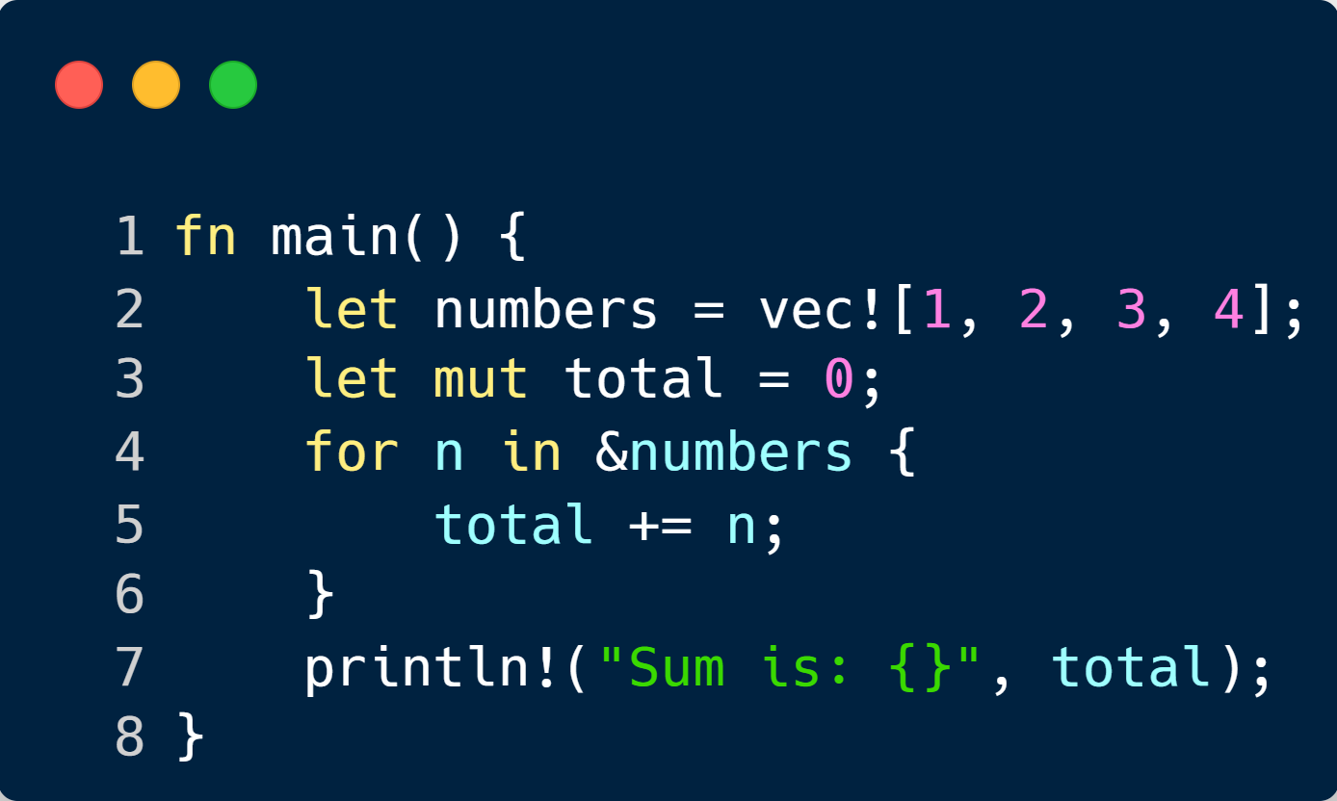
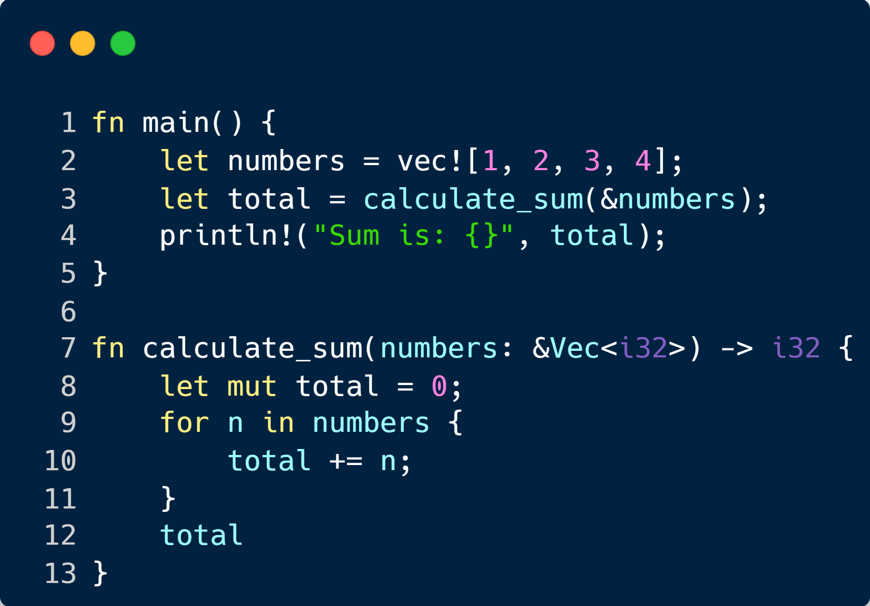
WHAT IS EXTRACT METHOD?
DO DEVELOPERS DO IT?
One Thousand and One Stories: A Large-Scale Survey of Software Refactoring (Jetbrains) – The answers to question 3: “In the past month, how
often have you performed any code refactoring?”

Slide 6
02
WHY IS IT SO HARD IN RUST? + HOW DID AoL AND REM TACKLE IT?
When ownership and lifetimes make simple refactors anything but simple.

Slide 7
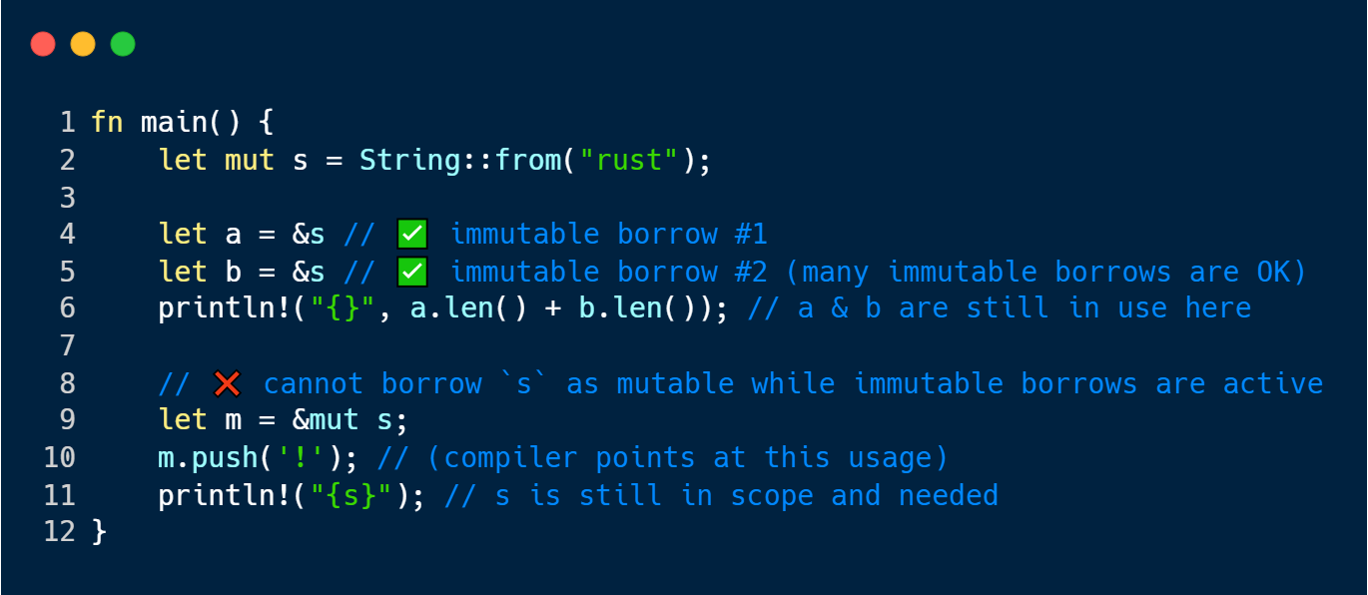
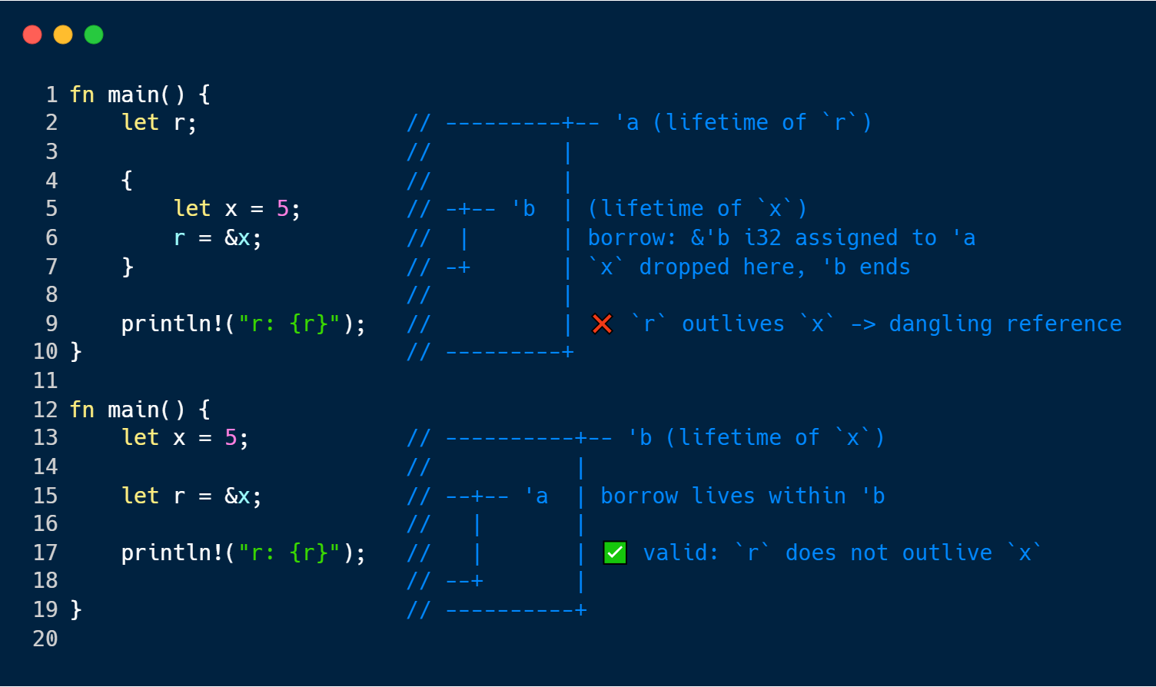
RUST’S SAFETY MODEL = COMPILER AS A BODYGUARD
OWNERSHIP & BORROWING
LIFETIMES
Every value has one owner
Ownership can move or be borrowed immutably (&) or mutably (&mut)
The compiler ensures that no two mutable borrows overlap and no invalid access occurs
Each reference has a lifetime – the span of code during which it’s valid
The compiler infers and checks that lifetimes never outlive the owed data
Violation cause compile-time errors instead of run-time crashes

Slide 8
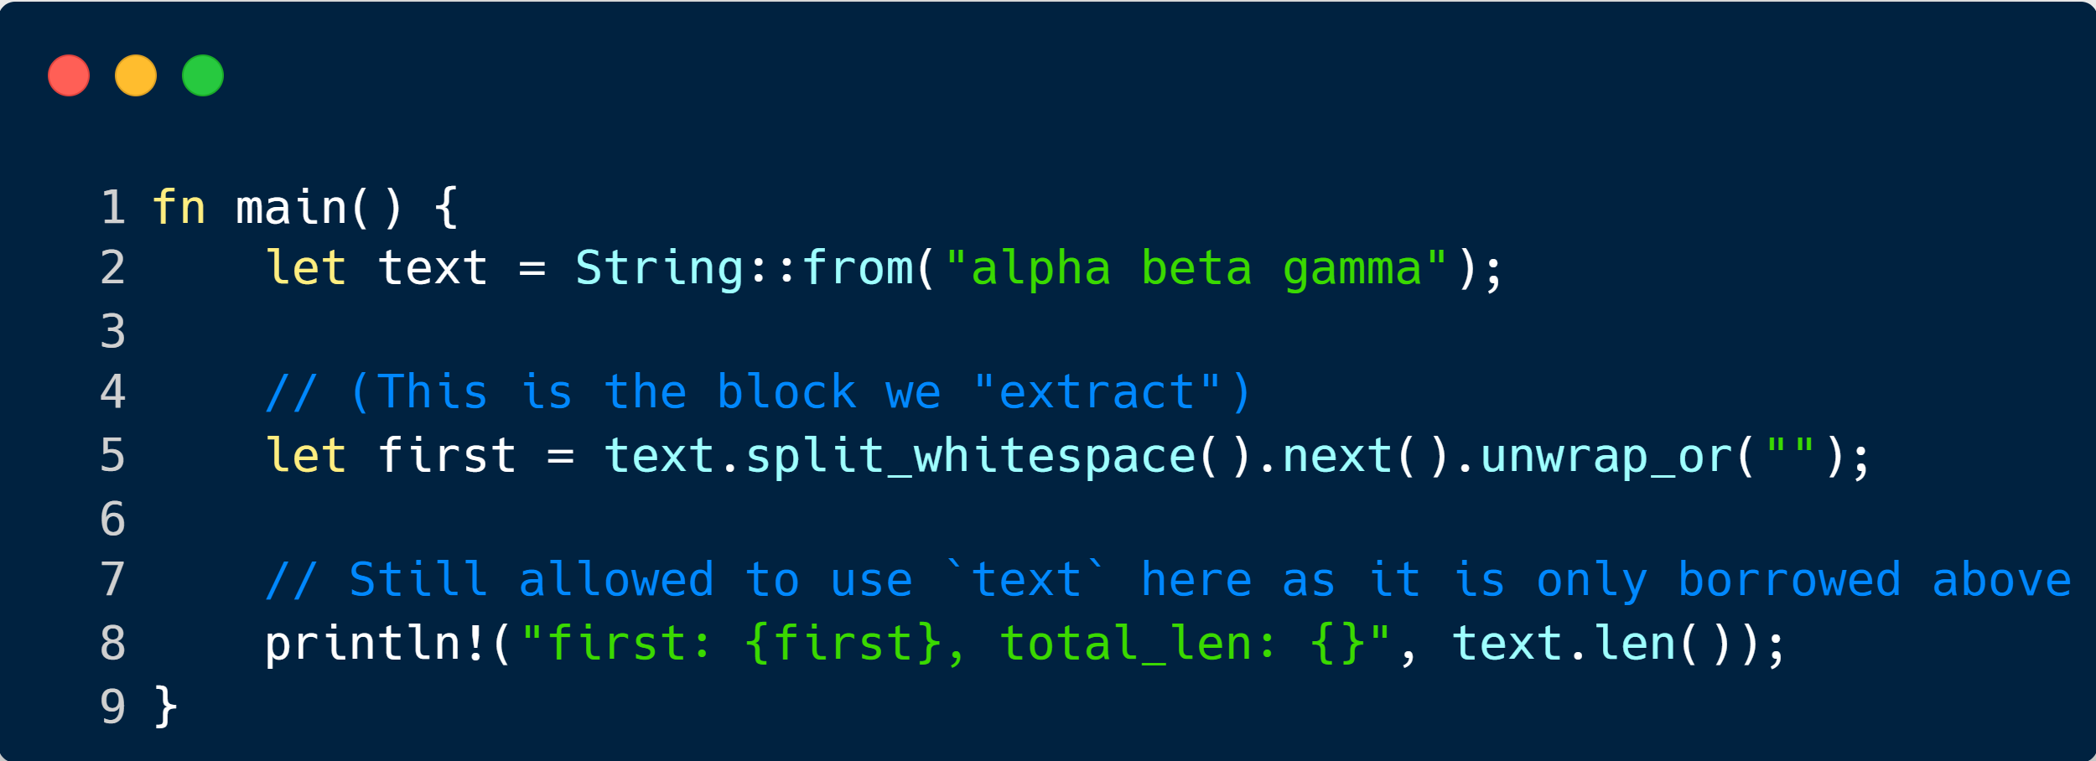
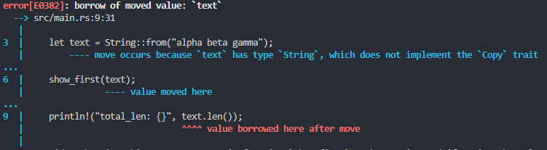
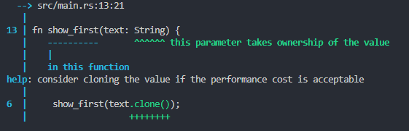
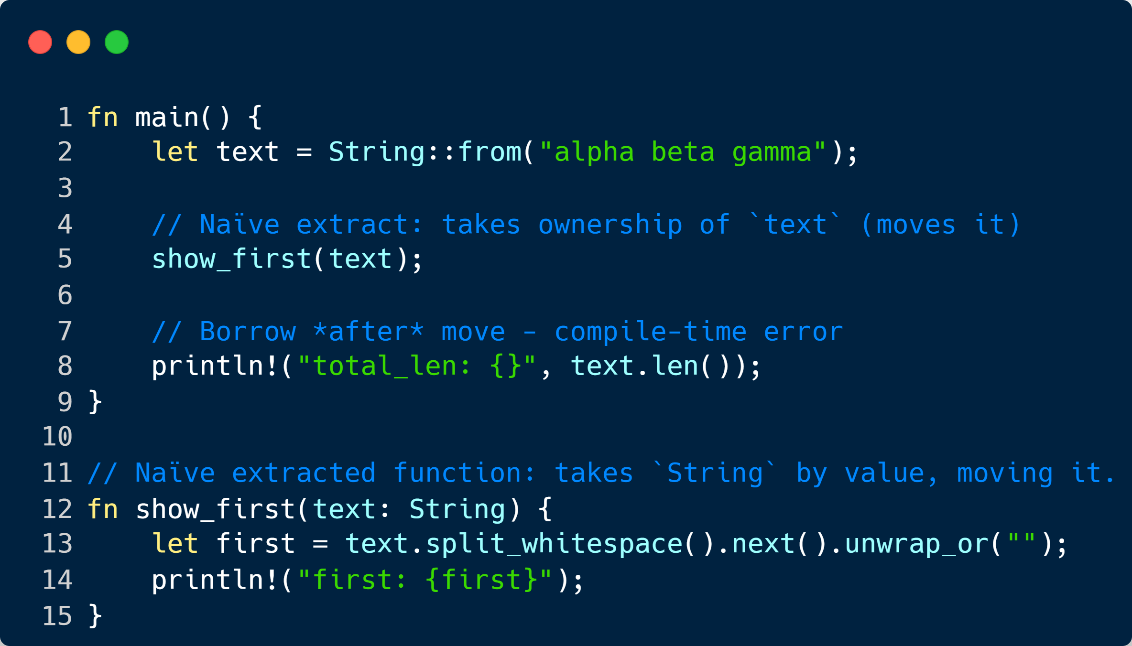
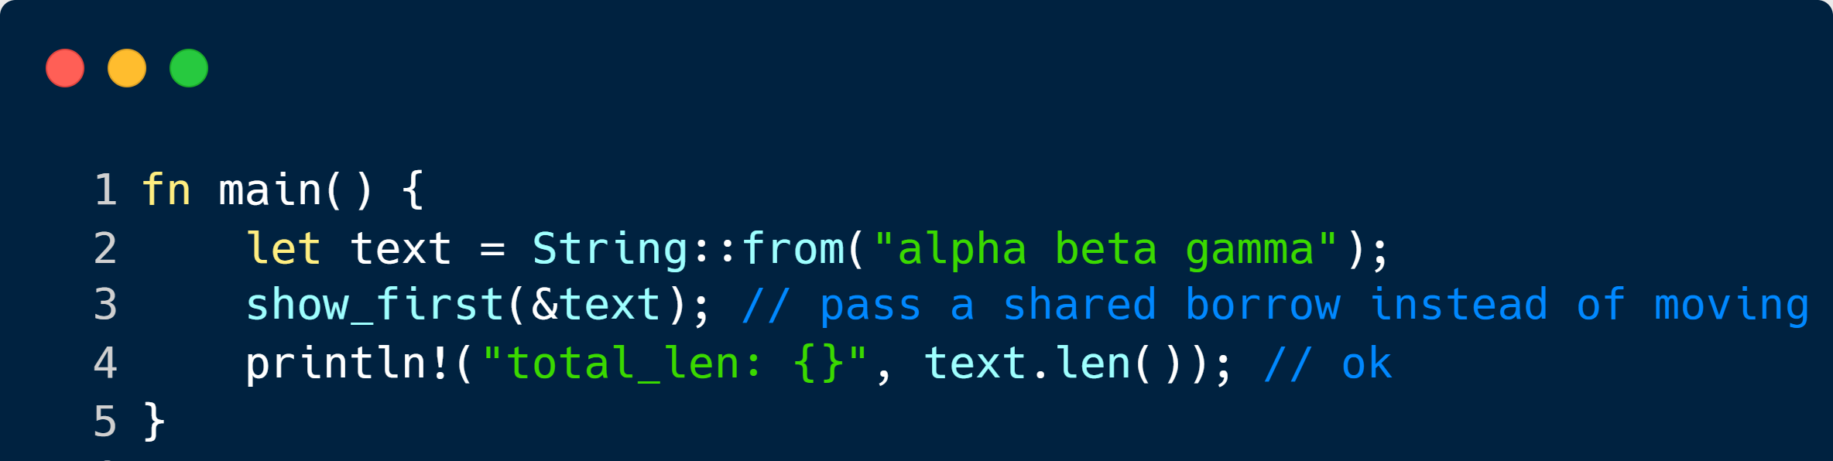
WHEN A NAIVE EXTRACTION FAILS
WE PERFORM THE EXTRACTION
WE GET AN ERROR – COMPILER HELPS US
↓ THE TOOL GIVES US THIS ↓
BUT WE ACTUALLY WANTED THIS…

Slide 9
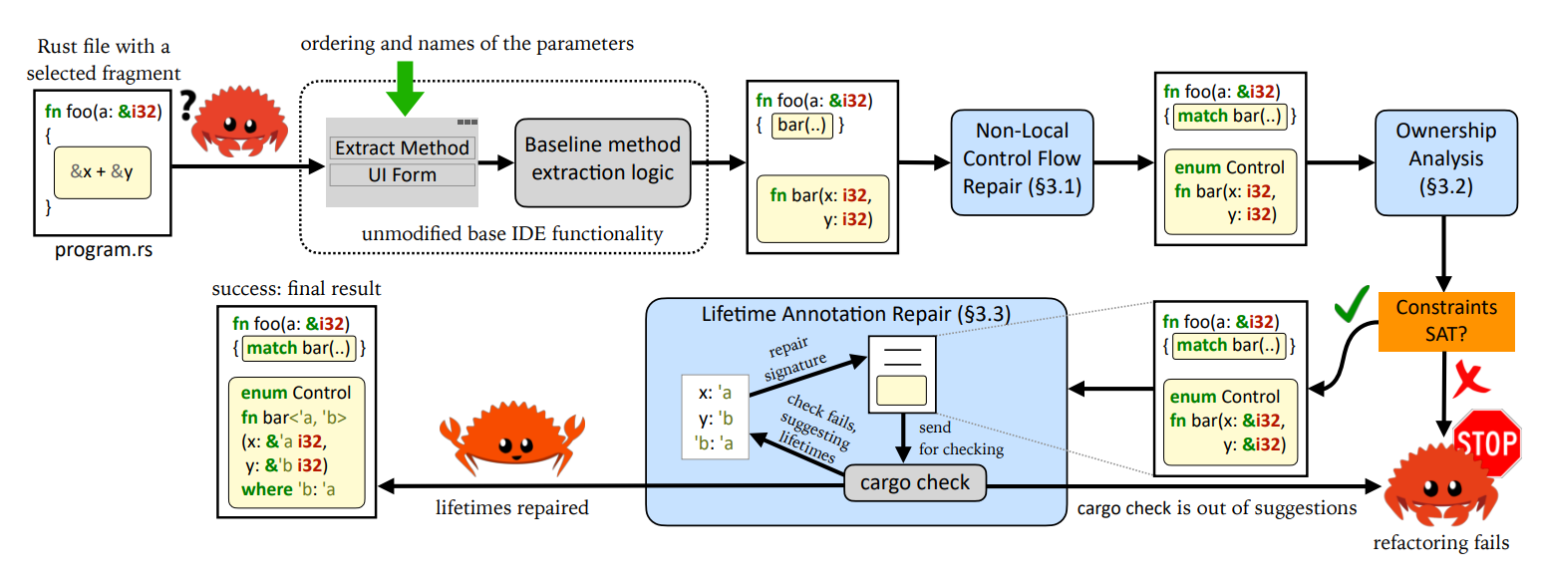
ADVENTURE OF A LIFETIME (2023) / BORROWING WITHOUT SORROWING (2023)
High level design of the original REM toolchain. Light-blue boxes are the stages of the refactoring contributed by this work. Grey boxes are the software components reused by us as-is. Figure from Adventure of a Lifetime (2023)
Notes:
Briefly explain what REM does – Fix non-local control flow, perform ownership analysis and repair lifetimes

Slide 10
03
MY CONTRIBUTIONS: EXPANDING REM
Expanding REM to meet the demands of modern Rust — faster, smarter, and IDE-ready

Slide 11
A NEW CORE ARCHITECTURE
Incremental IR Server
REM
VSCode Extension
It’s all about caching, incremental updates, and responsiveness.
Secondary analytical pass. Rewrites code based on compiler suggestions
Presents results interactively and integrates with the IDE.
CACHE
ANALYSE
REWRITE
UNIFY
INTEGRATE
Extraction Engine
CLI Interface
Core analytical pass. Performs data-flow and ownership analysis.
It ties all components together — one command-line entry point.

Slide 12
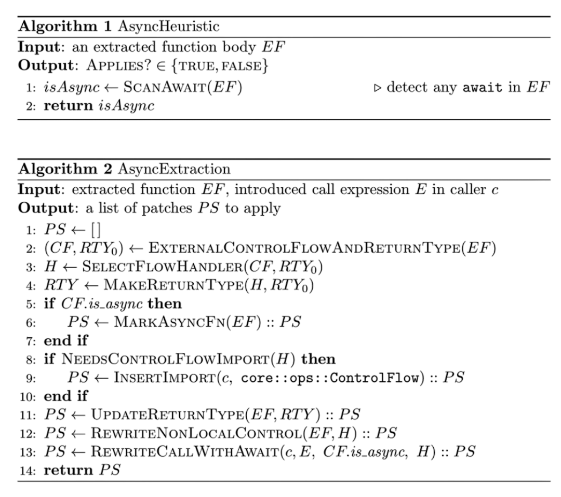
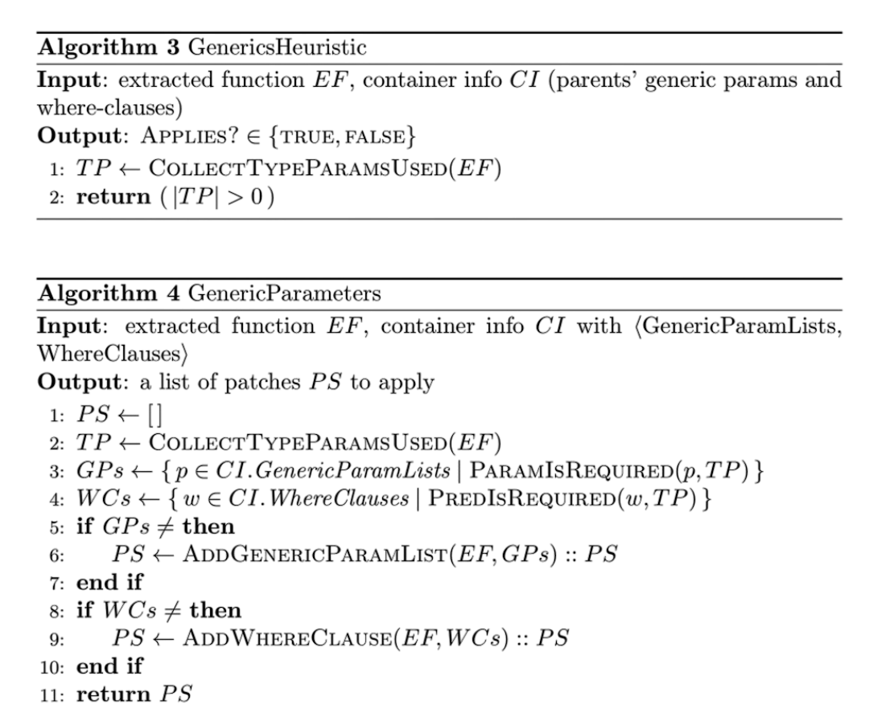
EXPERIMENTAL FRAMEWORK: INCREMENTAL IR AND COMPOSABLE EXTRACTION
File Watcher
Incremental IR Server
Generics Extraction Stage
Source Code
AST/MIR Cache
Incremental Rebuild Engine
Query Engine
Cached IR
Extraction Query
Extraction Engine
Asynchronous Extraction Stage
Analysis Component
Planning Component
Composable Extractions
New SRC
Execution

Slide 13
04
VERIFICATION TOOLCHAIN: PROVING IT’S CORRECT
Using formal methods and complex analysis to go from “it compiles” to “it’s correct.”

Slide 14
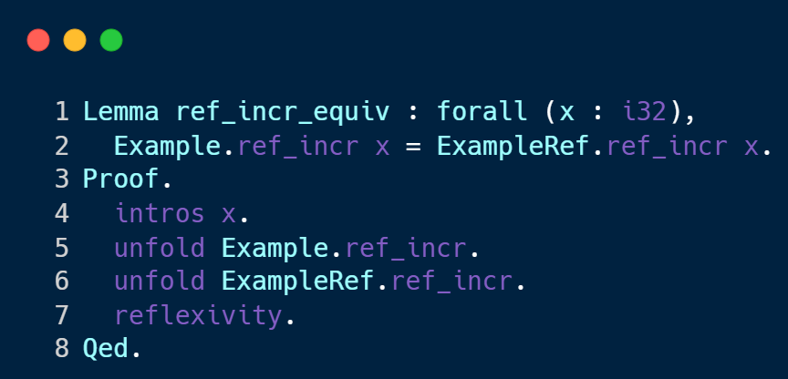

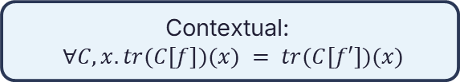
COMPILATION ≠ CORRECTNESS
WHAT WE PROVE
WHY COMPILATION ISN’T ENOUGH
Simplified:
$$∀x.tr\left(f\right)\left(x\right)=tr\left(f^{′}\right)\left(x\right)$$
The Rust compiler ensures type safety and memory correctness
But after extraction, the toolchain will rewrite lifetimes and restructure control flow, among others
These transformations can change behaviour – compilation only proves it runs, not that it behaves identically.
Contextual:
$∀C, x.tr(C[f])(x) = tr(C[f′])(x)$
HOW WE PROVE IT
Notes:
“Just because it compiles doesn’t mean it’s the same program.” “The Rust compiler guarantees safety — not sameness. When REM rewrites lifetimes or control flow, it can subtly change semantics. So even if both versions compile, we can’t be sure they’re equivalent.” “That’s why the verifier formalises the equivalence we want to prove.”
“Then it automatically generates and discharges a Coq proof, like this one, guaranteeing that the refactored and original programs behave identically.”

Slide 15
THE VERIFICATION PIPELINE
Extraction Toolchain
LLBC Translation
Coq + Solver
Produces two working programs – the original P and refactored P′.
Converts Rust into a structured low-level byte code representation (LLBC) suitable for proof.
Automatically proves P ≡ P′ under the same observable behaviour; reports pass/fail.
EXTRACT
LIFETIME
CHARON
AENEAS
VERIFY
REM
Coq Code Generation
Fixes lifetimes on P’ using compiler driven feedback
Translates LLBC to Coq definitions; generates corresponding semantics for both versions.

Slide 16
05
RESULTS AND ANALYSIS
Real-world performance and proof outcomes from the new toolchain.

Slide 17
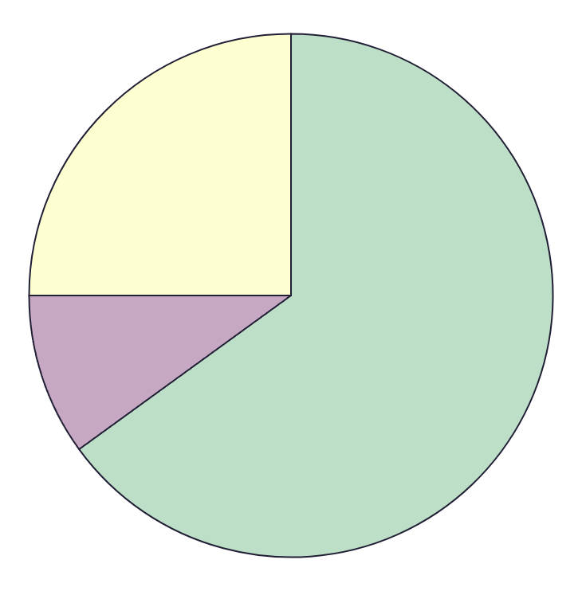
EXTRACTION EVALUATION
26
SUCCESS
40 NEW, REAL-WORLD CASES
4
PENDING
10
FAILURES
REM data only considers time REM is active.
Our data is taken from the VSCode extension – representative of UX.
Without IR server it takes 0.2-0.9 seconds to generate initial data
100%
COVERAGE OF REM-SUPPORTED CASES
Notes:
“We wanted to see if our architectural choices paid off — they did. Extraction is now fast and robust across real-world crates.”

Slide 18
VERIFICATION EVALUATION
KEY INSIGHTS:
Proof Generation is dominated by translation, not proof solving
Coq proof generation and return is almost instant
Verification can run asynchronously in the background
KEY OMISSIONS:
Charon occasionally “hangs” for >30s – these results are ignored for outliers.
Notes:
“Verification, while slower, proves correctness at a practical pace — the bottleneck is translation, not logic.”

Slide 19
06
CONCLUSIONS AND FUTURE WORK
Towards trustworthy, automated refactoring for every Rust developer.

Slide 20
KEY TAKEAWAYS FROM RESULTS
Extraction is Fast and Usable
The new toolchain achieves end-to-end extraction in under 0.5 seconds, including VSCode overhead.
Incremental IR Works
Incremental IR server responds to queries un under 10ms, drastically improving system latency.
Verified ≠ Slow
In the verifier, 80–90 % of time is spent generating LLBC; the proofs themselves complete almost instantly.
RESEARCH IMPACT
Proven Behaviour Equivalence
Across 20 verification cases, every refactoring produced a successfully discharged proof of equivalence.
Architecture Enables Research
The modular design allows each extraction stage to be studied and benchmarked in isolation.
From Prototype to Practical Tool
The system demonstrates that research-grade tooling can coexist with developer-grade usability.
Notes:
“In practice, extraction feels instantaneous — fast enough to support live, interactive development.”
“Our incremental IR design completely eliminates the lag between analysis and extraction.”
“The verification isn’t slow — translation is. Once the LLBC exists, proofs finish in the blink of an eye.”

Slide 21
WHATS NEXT?
⚙️ INCREMENTAL LLBC COMPILATION
💬 DIAGNOSTICS & IMPROVED USABILITY
🧩 EXPANDED COVERAGE
🦀 MERGE WITH RUST ANALYZER
The biggest speed up to the verifier possible – bring it to near instant operation
Explain extraction / verification failures with actionable feedback
Long-term goal: merge with official tooling for production-ready adoption
Research how to handle unsafe code, concurrency primitives, and complex control flow

