Slide 1
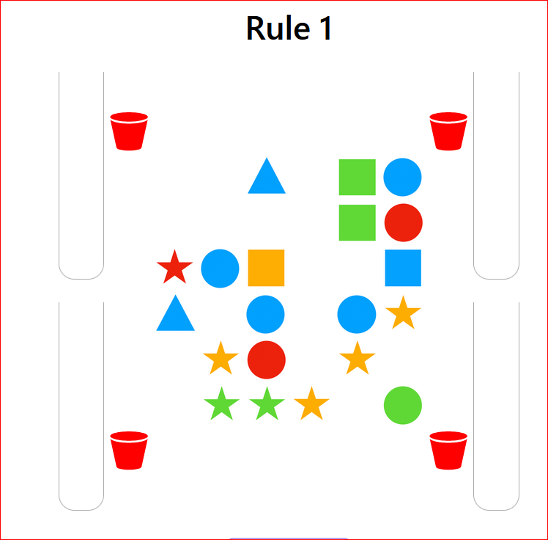
(1) Rule Number
In this task you will try to find secret rules (1) that control which pieces (2) can move, and which buckets (3) they can go into. You move them by drag and drop to earn a reward
You will have a chance to clear several boards for each rule
(2) Pieces
(3) Buckets

Slide 2
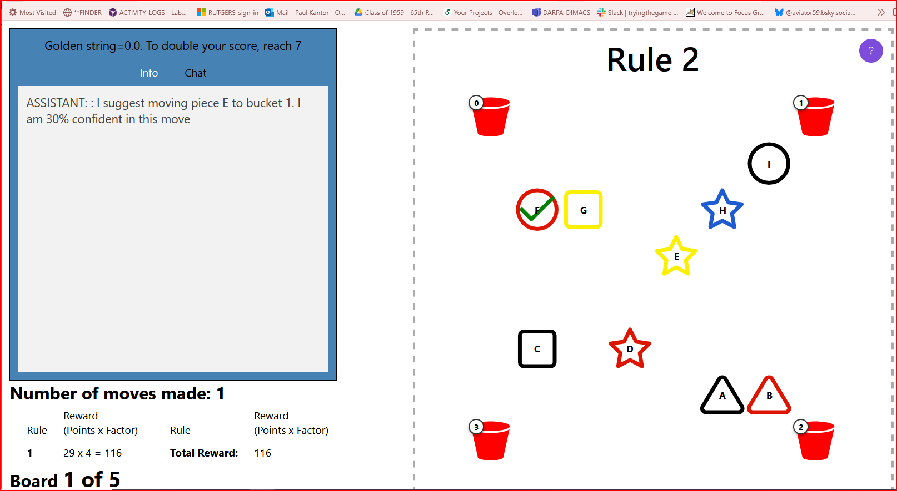
You will be playing alone or sometimes with a “bot” partner. This ASSISTANT bot will be watching the game, and may chat suggestions. The bot may not play all the rules with you. The board looks like this. The shapes have little letters in them, and the buckets have little numbers. The bot makes suggestions in the chat window on the left. The bot will tell you how confident it is about the move.

Slide 3
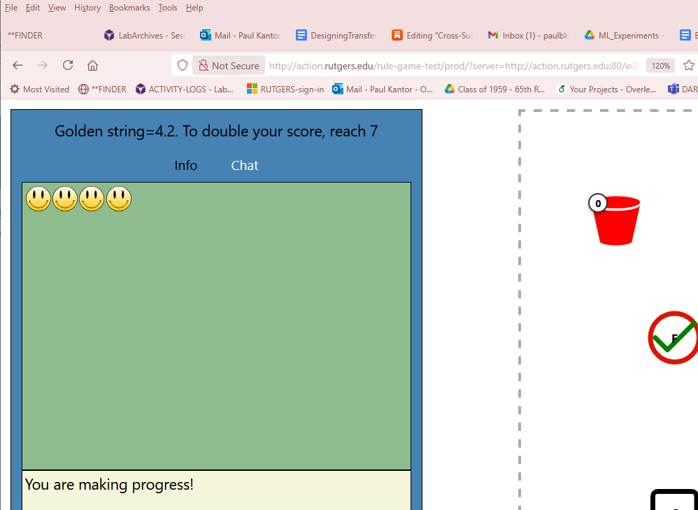
You can peek at the info tab
On the [Info] tab A wrong move is shown with a frown face.
A correct move is shown with a smile face.
Sometimes some pieces can't move. Touching them makes a frown face.
Remember to come back to chat tab

Slide 4
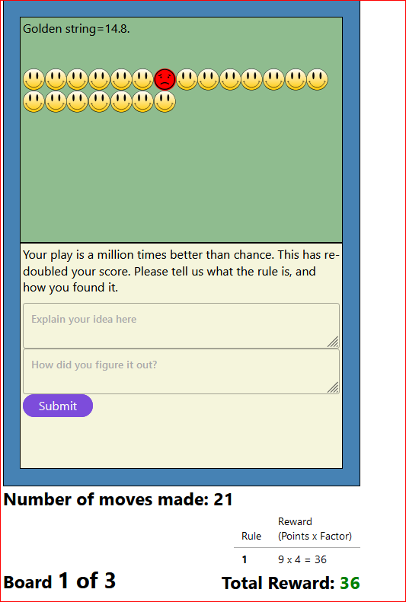
If you can get many correct moves in a row, you will get a big reward.
We will also ask what you think the rule is, and how you found it.
After you answer, please click “Submit” to move on with a new rule (if any).
After you (1) explain the rule and (2) tell how you found it, (3) click Submit to continue
(1)
(2)
(3)

Slide 5
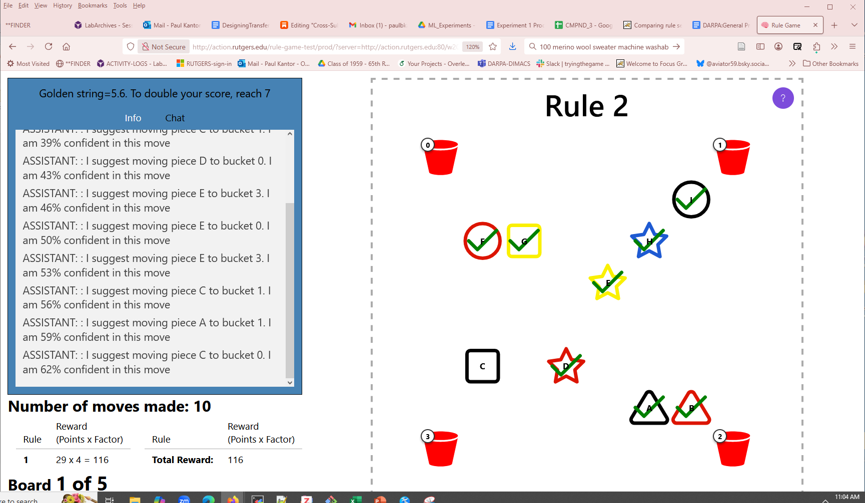
Click for these hints!
Now try to find the hidden rules, with occasional help from the bot.
Click the question mark to see these hints afain
At the end of each rule, be sure to click [Next]. It takes you forward.
Good luck!

