Slide 1
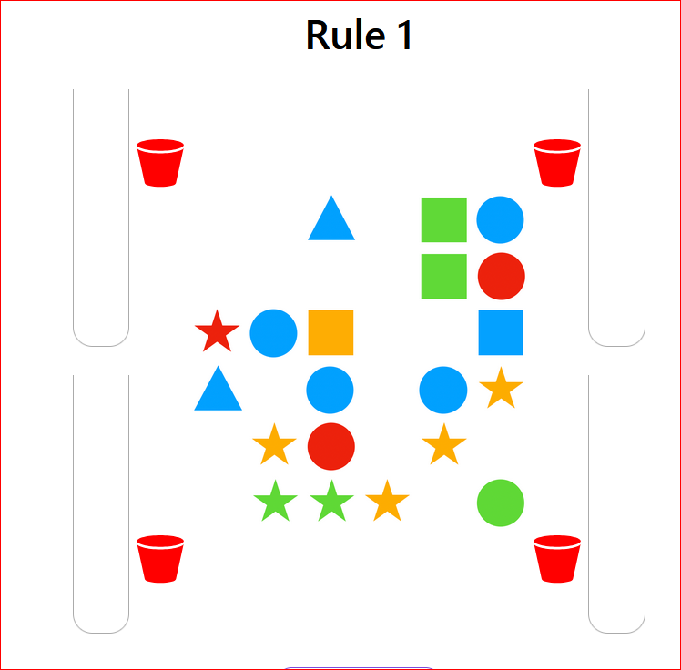
(1) Rule Number
In this task you will try to find secret rules (1) that control which pieces (2) can move, and which buckets (3) they can go into. You move them by drag and drop to earn a reward
You will have a chance to clear several boards for each rule
(2) Pieces
(3) Buckets

Slide 2
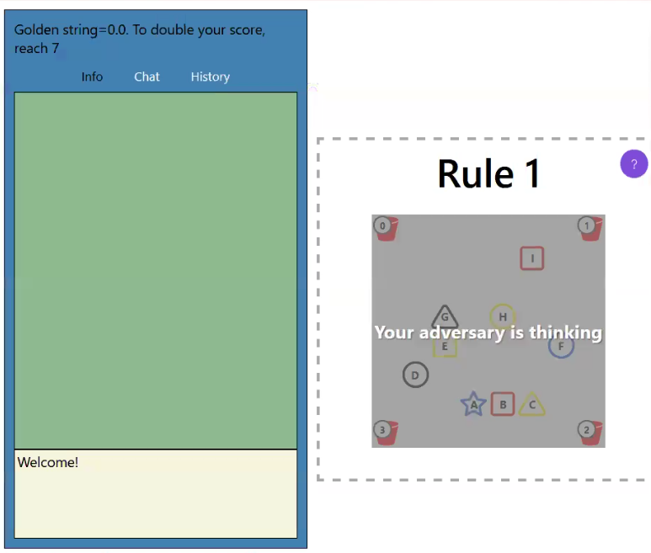
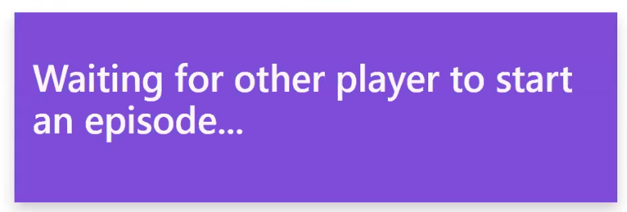
When your adversary logs on you will see this:
You will be competing with a random “adversary.” A correct move keeps control. A wrong move switches control to your adversary. If you log on first you see this message

Slide 3
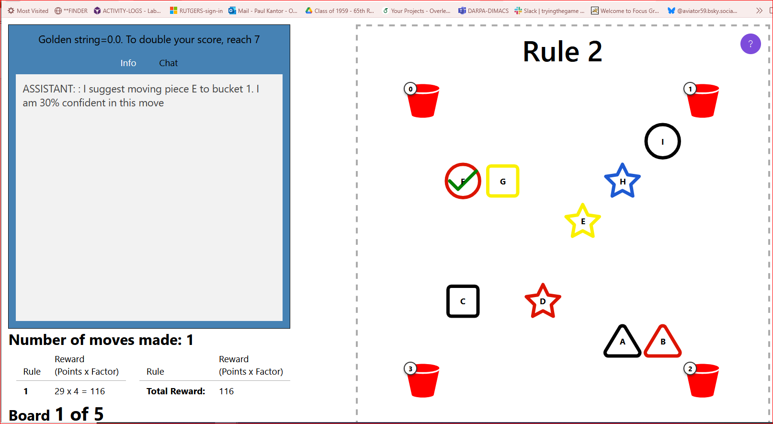
You will sometimes have a “bot” partner. This ASSISTANT bot will be watching the game, and may chat suggestions. The bot may not play all the rules with you. The board looks like this. The shapes have little letters in them, and the buckets have little numbers. The bot makes suggestions in the chat window on the left. The bot will tell you how confident it is about the move. NOTE: if the chat tab is WHITE, click it to see the suggestion

Slide 4
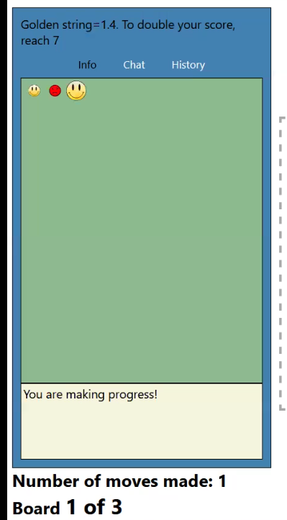
You can peek at the info tab
On the [Info] tab A wrong move is shown with a frown face.
A correct move is shown with a smile face.
Your moves have big faces. Adversary moves have small faces.
Sometimes some pieces can't move. Touching them makes a frown face.
If you have a bot, remember to come back to chat tab

Slide 5
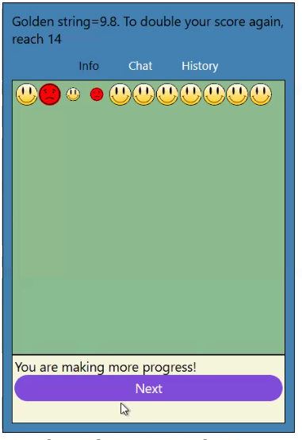
When the board is cleared press [Next] to get the next board. You BOTH have to do this even if it is your adversary who removed the last piece.

Slide 6
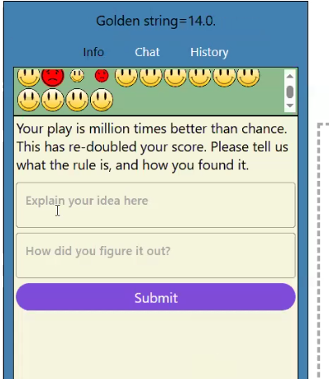
If you can get many correct moves in a row, you will get a big reward.
We will also ask what you think the rule is, and how you found it.
After you answer, please click [Submit] to move on with a new rule (if any).
If your adversary won, click [Next] to keep playing
After you (1) explain the rule and (2) tell how you found it, (3) click Submit to continue
(1)
(2)
(3)

Slide 7
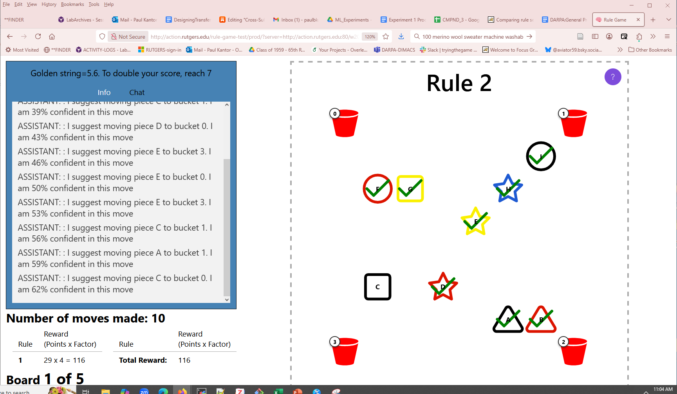
Click for these hints!
Now try to find the hidden rules, with occasional help from the bot.
Click the question mark to see these hints again
At the end of each rule, be sure to click [Next]. It takes you forward.
Good luck!

