Slide 1
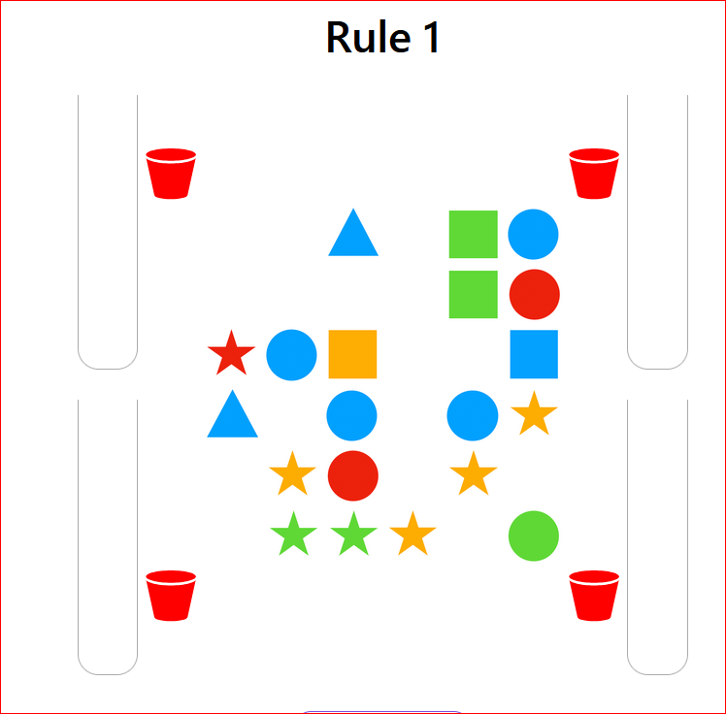
(1) Rule Number
In this task you will try to find secret rules (1) that control which pieces (2) can move, and which buckets (3) they can go into. You move them by drag and drop to earn a reward
You will have a chance to clear several boards for each rule
(2) Pieces
(3) Buckets

Slide 2
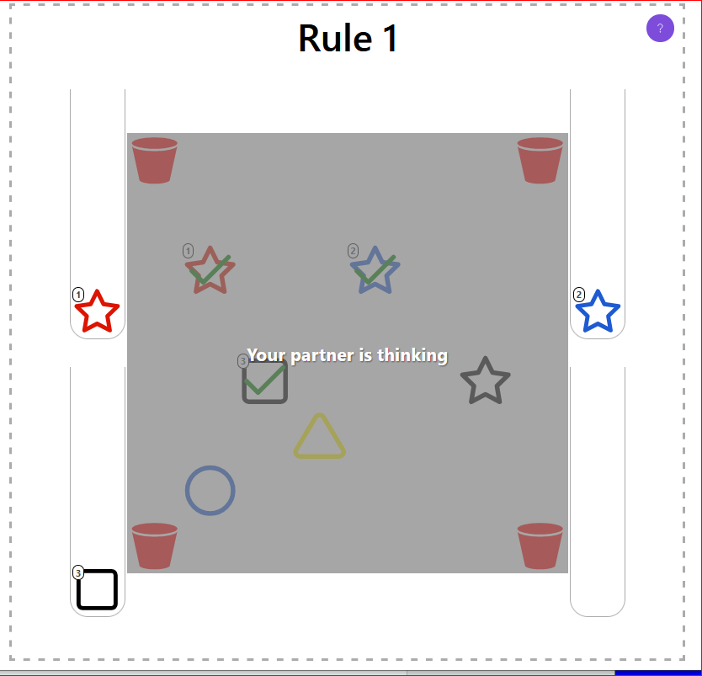
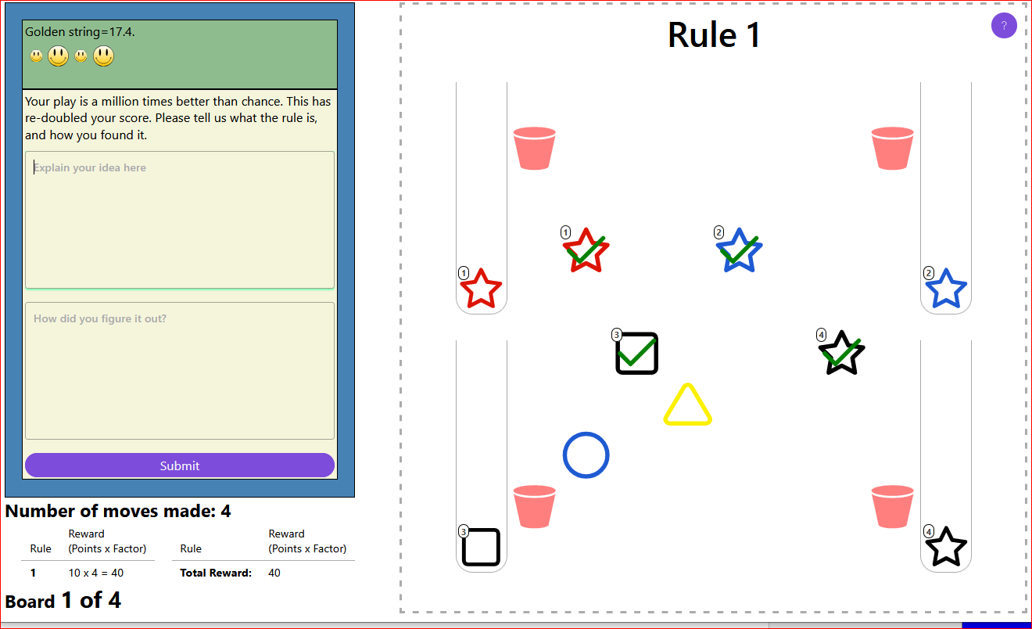
You will be playing with a random partner. If you are the second player, your screen asks you to wait. If you are ready to play, it has no gray screen over it. You will take turns moving.

Slide 3
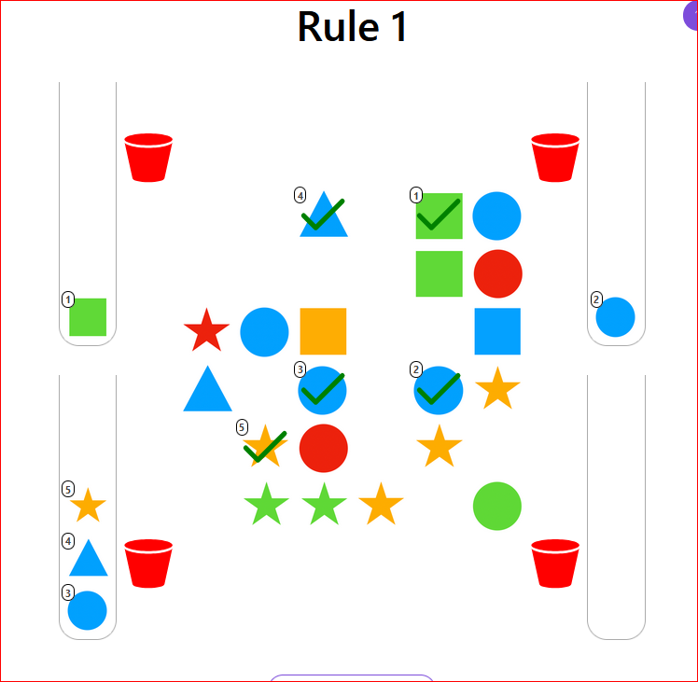
(1) “Test tubes”
There is information to help.
The “test tubes” (1) next to each bucket show every piece you have successfully dropped in that bucket.
The numbers in the test tube show which order they were dropped in, and link to the position where the piece used to be.

Slide 4
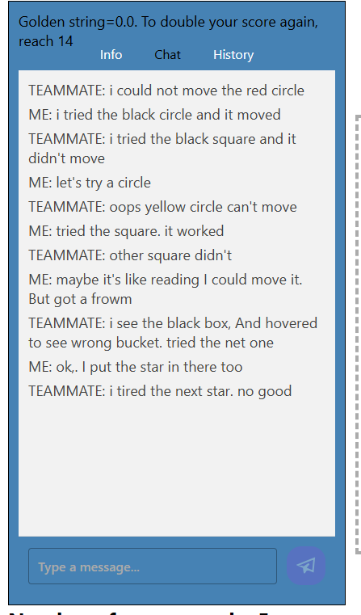
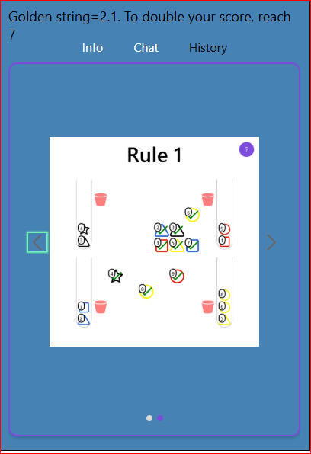
Tabs: Active tab is black. Remember to come back to chat
You have a chat window that you can use to “talk” with your partner.
Your conversation will show up in this [Chat] window – click the blue arrow to send your chat
After the board is cleared you will get a new board.
You can review the old boards by switching to the [History] tab to see how you cleared them. The arrows scroll forward and back in the history

Slide 5
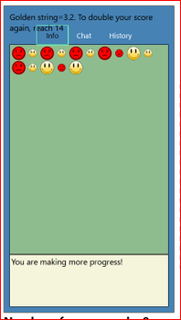
On the [Info] tab A wrong move is shown with a frown face.
A correct move is shown with a smile face.
Sometimes some pieces can't move. Touching them makes a frown face.
The [Info] tab will show the “golden string” for you and your partner
Your faces are big and your partner’s faces are small.
Remember to come back to chat

Slide 6
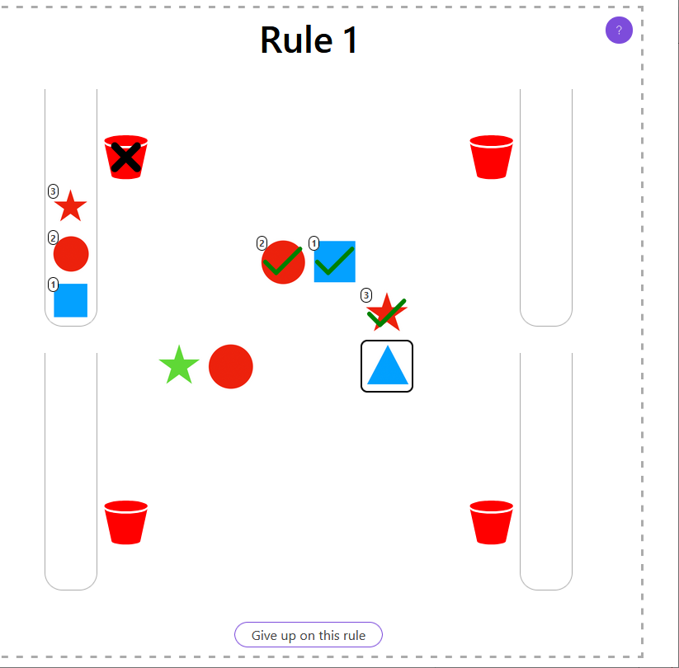
Sometimes your partner has tried a piece and found that it could not move
You will see a black square around that piece AND
When you hover on it, the bucket it cannot move to will be marked with an X
Don’t try that bucket!

Slide 7
After you explain the rule and how you found it, click Submit to continue
If your team can get many correct moves in a row, you will get a big reward.
We will also ask what you think the rule is, and how you found it.
After entering your guess of the rule, please click “Submit” to move on with a new rule (if any).
(1)
(2)
(3)

Slide 8
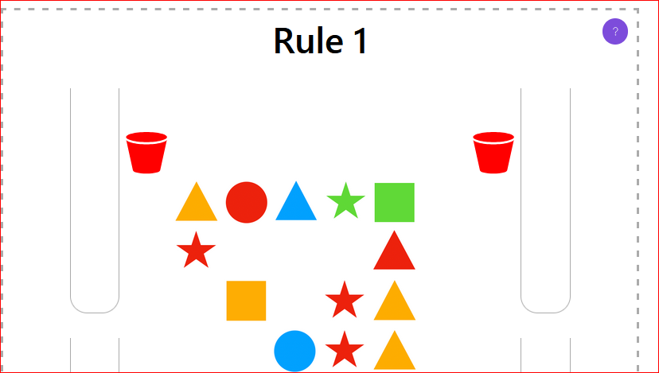
Click for these hints!
Now try to find the hidden rules for yourself
Click the question mark to see these hints
At the end of each rule, be sure to click [Next]. It takes you forward.
Good luck!
Remember: You can only drop pieces into the buckets. NOT into the test tubes. ☺

