Slide 1
A Generic Module System for Web Rule Languages: Divide and Rule
Uwe Aßmann, Sacha Berger, François Bry,
Tim Furche, Jakob Henriksson,
Paula-Lavinia Pătrânjan
RuleML 2007 October 2007

Slide 2
Modules
  Software units that
    Group together parts of programs and knowledge
    Usually serve a specific purpose
  An essential feature for programming languages
    Make large scale projects tractable by humans
    Facilitate the integration of existing applications
    Offer a flexible solution to application development

Slide 3
… and Rule Languages
  The rule-based programming paradigm
    High-level means for developing applications of various domains
    Flexible and adaptive approach towards application development
  Rule languages
    Have been developed within different communities
      Database systems, business rules, (Semantic) Web
    There is still room for further exploiting their potential
      Reuse and integrate knowledge
      Specified in different rule languages

Slide 4
Modules for Web Rule Languages
Besides the (general) advantages of modules in programming languages:
  Scoped inference
    Infer new knowledge within an explicitly given scope
  Data integration
    Issue also for the W3C RIF WG
… most of (Web) rule languages still lack a module system!

Slide 5
Modules for Web Rule Languages
Our Proposal
  A conceptual framework for modules in rule languages
    Provides abstract language constructs
    Abstracts away from a particular data model
    Preserves the languages’ semantics
  Main idea
    Rewriting modular programs into semantically equivalent non-modular programs
    Based on so-called reduction semantics
  Focus on genericity
    Applicable to many Web rule languages

Slide 6
Modules for Web Rule Languages
Framework
  Languages based on deductive rules
    Of the form head <- body
    Where head and body are finite sequences of atomic formulas
  Requirement for rule languages
    Rule chaining (or rule dependency)
    Dependency relations between body and head parts of a program (or module)
  Example rule languages
    SWRL, RIF BLD, Datalog, Triple, Prolog
    but not CSS

Slide 7
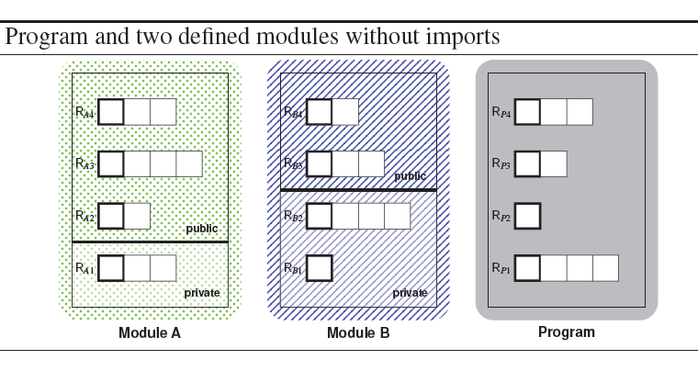
Module System Algebra
Module Definition
  A module M is a triple (R_{PRIV}, R_{PUB}, △)
    R_{PRIV}, R_{PUB} are the private and public, respectively, rules of M
    △ is the dependency relation between body parts and heads of rules

Slide 8


Module System Algebra
Module Composition Operators
  Import, denoted M1 M2
    Public rules of M2 are visible in M1
    … and in all other modules importing M1
  Qualified import
    Import public, denoted M1 M2
    Import private, denoted M1 ⋈ M2
      M2 not visible in modules importing M1
  Scoped import, denoted M1 _{S} M2
    M2’s rules become visible only to specifically marked body parts of M1
    Extends the dependency relation of M1
    Pairs of body parts from M1 and heads of rules from M2
  …

Slide 9
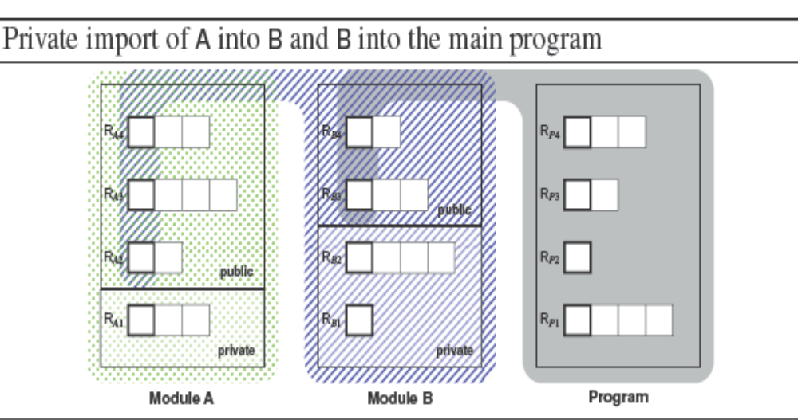
Module System Algebra
Public and Private Import

Slide 10
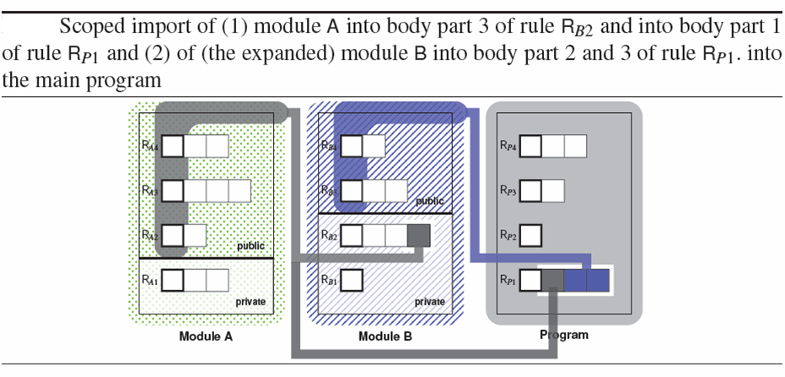
Module System Algebra
Module Composition

Slide 11
Module System Algebra
Module Composition
  A single fundamental module composition operator
    Scoped import as base of our module algebra
    Public and private import
      Can be reduced to scoped import in presence of views
      Details in the paper
  By composing modules a new set of rules is formed
    A new dependency relation is attached to this set
    An operation is needed
      For adjusting a given dependency relation
      The slide operation suffices
      Formal definitions in the paper!

Slide 12
Concluding Remarks
  We do not
    Propose a concrete module system for a given rule language!
  Instead, our work
    Abstracts from similar module systems realizable for different rule languages
    Proposes a framework for a generic module system
    That can be implemented e.g.
    By means of a composition framework such as Reuseware
    http://www.reuseware.org/
    As done e.g. for the Web rule language Xcerpt

Slide 13
Thank you for your attention!
For more information on our research work:
http://rewerse.net/

