Slide 1
Complex Information Management Using a Framework Supported by ECA Rules in XML
Presented By
Essam Mansour

Slide 2
Over View
Introduction
Problem of Managing Complex Information
An Approach for Modelling the Complex Information
SEM Framework for Managing Complex Information
The Role of ECA Rule Paradigm and XML
Conceptual Architecture for A Complex Information Management System
Summary

Slide 3
Introduction
My Project is the second stage of an on-going research
My Project Objectives:
  Generalizing and enhancing the concepts and management framework done in the first stage;
  Developing a high-level language for facilitating the management of the generalized framework;
  Developing intermediate models for implementing the language using the available technologies, such as XML and DBMS;
  Developing a proof-of-concept system;
  Evaluating the work done in the second stage

Slide 4
Problem of Managing Complex Information
Examples
Generalizing
The Work Done
Research Focus
Not the Research Focus
First Stage
Second Stage
Clinical
Guidelines
Stock Exchange
Regulation
Best
Practice
Formalization
And Modelling
Language
Enriching these
Functionalities
Main
Research
Focus
Medical
Patient Plan
Customer
Order
Complex
Information
Modelling Language
Maintenance Support
Execution and
Manipulation
Enriching these
Functionalities
Healthcare
Record
Stock
Items
Domain
Information

Slide 5
Problem of Managing Complex Information
The Complex Information is produced by incorporating the best practices into the daily management.
The medical plans and customer orders are examples for Complex Information produced by incorporating clinical guidelines and stock regulation into the disease and order management, respectively.
Managing Complex Information
Integrating the Complex Information Management into DBMSs, which are utilized to manage the domain information

Slide 6
An Approach for Modelling Complex Information
Main Components of the Complex Information
The Complex Information is managed as one distinct entity
The management is supported by a high level declarative language, called AIM language
Complex
Information
Domain
Information
Knowledge
Action
History
Description
Model the
monitored
Information
Model the
reactive
behaviour
Model the
evolution history
Model
The descriptive
Information

Slide 7
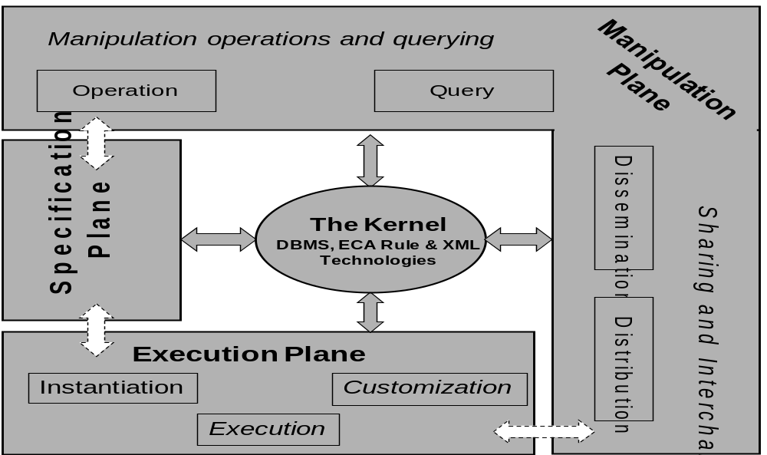
SEM: Framework for Managing Complex Information

Slide 8
The Role of ECA Rule Paradigm and XML
Realizing the functionality of SEM Framework requires:
  Seamlessly integrated and easily incorporated technologies
  Support the monitoring process and distributed management
Utilizing the ECA Rule Paradigm and XML provides a flexible environment for the management functions provided by SEM.
These technologies provide support for the main components of AIM language.

Slide 9
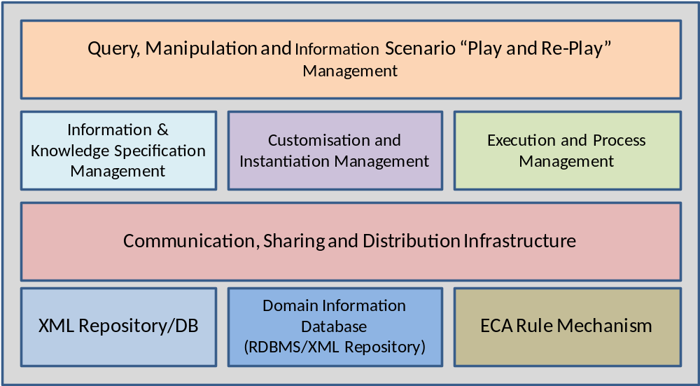
Conceptual Architecture for A Complex Information Management System

Slide 10
Summary
The requirements for managing the complex information
A Management Support Framework for the Complex Information
The Technologies supporting the Complex Information
Complex Information Management System

Slide 11
T
h
a
n
k
Y
o
u

