Slide 1
AIM: An XML-Based ECA Rule for Supporting a Framework for Managing Complex Information
Presented By
Essam Mansour

Slide 2
Over View
Introduction
AIM language
AIM Specification Component
The Complex Information Model in AIM
AIM Query Component
Summary

Slide 3
Introduction
My Project is the second stage of an on-going research
My Project Objectives:
  Generalizing and enhancing the concepts and management framework done in the first stage;
  Developing a high-level language for facilitating the management of the generalized framework;
  Developing intermediate models for implementing the language using the available technologies, such as XML and DBMS;
  Developing a proof-of-concept system;
  Evaluating the work done in the second stage

Slide 4
Introduction
Examples
Generalizing
The Work Done
Research Focus
Not the Research Focus
First Stage
Second Stage
Clinical
Guidelines
Stock Exchange
Regulation
Best
Practice
Formalization
And Modelling
Language
Enriching these
Functionalities
Main
Research
Focus
Medical
Patient Plan
Customer
Order
Modelling Language
Maintenance Support
Complex
Information
Execution and
Manipulation
Enriching these
Functionalities
Healthcare
Record
Stock
Items
Domain
Information

Slide 5
Introduction
The Complex Information is produced by incorporating the best practices into the daily management.
The medical plans and customer orders are examples for Complex Information produced by incorporating clinical guidelines and stock regulation into the disease and order management, respectively.
Managing Complex Information
Integrating the Complex Information Management into DBMSs, which are utilized to manage the domain information

Slide 6
AIM Language
Supporting the SEM Framework at three plans:
AIM is an XML-Based language
AIM Components
AIM
ECA
XML
PLAN
XQuery
AIMSL
CI Model
AIMQL
Support the
Specification
Process
Support
instantiation and
maintenance
processes
Support
Manipulation and
Information Retrieval

Slide 7
AIM Specification Component (AIMSL)
The main concepts in AIMSL model are:
  Protocol
  Schedule
  Rule
Generic and Customization.
Protocol
Name
Category
Header
Protocol Rule
Schedules
Schedule
Name
Header
Schedule Rules
Rule
Name
Properties
Header
Rule Body
terms
Event
Condition
Action

Slide 8
AIM Specification Component (AIMSL)
AIMSL utilizes ECA Rules to represents the best practice.
In AIMSL, ECA Rules are distinguished by:
  The event, condition, and action are defined using domain application terms, ex:
  Rule 1: on two days after patient admission, order the blood test.
  Temporal Events:
    Absolute time or Relative time event
    on June 1, 2008
    on day 2 of patient admission
    Once-off or Repetitive with before or after support
    on day 2 of patient admission
    every 10 hours before the operation time

Slide 9
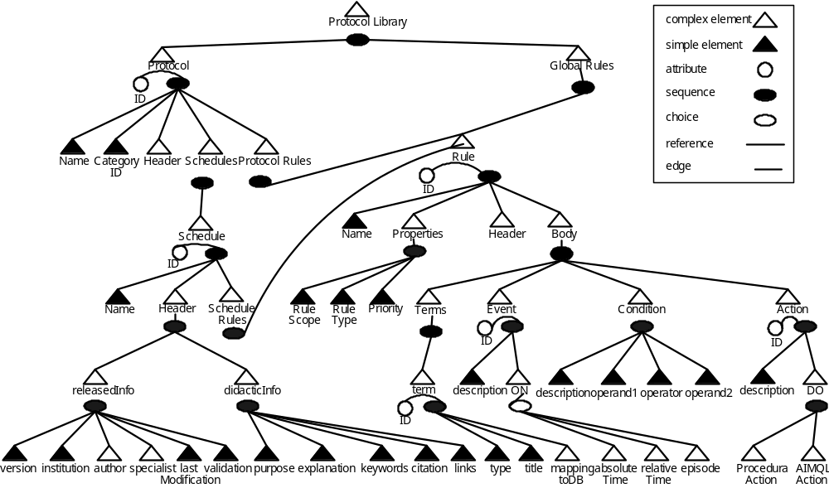
AIM Specification Component (AIMSL)

Slide 10
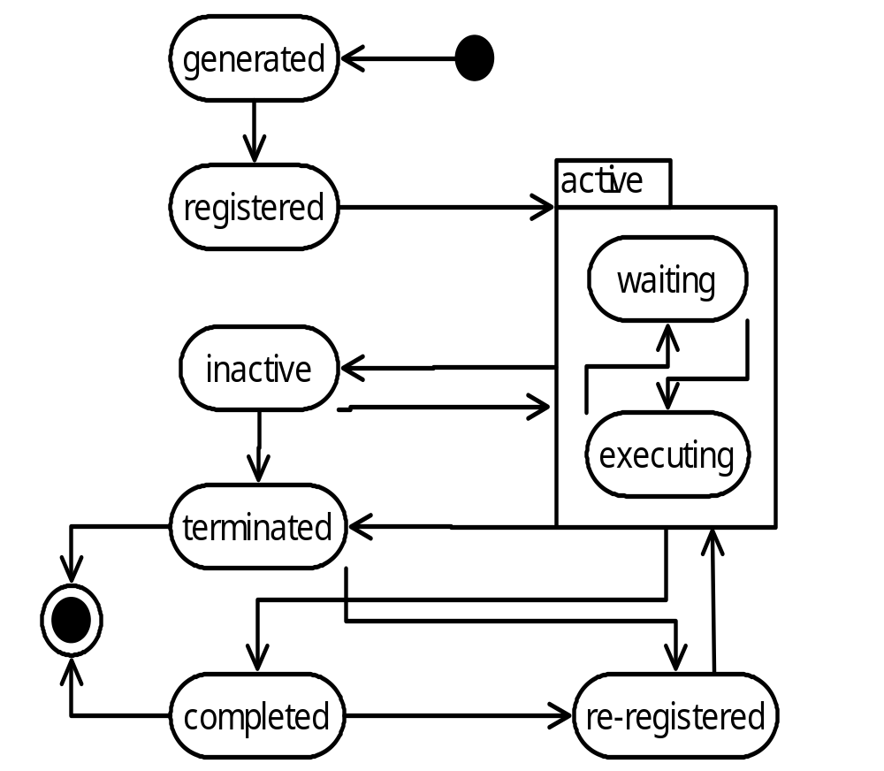
The Complex Information Model in AIM
Complex
Information
Life-Cycle
in AIM

Slide 11
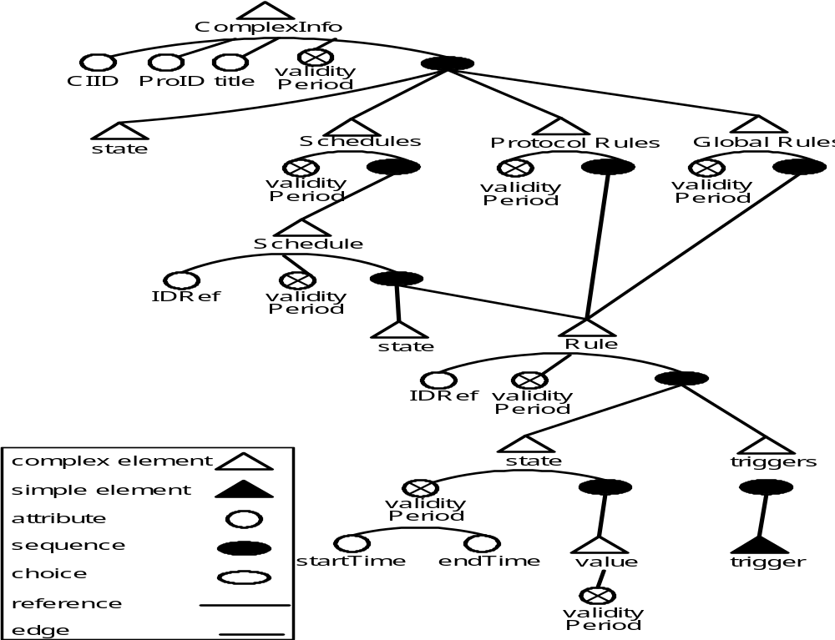
The Complex Information Model in AIM
Complex
Information
Schema
in AIM

Slide 12
The Complex Information Model in AIM
Rule MAS1: ON day 2 of the patient admission,
DO order the test albumin creatine ratio (ACR).
Rule MAS2: ON receiving the result of test ACR
IF the ACR result is greater than 25
DO Add rule 3 and 4 to order ACR test at day number 6 and 38
Day 2
Schedule
What is CI in Day 4?
Day 3
1-Now
1-2
1-Now
1-3
3-Now
3-Now
MAS1
MAS2
MAS3
MAS4
Replay CI from Day 3 to 5
1-2
1-3
1-Now
3-Now
3-Now
1-Now
state
state
state
state
Element
1-Now
1-Now
1-2
2-2
1-3
3-3
3-Now
3-Now
Attribute
Text Node
Value
Value
Value
Value
edge
Value
Value
validity
1-3
reg
executed
reg
executed
reg
reg

Slide 13
AIM Query Component (AIMQL)
Requirements
  Move complexity from user/application code to high level declarative language
  Changes Propagation
  Declarativity
  XQuery –based language
  Convenient for human to read and write
XQuery Extensions:
  Manipulation Operations: add, remove, modify, activate, deactivate, terminate, and Fire.
  Temporal Query Support for the replay functionality

Slide 14
AIM Query Component (AIMQL)
Natural language:
Replay the plans of category no CAT, which was working through out the past Y days.
AIMQL
REPLAY Complex Information CI
SHOW When, How, Why OF CI
Where CI.cast(“day”) >= Y
and CI.meets(NOW)
and CI[@catID=CAT]

Slide 15
Summary
Our Research focuses on providing a comprehensive management for the complex information
K-CAMP provides a generic approach and framework for Complex Information Management
AIM language consists of:
  AIM Specification Component
  The Complex Information Model in AIM
  AIM Query Component

Slide 16
T
h
a
n
k
Y
o
u

