Slide 1
TAKE – A Derivation Rule
Compiler for Java
Jens Dietrich, Massey University
Jochen Hiller, TopLogic
Bastian Schenke, BTU Cottbus/REWERSE

Slide 2
Why Derivation Rules
Query driven.
Well defined semantics.
Non state changing.
Easy integration into pull based applications (http requests, DB queries).
No need to replicate (keep and keep up-to-date) facts in memory – fetch as needed, cache if you want
Good scalability in scenarios with large fact bases and small or medium sized (up to thousands) rule bases.

Slide 3
Rule Engines vs Rule Compilers
Rule engine: interpret rules at runtime.
Rule compiler: convert rules into executable code.
Advantages: speed + free verification by underlying compiler.
Disadvantages:
    compilation happens at build time - application must be redeployed if rules change.
    rules not available at runtime, they are “compiled away” and cannot be referenced to explain computation
But: runtime compilation and deployment is possible and supported by standards (JSR-199) (used for applications like JSPs)‏
Problems with derivation rules: compiler must handle backtracking and variable binding (unification)

Slide 4
Compilation
TAKE scripts
knowledge sources
TAKE domain model
TAKE compiler
rule markup
Java Source
Java bytecode
Java compiler
platform code
JVM

Slide 5
Deployment
Option1 - static
Compile rules into classes
Build application
Deploy application
Option2 - dynamic
Compile rules into interfaces
Build application
Deploy application
Compile rules into classes
Deploy (+undeploy) rules into running applications

Slide 6
Writing Rules
TAKE scripting language – easy to use, slightly prologish
TAKE R2ML adapter (beta) – imports rules from REWERSE R2ML markup language

Slide 7
TAKE scripts
Java type references
Java object references (by name, must be bound)‏
global (rule base) and local (rule) annotation
aggregations
fact stores
queries
rules and facts

Slide 8
TAKE example
// example
@@dc:creator=jens dietrich
@@dc:date=27/05/2007
var example.nz.org.take.compiler.eurent.RentalCar car
var example.nz.org.take.compiler.eurent.Rental rental
var example.nz.org.take.compiler.eurent.Branch branch
@take.compilerhint.class=IsAvailable
@take.compilerhint.slots=car,branch
@take.compilerhint.method=isAvailable10
query availableAt[in,out]
// rules
rule1: if storedAt[car,branch] and not isScheduledForService[car]
and not assignedTo[car,rental] then availableAt[car,branch]
annotations (meta data)‏
variables, types are Java classes
more annotations,
names used by compiler
query, defines the public
methods to be generated
rules

Slide 9
Generated Code
Generates simple PLOJO classes for predicates
Central main class with interface for queries
Actual code in fragment classes referenced by main query class for scalability
Call backs to Java methods in domain model
Large parts of the generated code are template based

Slide 10
Generated Data Structure
PLOJOs are generated for all referenced predicates
public class IsAvailable {
public example.nz.org.take.compiler.eurent.RentalCar car;
public example.nz.org.take.compiler.eurent.Branch branch;
public IsAvailable() {
super();
}
}

Slide 11
The Resource Iterator Pattern
Iterator - GangOf4 pattern – iterate over collections without knowing their internals
Resource Iterator – Iterator + close – suitable to iterate over resources not necessarily available in memory (fetch as needed)‏
Performance can be boosted by caching and background prefetching if needed

Slide 12
External Fact Stores
Describe where facts are supplied by external resources like databases and web services
Compiler will generate interface that produces iterators
Interfaces can be implemented to access facts
Bound to implementation class when KB is instantiated

Slide 13
Query API
Iterator based– pull results as needed.
Iterators are called “ResultSets”
result sets have API to extract rules used

Slide 14
Generated Query API
public class KB {
public Map<String, String> getAnnotations(String id) {..}
public Map<String, String> getAnnotations() {..}
public ResultSet<IsAvailable> isAvailable10(RentalCar car) {
..
}
}
name can be set in annotation
runtime access to annotations
method generated for query, ResultSet is iterator

Slide 15
Code Generated for Rules
Use Iterator “algebra”
Similar to Apache Commons Collections library
Multiple rules supporting the same query – use chained iterator
Evaluate prerequisites within a rule – use nested iterators
Single supporting fact – use singleton iterator
false – use empty iterator

Slide 16
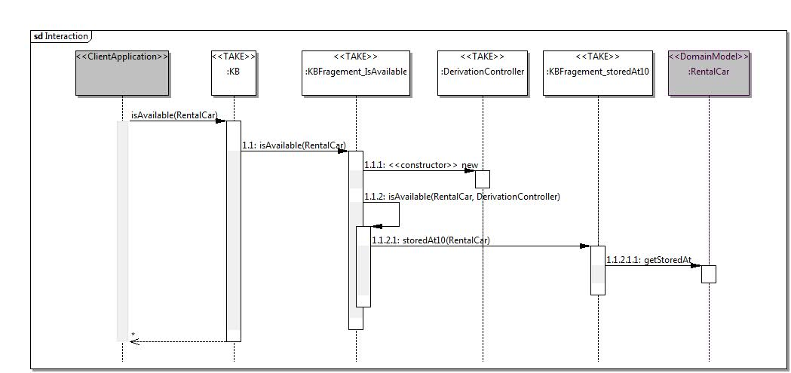
Generated Code (ctd)‏
public query
TAKE internals - clustering
wrapper
domain model
call backs

Slide 17
Semantic Reflection
Generated code is reflective
Information about rules used to generate application is accessible at runtime
Similar to reflection is OO – but reflection is only about syntax
API keeps not rules but only rule ids, and supports querying meta data by id
Examples: creator, date modified, description .. standard vocabularies (DC) should be used
Addresses many business use cases, such as tracing code to requirements
Alternative to dominating black box principle

Slide 18
Example: Application API
RentalCar c = ...;
Branch b = ...;
Rental r = ...;
KB kb = new KB();
ResultSet<IsAvailable> rs = kb.isAvailable10(c);
IsAvailable result = rs.next();
List<DerivationLogEntry> log = rs.getDerivationLog();
System.out.println(result.branch.getName());
for (DerivationLogEntry e:log) {
Map<String,String> annotations = kb.getAnnotations(e.getName());
if (annotations!=null){
System.out.println(annotations.get("take.auto.date"));
System.out.println(annotations.get("take.auto.creator"));
System.out.println(annotations.get("take.auto.tostring"));
}
}

Slide 19
Validation
UServ Product Derby Case Study
execute by clicking on link on TAKE home page http://code.google.com/p/take/
69 rules -> 111 source code files, 354 classes
Compilation takes 2567 ms on a system with a 2.0GH T5600 dual core processor, 2.0GB of RAM running on Ubuntu 7.10 with Java 1.6.
Handicaps: logging and code pretty printing enabled

Slide 20
Using TAKE
Project Home:
http://take.googlecode.com/svn/trunk/take/
Subversion:
http://take.googlecode.com/svn/
Example App (WebStart):
http://www-ist.massey.ac.nz/jbdietrich/userv/userv.jnlp
License: LGPL

Slide 21
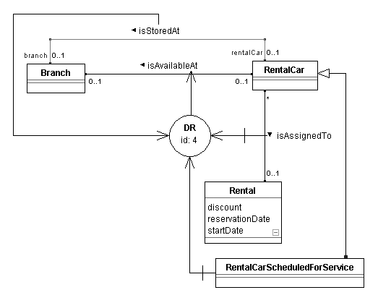
Next Steps
Tool support (Eclipse plugin)‏
Better integration with rule markup languages.
Use concurrency in compiler.
Use in MDA scenario to generate code for derived associations.

