Slide 1


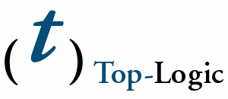


International RuleML Symposium
on Rule Interchange and Applications (RuleML-2007)
October 25th – 26nd, 2007
Orlando, Florida
http://2007.ruleml.org
Submission deadline:
June 29th, 2007
„The International RuleML Symposium on Rule Interchange and Applications (RuleML-2007) is devoted to practical distributed rule technologies and rule-based applications which need language standards for rules operating in the context of, e.g., the Semantic Web, Intelligent Multi-Agent Systems, Event-Driven Architectures and Service-Oriented Computing Applications. “
Sponsored by:
Co-Located
with:
(Gold Sponsor) (BronzeSponsor) (Bronze Sponsor)

