Slide 1
A Rule-Based Framework Using Role Patterns for Business Process Compliance
Akhil Kumar
Smeal College of Business, Penn State University,
University Park, PA 16802, USA
(akhil@psu.edu)
Rong Liu
IBM Research, 19 Skyline Drive,
Hawthorne, NY 10532, USA
(rliu@us.ibm.com)

Slide 2
Agenda
Background concepts and Motivation
Framework
Example process
UML model describing entities and relationships
Role patterns
Implementing patterns in Prolog
Task Categories
Architecture
Discussion and conclusions

Slide 3
Background
The Sarbanes-Oxley Act of 2002 imposes tough requirements and penalties to ensure that financial statements accurately represent the actual business position of a company. Relevant sections:
Section 302: CEOs and CFOs must personally sign off on their companies' financial statements…
The main point of this section is to establish CEO/CFO accountability for the rest of the Act's sections…
with the possibility of prison for noncompliance.
Section 404: Well-defined and documented processes and controls must be in place for all aspects of a company’s operations that affect financial reports.
Furthermore, executive management and a company's auditors must each state in writing that these processes and controls have been examined and are effective.
Notes:
Basel 2, COBIT, also.

Slide 4
Concepts (1)
Business Process Compliance : does a process perform according to boundaries defined by business rules, e.g.
Related to Role/task attributes
`3-Eyes’ rule: Separation of custody, approval, recording,
`4-eyes’ rule: Separation of request, authorize, prepare, release payment
A loan for $100,000 must be approved by a vice-president
A loan for $500,000 must be approved by two vice-presidents
Related to temporal order:
Payment can only be made after goods are received and approved
Related to Agents/cases:
The same `agent' in the vice-president role cannot simultaneously work on more than two loan approval cases for the same client
Goal: To make every process conform to these rules…

Slide 5
Concepts (2)
  Role = Organizational title
  Compliance Checking = Auditing
  Management will define rules, and the system will implement them
  Want a system where all process instances conform to all rules
  Modes of operation:
    Dynamic, Real-time: disallow any action/task that is forbidden
    Corrective: system will also analyze logs to ensure that no rules have been violated. If so, it will flag any discovered errors.

Slide 6
Motivation
Problems:
Systems and business processes are becoming more complex
Systems may span multiple applications and organizations
Business rules are also becoming more complex along with organizational complexity
Classical audit techniques are not adequate anymore
Solutions:
More application of formal verification methods such as logic
Integrate modeling and execution of business rules for compliance within the business process description
Need continuous, real-time auditing rather than after the fact

Slide 7
Dimensions of our framework
We propose a framework with 4 dimensions:
Process patterns: Building blocks to describe the control flow of a business process
Role patterns: Standard built-in rules to be associated with process patterns
Task Categories: 10 main categories of tasks in a business process
User-defined constraints: additional rules defined by the user

Slide 8
Process Patterns
and
and
(a) Immediate
Sequence
(ISeq)
(b) Parallel
structure
(Par)
or
or
or
or
(c) (exclusive) Choice
structure –
(Choice)
(d) Loop
structure
(Loop)

Slide 9
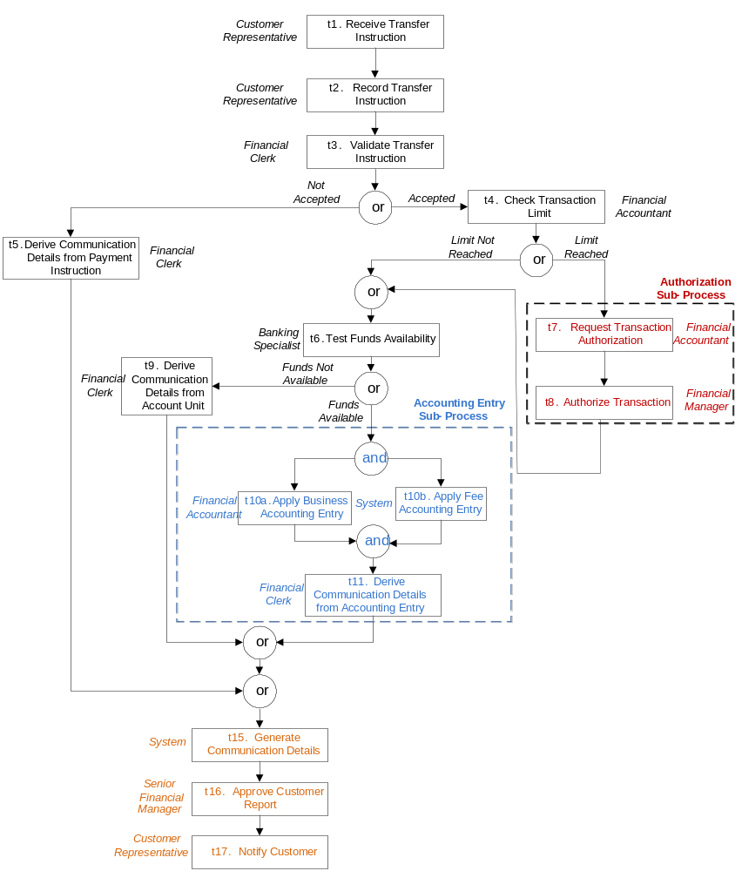

An Example Process – account transfer request
Roles
Customer rep
Financial clerk
Financial accountant
Banking specialist
Senior fin. Manager
Subprocesses
Authorization
Accounting entry

Slide 10
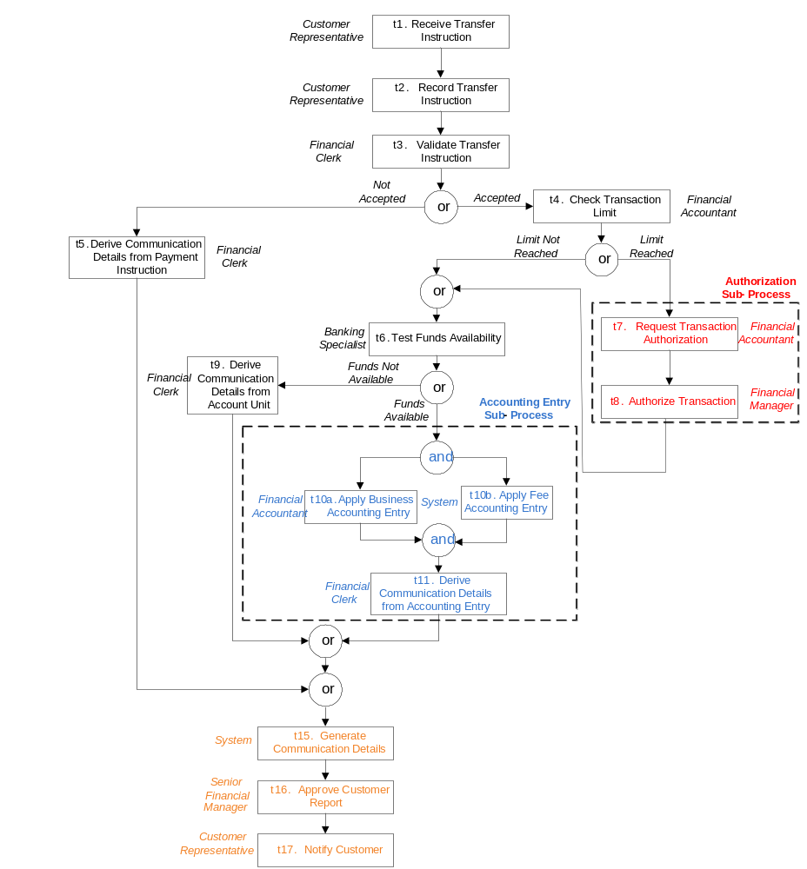
An Example Process

Slide 11
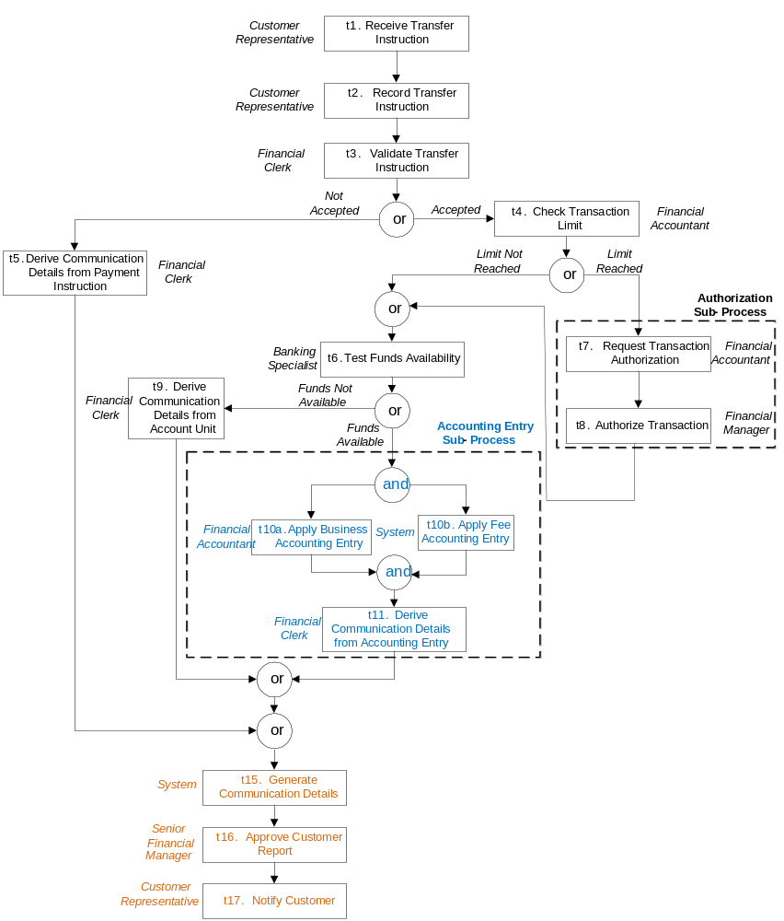
An Example Process

Slide 12
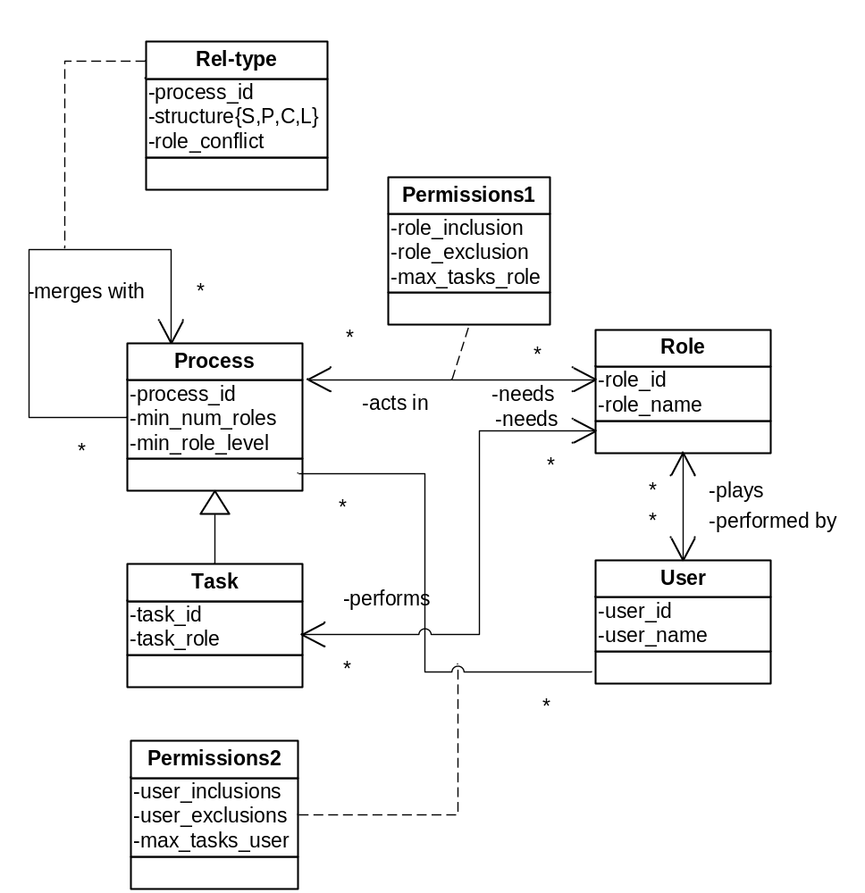
UML Model for Compliance

Slide 13
Proposed role patterns
# | Role Pattern (RP) Description | Formal Expression
1 | Role Uniqueness: A (sub) process p must contain at least N unique roles. | RP1(p, N)
2 | Intra-Process Role Exclusion: No pair of tasks with the lowest level common relationship Rel can be done by the same role in a (sub) process p, Rel {Iseq, Par, Choice, Loop} | RP2(p, Rel)
3 | Inter-Process Role Exclusion: No task pair from a pair of different sub-processes, say sp1 and sp2, can be done by the same role. | RP3(sp1,sp2)
4 | Minimum Role Level: At least one task in (sub) process p must be done by min_role or higher. | RP4(p, min_role)
5 | Maximum Task Limit: A role r can perform a maximum of N tasks in (sub) process p. | RP5(p, r, N)
Note:
Patterns can apply at different levels of granularity
Tasks relationships can impact permissions

Slide 14
Process Compliance Control matrix
Key idea: associate role patterns with process
 | Role Uniqueness count | Intra process Role Exclusion | Inter process Role Exclusion | Minimum Role Level | Maximum Task Limit per role
Authorization sub-process | 2 | X | accounting entry | Financial accountant | 2
Accounting entry sub-process | 3 | X | authorization | Financial clerk | 2
Approve customer report | 1 |  | Generate report | Senior financial manager
Record instructions | 1 |  | Validate instructions

Slide 15
Implementation of basic role patterns
Rp1(Proc ,N) :- setof(R, role_occurs(Proc,R),Rset), length(Rset, M), M > N.
Rp2(Proc, Rel) :- contain(Proc, SP1), anc(SP1, T1,T2), T1 ≠ T2, merge(_, _, SP1, Rel), role_assign(T1, R, Proc), role_assign(T2, R, Proc).
Rp3(Proc1, Proc2):- contain(Proc1, T1), contain(Proc2, T2), T1 ≠ T2, role_assign(T1, R, Proc), role_assign(T2, R, Proc).
Rp4(Proc,Min_role):- setof(R, role_occurs(Proc, R),Rset), not(member(Min_role, Rset)).
Rp5(Proc,R,N) :- contain(Proc, T), setof(T,role_assign(T, R, Proc), Tset), length(Tset,M), M >= N.

Slide 16
Overall approach
The main steps in our approach are:
Basic process patterns are used to describe processes
Basic role patterns are used to describe control requirements.
The role patterns are associated with a process at different levels of granularity (i.e. whole process, subprocess, task, etc.) as per the business policies.
The patterns are implemented in a logic-based language, e.g. Prolog.
Before making any task assignment to a role, the execution engine performs checks and disallows certain tasks if they violate the requirements.

Slide 17
Generic task categories
Assign all tasks to one of 10 generic categories
Task category | Description
Prepare | Make something ready for use
Record | Note, enter into system, store in database
Approve | Accept, reject, decide, signoff
Requisition | Request, ask, initiate, order
Transmit | Notify, provide, deliver, send payment, goods, etc. (outside the organization).
Acquire | Receive, obtain
Administer | Manipulate, move, inquire, search
Inspect | Test, evaluate, check
Suspend/ Terminate | Hold, finish, complete, stop temporarily
Report | Prepare a report, or any kind of output
Then, role patterns can refer to task categories

Slide 18
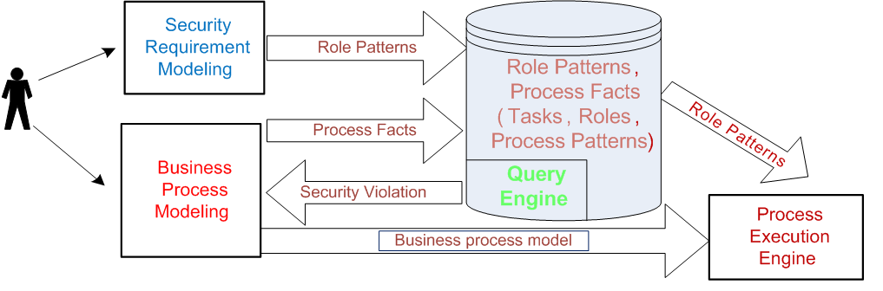
An architecture

Slide 19
Discussion
This framework is preliminary…
More work needed to:
  Check completeness of patterns (temporal, instance-based, value related patterns, etc.)
  Verification
  Delegation
  Implementation
There are also links with process mining:
  Process mining techniques can be used to discover actual models which may deviate from the official model.
  This could have implications for security

Slide 20
Future: Dream or vision slide …
Design of the Monitor: Architecture
logging
event
database
business
rules
official
process
model
process
discoverer
model
comparator
Information system
guards
Logic checker
model
checker
discovered
process
model
detection
potential
risks
deviations
[Source: Kees Van Hee]

Slide 21
Conclusions
Business rules are key to compliance and auditing of business processes
Need tighter integration of process and business rules
Also need an easy way for end-users to incorporate such rules
Proposed a framework for compliance based on preliminary role patterns that can be checked by predicate logic
More work needed to check completeness, verification delegation, implementation, etc.

Slide 22
THANK YOU!

Slide 23
Example predicates for role (ex)inclusion
Role_exclude1(Proc,R1,R_excl) :-
role_occurs(Proc, R1),
role_exclude(R1, R_excl),
role_occurs(Proc, R_excl).
Similarly, a role_include1 predicate can be created as:
Role_include1(Proc, R1,R_incl) :-
role_occurs(Proc, R1),
role_include(R1, R_incl)
not(role_occurs(Proc, R_incl)).
Restrict_user_role (Proc, R, N) :-
contain(Proc, T),
setof(T,assign_role(T, R).

Slide 24
Business processes
Process languages:
  Large number of languages, e.g. BPEL, WSFL, WPDL, etc.
  Drawback:
  Most current modeling approaches take a control flow view.
  They do not take a wholistic perspective.
  Our objective:
  Extend current languages with role patterns that can be associated with the control flow of the process.

