Slide 1
Comparison of BaseVISor, Jena and Jess Rule Engines
Jakub Moskal, Northeastern University
Chris Matheus, Vistology, Inc.

Slide 2
Introduction
SIXA
  Detection of suspicious naval activity
  Multiple sources of information: location, speed, bearing
  Requirement: multiple rule engines
Why these?
  BaseVISor – developed at Vistology, Inc.
  Jena – popular in Semantic Web community
  Jess – previous experience

Slide 3
Rule Engines
 | BaseVISor | Jena | Jess
Developer | Vistology, Inc. | HP Labs | Sandia Nat’l Labs
Webiste | www.vistology.com | www.jessrules.com | jena.sourceforge.net/
License | Academic-free | Open-Source | Academic-free
Reasoning method | Forward+Rete | Depends on the reasoner | Forward+Rete, Backward, Hybrid
Support for RDF-based documents | Yes | Yes | No
Rule syntax | XML-based | Non-XML custom | Lisp-like, JessML
DB storage | Yes | Yes | No
Query language | Rules with no head | SPARQL, RDQL, ARQ | Rules with no head
Notes:
Bvr- in-db reasoning, Jena- fastpath, not sure how it works

Slide 4
Syntax
Fact
“Confidence c1 has a value of 0.67”
<triple>
<subject variable=“c1”/>
<object rdf:datatype=“xsd:double”>0.67</object>
<predicate rdf:resource=“cdm:hasValue”/>
</triple>
BaseVISor
Jena
(?c1 cdm:hasValue ‘0.67’^^xsd:double)
Jess
(triple (subject ?c1) (predicate “cdm:hasValue”) (object 0.67D))

Slide 5
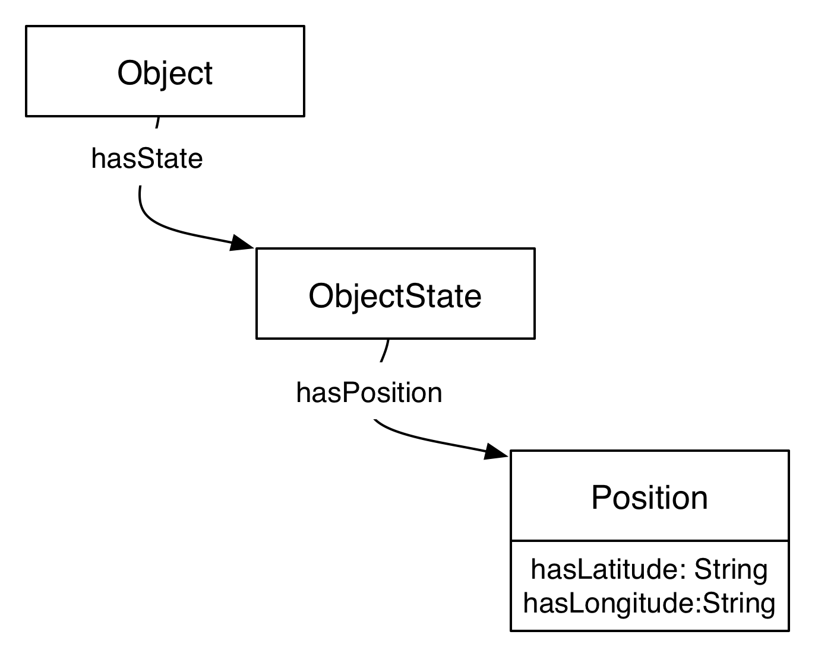
More complex example
BaseVISor (Abbreviated syntax)
<Individual rdf:type=”cn:Object" variable="Object1">
<cn:hasState>
<cn:hasPosition>
<cn:hasLatitude variable="PosLat1"/>
<cn:hasLongitude variable="PosLon1"/>
</cn:hasPosition>
</cn:hasState>
</Individual>
Jena, similarly in Jess
(?Object1 rdf:type cn:Object)
(?Object1 cn:hasState ?Object1State1)
(?Ojbect1State1 cn:hasPosition ?P1)
(?P1 cn:hasLatitude ?PosLat1)
(?P1 cn:hasLongitude ?PosLon1)

Slide 6

Procedural attachments
Expression
z = (a+b)*(c+d)
<bind variable="z">
<product>
<add><a/><b/></add>
<add><c/><d/></add>
</product>
</bind>
BaseVISor
sum(?a, ?b, ?z1)
sum(?c, ?d, ?z2)
product(?z1, ?z2, ?z)
Jena
Jess
(bind ?z (* (+ ?a ?b) (+ ?c ?d)))
Notes:
BaseVISor – explicit, flexible, but verbose
Jena – compact, succinct but binding implicit, not clear, temporary variables necessary
Jess – compact, flexible binding, but hard to read due to its prefix notation

Slide 7
User Experience
BaseVISor
  lengthy but explicit syntax
  flexible variable binding
  XML editing software support
  small user community
Jena
  succinct and easiest to read syntax
  limited variable binding
  rich but not intuitive API
  large user community
Jess
  not well suited for RDF processing
Notes:
BaseVISor
Converter Jena2Bvr
Jena
Nested binding not allowed
Implicit binding is harder to read, requires use of documentation
Jess
problem with namespaces
lack of understanding of parts of RDF graph – not optimized for it
harder to write procedural attachments

Slide 8
Performance
Jess already compared [1]
Owlim [2] used as a reference point
Reasoner | Axioms
BaseVISor | Subset or R-Entailment[3] rules
Jena | OWL_MEM_MICRO_RULE_INF
Owlim | owl-max
[1] C. Matheus, K. Baclawski and M. Kokar: BaseVISor: A Triples-Based Inference Engine Outfitted to Process RuleML and R-Entailment Rules, ISWC 2006
[2] A. Kiryakov, D. Ognyanov and D. Manov: OWLIM – A Pragmatic Semantic Repository for OWL, WISE 2005 Workshops
[3] Herman J. ter Horst: Combining RDF and Part of OWL with Rules: Semantics, Decidability, Complexity, ISWC 2005
Notes:
Jess – already compared – much worse in time and space than BaseVISor—doesn’t take advantage of triple base, even though it’s also Rete algorithm
Preliminary test: Jena tested on LUBM(1,0) with one department, OWL_MEM_MICRO_RULE_INF the best results overall

Slide 9
Benchmark
Lehigh University Benchmark (LUBM) [4]:
  Provides ontology, 14 queries, data generator and tester
Sets of 1, 5, 10 and 20 universities
All in-memory, 2GB heap size
Test platform:
  2.16GHz, 3GB RAM, Mac OS X 10.5.4, Java 1.5.0_13
[4] Y. Guo, Z. Pan, and J. Heflin: LUBM: A Benchmark for OWL Knowledge Base Systems, Journal of Web Semantics 3(2), 2005, pp158-182

Slide 10

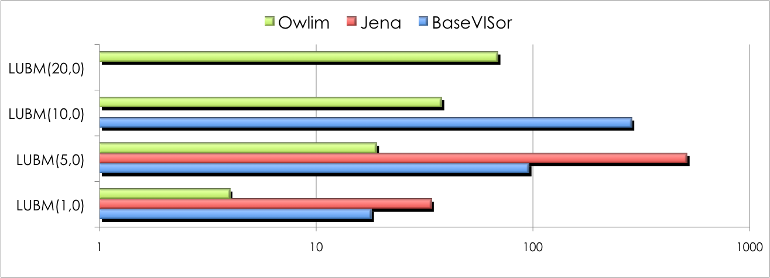

Load + inference time
[ms]
 | LUBM(1,0) | LUBM(5,0) | LUBM(10,0) | LUBM(20,0)
Approximate number of triples | 170k | 1m | 2m | 4.5m
Notes:
Memory: 2g

Slide 11
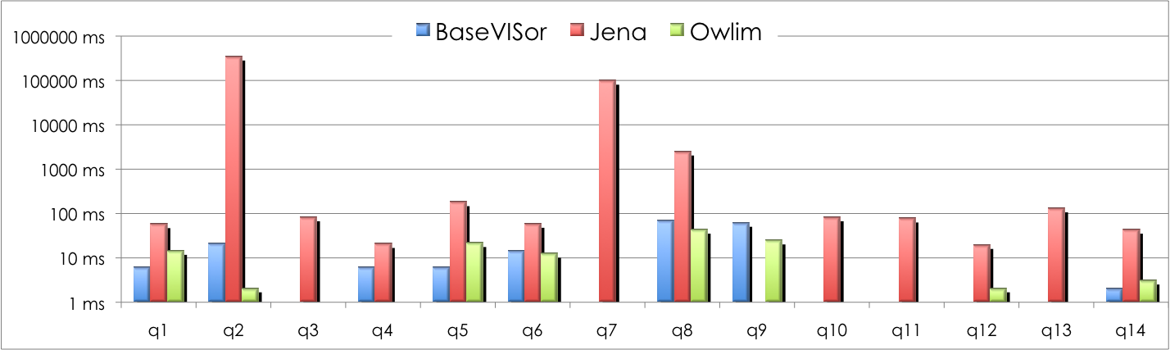

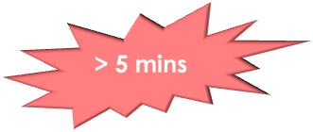
Queries: LUBM(1,0), 127k triples

Slide 12

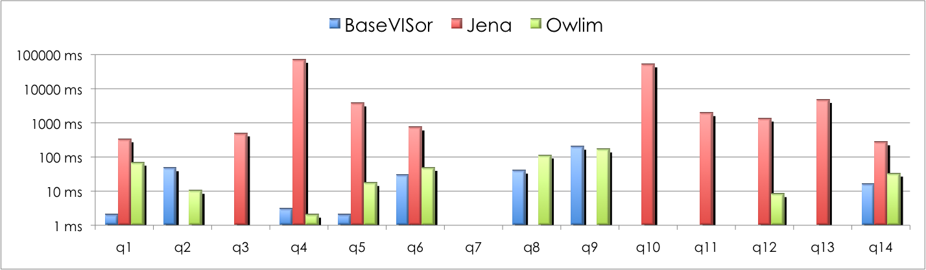

Queries: LUBM(5,0), 1m triples

Slide 13
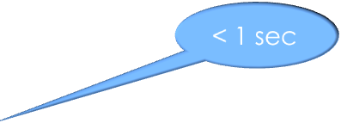
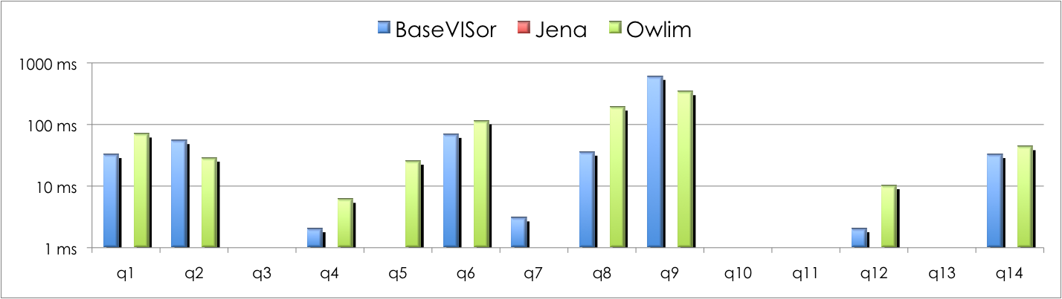
Queries: LUBM(10,0), 2m triples

Slide 14
Summary
BaseVISor:
  short load+inference time
  very fast query mechanism
Jena:
  less efficient storage
  not always efficient reasoning
Notes:
BaseVISor – use in-DB querying for larger triple stores

Slide 15
Thank you

