Slide 1


A RuleML Study on Integrating
Geographical and Health Information
S. Gao, D. Mioc, H. Boley, F. Anton, X. Yi

Slide 2
Outline
Introduction
Objective
Methodology
Implementation and Result
Conclusion

Slide 3
Introduction
Semantic Web improves machine understanding of
Web-based information
Ontologies and rules in Semantic Web
Given the growing number of diseases, health information
integration and retrieval becomes very important
Appropriate systems are needed to query and map health
information for eliminating the impact of disease outbreaks
Notes:
Point 1) Information on the internet, Semenantic Queries, Semantic Intergration and Semantic Analytics
Point 2) Specialization of Conceptualization
Ontology is an important notation but not all knowledge in an ontology
Using Rules can enhacnce the expressiveness of the ontology
Point 3) On slide
Slide 4) to achieve good health survilence followed by slide

Slide 4
Challenges
Health data are stored in heterogeneous ways
Health data representation
Notes:
Point 1) In health surveillance, efficiently integrating and deducing health information from different sources and flexible representing it is very important
the following challenges should be considered integrating information from different sources and representing them homogenously
First of all health data is collected by different organization using different tools or schemas, many kind of heterogeneities might existence in the data
Secondly Health data has the spatial, temporal (time), and the semantic component. Maps important tools in visualizations of health information. It can give health practitioners intuitive view of the health events.

Slide 5
Objectives
Create an ontology for spatial, temporal and
thematic health data query
Generate logic rules for semantic query
Support roll-up health data and visualization.
Notes:
These are the objects.
Create an ontology.
2) Reasoning is very important in implicitly information discovery. We will genereate the logic rules for semantic queries.
3) Health data should be able to roll-up from a low level to a high level and maps will be generated for visualization.

Slide 6
Methodology – Data description
New Brunswick Lung Association
Data
  NB_PATIENTINCIDENT
  NB_PROVINCE
  NB_HEALTH_REGION
  NB_CENSUS_DIVISION
  NB_PC3
Notes:
The Data used in this study are gathered from NB Lung Association.
Collects respiratory disease data.
The data contents – on slide.
NB_PATIENTINCIDENT – patient incident data, the hopsital they went to, hospital record
NB_PROVINCE – spatial boudny of the nb province
NB_HEALTH_REGION – helath regeion they are in
NB_CENSUS_DIVISION – census divsion
NB_PC3 – center location of postal code area of new brunswick

Slide 7
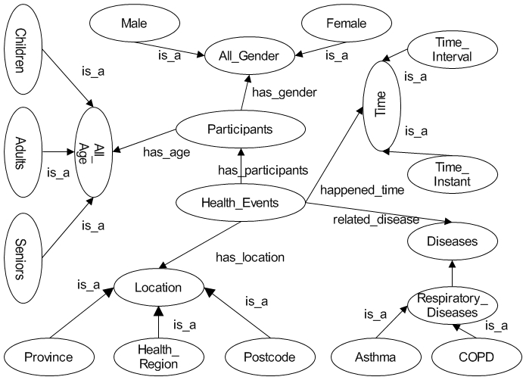
Methodology – Ontology design
Notes:
In the ontology design we focused on health events.
The following properties are association with health events are considered:
Health events –have properties disease and a location and time Participants of health event have properties Gender and Age
To represent the structure and properties of health events to related vocabulary is generated, this picture shows a part of the generated ontology.

Slide 8
Methodology–Knowledge representation
RuleML - de facto open language standard for Web
rules
Use RuleML to transcribe and refine our ontology as a knowledge base, consisting of facts and rules
Notes:
For deducing helath information we use RuleML.
RuleML is initiated by the Rule mark up initiative. Read defacto from the slides
Following the format of the RuleML we transcribe and refine our ontology as knowledge base consisting of facts and rules.

Slide 9

Implementation - Architecture
Reasoning Engine (OOJDREW)
Database
Facts
Rules
Ontology
Mapping
Engine
(Geotools)
Server
Files
Data
User
Interface
Request
Client
Notes:
Architeicture of implemented system.
the main components of the system contains three tiers, data tier, server tier, and client tier.
The georefernced health information can be stored in databases or files. Following our designed ontology, it can be imported to the server side as facts.
The reasoning engine in the server side utilize the facts and rules. Most of the facts are from the georefernced health information. Futher facts are genereated from spatial operations. Another important engine in the server side is the mapping engine which create thematic maps.
It joins the spatial data with the query results from the reasoning engine to generate classification maps.
The client side send the request to the server and get the thematic map back from the server.

Slide 10
Implementation – Facts
Location facts
inside(place1->E1V;place2->Health_Region_7).
…
Patient incident facts generated from the health information.
event(id->306947;
  disease->COPD;
  postcode->E1V;
  age->61:Integer;
  gender->Male).
…
Notes:
Location facts are generated from spatial operations and knowleges about administrative boundaries.
For instance, postcode e1v is inside health region 7.
Patient follow slides

Slide 11
Implementation – Facts
Disease facts
subclass(disease1->COPD; disease2->Respiratory_Disease).
…
Age facts
agerange(agetype->adults;age1->18:Integer;age2->64:Integer).
…
Notes:
Disease facts show the taxonomic inheretance of disease categoris.
Such as chronic obstructive pulmonary disease is a kind of respiratory diseases.
Age facts show the general notion of the range of each age group.

Slide 12
Implementation – Rules
Location relation rules
inside_closure(place1->?placeA;place2->?placeB) :-
  inside(place1->?placeA;place2->?placeB).
inside_closure(place1->?placeA;place2->?placeC) :-
  inside(place1->?placeA;place2->?placeB),
  inside(place1->?placeB;place2->?placeC).
Age rule
age(agetype->?agetype;agen->?agex:Integer) :-
  agerange(agetype->?agetype;
    age1->?age1:Integer;
    age2->?age2:Integer),
  greaterThanOrEqual(?agex:Integer,?age1:Integer),
  lessThanOrEqual (?agex:Integer,?age2:Integer).
Notes:
These are the rules.
Location relation rules show the transitive closure of the inside relations.
Age rules determine the age group certain age belongs to.

Slide 13
Implementation – Rules
Disease relation rules
subclass_closure(disease1->?diseaseA;disease2->?diseaseA).
subclass_closure(disease1->?diseaseA;
      disease2->?diseaseC) :-
  subclass(disease1->?diseaseA;disease2->?diseaseB),
  subclass(disease1->?diseaseB;disease2->?diseaseC).
Notes:
Disease relation rules show the reflexive and transitive closure of subclass relations, with a non-ground fact and rule.

Slide 14
Implementation – Rules
Disease_locator rule
disease_locator(id->?id;
  location->?location;
  disease->?disease;
  agetype->?agetype;
  gender->?gender) :-
  event(id->?id;
  postcode->?postcode;
  disease->?kindofdisease;
  age->?ageofid:Integer;
  gender->?gender!?),
  age(agetype->?agetype;agen->?ageofid:Integer),
  inside_closure(place1->?postcode;place2->?location),
  subclass_closure(disease1->?kindofdisease;
  disease2->?disease).
Notes:
Disease locator rules combine all the above rules to support the query of georefernced health information (contain the spatial location information, such as the location of disease outbreaks).

Slide 15
Implementation – Roll-up data
Determine health event location relationships with administrative boundaries
Use spatial operations
Notes:
From georefernce health data, some implicit information can be discovered. Using the spatial operation like point in polygon or polygon in polygon, we can determine health event location relationships with administrative boundaries

Slide 16
Implementation – Development kits
OOjDREW
A deductive reasoning engine for the POSL and RuleML, written in Java.
Geotools
An open source Java code library which provides
standards compliant methods for the manipulation of
geospatial data.
Notes:
Oojdrew and geotool are used as reasing engine and mapping engine respectively. Both are open source java libraries.

Slide 17
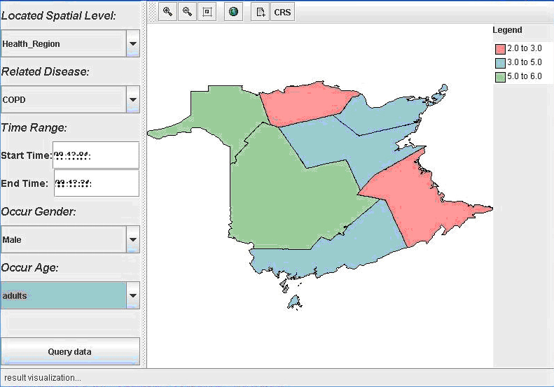
Result
health region level, COPD, male, and adults
Notes:
With the reasoing engine and mapping engine, health information can be retrieved by combining the deducing and spatial processes. The maps show the count results ( health regions level, copd, male and adults).
the health data can be visulized using different spaital levels, disease types, gender type and age group.

Slide 18
Conclusion
Designed an ontology to explore semantic query
of health information
Integrated rules in semantic reasoning of spatial
and thematic factors.
Supported health data roll-up and visualization
Future work will be on the optimization of spatial,
temporal and thematic reasoning.
Notes:
Conclusion
We Designed an ontology to explore semantic query of health information
Rules are Integrated in semantic health information query with the consideration of spatial and thematic factors.
health data roll-up can be roll up from a low level to high level and visualized
Future work will be on the optimization of spatial, temporal and thematic reasoning to build a rule-based health decision support system.

