Slide 1
SBVR Use Cases
RuleML ’08 - Orlando
October 31, 2008
Mark H. Linehan
mlinehan@us.ibm.com

Slide 2
Agenda
1 page introduction to SBVR
Modeling use cases
  Business modeling
  Requirements management
  Multi-lingual support
Transformation use cases
  Top down
  Bottom up
  Meet-in-the-middle
  Traceability
MDBT Top-Down Transformation
  Demo
Summary

Slide 3
Model Driven Architecture
A metamodel that captures the meaning of vocabulary & rules
Not a rule implementation language or engine
Expressed in “Structured English” or diagram or other forms
Example: Each Clerk may Validate each App, only if the App is paid and there is a test of the App.
Computation-Independent (Business) Model (CIM)
Semantics of Business Vocabulary & Rules
Business Vocabulary
Business Rules
?
Mapping
Platform-Independent Model (PIM)
Production Rules Representation
Forward chaining
Sequential Rules
RuleML
Family of related rule languages
Nouns, fact types (relationships)
Definitions – intensional & extensional; formal, partially formal, informal
Synonyms
Open vs closed world
Subsumption, structural, conceptual, and behavioral relationships
Reference schemes
Supporting material (examples, etc.)
etc.
Formulated using propositional & predicate logic
Alethic & deontic modalities
  Obligation
  Prohibition
  Necessity
  Impossibility
Objectifications
Exception rules
etc.
?
Rule Interchange Format
Rule exchange among implementations
UML Object Constraint Language (OCL)
Constraints and derivations
?
Mapping
Platform Specific Model (PSM)
Vendor-Specific Rule Languages
Other Implementation Techniques (e.g. Java, SQL, ...)
?

Slide 4
Business Modeling Example
customer
  Definition: one that purchases a commodity or service
  Source: Merriam Webster Collegiate Dictionary
customer submits order to company
  Definition: the customer transmits the order to the company
firm order
  Definition: order that is final
letter of intent
  Synonym: LOI
  Definition: order that is not final
  Note: A customer may submit an LOI to get a price quote, delivery schedule, or other terms of sale.
order
  Definition: customer request for items
order has item
  Necessity: Each order has at least one item.
A clerk may ship an order only if all the items of the order are in inventory.
  Synonymous Statement: No clerk may ship an order if an item of the order is not in inventory.
  Description: All parts of the order must be available in the warehouse before any of the order may be shipped.
  Enforcement Level: notify customer

Slide 5
Requirements Management Example
Initial Requirements (sample):
  Training costs are US$300 per student per course.
  All training material will be provided to student on first day of class
Some questions:
  Is a “course” the same thing as a “class”?
  Who provides the training material?
  Who pays the training costs?
Vocabulary (sample):
  class
  Synonym: course
  class has training material
  Synonymous Form: training material for class
  student enrolls in course
  student pays amount for course
Formalized Requirements (sample):
Each student enrolled in a course must pay $300 for the course.
Each school must provide all training material for a class to each student of the class on the first day of the class.

Slide 6
Example Top-Down Transformation
Computation-Independent (Business) Model (CIM)
Rule: Each order always has at least one item.
Vocabulary: ‘order has item’ is internally closed in order schema
Platform-Independent Model (PIM)
Platform Specific Model (PSM)
Database table structure, with referential integrity constraint
User Interface design, that prevents new orders with no items

Slide 7
SBVR Prototype in IBM Research “MDBT” Project
Computation-Independent (Business) Model (CIM)
Business Operation Model
Artifacts
Artifact lifecycles
User roles + tasks
SBVR rules
“Restricted permission” rules
Platform-Independent Model (PIM)
UML Model
Artifacts map to UML classes
Artifact lifecycles map to UML state machines
User roles + tasks map to use cases, views
Rules map to OCL constraints
Platform Specific Model (PSM)
Database Tables
Database Tables
Database Tables
Database Tables
Database Tables
Database Tables
Database Tables
Business State Machines
Service Data Objects
Java ™ Server Pages
Enterprise Java Beans
Java classes

Slide 8
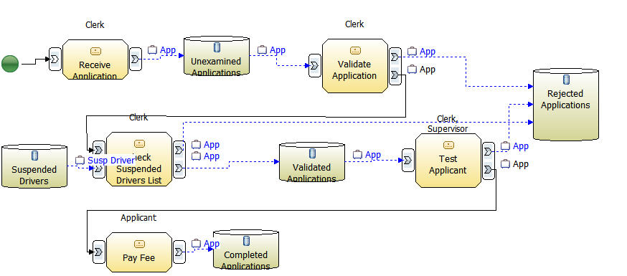
Artifact-Centric Business Modeling & SBVR
Rule pattern supported in prototype:
  Each <user role> may <verb> each <business artifact>, only if <some condition₁> [and/or/xor/…] <some condition₂] …
processing paths (understood as verbs): reject, pass
business artifact
user role

Slide 9
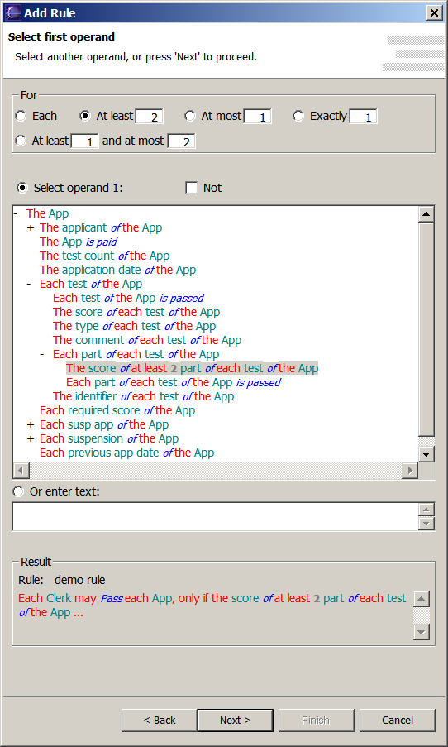
Demonstration – Wizard “Select Operand” Page
Area for specifying quantifications.
Checkbox for negating quantification tests.
Area for selecting vocabulary elements.
Field for entering literals.
See the rule you are building as you go.

Slide 10
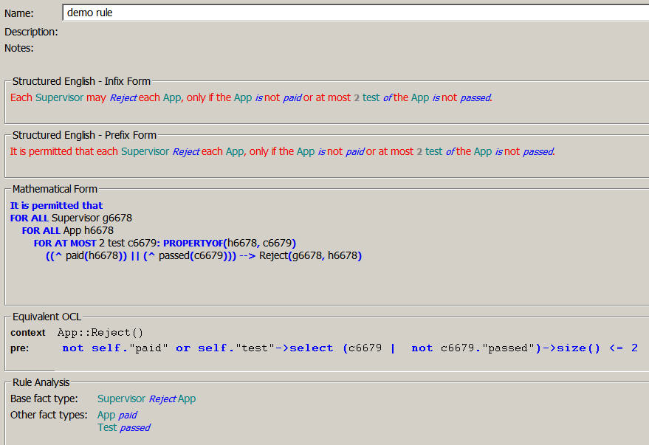
Rule View
The name of the rule, and other supporting information.
The rule in two forms of “Structured English”. “Infix” means the modality (e.g. “may” is embedded within the rule. “Prefix” form puts the modality (e.g. “It is permitted that” in front. Otherwise, these are equivalent.
A formatted version of the underlying XML, showing the predicate logic expression that captures the meaning of the rule.
The same rule transformed into UML’s Object Constraint Language (OCL).
An analysis of the relationships referenced by the rule.

Slide 11
Transforming SBVR Rules to Implementations
Each Clerk may Validate each App, only if the App is paid and there is a test of
the App.
State machine guards that use the Java method to determine whether the “validate” state transition is permitted for the “clerk” role
OCL
Context: App:: Validate()
pre: self.tests --> exists()
Java method that evaluates the condition and returns a boolean
JSP code that uses the Java method to determine whether to enable or disable the “validate” button for the “clerk” role
SDOs (“views”) that identify what information must be read from the database in order to evaluate the condition

Slide 12
Related Work
Bernstein & Kaufmann, GINO - A Guided Input Natural Language Editor
Fuchs & Schwitter, U. Zurich, ACE - Attempto Controlled English
Sowa, Common Logic Controlled English

Slide 13
Summary
SBVR is a new approach to knowledge representation
  The SBVR standard itself defines an “upper ontology”
  Combines established techniques from ontologies, propositional & predicate logic, modal logic
With the ability to display rules and vocabulary in “Structured English”
  A bridge between formal techniques and “human language like” representations
Complementary to implementation techniques
  e.g. RIF, RuleML, ...
  e.g. OWL
  e.g. rule engines such as Ilog, Blaze, DROOLS, ...
  e.g. traditional programming languages
  e.g. database constraints
Addresses a key aspect of “business architecture”
  But needs to be integrated with business process management techniques

