Slide 1

A Rule-based Notation to Specify Executable Electronic Contracts
  Massimo Strano, Carlos Molina-Jimenez, Santosh K. Shrivastava

Slide 2
Features of the EROP Language
Capable of dealing with the distributed nature of electronic business interactions.
High level, declarative approach.
ECA; but ordinary and exceptional situations are mapped on a small set of combinations of events.
Use of ROP Sets as synthesis of transaction history.
  ROP = Rights, Obligations, Prohibitions.
  Explicit manipulation of participants' ROP Sets.

Slide 3
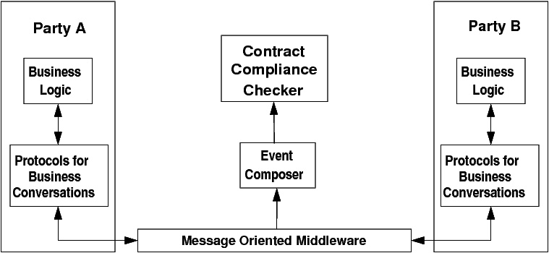
Overall Architecture

Slide 4
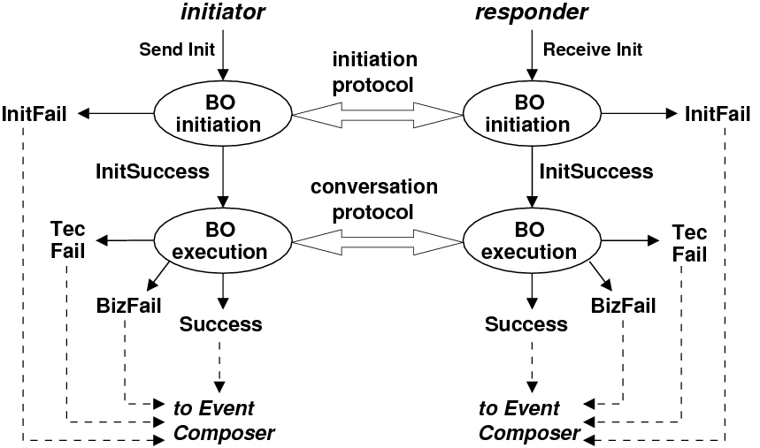
Execution of a Business Operation

Slide 5
Rules in the EROP language
when eventMatch [&& conditions]
then
action block
end
Conditions: constraints on ROP sets, event attributes or historical logs.
Actions: modifications of the ROP setsss.
Action blocks can be structured by event status using status guards (Success, TecFail, BizFail, InitFail).

Slide 6
Example
Clause: The Buyer's right to submit Purchase Order will be revoked after the Payment fails for business reasons three times.
when e is Payment && e.originator == buyer
&& count(happened(Payment, buyer, BizFail))>=2 then
BizFail:
buyer.rights -= POSubmission;
Otherwise: pass;
end

Slide 7
Final Remarks
Comprehensive model and language capable of dealing with business situations arising from the distributed nature of electronic business interactions.
Experimental implementation based on Drools
Further applications:
  Contractual Enforcement
  Monitoring of Service Level Agreements
  Role Based Access Control
Extended discussion: TR 1094, TR 1115 on
http://tinyurl.com/ncl-distgroup

