Slide 1



Semi-automatic Composition of
Geospatial Web Services using JBoss Rules
Raluca Zaharia, Laurentiu Vasiliu (DERI)
Costin Badica (UCV)
RuleML-2008,
October 31, Orlando.
University of Craiova

Slide 2
Overview
Motivation
Scenario
Semantic model
Execution
Results
Conclusions
University of Craiova

Slide 3
Motivation
Each domain has particular requirements
=> discovery, mediation, execution etc. stressed in a different way
A semantic framework (WSMO/L/X)
semantic descriptions modelled
unsatisfactory execution performance
  complex scenario
  large amount of data
Automation, generality vs. performance
=> Integrate a rule engine (JBoss Rules)
University of Craiova

Slide 4



Scenario
Average
consumption
Population
Consumption
(lat, long)
Quarries
Production
(lat, long)
Departments
Production-
Consumption
Map data
Population
Consumption
Quarries
Production
University of Craiova

Slide 5
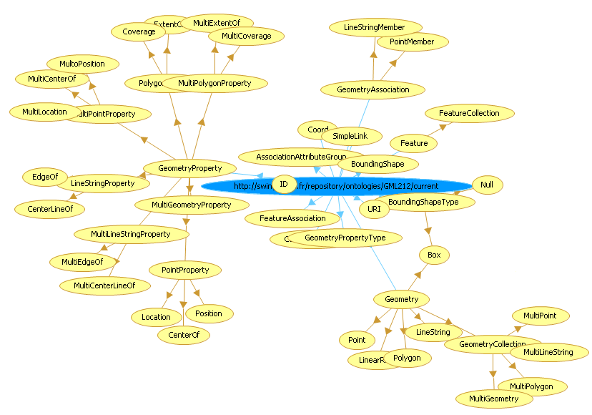


Semantic Model
Mediators
Ontologies
Goals
Web services
University of Craiova

Slide 6
Execution
Core
AdminWFS
QuarriesWFS
Communication Manager
Parser
Discovery
Data Mediation
Choreography Engine
Invoker
Passthrough
Resource Manager
WSMO2Reasoner Framework
WSMX
Web Services
University of Craiova

Slide 7
Execution
WSMX Execution Semantics
WSMX Choreography Engine
Requester Choreography
Provider Choreography
WSMX Invoker component
registerChoreography (goal)
initialize (state signature, choreography rules)
registerChoreography (WS)
initialize (state signature, choreography rules)
in Choreography Execution
updateState (R-to-P, instances)
update (instances)
step
instances to send
instances to send > 0
invokeWS (instance to send)
service response ontology
updateState (P-to-R, instances)
update (instances)
step
isProviderChorInEndState()
create response ontology
University of Craiova

Slide 8
Results
Surface size | Web services (Total duration) | Instances in the state ontology | Current implementation with reasoning tool
 |  |  | KAON2 | IRIS | JBoss Rules
1 department | 7 WS (3.84s) | 164 | 88.57s | 25.43s | 6.58s
2 departments | 12 WS (5.03s) | 321 | 174.5s | 41.48s | 8.938s
3 departments | 17 WS (6.89s) | 430 | 314.37s | 55.78s | 10.72s
14 departments | 72 WS (33.89s) | 2082 | 4231.41s | 442.32s | 56.40s
University of Craiova

Slide 9
Conclusion
Support for creation and execution of complex and flexible compositions
Service requester and service provider completely decoupled
An approach for generating the composition rules can used on top of the existing framework
ASM: simple and intuitive way of defining service compositions
“describe the requirements rather than telling the system step by step what to do”
University of Craiova

Slide 10
Conclusion
SWS techniques over real services from the geospatial domain => huge execution overhead introduced
Significant advantages of the approach
mandatory to improve the framework performance
JBoss Rules-based implementation is a fast and reliable reasoning and execution solution in SWS compositions
University of Craiova

