Slide 1
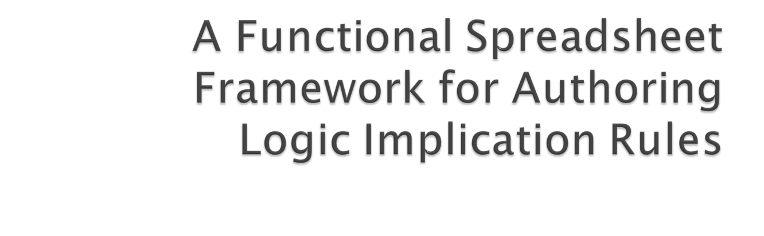
Marcelo Tallis and Robert M. Balzer
USC/ISI and Teknowledge Corp.

Slide 2

People who write programs for their own use but are not employed as programmers
They can be a teacher, engineer, physicist, secretary, accountant, or manager
End-user programmers outnumber professional programmers by more than an order of magnitude
The Spreadsheet is their programming language of choice
RuleML 2008 - Tallis and Balzer
10/30/2008

Slide 3
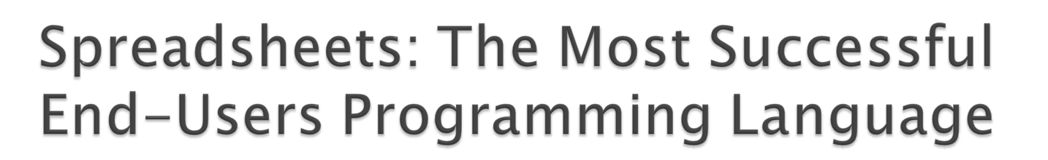
Spreadsheets: are functional programs in which spreadsheet cells are used as variables
Contributors to the spreadsheet success:
  Immediate feedback through formula evaluation
  Tabular grid format
  Reducing complexity by splitting formulas over different cells
  Values of variables are permanently displayed
RuleML 2008 - Tallis and Balzer
10/30/2008

Slide 4

Previous work (The Knowledge Engineering Review, Sept/07):
  Integrated deductive reasoning within Excel
  Based on OWL + SWRL implemented by KAON2 (kaon2.semanticweb.org)
  Mapped spreadsheet cells to Asserted or Entailed literals
  Referred an external Ontology (including SWRL rules)
Current work (RuleML 2008):
  Support for authoring Logic Rules as Spreadsheet Models
  Rule example:
  Mother(?X,?M) ^ Father(?X,?F) ^
  Mother(?Y,?M) ^ Father(?Y,?F) ^ different (?X,?Y)
  → Sibling(?X,?Y)
RuleML 2008 - Tallis and Balzer
10/30/2008

Slide 5

A PDW is a spreadsheet model that defines logic implication rules
The rule consequent has to be an OWL Property (i.e., a binary predicate, like Sibling)
A PDW is a spreadsheet model that given a value of the property domain (stored in a determined cell) computes a set of corresponding values of the property range
PDWs are automatically translated into SWRL rules and loaded into the deductive engine
PDWs use especial operators conceived specifically for defining properties
The design of this framework was driven by adopting spreadsheet characteristics that enhance end-users usability
RuleML 2008 - Tallis and Balzer
10/30/2008

