Slide 1
W3C rule interchange format
The production rule dialect
30 October 2008
Christian de Sainte Marie
csma@ilog.fr

Slide 2


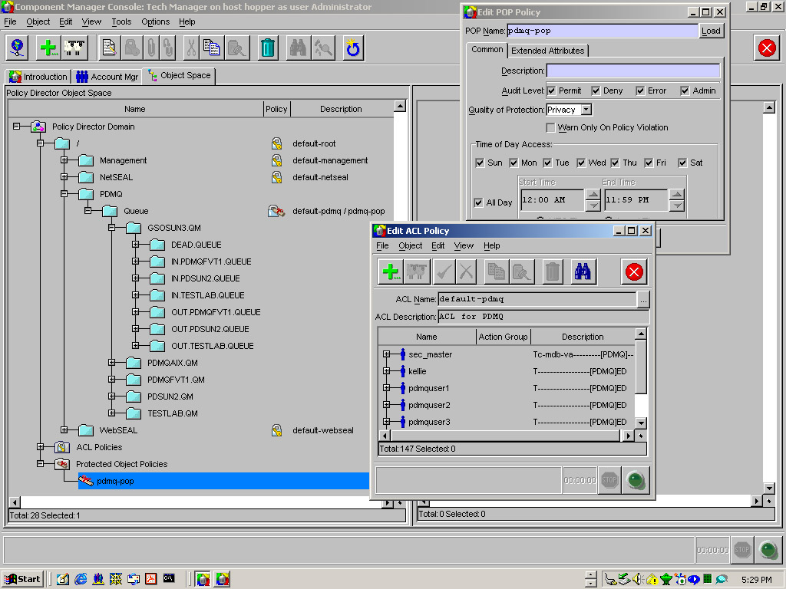
Rule interchange
Rules
Application A
<RIF doc>
Application B
Rules
serialize
de-serial.
Rules
Data model
(OWL, RDF-S, XML-S, XMI, …)
Rule system 1
Rule system 2
Data
<XML doc>
Data
serialize
de-serial.
data

Slide 3
What is the Rule Interchange Format?
Format for interchanging rules, so they can be used across diverse systems
A common XML serialisation for multiple rule languages
  allowing rules written for one application to be published, shared, and re-used in other applications and other rule engines.
  In a semantic preserving way (between languages with compatible semantics)
  Encouraging interoperability
  XML syntax
  Compatible with relevant standards (PRR, RDF, OWL, …)
A rule is (just another) data item
  RIF provides a standard means to feed rules into an application (at run time)
  Semantics to prescribe (intended) application’s behaviour

Slide 4
W3C RIF: Design issues
Very large number of rule users/use cases and types to satisfy!!!
  Many rule languages in use and 1,000,000’s of rules deployed
  Descriptive {OMG MDA level = CIM} VS executable rules {OMG MDA level = PIM & PSM}
  Logical (side-effect free) VS active (side-effect full) rules
  Data-oriented (SQL triggers, PR, …) VS proof-oriented (FOL…)
    All kinds of different data sources (DB, WM, OO, OWL, data streams…)
  Semantic Web VS non-SW usage
Simplicity VS coverage
Extensibility VS compliance VS interoperability
Executable (AST) VS human-readable syntax
…

Slide 5
Superset approach
RLi
RL2
RL1
RLn
RLj
superRIF

Slide 6
A common core…
RL2
RLi
RIF Core
RLj
RL1
RLn

Slide 7
…and standard dialects
RL2
RLi
RIF dialect
RIF dialect
Core
RIF dialect
Core
RIF dialect
Core
RLj
RL1
RLn

Slide 8
Separate families + Core
IRL
RIF PRD
Core
RIF BLD
Core
RLj
JBoss
RLn

Slide 9
Separate families + Core
Define a logic-based core and a separate production-rule core
  @version 0.1: BLD LC (July 08)
  @version 0.0.1: PRD FPWD (July 08)
If there is an intersection, define the common core (which may possibly be just a syntax)
  @version 0.0.1: Core FPWD (November 08?)
Define a framework in the form of a menu of syntactic and semantic features that can be combined into dialects
  @version 0.0.9: FLD LC (November 08?)

Slide 10
Design principles
Translation paradigm
  Serialize, deserialize
  No intrusion in covered rule languages and rule sets
Same semantics ⇔ same syntax
  Share constructs accross dialects wherever they agree on the semantics
  Different constructs where semantics do not agree
Fully striped XML (type-tagged, object-oriented, …)
  alternating Class and role tags
  Metadata can be attached to any class element
Only XML schema is normative
  Presentation syntax added for specification’s readability (examples, semantics etc)
Principles are there so you can rest on them…until they break

Slide 11
Production rules
If condition then action
  Logical rule: « if condition then condition »
Production rules change the facts
  Logical rules only add knowledge
  Non-monotonic
  If not(P(?x)) then P(?x)
Examples
  If a work item has not been processed, then process it
  In order to grant access a buyer must provide valid credit card information together with valid delivery information
    Forall ?buyer
    Forall ?card ?address
    such that (?buyer[ex:creditCard->?card
    ex:deliveryAddress->?address])
    if ex:validAddress(?address) and ex:validCreditCard(?card)
    then Execute(ex:grantAccess(?buyer))

Slide 12
PRD syntax
Production rules
  FOR <variables> WITH <binding patterns>,
  IF <condition> THEN <actions>
  FORALL Var* (actions :- And(patterns, condition))
Patterns and condition
  Conjunction, disjunction, negation, existentials
  Relations, frames (and objects), membership, subclass
  XML Schema data types and builtins (RIF-DTB)
  internationalized resource identifiers (IRIs) as identifiers
  RIF-BLD condition language minus logic functions plus negation
Assert, Retract, New
  Assign, Modify, Execute
Rules occur in Groups
Groups occur in Documents
  or in other groups
Metadata can be attached to any class element

Slide 13
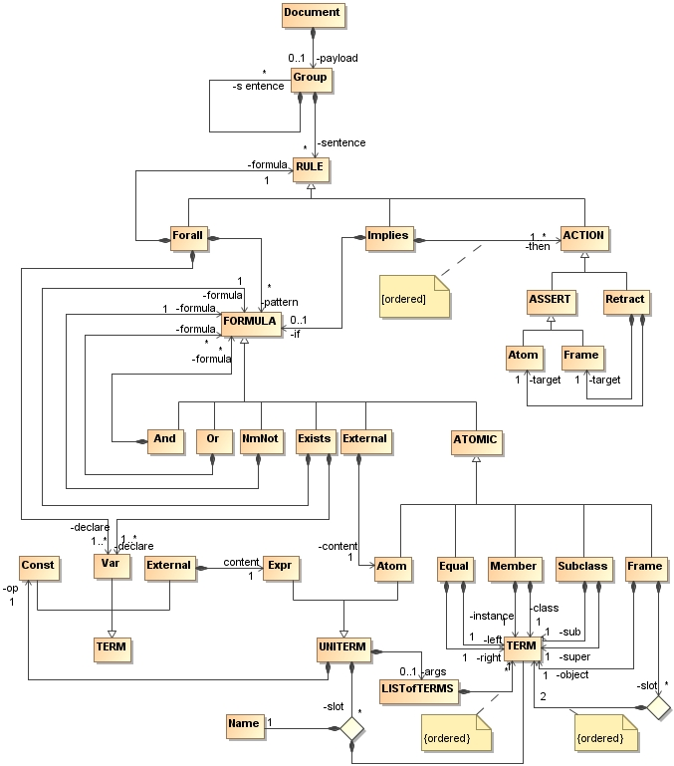
PRD syntax

Slide 14
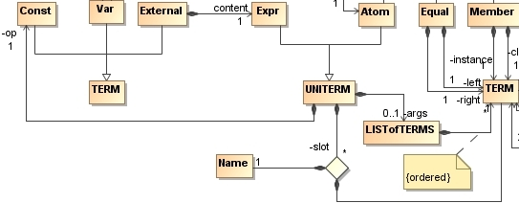
TERM
<Const type=xsd:anyURI [xml:lang=xsd:language]? >
Any Unicode string
</Const>
<Var> any Unicode string </Var>
<External><content><Expr><op> Const </op>
<args rif:ordered="yes"> TERM* </args>?
</Expr> </content> </External>

Slide 15
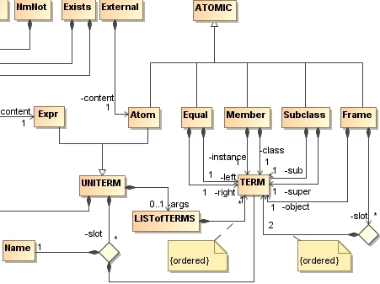
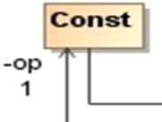

ATOMIC

Slide 16
ATOMIC
jim:owns(?c ?p)
  <Atom>
  <op>
  <Const type="rif:iri">http://rif.examples.com/2008/jim#owns</Const>
  </op>
  <args rif:ordered="yes">
  <Var> ?c </Var>
  <Var> ?p </Var>
  </args>
  </Atom>
?c.age -> ?a
  <Frame>
  <object> <Var> ?c </Var> </object>
  <slot rif:ordered="yes">
  <Const type="rif:iri"> ttp://rif.examples.com/2008/jim#Chicken/age </Const>
  <Var> ?a </Var>
  </slot>
  </Frame>

Slide 17
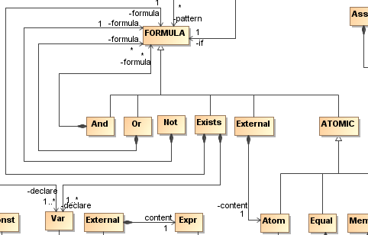
FORMULA

Slide 18
FORMULA
Exists Chicken(age>8)
  <Exists>
  <declare> <Var> ?c </Var> </declare>
  <declare> <Var> ?a </Var> </declare>
  <formula>
  <And>
  <Member> ?c jim:Chicken </Member>
  <Frame> ?c.age=?a </Frame>
  <External>
  <content>
  <Atom>
  <op> <Const type="rif:iri"> op:numeric-greater-than</Const> </op>
  <args rif:ordered="yes">
  <Var> ?a </Var>
  <Const type="xsd:decimal"> 8 </Const>
  </args>
  </Atom>
  </content>
  </External>
  </And>
  </formula>
  </Exists>

Slide 19
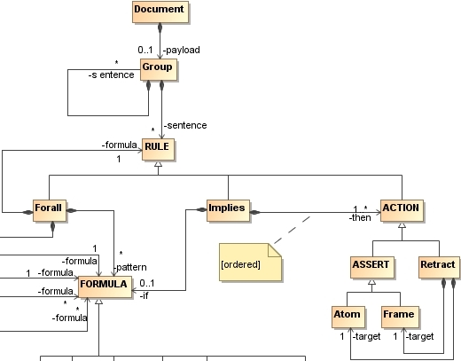

RULE etc

Slide 20
RULE
When
?c Chicken(age==8)
evaluate(today()=’’Monday’’)
Then …
<Forall>
  <declare> <Var> ?c </Var> </declare>
  <pattern>
  <And>
  <Member> ?c jim:Chicken </Member>
  <Frame> ?c.age=8 </Frame>
  </And>
  </pattern>
  <formula>
  <Implies>
  <if> <External> today()=’’Monday’’ </External>
  <then> … </then>
  </Implies>
  </formula>
  </Forall>

Slide 21
Metadata
<CLASSELT>
  <id> Const </id>?
  <meta>
    [ Frame
    |
    <And>
      <formula> Frame </formula>*
    </And> ]
  </meta>?
  other CLASSELT content
</CLASSELT>
<Forall>
<id><Const type="rif:iri“>jim:CMP</Const></id>
<meta><Frame>
<object ><Const type="rif:iri“>
jim:CMP
</Const>
</object>
<slot rif:ordered=“yes">dc:creator csma</slot>
<slot rif:ordered=“yes">…</slot>
…
</Frame>
</meta>
<declare> <Var> ?c </Var> </declare>
<pattern>…</pattern>
<formula>…</formula>
</Forall>

Slide 22
PRD semantics
Patterns and conditions have a model-theoretic semantics (compatible with BLD)
Groups of production rules have an operational semantics as a labelled transition system
Actions define the transition relation
Metadata has no semantics

Slide 23
Condition satisfaction and matching substitution
A set of ground formulas Φ = {φ1, ..., φm}, m ≥ 1 satisfies a condition formula ψ iff
  Φ |= (Exists ?v0 ... ?vn (ψ)), where {?v0, ..., ?vn}, n ≥ 0 = Var(ψ)
Let ψ be a condition formula; let σ be a ground substitution for the free variables of ψ, that is, such that: Var(ψ) ⊆ Dom(σ); and let Φ be a set of ground formulas that satisfies ψ. We say that σ is matching ψ to Φ (or simply, matching, when there is no ambiguity with respect to ψ nor Φ) if an only if, for every semantic structure I that is a model of all the ground formulas φi in Φ, there is at least one semantic structure I*, such that:
  I* is a model of ψ: I* |= ψ;
  I* is exactly like I, except that a mapping I*V is used instead of IV, such that I*V is defined to coincide with IV on all variables except, possibly, on the variables ?v0 ... ?vn that are free in ψ, that is, such that: Var(ψ) = {?v0 ... ?vn};
  I*V(?xi) = IC(σ(?xi)), for all ?xi in Var(ψ).

Slide 24
Operational semantics
→RIF-PRD : w → w’
  w → w’: w' |= φ if and only if And(w, f) |= φ
→RS : w → w’
  actions = extractACTIONS(PICK(instances(w), strategy))
  (w, actions, w’) in →*RIF-PRD
  instance(w') = {(r σ) | r ∈ RS and σ is matching w}
  w ∉ TRS
Halts iff FINAL(c, RS)
  FINAL(w, RS) if PICK(w, strategy) = {}
action
Assert(f)
actions

Slide 25
What’s next?
Non-equality accessors?
  ?c.age>8
Aggregates?
  Collect
Specification of externally defined data model?
  Issue-37: Interoperation with object-oriented XML (using XML Schema, like JAXB)
  OXL+RDF compatibility
Typed variables?
Anonymous frames?
  For use in Exists (and Notexists)
External data sources?
  From
User-defined extensions
  User-defined data types, external functions/methods/predicates
  User-defined constructs/features

Slide 26
Conclusion
If you want RIF (PRD) to suit your needs, get involved
  Read the public drafts and comment
  Read the mailing list, and comment
  Join the WG and attend the weekly telecon and ~quaterly F2F
  Become a co-editor of the specification
Also…
  Propose test cases
  Implement
  Comment, comment, comment…
    public-rif-comments@w3.org
Schedule
  2nd public working draft: November 2008
  Last Call: May 2009

Slide 27
Credits
PRD Editors
  Christian de Sainte Marie (ILOG), Adrian Paschke (FUBerlin), Gary Hallmark (ORACLE)
BLD and FLD Editors
  Michael Kifer (U. Stonybrook), Harold Boley (NRCC)
DTB Editors
  Axel Polleres (DERI Galway), Michael Kifer (U. Stonybrook), Harold Boley (NRCC)
SWC Editor
  Jos de Bruijn (FUB)
Active WG members
  Adrian Paschke (FUBerlin), Axel Polleres (DERI), Dave Reynolds (HP), Gary Hallmark (ORACLE), Hassan Aït-Kaci (ILOG), Igor Mozetic (JFI), John Hall (OMG), Jos de Bruijn (FUB), Leora Morgenstern (IBM), Mike Dean (SRI), Stella Mitchell (IBM), Changhai Ke (ILOG), Stuart Taylor (U Aberdeen), Paul Vincent (Tibco), Mark Proctor (Red Hat)
WG Team
  Chris Welty (IBM), Christian de Sainte Marie (ILOG), and Sandro Hawke (W3C/MIT)

Slide 28
Thank you!
Questions?
http://www.w3.org/2005/rules/wiki/RIF_Working_Group
http://www.w3.org/2005/rules/wiki/PRD

Slide 29
Rules interchange
Is good for compliance
Policy compliant
organisation
(regulated)
Compliance
organisation
Policy setting
organisation
(regulator)
Specifies operational interpretation of rules (PIM level)
Merges rules from relevant sources
Implements rules
(PSM level)
specifies rules
(CIM level)
Implements rules
Implements rules
Implements rules
Implements rules

Slide 30
Differences: RIF vs PRR
PRR: a rule is (just another) class in a model
  PRR provides a standard means for including rules into the model of an application (at design time)
  PRR OCL to constrain allowed instances (objects) at runtime
RIF: a rule is (just another) data item
  RIF provides a standard means to feed rules into an application (at run time)
  Semantics to constrain allowed data to which rule applies (models)
PRR focused on 1 rule type based on existing use
  Generic model defined for extensibility
RIF intended to cover many rule types and uses
  Dialects defined for implementability

Slide 31
Differences: RIF vs PRR
Application A
<RIF doc>
Application B
Rules
maps
maps
Rules
Rule system 1
Data
Data
Rule system 2
Domain specific vocabulary
Modelling tool x
<XMI doc>
Modelling tool y
maps
maps
Includes application object model and PRR model of rules

Slide 32
JSR 94 – Java Rule Engine API
Defines a Java API for rule engines
  Targeting the J2SE platform
  Prescribing a set of fundamental rule engine operations
Status
  Final specification released August 04
  Integrated by SUN into the JDK
  Integration with the Java Open Source Spring framework
  40+ Open Source and commercial implementations
    E.g. ILOG JRules, Fair Isaac Blaze Advisor, Yasutech QuickRules, Jess, Drools, Computer Associates, OpenRules
Issues
  Specification does not define the behavior of the engine
  No underlying rule language

