Slide 1






A Rule Based System for Semantical Enrichment of Building Information Exchange
Tarcisio Mendes de Farias, Ana Roxin and Christophe Nicolle

Slide 2

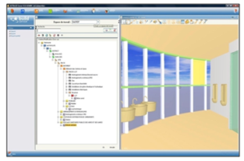

Introduction
BIM
Plan & Design
Facility Management
Building Construction

Slide 3



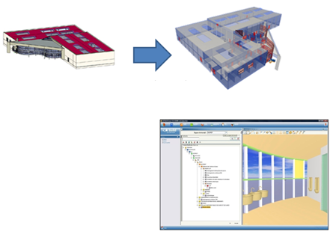
Introduction
Standardization of BIM: interoperability through IFC files
Generation of the Facility Management BIM
Architect Plan
IFC export
BIM in Active3D

Slide 4
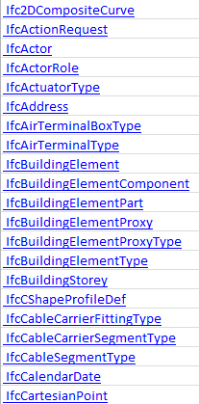

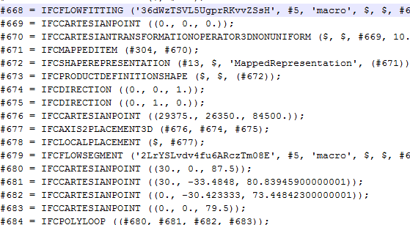

Introduction
Extraction of a subgraph of entities from the IFC file(s) related to a business process.
Manuel and fastidious process
Plumbing View
Architect View
- More than 800 entities
- Vocabulary and data structure is not easily understandable

Slide 5
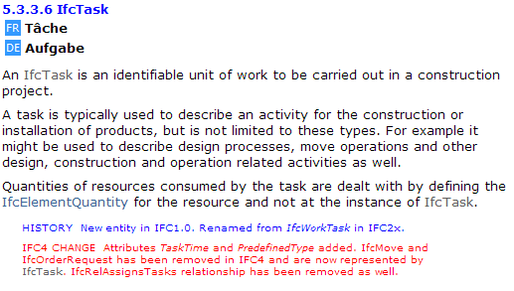
Introduction
Modification or creation of entities and roles
Incompatibility with applications based on an old IFC version;
An application based on a new version of the IFC standard can be not fully backward compatible.

Slide 6


Semantic Web
Web of data
For humans and machines
Based on the standard representations and formal resources
Definition of an ontology by :
“Ontology is a term borrowed from philosophy that refers to the science of describing the kinds of entities in the world and how they are related.”
An ontology comprises:
TBox
ABox

Slide 7


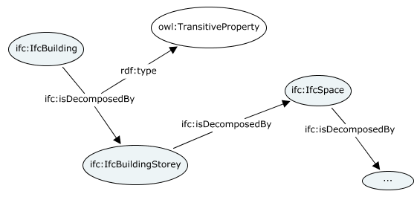
Semantic Web
OWL is a language for defining and instantiating Web ontologies (classes, properties and instances)
Management of the semantic interoperability
Inference capacity (DL-based)
SWRL is a rule language that complements DL-based languages.
Reasoning problems involving data.

Slide 8
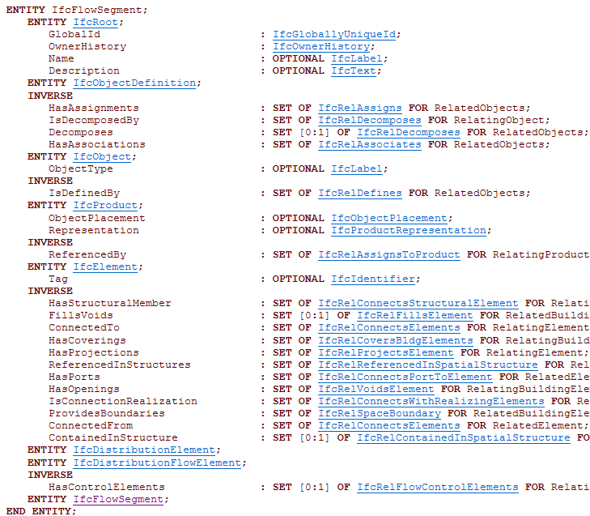
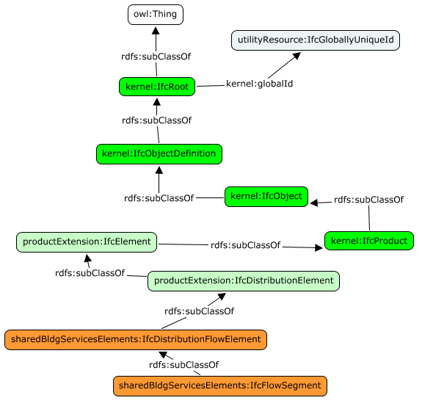
Related Works: Ifc Ontology
Beetz et al. propose a semi-automatic conception of an IFC ontology
IFC to OWL
Defined types are not well translated on OWL
Express LIST is translated as OWL List
Beetz, J., Leeuwen, J. V., & Vries, B. (2009). IfcOWL: A case of transforming EXPRESS schemas into ontologies. Artificial Intelligence for Engineering Design, Analysis and Manufacturing (AI EDAM) , 89-101.

Slide 9
Related Works: Ifc Ontology
Pauwels et al. deal with the interoperability of 3D information from IFC to X3D and SLT
N3 Logic rules applied to IfcOWL
Pauwels, P., Van Deursen, D., De Roo, J., Van Ackere, T., De Meyer, R., Van de Walle, R. & Van Campenhout, J.: Three-dimensional information exchange over the semantic web for the domain of architecture, engineering, and construction. Artificial Intelligence for Engineering Design, Analysis and Manufacturing, 25(4) 317-332 (2011).

Slide 10
Related Works: Ifc Ontology
The enrichment of the IFC model without compromising the system interoperability
Allowing coexistence of data from different versions of IFC files
Notes:
There are not works which point out

Slide 11
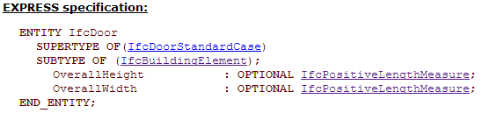
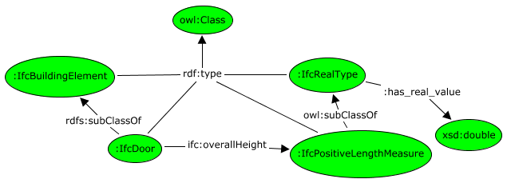
CONCEPTION OF IFC ontology
IFC 2x3 EXPRESS specification to OWL
Translations rules based on IfcOWL
IFC Entity => OWL Class
IFC Attribute => OWL Property
IfcOWL Structure

Slide 12
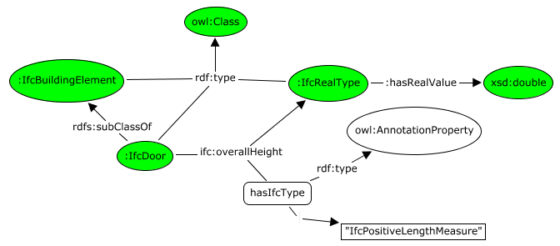
CONCEPTION OF IFC ontology
IfcOWL Modified: Defined types (117)
Merge Defined Types that have the same data type in one class
(i.e.: IfcVolumeMeasure, IfcAreaMeasure, IfcPositiveLengthMeasure are real values)
Some Defined Types are indeed enumerations
IfcTextAlignment is mapped as the data property hasTextAlignment rdfs:range {“left”, “right”, “center”, “justify”}.

Slide 13
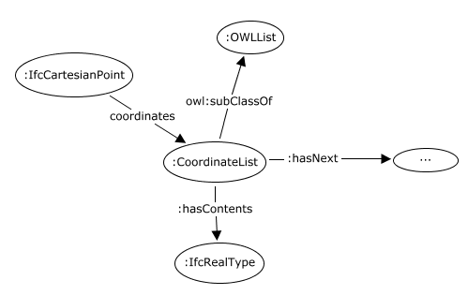
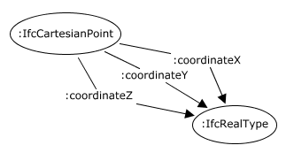
CONCEPTION OF IFC ontology
IfcOWL Modified: Collections
If the order is not important, a collection (LIST) is mapped as values of a non-functional OWL property
If the order is important different properties are created

Slide 14
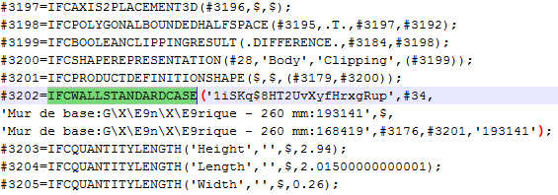
CONCEPTION OF IFC ontology
Populating the so-built Tbox with information from IFC files
One repository per IFC file
Instances

Slide 15
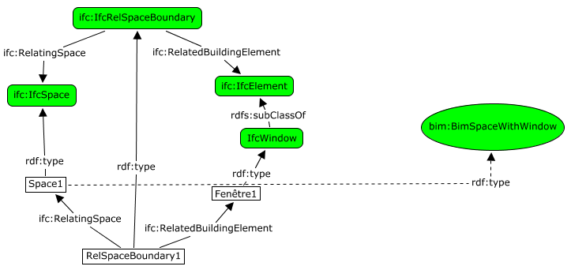
SWRL RULES TO handle IFC files
Defining novel concepts as used by AEC/FM actors by means of SWRL rules
Concepts
SWRL
Instances
SWRL Rule
:IfcRelSpaceBoundary(?x) & :IfcSpace(?y) & :IfcWindow(?z) & :RelatedBuildingElement(?x, ?z) & :RelatingSpace(?x, ?y) ⇒ bim:BimSpaceWithWindow(?y).
Notes:
Mitigate the semantic heterogeneity
The implicit information becomes explicit
Full compatibility with IFC
For example: A facility manager that needs to plan the cleaning of all windows

Slide 16
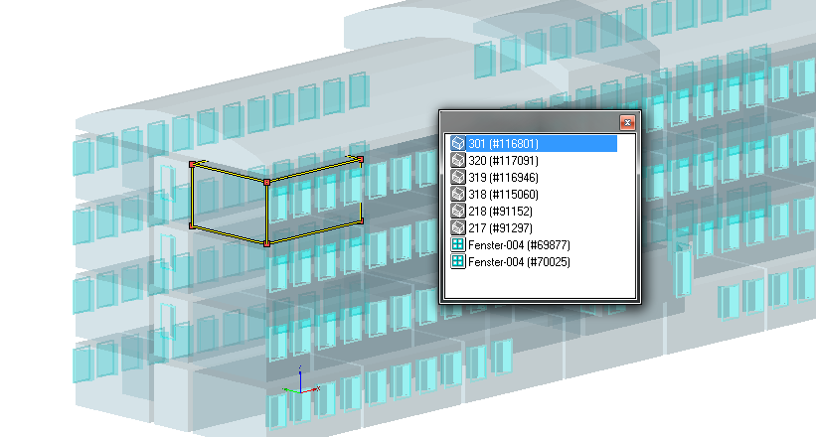
SWRL RULES TO handle IFC files
Before adding the SWRL rule
After adding the SWRL rule

Slide 17
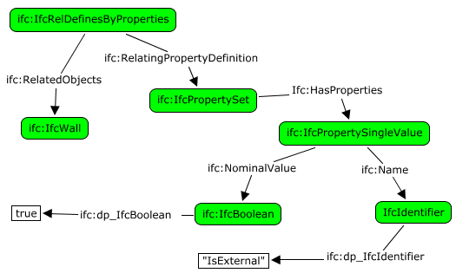

SWRL RULES TO handle IFC files
Simplifying the writing of SPARQL queries
Define a more fine-grained ontology
SELECT ?externalWall WHERE {
? externalWall a ifc:IfcWall.
?o a ifc:IfcRelDefinesByProperties;
ifc:RelatedObjects ? externalWall ;
ifc:RelatingPropertyDefinition ?pSet.
?pSet a ifc:IfcPropertySet;
Ifc:HasProperties ?p.
?p a ifc:IfcPropertySingleValue;
ifc:Name ?name.
?name ifc:dp_IfcIdentifier "IsExternal".
?p ifc:NominalValue ?val.
?val a ifc:IfcBoolean;
ifc:dp_IfcBoolean "true"^^xsd:boolean}

Slide 18
SWRL RULES TO handle IFC files
With this SWRL rule on top of our TBox:
ifc:HasProperties(?a, ?x) & ifc:NominalValue(?x, ?z) & ifc:Name(?x, ?y) & ifc:RelPropertyDefinition(?b, ?a) & ifc:RelObjects(?b, ?c) & ifc:IfcWall(?c) & ifc:dp_IfcBoolean(?z, true) & ifc:dp_IfcIdentifier(?y, "IsExternal") ⇒ :BimExternalWall(?c).
We simplify the previous query as follow:
SELECT ?externalWall WHERE { ?externalWall a :BimExternalWall.}.

Slide 19
SWRL RULES TO handle IFC files
Dynamic handling of the IFC standard’s evolution
Various versions of IFC standard were deployed
Not fully backward and upward compatible
The ontology conceived is based on IFC2x3 standard
Interoperability among different IFC versions

Slide 20
SWRL RULES TO handle IFC files
Backward compatibility:
IFC2x4 version has added the entity IfcPipeSegment as a subclass of the entity IfcFlowSegment
“pipe segment” concept is implicit in IFC2x3
:IfcFlowSegment(?a) & :IfcDefinesByType(?b) & :RelatedObjects(?b,?a) & :RelatingType(?b,?c) & :IfcPipeSegmentType(?c) ⇒ ifc4rc2:IfcPipeSegment(?a).
Upward compatibility
IFC2x4 RC2 deletes IfcAnnotationSymbolOccurrence
Still, its superclass IfcStyledItem has been preserved
ifc:IfcStyledItem(?x) & ifc:Item(?x, ?y) & ifc:IfcDefinedSymbol(?y)⇒ ifc:IfcAnnotationSymbolOccurrence(?x).

Slide 21
Conclusion
Conception of a more suitable IFC ontology based on IfcOWL
Benefits of applying SWRL rules to handle IFC files
Separate the BIM data structure model (e.g.: IFC) from its semantics
Increase the data model expressivity without compromising the interoperability made by IFC files
Increase the interoperability of information exchange among stakeholders.
Rule-based system that aims at easing the processes and the information exchanges related to AEC/FM
Notes:
Minimizes the loss of data

Slide 22
Future Works
Comparison of SWRL rules syntax to other ones
Checking for inconsistencies or ambiguity by introducing new rules
Rule Interchange Format (RIF);
N3 Logic.

