Slide 1
Learning Business Rules with Association Rule Classifiers
Tomáš Kliegr^{1,4}, Jaroslav Kuchař^{1,2}, Davide Sottara³, Stanislav Vojíř¹
¹ Dep. of Inf. And Knowl. Eng., University of Economics, Prague
² Web Engineering Group, Czech Technical University
³ Biomedical Informatics Department, Arizona State University
⁴ Multimedia and Vision Research Group, Queen Mary, University of London

Slide 2

Motivation example
BRMS
Iris ???
Iris versicolor
RESTRICTION: In this paper, we focus on “classification business rules”.

Slide 3

Problem statement
With Business Rule Management System (BRMS) applications can invoke decision logic which is input in the form of rules, instead of procedural code
Knowledge base
Domain experts
petalWidth>1.75
iris-virginica
+ This reduces reliance on the IT experts
petalLength=[2.45;4.75] and
sepalWidth = [3.05;3.4]
…
iris-versicolor
Requires extensive subject matter expertise
(A lot of) Expert time
Rule Engine
Iris ???
Iris versicolor
RESTRICTION: In this paper, we focus on “classification business rules”.

Slide 4
Problem statement
Rule Learning
Database
Ideally, the rule learning algorithm executed on the database of iris varieties would substitute the human expert.
Knowledge base
petalWidth>1.75
iris-virginica
As we will see, rule learning algorithms often yields rule sets that are
Conflicting
Contain redundant rules
Excessive number of rules
Syntactically simple
Probabilistic
petalLength=[2.45;4.75] and
sepalWidth = [3.05;3.4]
…
iris-versicolor
Rule Engine
Iris versicolor

Slide 5
Problem statement
Conflicting
Contain redundant rules
Excessive number of rules
Syntactically simple
Probabilistic
R1: petalWidth>1.75
iris-virginica,
supp= 0.296, conf=1
R2: petalWidth>1.75 and
sepalWidth = [3.05;3.4]
…
R9: sepalLength= (5.55;3.40] and
sepalWidth<3.05
… 50 more rules
iris-virginica
supp= 0.100, conf=1
iris-versicolor
supp=0.230, conf=0.05
While this is not an issue for a completely automated “black box” classifier, in a business setting the policy can be that the rule set
is expert-reviewed before deployment,
each decision made by the system can be explained,
the rules must be convertible to a form that can be processes by BRMS
Notes:
Petal width

Slide 6
BR Learning Requirements
Rule Learning
Database
Business rule learning needs a rule-learning approach, which has
BRMS supported rule expressiveness
Syntactically rich
Small number of output rules
Exhaustive set of rules
Ability to control rule quality
Knowledge base
Edit
BRMS can then take care of
Refine the rule base (by Subject Matter Expert)
Execute rules
Classify objects at run time
Evaluate complex criteria
Handle uncertainty
Manage rule conflicts
Defeasible logic, higher order rules, …
Rule Engine
Iris versicolor

Slide 7
Choosing “base” classifier
Business rule learning needs a rule-learning approach, which has
BRMS supported rule expressiveness
Small number of output rules
Exhaustive set of rules
Expressive rule language
Rule conflict resolution
Ability to control rule quality
Multiple rule learning algorithms have been proposed.
Focus on algorithms which match our criteria, but are additionally scientifically well established and with tried open implementations.
Two algorithms were shortlisted:
RIPPER (Cohen 1995): 3017 citations in Google scholar. Available in the open source WEKA and RapidMiner systems.
CBA (Liu et al., 98): 1968 citations GS. Based on apriori, which is available in most data mining systems.
Eventually, we have settled for CBA
in our experiments processing large datasets (N>10k) with RIPPER was unfeasible (JRIP - WEKA and RapidMiner impl.).
CBA better fits the BR learning usecase
Better rule quality control
Exhaustive searchh
CLEF NewsReel’14
21.000 instances 1671 class labels
Notes:
CLEF – NewsReel (21.000 instances), JRIP>12h (many target class values)

Slide 8
Classification based on Association Rules
CBA generally proceeds as follows:
Rule Generator
Mining of Class Association Rules based on Apriori
Classifier Builder
v1 – many passes over the data
Sort Rules (conf, supp, earlier)
Pruning
For each rule iterate over all data
v2 – find best rule for each data case
Sort Rules
Preselecting of rules based on precedence
Add candidate rules filtered out due to the lower precedence, improve coverage
Final filter by total error + default class
Business rule learning needs a rule-learning approach, which has
BRMS supported rule expressiveness
Small number of output rules
Exhaustive set of rules
Expressive rule language
Rule conflict resolution
Ability to control rule quality
Business rule CBA (brCBA)
CBA (Liu et al., 98) nearly matches the requirements of BR learning

Slide 9
Why brCBA?
CBA has three rule pruning steps
Difficult to track why a specific rule was removed
Business rule learning needs a rule-learning approach, which has
BRMS supported rule expressiveness
Small number of output rules
Exhaustive set of rules
Expressive rule language
Rule conflict resolution
Ability to control rule quality

Slide 10
Why brCBA?
CBA has three rule pruning steps
Difficult to track why a specific rule was removed
CBA learns conjunctive rules
Business rule learning needs a rule-learning approach, which has
BRMS supported rule expressiveness
Small number of output rules
Exhaustive set of rules
Expressive rule language
Rule conflict resolution
Ability to control rule quality

Slide 11
Why brCBA?
CBA has three rule pruning steps
Difficult to track why a specific rule was removed
CBA learns conjunctive rules
CBA is a complete classifier
Adds unnecessary complexity when data is not separable
The default rule pruning step may deteriorate overall rule set accuracy far below the preset confidence threshold
The default rule forces all objects into one of the target classes, which is undesirable in many business rule use cases
Business rule learning needs a rule-learning approach, which has
BRMS supported rule expressiveness
Small number of output rules
Exhaustive set of rules
Expressive rule language
Rule conflict resolution
Ability to control rule quality

Slide 12
brCBA
brCBA is a simplification of CBA, so that the algorithm can be quickly built on top of standard association rule learning implementation (e.g. Christian Borgelt’s arules package in R).
Business rule learning needs a rule-learning approach, which has
BRMS supported rule expressiveness
Small number of output rules
Exhaustive set of rules
Expressive rule language
Rule conflict resolution
Ability to control rule quality
Rule learning (brCBA)
Learn association rules (constrained to contain the class attribute in consequent) with GUHA method
Perform data coverage pruning
Classification (same as in CBA algorithm)
A standard BRMS rule engine can be used to apply the model (rule set) on data

Slide 13
brCBA
brCBA is a simplification of CBA, so that the algorithm can be quickly built on top of standard association rule learning implementation (e.g. Christian Borgelt’s arules package in R)
Business rule learning needs a rule-learning approach, which has
BRMS supported rule expressiveness
Small number of output rules
Exhaustive set of rules
Expressive rule language
Rule conflict resolution
Ability to control rule quality
Rule learning (brCBA)
Learn association rules (constrained to contain the class attribute in consequent) with GUHA method
Perform data coverage pruning
Classification (same as in CBA algorithm)
A standard BRMS rule engine can be used to apply the model (rule set) on data
The data coverage pruning makes it simple to understand for business analyst why a specific rule output in the association rule learning was removed. No other pruning is performed.

Slide 14
brCBA
brCBA is a simplification of CBA, so that the algorithm can be quickly built on top of standard association rule learning implementation (e.g. Christian Borgelt’s arules package in R)
Business rule learning needs a rule-learning approach, which has
BRMS supported rule expressiveness
Small number of output rules
Exhaustive set of rules
Expressive rule language
Rule conflict resolution
Ability to control rule quality
Rule learning (brCBA)
Learn association rules (constrained to contain the class attribute in consequent) with GUHA Method
Perform data coverage pruning
Classification (same as in CBA algorithm)
A standard BRMS rule engine can be used to apply the model (rule set) on data
The data coverage pruning makes it simple to understand for business analyst why a specific rule output in the association rule learning was removed. No other pruning is performed.
The absence of default rule pruning ensures that all rules matching the specified quality measures (minSupp and minConf) are on the output, and no default rule of possibly lower quality is introduced by the algorithm

Slide 15
brCBA
brCBA is a simplification of CBA, so that the algorithm can be quickly built on top of standard association rule learning implementation (e.g. Christian Borgelt’s arules package in R)
Business rule learning needs a rule-learning approach, which has
BRMS supported rule expressiveness
Small number of output rules
Exhaustive set of rules
Expressive rule language
Rule conflict resolution
Ability to control rule quality
Rule learning (brCBA)
Learn association rules (constrained to contain the class attribute in consequent) with GUHA Method
Perform data coverage pruning
Classification (same as in CBA algorithm)
A standard BRMS rule engine can be used to apply the model (rule set) on data
The data coverage pruning makes it simple to understand for business analyst why a specific rule output in the association rule learning was removed. No other pruning is performed.
The absence of default rule pruning ensures that all rules matching the specified quality measures (minSupp and minConf) are on the output, and no default rule of possibly lower quality is introduced by the algorithm
GUHA method learns rich association rules with disjunctions and negations

Slide 16
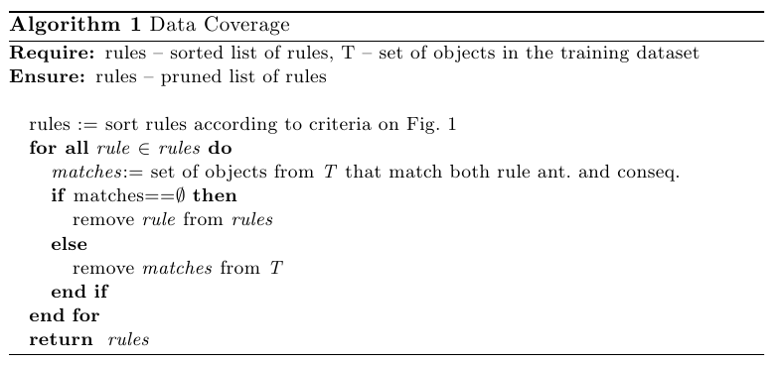
Rule Pruning
Data coverage pruning is the most commonly used pruning technique in CBA-derived algorithms
Rule ranking criteria
Confidence
Support
Rule length (shorter is better)

Slide 17
Experiment objectives
Evaluate impact of pruning
No pruning (use apriori output directly for classification)
brCBA (apriori, then data coverage pruning)
Original CBA (data coverage, pessimistic and default rule pruning)
Evaluate the impact and sensitivity to:
minSupport threshold
minConfidence threshold
Evaluate the impact of added rule language expressivity
negations
disjunctions in rule body

Slide 18
Experimental setup
Experiment objectives
1) Compare results with other classifiers
2) Determine impact of:
minSupport thr.
minConfidence thr.
pruning
Datasets
UCI: Iris, Glass
Preprocessing
Numerical attributes were discretized with equidistant binning with custom merging of bins with small support
Rule learning
LISp-Miner implementation, apriori-like setup
Pruning
Data coverage pruning on/off
Dataset | Rows | Attributes
Iris | 150 | 4
Glass | 214 | 9

Slide 19
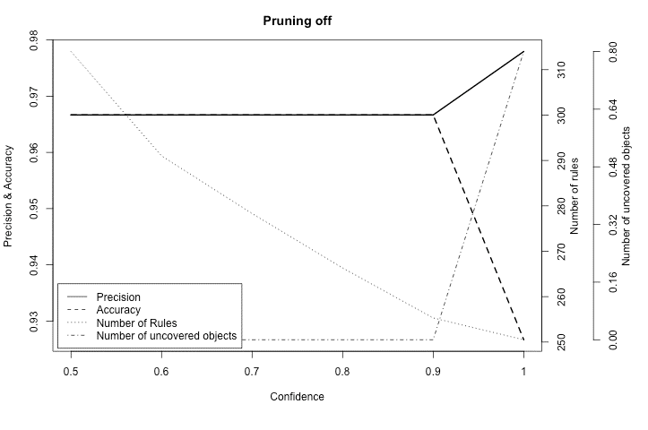
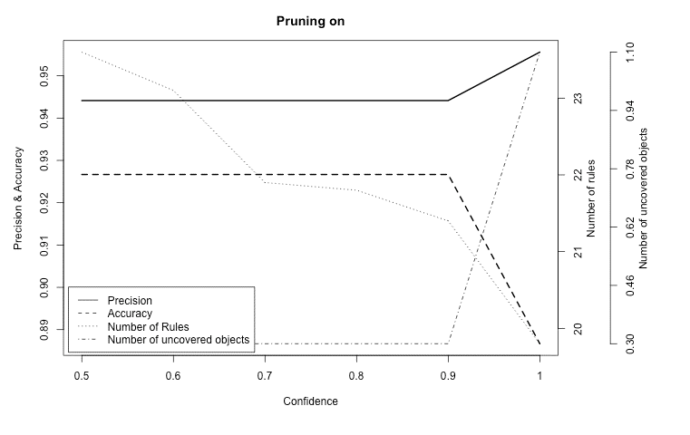
Experimental results_{pruning}
Effect of pruning. Iris dataset, minimum support threshold 1
iris dataset
Pruning: decreased the rule count by 90%, lowering accuracy only by 1%
+ for business rule learning

Slide 20
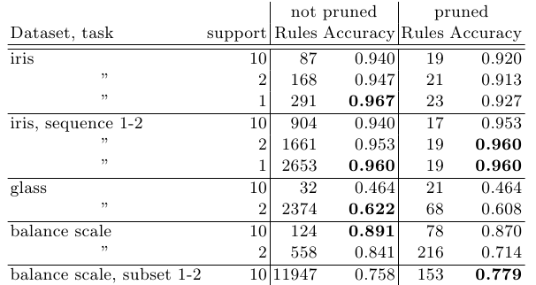
Experimental results_{minSupp}
Impact of minimum support threshold, minConf=0.6
Support: The lower, the better (and slower).

Slide 21
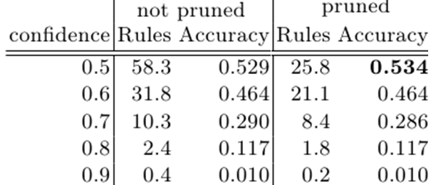
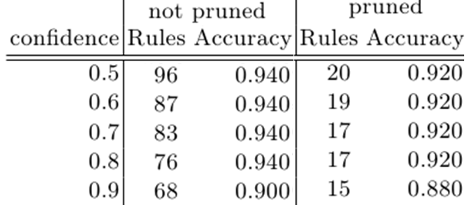
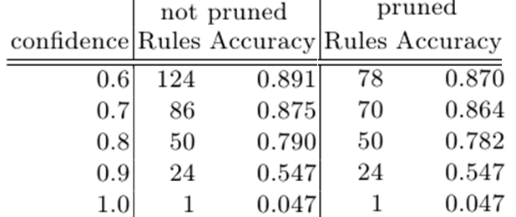
Experimental results_{minConf}
Glass, minSupp=10 objects (5.18%)
Iris, minSupp=10 objects (1.78%)
Balancescale, minSupp 10 objects (1.78%)
Confidence: The lower, the better.

Slide 22
Additional experiments
Datasets
UCI: Iris, Balance scale, Glass
Preprocessing
Numerical attributes were discretized with equidistant binning with custom merging of bins with small support
Rule learning
Default run (as in apriori)
Negations
for each item, a dual “negated” item is created
Dynamic binning – nominal attributes (“subset” length = 2)
Dynamic binning – cardinal attributes (“interval” length = 2)
Pruning
Data coverage pruning on/off
Dataset | Rows | Attributes | Bins after preprocessing
Iris | 150 | 4 | 18
BalanceScale | 625 | 4 | 20
Glass | 214 | 9 | 19

Slide 23
Higher expressivity rules with GUHA
The standard apriori algorithm outputs conjunctive rules
BRMS systems routinely work with rules that contain disjunctions between attribute values (dynamic binning) or negated literals.
In our experiments, we have employed in the LISp-Miner system which unlike apriori implementations is able to learn higher expressiveness rules.
Original intervals
[20-25)
[25-30)
[30-35)
[35-40)
[40-45)
[45-50)
Sequence 1-2
Original intervals…
[20-25),[25-30)
[25-30),[30-35)
[30-35),[35-40)
[35-40),[40-45)
…
Subset 1-2
Original intervals…
[20-25),[25-30)
[20-25),[30-35)
[20-25),[35-40)
[20-25),[40-45)
[25-30),[30-35)
…
Sequence: binning of following categories (for ordinal attributes)
Subset: binning of categories regardless of the order
Length 1-2: generated bins contain at least 1 and maximum 2 original bins

Slide 24

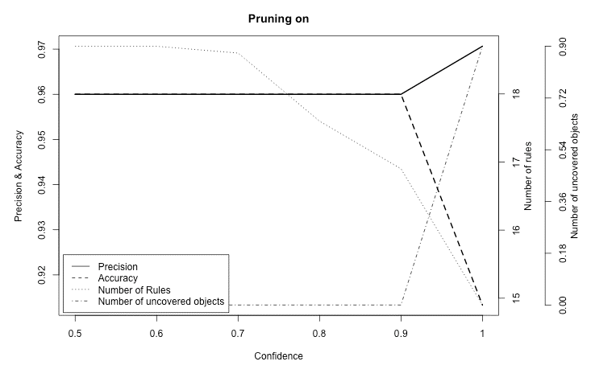
Experimental results_{dynamic binning}
Effect of dynamic binning on cardinal attributes.
Iris dataset
sepalWidth = [3.2;3.44) or sepalWidth = [3.44;3.68) => XClass(Iris-setosa)
Dynamic binning off
Dynamic binning (cardinal attributes) – better accuracy (3.4% improvement ) and lower rule count (18 vs 23).
However – much longer learning time.
Dynamic binning on

Slide 25
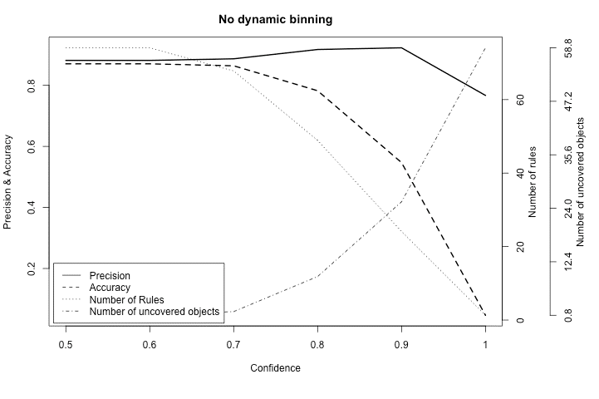
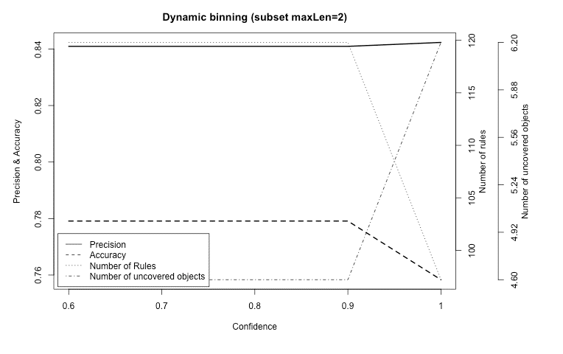
Experimental results_{dynamic binning}
Effect of dynamic binning on nominal attributes.
Balancescale dataset
(LeftDistance=S or LeftDistance=M) and (LeftWeight=L or LeftWeight=H) => XClass=L
Dynamic binning (nominal attributes)– worse accuracy, higher rule count and drastically longer learning time.

Slide 26
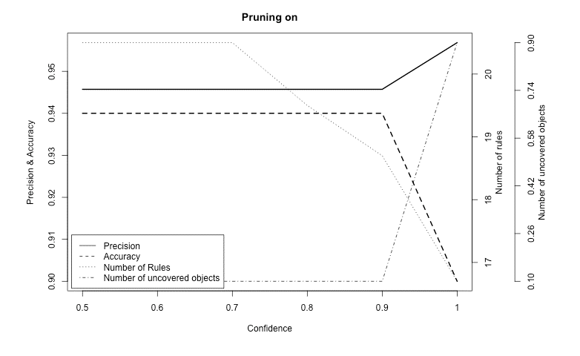
Experimental results_{negative literals}
Effect of including negative literals.
Iris dataset
petalLength =[1;1.59) and petalWidth=[0.1;0.34) and not(sepalLength=[4.3;4.66) and not(sepalWidth=[2;2.34)
=> XClass(Iris-setosa)
Negative literals – worse accuracy, higher rule count and higher learning time.

Slide 27
Experimental results_{time complexity}
Dataset/Task | Attributes | Verifications | Rules | Mining duration
 | without binning | 315 | 80 | less than 1 s
 | with negations | 13 542 | 2 472 | 12 s
 | disjunctions (nominal) | 19 413 | 4 715 | 27 s
BalanceScale (min Conf 0,5) | without binning | 510 | 146 | less than 1 s
 | with negations | 33 045 | 9 040 | 43 s
 | disjunctions (nominal) | 73 230 | 17 004 | 99 s
 | disjunctions (cardinal) | 9 582 | 2 122 | 10 s
 | disjunctions (cardinal – 3 values) | 45 915 | 11 846 | 75 s
Glass (min Conf 0,9) | without binning | 3 920 | 24 | less than 1 s
 | with negations | 669 075 | 8 146 | 64 s
 | dynamic binning | not suitable (attributes have only 2 values)

Slide 28
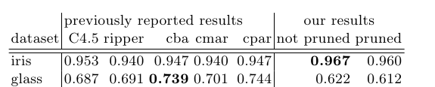
Experimental results_{overview}
brCBA
brCBA modification of CBA is not only simpler than CBA, but also fully matches our criteria for business rule learning (due to removal of default rule pruning).
Requirements
BRMS supported rule expressiveness
Small number of output rules
Exhaustive set of rules
Expressive rule language
Rule conflict resolution
Ability to control rule quality
brCBA
d
Redundant rules removed by pruning
GUHA rules – no improvement
Classification by highest ranked rule
All rules matching confidence and support thresholds

Slide 29
Future work
Perform benchmarks on all 25 UCI datasets used in the original CBA paper
A certain complication in using brCBA (or apriori-based algorithms) for business rule learning not addressed in this paper is the need to perform discretization of numerical attributes in the preprocessing phase.
Hand designed bins are laborious to produce and may negatively impact performance
Automatic binning (e.g. Entropy-based) produces unnatural output, and may not also provide the best results
We are looking for an algorithm that would remove the need to perform discretization, or at least soften its impact on classification performance.

Slide 30
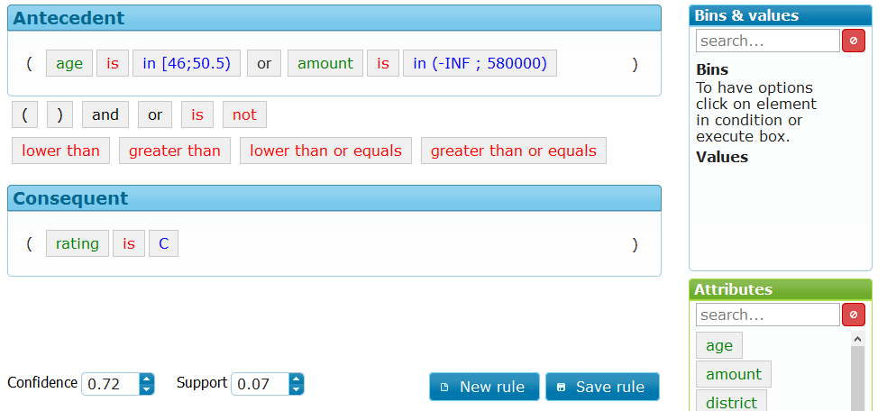
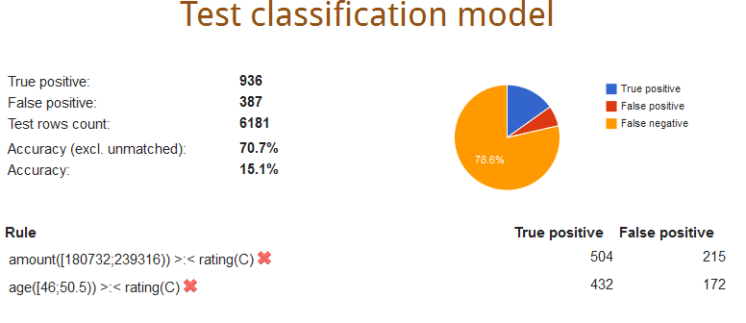
Demo
Demo of a Drools-based with brCBA rule learner will be presented at the RuleML Challenge - Today from 14:50 at this room
Demo of a recommender system using brCBA will be presented at PAIS
Stanislav Vojir, Premysl Vaclav Duben and Tomas Kliegr. Business Rule Learning with Interactive Selection of Association Rules. RuleML Challenge’14
http://easyminer.eu
Tomas Kliegr, Jaroslav Kuchar. Orwellian Eye: Video Recommendation with Microsoft Kinect. PAIS’14
http://inbeat.eu/demo/pais14/

