Slide 1
Business Rule Learning with Interactive Selection of Association Rules
Stanislav Vojíř, Přemysl Václav Duben and Tomáš Kliegr
Department of Information and Knowledge Engineering
University of Economics, Prague

Slide 2
Relevant paper
Learning Business Rules with Association Rule Classifiers Tomáš Kliegr, Jaroslav Kuchař, Davide Sottara, Stanislav Vojíř

Slide 3
Motivation
2 possible scenarios
Automatic model creation
Data mining of rules (without support)
Rules prunning
User-managed model creation
Selection of rules gained from data mining
Manually rules input

Slide 4
Rule base preparation
Data preparation
Association rule mining, rule selection
Classification model testing
Ruleset editing
Classification model testing

Slide 5
Data preparation
Data set for data mining (CSV file, MySQL source)
Import configuration (encoding, separators, primary key)
(Training and testing dataset)
Preprocessing
Columns in data set => attributes for data mining
Numerical columns => intervals, bins of values
Categorical columns => bins of values

Slide 6
Data mining of association rules
GUHA procedure ASSOC
Interactive data mining task configuration using rule pattern
Attributes with fixed values, dynamic binning wildcard…
Interest measures (not only confidence, support)
Support for disjunctions, negations, brackets
Rules selection into rule clipboard
classification model testing
export of rules into knowledge base

Slide 7
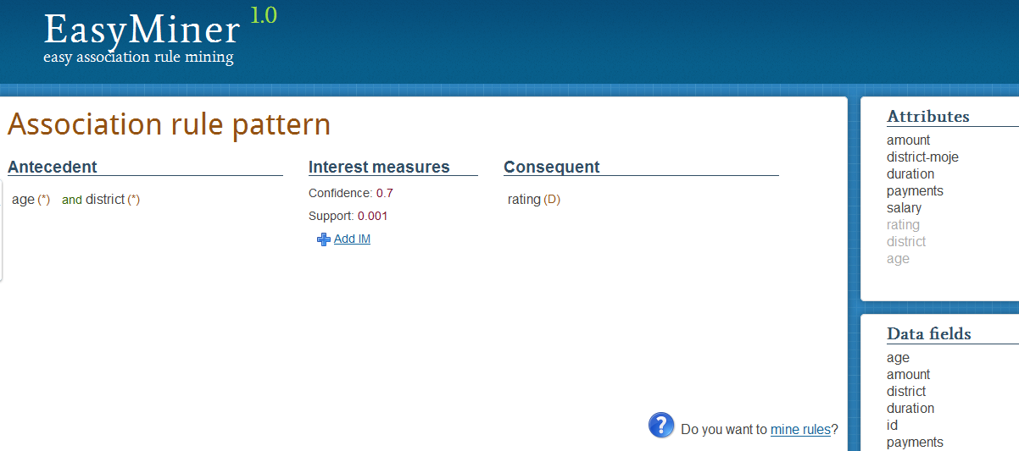
Data mining of association rules

Slide 8
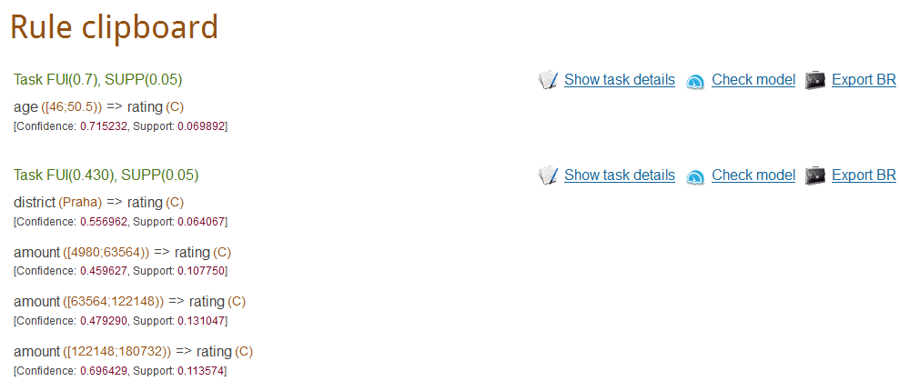
Data mining of association rules

Slide 9
Classification model testing
Using training dataset or testing dataset with columns with the same names
Rules in DRL form => testing using Drools Expert
Conflict resolution
Confidence ➔ Support ➔ First fired rule

Slide 10
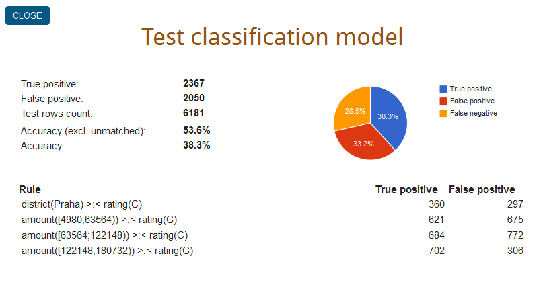
Classification model testing

Slide 11
Ruleset editing
Not only selection of rules gained from data mining results
Rule editing using interactive editor
Antecedent => Rule condition
Consequent => Rule body

Slide 12
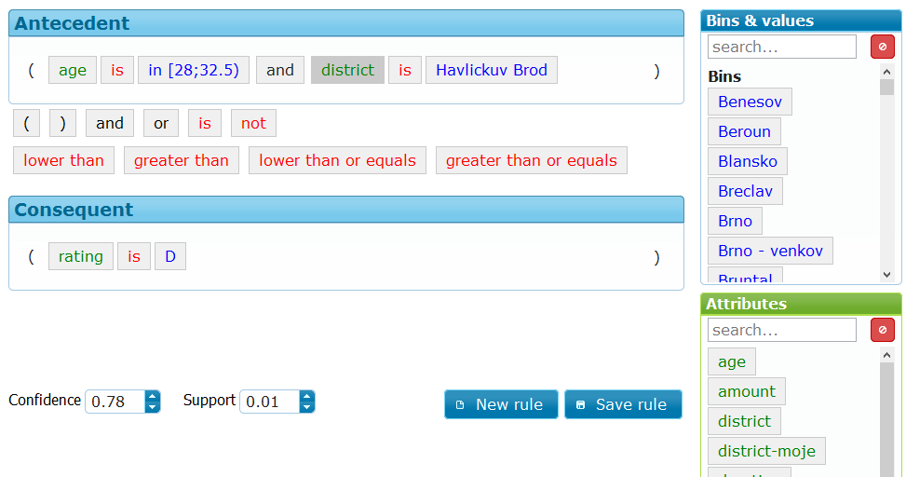
Ruleset editing

Slide 13
Software components summary
EasyMiner
Interactive data mining system
PHP, JavaScript + Joomla! based CMS (reports support)
Based on LISp-Miner system
C++, C#.NET
GUHA procedure ASSOC
EasyMinerCenter
New component for background knowledge management
PHP
Data saved in RDF form (using ARC2 Store)

Slide 14
Software components summary
Business rules editor
JavaScript
Model tester
Java EE application based on Drools Expert component

Slide 15
Future work
New data mining backend
Support for rule prunning
Work with background knowledge base

Slide 16
Demo
Example dataset
7 columns (age, salary, district, amount, payments, duration, rating)
6181 rows
Demo screencast
http://easyminer.eu/screencasts

Slide 17
Try it yourself! EasyMiner.eu
For more information, please visit the web: http://easyminer.eu
Screencasts
Demo
Technical information and papers

