Slide 1
Expert Finding for eCollaboration Using
FOAF with RuleML Rules
MCeTECH 2006 18-19 May 2006
Jie Li^{1,2}, Harold Boley^{1,2}, Virendrakumar C. Bhavsar¹, Jing Mei³
¹University of New Brunswick, Canada
²National Research Council of Canada
³Peking University, China

Slide 2
Contents
1. RuleML FOAF
1.1 Enhancing FOAF
1.2 Rules Extending FOAF Profiles
1.3 RuleML FOAF Approach
2. FindXpRT Use Case
2.1 Extend FOAF Vocabulary for Expert Finding
2.2 FindXpRT Rule System
3. Conclusions

Slide 3
1. RuleML FOAF
RuleML: Rule Markup Language: www.ruleml.org
  XML-based language for Web rules
  Evolving family with current version 0.9
  Allows publishing and sharing rulebases on the Web
  Object-Oriented RuleML (OO RuleML)
    Natural extension to RuleML
    Includes “slot  filler” sublanguage of RuleML
  Execution via rule engines such as OO jDREW¹
    Forward (bottom-up)
    Backward (top-down)
OO jDREW: Object-Oriented Java Deductive Reasoning Engine for the Web.
Online at: www.jdrew.org/oojdrew

Slide 4

FOAF: the Friend Of A Friend
project, online available at
www.foaf-project.org
  Semantic Web application
  Web-based social networking
  Describes people and their relationships
  In RDF/XML
  Semantic Web vocabulary (taxonomy)
  Open to extensions for various applications
  Contains only facts (and taxonomies)

Slide 5
1.1 Enhancing FOAF
Lack of rule-based deduction
Need for applying rules, e.g. RuleML
  Enable XML-based
    Rule formalisation
    Rule interchange
    Rule execution
  Derive new FOAF facts

Slide 6
1.2 Rules Extending FOAF Profiles
Make implicit properties and relationships explicit
Constitute person-centric metadata properties conditional on other persons, the time/place, …
phonePreference(Peter_Pan,office) :-
time(9-12) OR time(13-17).
phonePreference(Peter_Pan,cell) :-
time(12-13) OR time(17-18).
phonePreference(Peter_Pan,home) :-
time(18-21).
phonePreference(Peter_Pan,voicemail) :-
time(21-9).
Profile of Peter_Pan, published and maintained by himself

Slide 7
1.3 RuleML FOAF Approach
Develop general RuleML FOAF vocabulary for rules
  Fact Vocabulary
  Rule-Conclusion Vocabulary
Implement two normal forms
  Rule-Oriented Normal Form (RNF)
  Fact-Oriented Normal Form (FNF)

Slide 8
Two Normal Forms
Rule-oriented Normal Form (RNF):
  The RNF includes rules as well as the (elementary) facts that are needed by the premises of the rules, omitting derivable facts
  Advantage: The RNF thus achieves compactness
Fact-oriented Normal Form (FNF):
  The FNF includes elementary facts and derived facts, but omits the rules from the published rulebase
  Advantage: The FNF maps to RDF FOAF facts

Slide 9
2. FindXpRT Use Case
Find an eXpert via Rules and Taxonomies
Technology taxonomy in computer science from the 1998 ACM Classification
Make taxonomic similarity applicable in match-making based on the algorithm of Teclantic.ca
Enable querying specific expertise
Find an appropriate expert with relevant expertise, through match-making
If none can be found, provide ‘proxy’ suggestions
Support collaboration between people,
e.g. computer science (AI) and music (Pop)

Slide 10
2.1 Extend FOAF Vocabulary for
Expert Finding
Original FOAF vocabulary
  Vocabulary of Classes: e.g. foaf:Person
  Vocabulary of Properties: e.g. foaf:knows
Extended for expert finding application
  Fact Vocabulary
  Rule-Conclusion Vocabulary

Slide 11
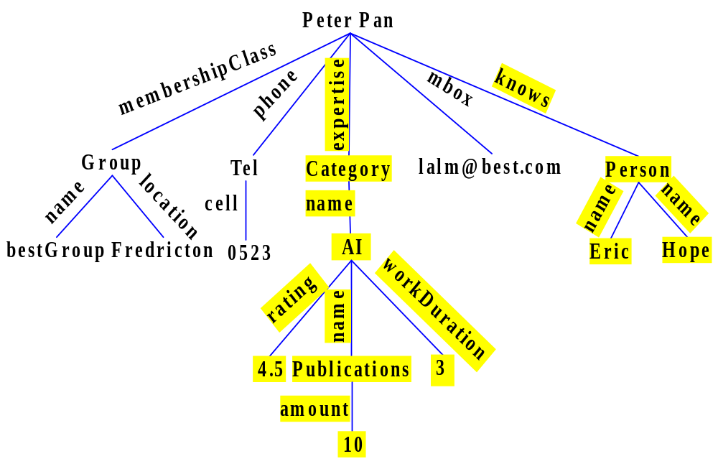
Extended Fact Vocabulary²
foaf.person(Peter_Pan[
…
ex.expertise->Category[
foaf.name->AI[
ex.rating->4.5;
foaf.name->
Publications[
ex.amount->10];
ex.workDuration->3]];
…
foaf.knows->Person[
foaf.name->Eric;
foaf.name->Hope]]).
2. ‘.’ is used for the implementation instead of the symbol ‘:’ to express
namespaces, because ‘:’ is reserved in OO jDREW

Slide 12
Extended Rule-Conclusion Vocabulary
(rule-1)
expertise(?Person,?Area) :-
rating(?Person,?Area,?Score),
greaterThanOrEqual(?Score,4),
workDuration(?Person,?Area,?Year),
greaterThan(?Year,2).
(rule-2)
expertise(?Person,?Area) :-
publication(?Person,?Area,?Amount),
greaterThanOrEqual(?Amount,3).
(rule-3)
expertise(?Person,?Area) :-
RecordedCDs(?Person,?Area,?Amount),
greaterThanOrEqual(?Amount,6).
(fact-0) * Only Stored *
expertise(Bill,AI).
(fact-1) * Stored & Derivable*
expertise(Peter_Pan,AI).
(fact-2)
rating(Peter_Pan,AI,4.5).
(fact-3)
workDuration(Peter_Pan,3).
(fact-4) RecordedCDs(Lucy_Alm,Pop,6).
(fact-5) * Newly Derived*
expertise(Lucy_Alm,Pop).
Local Rules³
Local Rules: exactly one person argument (by convention, the first one).
Global Rules: two or more person arguments (by convention, the first two)

Slide 13
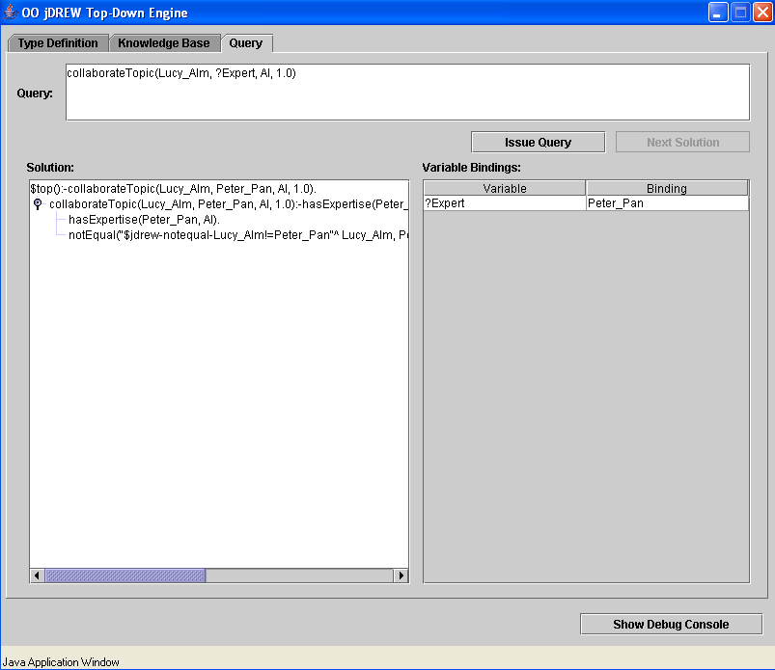
collaborateTopic(Lucy_Alm, ?Peer, ?Expertise, 1.0):-
hasExpertise(?Peer, ?Expertise),
notEqual(Lucy_Alm, ?Peer).
hasExpertise(Peter_Pan, AI).
hasExpertise(Lucy_Alm, Pop).
collaborationTopic:
Rules for specifying
the collaboration topic
Global Rules³

Slide 14
2.2 FindXpRT Rule System
Rule Systems/Sets:
  Rule system for expert finding (Fig. 4)
  Rule subsystem for decision making on collaboration (Fig. 5)
  Rules for specifying the collaboration mode (Rule Set 1, first in POSL4 and then as RuleML serialization)
4. POSL: An integrated Positional-Slotted human-oriented language for
Semantic Web knowledge

Slide 15
S
t
a
r
t
FindXpRT:
Rule system for expert finding
?
C
-
-
t
h
e
c
l
i
e
n
t
?
E
-
-
t
h
e
e
x
p
e
r
t
?
X
,
?
Y
-
-
e
x
p
e
r
t
i
s
e
?
T
-
-
t
h
r
e
s
h
o
l
d
d
e
g
r
e
e
=
6
N
e
x
p
e
r
t
I
s
e
(
?
E
,
?
X
)
Y
N
n
o
t
E
q
u
a
l
(
?
C
,
?
E
)
F
a
i
l
Y
c
o
l
l
a
b
o
r
a
t
e
I
n
(
?
C
,
?
P
r
o
j
e
c
t
1
)
,
Y
c
o
l
l
a
b
o
r
a
t
e
s
(
?
C
,
?
E
)
c
o
l
l
a
b
o
r
a
t
e
I
n
(
?
E
,
?
P
r
o
j
e
c
t
1
)
N
o
f
f
e
r
s
E
x
p
e
r
t
i
s
e
(
?
E
,
?
X
)
,
N
s
e
e
k
s
E
x
p
e
r
t
i
s
e
(
?
C
,
?
Y
)
,
t
a
x
o
n
o
m
i
c
S
i
m
i
l
a
r
i
t
y
(
?
X
,
?
Y
)
>
=
?
T
Y
n
a
f
(
b
u
s
y
W
i
t
h
(
?
E
,
?
P
r
o
j
e
c
t
2
)
)
,
Y
c
o
n
s
u
l
t
e
d
B
y
(
?
C
,
?
E
)
C
o
l
l
a
b
o
r
a
t
i
o
n
D
e
c
i
s
i
o
n
(
?
C
,
?
E
,
?
X
)
=
'
A
c
c
e
p
t
'
N
N
?
E
:
=
?
P
(
d
e
g
r
e
e
-
-
)
>
0
Y
Y
k
n
o
w
s
(
?
E
,
?
P
)
,
N
E
n
d
h
a
s
E
x
p
e
r
t
i
s
e
(
?
P
,
?
X
)
Fig. 4

Slide 16
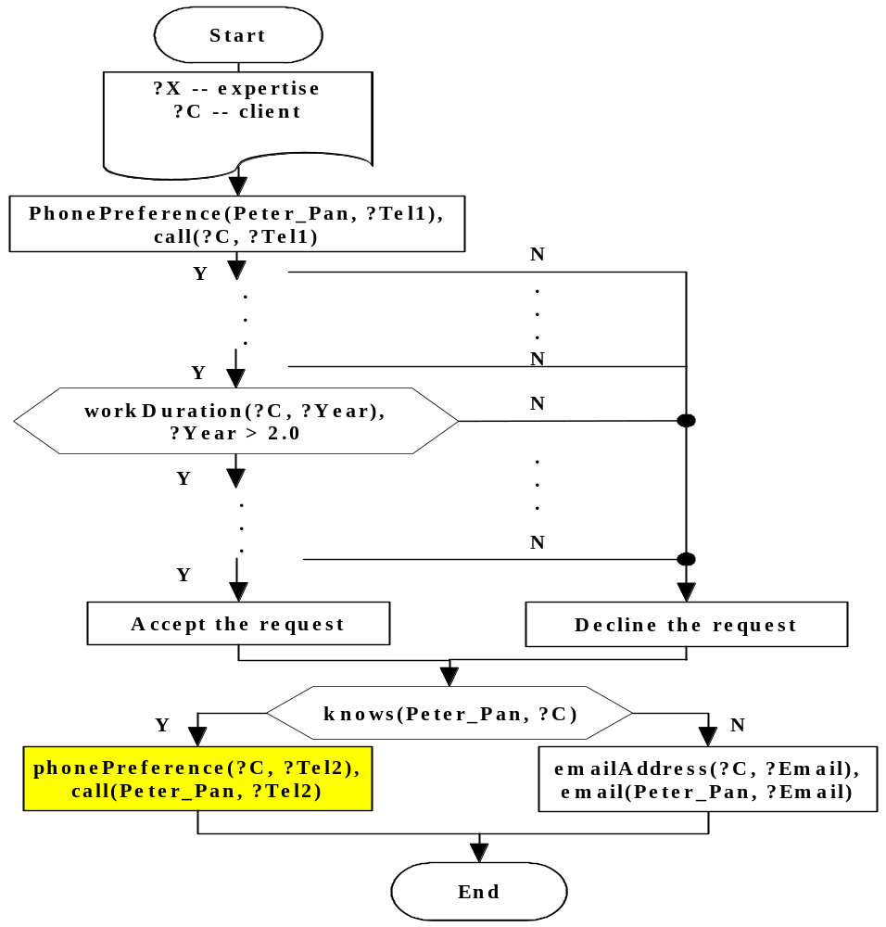
CollaborationDecision:
Rule subsystem for decision making
on collaboration
Fig. 5

Slide 17
... after consultedBy is established, further rules benefit the collaboration:
collaborationMode:
Rules for specifying the collaboration mode
(POSL-1)
collaborationMode(F2F, ?Date, ?Distance) :-
workDay(?Date),
lessThan(?Distance, 20).
(POSL-2)
collaborationMode(Tel, ?Date, ?Distance) :-
workDay(?Date),
greaterThanOrEqual(?Distance, 20).
(POSL-3)
collaborationMode(Web, ?Date, ?Distance) :-
naf(workDay(?Date)).
negation as
failure
Rule Set 1

Slide 18
<Assert>
<And mapClosure="universal">
<Implies>
<And>
<Atom>
        <Rel>workDay</Rel>
        <Var>Date</Var>
</Atom>
<Atom>
<Rel>lessThan</Rel>
<Var>Distance</Var>
<Ind>20</Ind>
</Atom>
</And>
<Atom>
<Rel>collaborationMode</Rel>
<Ind>F2F</Ind>
<Var>Date</Var>
<Var>Distance</Var>
</Atom>
</Implies>
</And>
</Assert>
RuleML Serialization
of (POSL-1)

Slide 19
3. Conclusions
General methodology for rule-augmented FOAF elaborated in RuleML FOAF
Expert Finding Use Case: Propose rule application to FOAF community
Extend factual FOAF vocabulary with properties defined via RuleML rules
Rule engine OO jDREW employed to run FOAF rules
  Bottom-up execution: all the newly derived facts as required for the FNF
  Top-down execution: enables clients to query specific information on demand, as requested by the RNF

Slide 20

Thank you!
Questions?

Slide 21
Local-Rule Example (Original Rulebase)
(rule-1)
fanOf(?Person, ?Band) :-
hasCD(?Person, ?Band, ?amount),
greaterThan(?amount, 3:Integer),
watchTVLive(?Person, ?Band).
(rule-2)
fanOf(?Person, ?Band) :-
go2Concert(?Person,?Band,?frequency),
greaterThan(?frequency, 2:Integer).
(fact-0)
fanOf(Bill, U2).
(fact-1)
fanOf(Peter, U2).
(fact-2)
hasCD(Peter, U2, 4:Integer).
(fact-3)
watchTVLive(Peter, U2).
(fact-4)
go2Concert(Peter, U2, 3:Integer).
(fact-5)
go2Concert(Lucy, U2, 5:Integer).

Slide 22
Local-Rule Example (RNF)
(rule-1)
fanOf(?Person, ?Band) :-
hasCD(?Person, ?Band, ?amount),
greaterThan(?amount, 3:Integer),
watchTVLive(?Person, ?Band).
(rule-2)
fanOf(?Person, ?Band) :-
go2Concert(?Person,?Band,?frequency),
greaterThan(?frequency, 2:Integer).
(fact-0)
fanOf(Bill, U2).
(fact-1)
(fact-2)
hasCD(Peter, U2, 4:Integer).
(fact-3)
watchTVLive(Peter, U2).
(fact-4)
go2Concert(Peter, U2, 3:Integer).
(fact-5)
go2Concert(Lucy, U2, 5:Integer).
(fact-6)

Slide 23
Local-Rule Example (FNF)
(rule-1)
(rule-2)
(fact-0)
fanOf(Bill, U2).
(fact-1)
fanOf(Peter, U2).
(fact-2)
hasCD(Peter, U2, 4:Integer).
(fact-3)
watchTVLive(Peter, U2).
(fact-4)
go2Concert(Peter, U2, 3:Integer).
(fact-5)
go2Concert(Lucy, U2, 5:Integer).
(fact-6)
fanOf(Lucy, U2). *Newly derived*

