Slide 1
Rule-based
Social Networking for
Expert Finding
MCS Defense
September 28th, 2006
Presented by: Jie Li^{1,2}
Supervisors:
Dr. Harold Boley^{1,2}
Dr. Virendrakumar C. Bhavsar¹
¹University of New Brunswick, Canada
²National Research Council of Canada

Slide 2
Contents
Introduction & Background
  Social Networking
  Rule Languages and Rule Engines
RuleML FOAF
  RuleML FOAF: Rules
  Extension of FOAF Vocabulary for Expert Finding
  Extension of FOAF Profiles for Rule-Based Social Networking
FindXpRT: A Profile-Based Expert Finder System
  The FindXpRT System
  FindXpRT Ruleset
Experiments
  Find an Expert via Direct Match
  Find an Expert with Referrals
  Execution Times
Conclusion

Slide 3
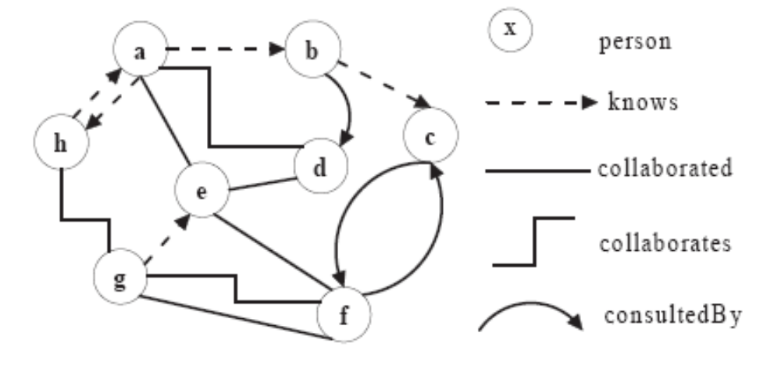
Social Networking
An example
Persons
Relationships
Determinable
structure

Slide 4
Expert Finding
People in large organizations don't know all other members well, nor their expertise
Expert finder:
  provides services for finding an expert or an expertise-developing project
  enables users to query for specific expertise and provide them with ranked list of experts

Slide 5

FOAF
The Friend Of A Friend project (www.foaf-project.org)
  Initiated in year 2000 by Dan Brickley and Libby Miller
  Semantic Web application
  Web-based social networking
  Describes people and their relationships
  Realized in RDF/XML
  Semantic Web vocabulary (ontology)
  Open to extensions for various applications
  Contains only facts

Slide 6
Rule Languages and Rule Engines
RuleML: Rule Markup Language (www.ruleml.org)
  Initially proposed in year 2000
  XML-based language for Web rules allowing to publish and share rulebases
  Evolving deductive family with current version 0.91
  Object-Oriented RuleML (OO RuleML)
    Natural extension to RuleML
    Includes “slot  filler” sublanguage of RuleML
    POSL used as human-oriented syntax
  Execution via rule engines such as OO jDREW
    Forward (bottom-up)
    Backward (top-down)

Slide 7
Rule Languages and Rule Engines (contd)
OO jDREW: Object-Oriented Java Deductive Reasoning Engine for the Web (www.jdrew.org/oojdrew)
  jDREW was implemented initially to teach how to build (pure) Prolog interpreters in Java
  has been under development as a reference implementation of RuleML
  includes OO jDREW BU (Bottom Up) and
  OO jDREW TD (Top Down)

Slide 8
RuleML FOAF
Previous system ― RDF FOAF:
Person-centric metadata facts only
Our contribution ― RuleML FOAF:
Person-centric metadata rules added
  Enables XML-based
    Rule Formalisation
    Rule Interchange
    Rule Execution
  Can derive new FOAF facts

Slide 9
RuleML FOAF: Rules
Make implicit properties and relationships explicit
Constitute person-centric metadata properties conditional on other persons, the time/place, …
\
phonePreference(Peter,office) :- time(9-12) OR time(13-17).
phonePreference(Peter,cell) :- time(12-13) OR time(17-18).
phonePreference(Peter,home) :- time(18-21).
phonePreference(Peter,voicemail) :- time(21-9).

Slide 10
Extension of FOAF Vocabulary for
Expert Finding
Original FOAF vocabulary
  Vocabulary of Classes: e.g., foaf:Person
  Vocabulary of Properties: e.g. foaf:knows
Extensions for expert finding applications
  Namespace specifies extensions
    “foaf”: original FOAF vocabulary
    “sesdl”: RuleML FOAF extension based on SeSDL taxonomy (Scottish electronic Staff Development Library)
    “ex”: our own RuleML FOAF vocabulary specification
  RuleML FOAF vocabulary is categorized into:
    fact vocabulary
    rule-conclusion vocabulary

Slide 11
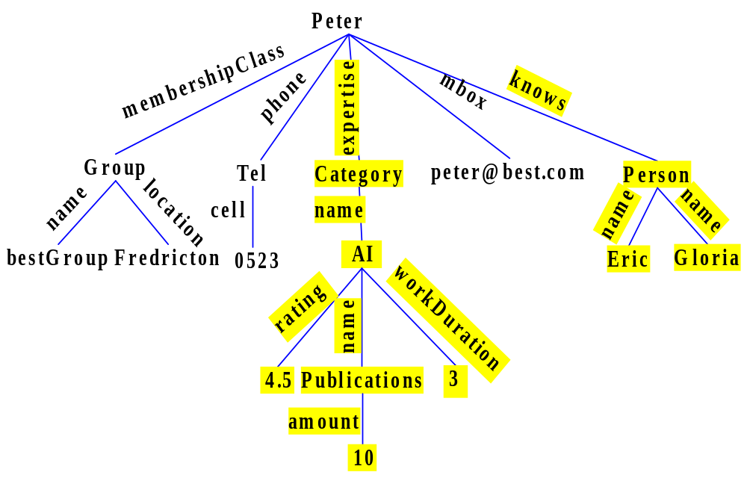
Extension of FOAF Profiles for
Rule-Based Social Networking
foaf.person(Peter[
…
ex.expertise->Category[
foaf.name->AI[
ex.rating->4.5;
foaf.name->
Publications[
ex.amount->10];
ex.workDuration->3]];
…
foaf.knows->Person[
foaf.name->Eric;
foaf.name->Gloria]]).
‘.’ is used for implementation instead of the symbol ‘:’ to express namespaces,
because ‘:’ is reserved in OO jDREW

Slide 12
Extension of FOAF Profiles for
Rule-Based Social Networking (contd)
(rule-1)
expertise(?Person,?Area) :-
rating(?Person,?Area,?Score),
greaterThanOrEqual(?Score,4),
workDuration(?Person,?Area,?Year),
greaterThanOrEqual(?Year,2).
(rule-2)
expertise(?Person,?Area) :-
publication(?Person,?Area,?Amount),
greaterThanOrEqual(?Amount,3).
(rule-3)
expertise(?Person,?Area) :-
recordedCDs(?Person,?Area,?Amount),
greaterThanOrEqual(?Amount,6).
(fact-0) * Only Stored *
expertise(Bill,AI).
(fact-1) * Stored & Derivable *
expertise(Peter,AI).
(fact-2) * Given Facts *
rating(Peter,AI,5).
(fact-3) * Given Facts *
workDuration(Peter, AI, 2).
(fact-4) * Given Facts *
recordedCDs(Lucy,Pop,6).
(fact-5) * Newly Derived*
expertise(Lucy,Pop).

Slide 13
FindXpRT: An Expert Finder System
(Find an eXpert via Rules and Taxonomies)
A profile-based RuleML FOAF expert finder:
uses person-centric metadata
Taxonomy of Computer Science from
the 1998 ACM Classification
Makes taxonomic similarity applicable in match-making based on the algorithm of Teclantic.ca
Enables querying specific expertise
Finds an appropriate expert with relevant expertise, through match-making
If none can be found, provides ‘proxy’ referrals
Supports collaboration between people

Slide 14
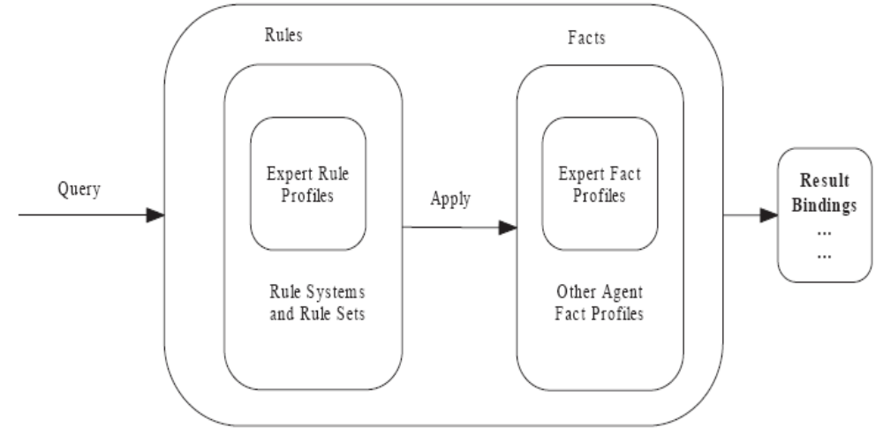
The FindXpRT System
When a user queries FindXpRT, the system works as follows:

Slide 15
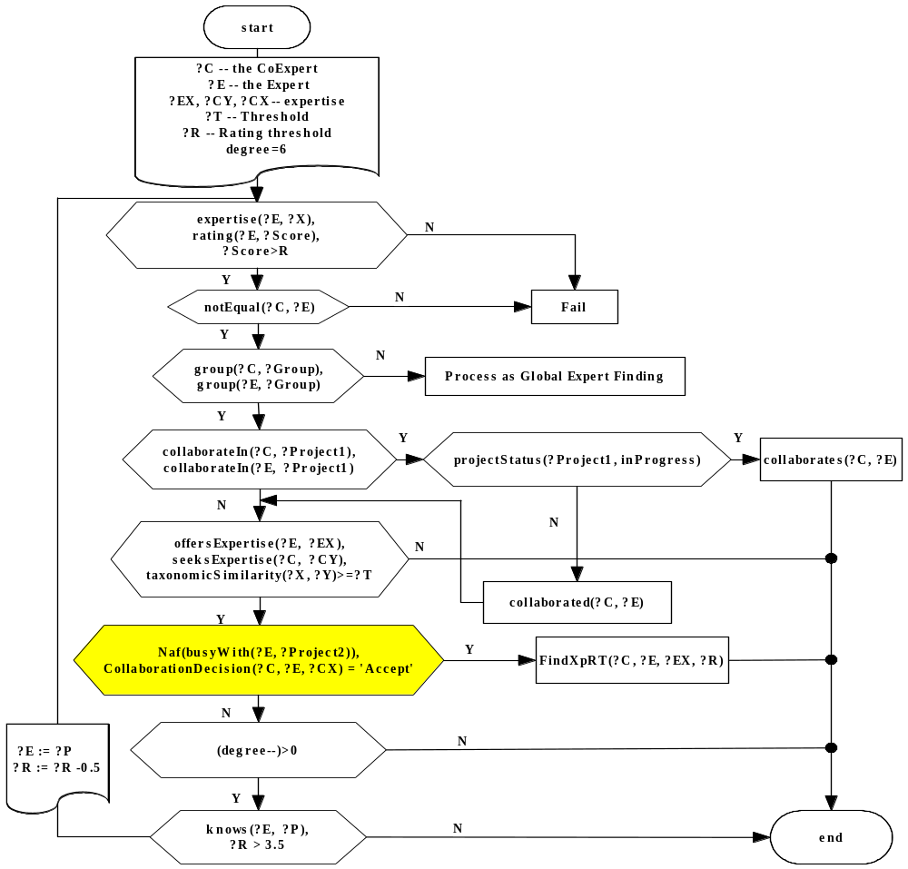
FindXpRT Flowchart:
Rule system for expert finding

Slide 16
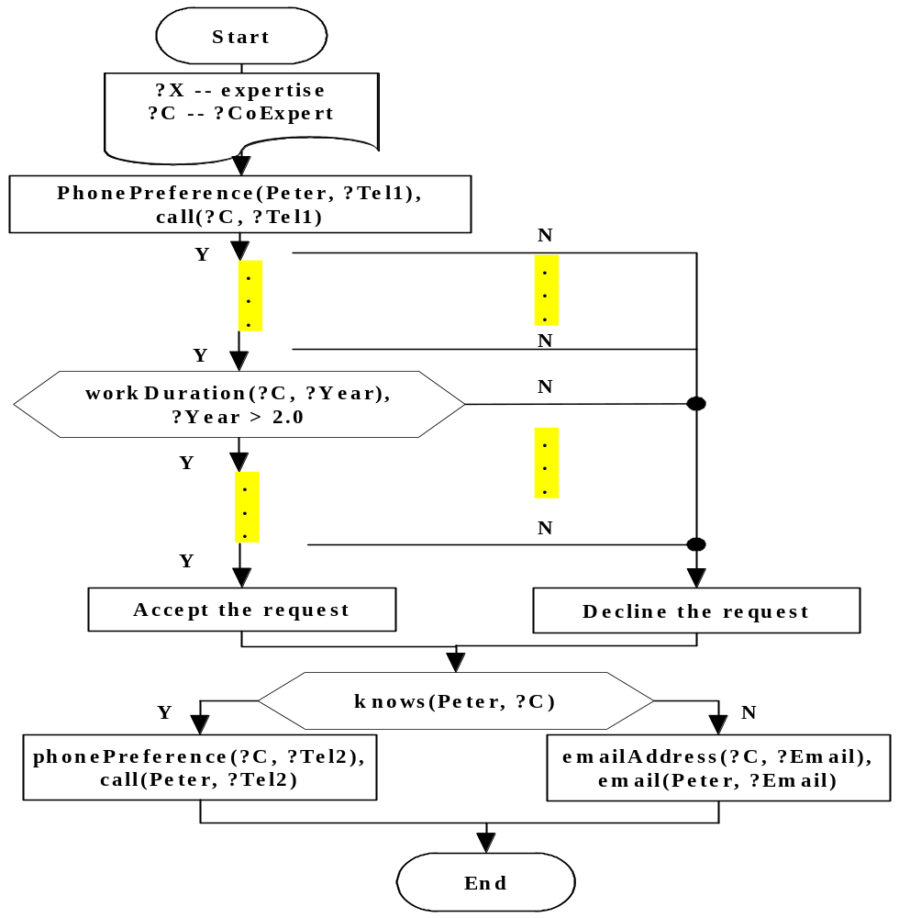
CollaborationDecision Flowchart :
Rule subsystem for decision making
on collaboration

Slide 17
(POSL-1)
collaborationMode(F2F, ?Date, ?Distance) :-
workDay(?Date),
lessThan(?Distance, 20).
(POSL-2)
collaborationMode(Tel, ?Date, ?Distance) :-
workDay(?Date),
greaterThanOrEqual(?Distance, 20).
(POSL-3)
collaborationMode(Web, ?Date, ?Distance) :-
naf(workDay(?Date)).
collaborationMode Ruleset:
Rules for specifying the collaboration mode

Slide 18
<Assert>
<And mapClosure="universal">
<Implies>
<And>
<Atom>
        <Rel>workDay</Rel>
        <Var>Date</Var>
</Atom>
<Atom>
<Rel>lessThan</Rel>
<Var>Distance</Var>
<Ind>20</Ind>
</Atom>
</And>
<Atom>
<Rel>collaborationMode</Rel>
<Ind>F2F</Ind>
<Var>Date</Var>
<Var>Distance</Var>
</Atom>
</Implies>
</And>
</Assert>
RuleML Serialization
of the Rule (POSL-1)

Slide 19
FindXpRT Ruleset:
Direct Match
% According to the criteria of both experts, find the most appropriate match, via possible referrals.
?CoExpert: the secondary expert, here the music expert
?Expert: the primary expert, here the Computer Science expert
?ReferredExpert: the referred primary expert, here the Computer Science expert
?CoExpertise: the expertise offered by the ?CoExpert
?Expertise: the expertise offered by the ?Expert
?RatingThreshold: the initial rating threshold
?UltimateRating: the rating of the ultimately referred-to expert
?Degree: the counter for controlling referral rounds
FindXpRT(?CoExpert,?Expert,?Expert,
?CoExpertise,?Expertise,?UltimateRating,?UltimateRating, ?Degree) :-
getRating(?RatingAgent, ?Expert, ?ExpertRating),
greaterThanOrEqual(?ExpertRating, ?UltimateRating),
satisfiedExpert(?CoExpert, ?Expert, ?Expertise),
naf(busyWith(?Expert, ?Project)),
CollaborationDecision(?Expert, ?CoExpert, ?CoExpertise).

Slide 20
FindXpRT Ruleset:
Referral ― when the expert is busy
FindXpRT(?CoExpert,?Expert,?ReferredExpert,
?CoExpertise,?Expertise,?RatingThreshold,?UltimateRating,?Degree) :-
getRating(?RatingAgent, ?Expert, ?ExpertRating),
add(?RatingTmp, ?RatingThreshold, 0.5:Real),
lessThan(?ExpertRating, ?RatingTmp),
greaterThanOrEqual(?CoExpertRating, ?RatingThreshold),
satisfiedExpert(?CoExpert, ?Expert, ?Expertise),
busyWith(?Expert, ?Project),
% cannot do it, but:
knows(?Expert, ?ReferredExpert),
greaterThan(?Degree, 0:Integer),
greaterThan(?RatingThreshold, 3.5:Real),
subtract(?DegreeNew, ?Degree, 1:Integer),
subtract(?RatingNew, ?RatingThreshold, 0.5:Real),
FindXpRT(?CoExpert,?Expert,?ReferredExpert,
?CoExpertise,?Expertise, ?RatingNew, ?UltimateRating, ?DegreeNew).

Slide 21
FindXpRT Ruleset:
Referral ― when the expert has declined
FindXpRT(?CoExpert,?Expert,?ReferredExpert,
?CoExpertise,?Expertise,?RatingThreshold,?UltimateRating,?Degree) :-
getRating(?RatingAgent, ?Expert, ?ExpertRating),
add(?RatingTmp, ?RatingThreshold, 0.5:Real),
lessThan(?ExpertRating, ?RatingTmp),
greaterThanOrEqual(?CoExpertRating, ?RatingThreshold),
satisfiedExpert(?CoExpert, ?Expert, ?Expertise),
naf(CollaborationDecision(?Expert, ?CoExpert, ?CoExpertise)),
% cannot do it, but:
knows(?Expert, ?ReferredExpert),
greaterThan(?Degree, 0:Integer),
greaterThan(?Rating, 3.5:Real),
subtract(?DegreeNew, ?Degree, 1:Integer),
subtract(?RatingNew, ?Rating, 0.5:Real),
FindXpRT(?CoExpert,?Expert,?ReferredExpert,
?CoExpertise,?Expertise, ?RatingNew, ?UltimateRating, ?DegreeNew).

Slide 22
FindXpRT Benchmark
Proposed Benchmark for
Computer Science (Expert)
and Music (CoExpert) Profiles
Consists of a suite for testing
expert-finding systems against various subsets of 10 characteristic expert profiles
Used to compare execution times of different profiles, as well as queries

Slide 23
Find an Expert via Direct Match
Lucy
Offers Expertise: Pop Music
Seeks Expertise: Logic Programming
Rating Threshold: 4.5
Degree Threshold: 0
… … … … … …
Peter
Offers Expertise: Logic Programming
Seeks Expertise: Pop Music
Overall Rating : 4.5
… … … … … …
FindXpRT(Lucy, ?CSXpRT, ?ReferredXpRT,
PopMusic, LogicProgramming, 4.5:Real, ?RatingSought, 0:Integer)

Slide 24
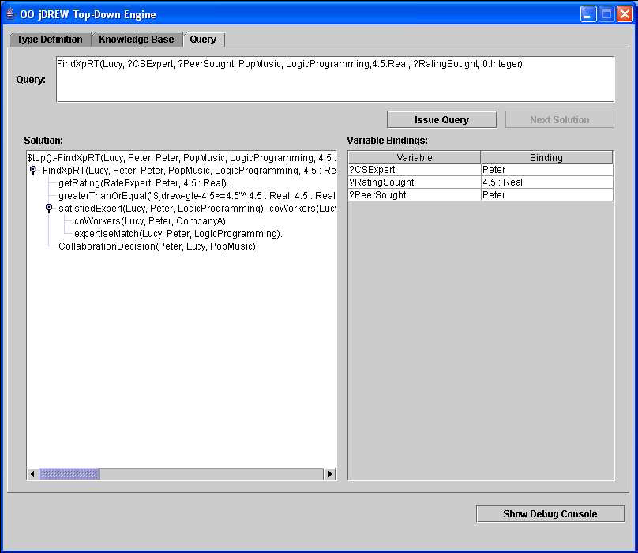

Slide 25
Find an Expert with Referrals
Lucy
Julia
Offers Expertise: Pop Music
Seeks Expertise: Logic Programming
Rating Threshold: 4.5
Degree Threshold: 0
… … … … … …
Offers Expertise: Logic Programming
Seeks Expertise: Pop Music
Overall Rating: 4.5
Status: Busy
… … … … … …
Hart
foaf:knows
Offers Expertise: Logic Programming
Seeks Expertise: Pop Music
Overall Rating: 4.0
… … … … … …
FindXpRT(Lucy, ?CSXpRT, ?ReferredXpRT,
PopMusic, LogicProgramming, 4.5:Real, ?RatingSought, 1:Integer)

Slide 26
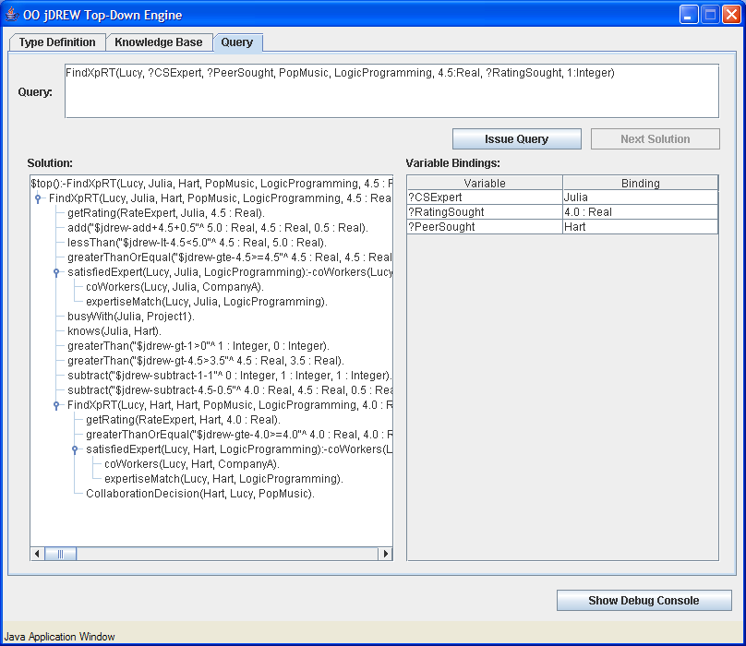

Slide 27
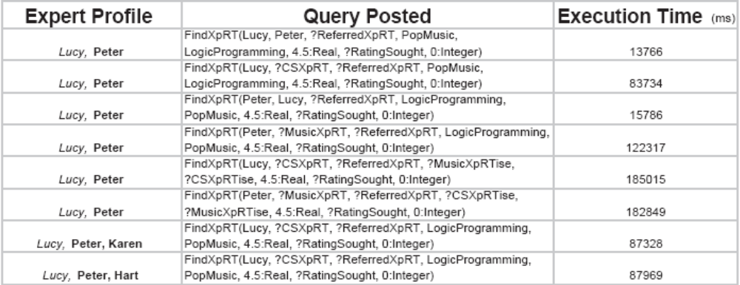
Execution Times
Table 1: Experiments on Direct Match, with Number of Matched Profiles Fixed

Slide 28
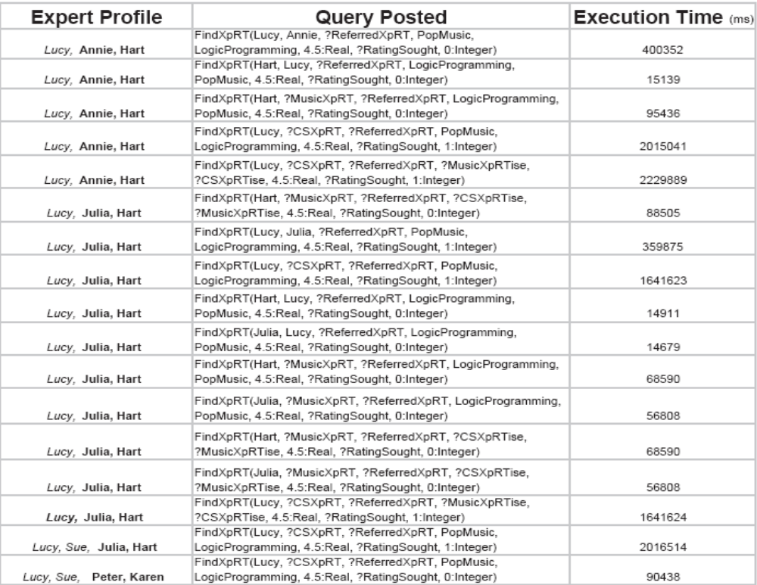
Table 2: Experiments on up to 1 Round of Referral, with Number of Matched Profiles Fixed

Slide 29
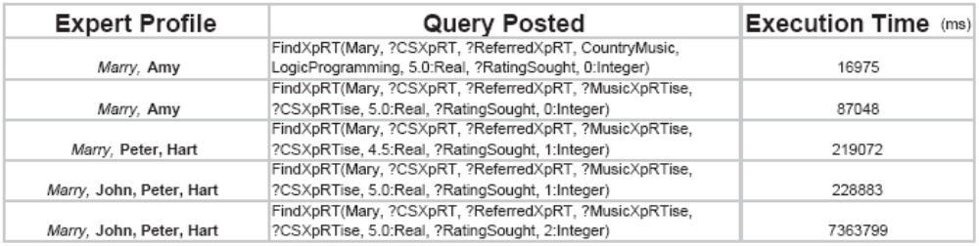
Table 3: Experiments on up to 2 Rounds of Referrals, with Number of Matched Profile Varied

Slide 30
FindXpRT Benchmark Execution Times
It appears that the execution times increase linearly with the number of profiles
The execution has a (clearly) superlinear growth in the number of referral rounds (no I/O modes: search needed)
The efficiency could be improved by introducing mode declarations in POSL / OO RuleML and in the OO jDREW implementation, to reflect the intended FindXpRT dataflow
Changing the parameter(s) in queries from variables to constant(s) decreases the execution times
The execution times can also be decreased if Naf is replaced with ‘negative’ relations
Because many rules are packaged as person-centric modules, for these, search can be localised

Slide 31
Conclusion: Contributions
General methodology for rule-augmented FOAF elaborated with RuleML FOAF
Expert Finding Use Case: Proposed rule application to FOAF community
Extended factual FOAF vocabulary with properties defined via RuleML rules
Rule engine OO jDREW employed to run FOAF rules
  Bottom-up execution: all the newly derived facts as required for the Fact Normal Form (FNF)
  Top-down execution: enables users to query specific information on demand, as called for by the Rule Normal Form (RNF)

Slide 32
Conclusion: Contributions (contd)
Implemented FindXpRT, our prototypical system for expert finding
Proposed expert finding benchmark in the domains of Computer Science and music
Tested the FindXpRT system in
OO jDREW to compute results for
expert finding
Analyzed factors that affect the
execution times

Slide 33
Future Work
Coupling of taxonomic expertise matching with similarity matching, cf. Teclantic.ca
"Stress testing" of FindXpRT on a large number of synthetic expert profiles to further evaluate FindXpRT system
Parallel processing of match-making in a distributed system to improve efficiency of FindXpRT
Make FindXpRT available to real-world experts
A joint initiative, ExpertFinder, on extending the FOAF vocabulary for expert finding, has been founded in
July, 2006 (http://rdfweb.org/topic/ExpertFinder),
partially based on our work

Slide 34

Questions?

