Slide 1
Data Systematics: The PSOA RuleML Metamodel Illustrated by Grailog Visualization of Wedding Atoms Harold Boley University of New Brunswick Faculty of Computer Science Fredericton, NB, Canada
(PDF version: ruleml.org/talks/PSOAMetamodelGrailogWedding.pdf)
Started: 13 July 2018
RULES: Logic and Applications (RULES 2019). NTUA, Athens, Greece, 16-17 December 2019

Slide 2
Introduction
PSOA RuleML builds on a novel data systematics: Discover here its new kinds of data, via 3D metamodel and 2D abstract visualization syntax for semantic intuition
Slicing and dicing the PSOA metamodel cube (from PSOAPerspectivalKnowledge, Appendix A)
Exemplify with oidless/oidful, tupled/slotted/combined, independent/dependent/combined atoms (2*3*3 = 18)
Illustrate all kinds of atoms by Grailog visualization, realized by concrete (symbolic) presentation syntax in PSOATransRun
Informal syntax templates and English semantics (formal in PSOAPerspectivalKnowledge, Sections 4 and 5)
Experience full metamodel dynamically by online PSOAMetaViz visualization, realized in JavaScript/JSON

Slide 3
Slicing and Dicing the PSOA Metamodel Cube
The full metamodel cube, via 3 (orthogonal) dimensions, systematizes 18 kinds of atoms that are contained in 18 unit cubes (units) named inj, dej, idj (j=1,…,6)
Choosing one of the reductions DVO, VDO, or OVD (s. below), users can slice and dice the cube, in a kind of (meta)OLAP, initially reducing its 3 dimensions to slices of 2 dimensions:
DVO reduction, via Dependency dimension, to 3 slices, each with 6 units structured by Variety-row (tupled/slotted/combined) and OID-column (oidless/oidful) dimensions:
6 independent units inj (j=1,…,6) vs. 6 dependent units dej (j=1,…,6) vs. 6 combined independent+dependent units idj (j=1,…,6)
The core metamodel is an 8-unit subcube of the full metamodel cube, which can be reduced, DVO-style, to 2 Dependency slices: in1-in4 and de1-de4
Each includes a ‘landmark’ unit: framepoint (in4) and relationship (de1) atoms
VDO reduction (e.g., for full metamodel), via Variety dimension, to 3 slices, each with 6 units structured by Dependency-row and OID-column dimensions:
6 tupled+slotted units inj, dej, idj (j=5,6) vs. 6 slotted units inj, dej, idj (j=3,4) vs. 6 tupled units inj, dej, idj (j=1,2)
OVD reduction (e.g., for full metamodel), via OID dimension, to 2 slices, each with 9 units structured by Variety-row and Dependency-column dimensions:
9 oidful units inj, dej, idj (j=2,4,6) vs. 9 oidless units inj, dej, idj (j=1,3,5)

Slide 4
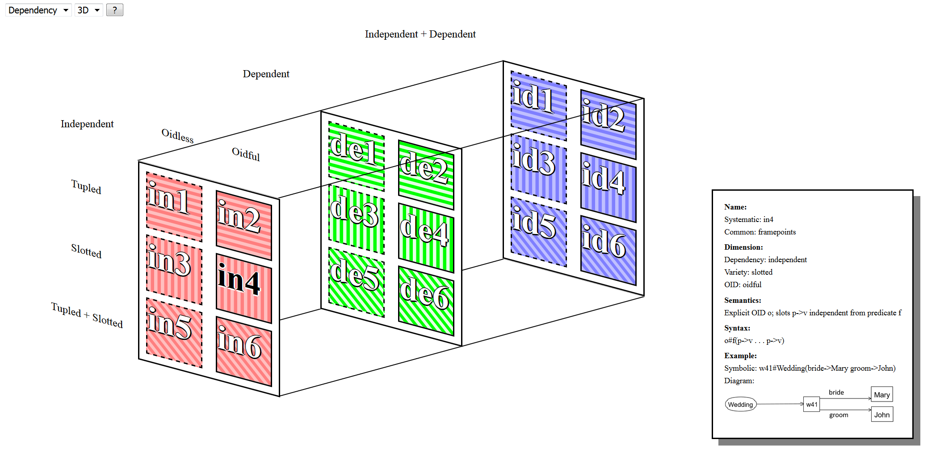
The PSOAMetaViz Cube with Current Selection of Framepoint Atoms from Independent Slice

Slide 5
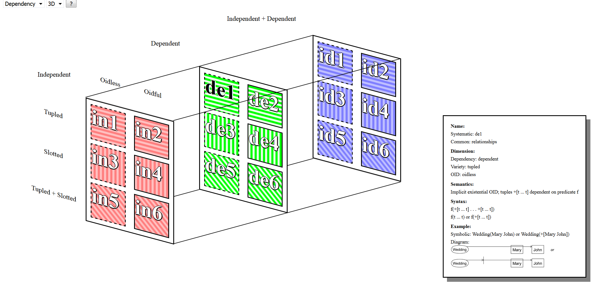
The PSOAMetaViz Cube with Current Selection of Relationship Atoms from Dependent Slice

Slide 6
Running Example
Wedding events with
bride and groom roles
etc.
Disambiguating “groom” using a dependent slot (e.g., within pairpoints):
noun: groom
1. a person employed to take care of horses.
2. a bridegroom
https://www.google.com/search?q=groom

Slide 7
Move between visualization syntax …
framepoints:
Mary
bride
Wedding
w41
groom
John

Slide 8
… and (symbolic) presentation syntax
framepoints:
w41#Wedding(
bride->Mary
groom->John
)

Slide 9
Exemplifying the Dependency Slices
Core oidless/oidful, tupled/slotted atoms that are independent:
Grailog:
in1. for single-tuple:
shelfships
Wedding
Mary
John
Wedding(-[Mary John])
in2. for single-tuple:
shelfpoints
Wedding
w21
Mary
John
w21#Wedding(-[Mary John])
bride
Mary
in3. frameships
Wedding
groom
John
Wedding(bride->Mary groom->John)
bride
Mary
in4: framepoints
Wedding
w41
groom
John
w41#Wedding(bride->Mary groom->John)

Slide 10
Extra oidless/oidful, combined tupled+slotted atoms that are independent:
in5. for single-tuple:
shelframeships
Wedding
Mary
John
loc
LA
Wedding(-[Mary John] loc->LA)
in6. for single-tuple:
shelframepoints
Wedding
w61
Mary
John
loc
LA
w61#Wedding(-[Mary John] loc->LA)

Slide 11
Core oidless/oidful, tupled/slotted atoms that are dependent:
Wedding
Mary
John
or
de1. for single-tuple:
relationships
Wedding
Mary
John
Wedding(Mary John) or Wedding(+[Mary John])
de2. for single-tuple:
relationpoints
Wedding
w11
Mary
John
w11#Wedding(+[Mary John])
bride
Mary
de3: pairships
Wedding
groom
John
Wedding(bride+>Mary groom+>John)
bride
Mary
de4. pairpoints
Wedding
w31
groom
John
w31#Wedding(bride+>Mary groom+>John)

Slide 12
Extra oidless/oidful, combined tupled+slotted atoms that are dependent:
de5. for single-tuple:
relpairships
Mary
John
Wedding
loc
LA
Wedding(+[Mary John] loc+>LA)
de6. for single-tuple:
relpairpoints
Wedding
w51
Mary
John
loc
LA
w51#Wedding(+[Mary John] loc+>LA)

Slide 13
Adding oidless/oidful, tupled/slotted, combined independent+dependent atoms:
2018
8
18
id1
Wedding
Mary
John
Wedding(-[2018 8 18] +[Mary John])
2018
8
18
id2
w71
Wedding
Mary
John
w71#Wedding(-[2018 8 18] +[Mary John])
bride
Mary
id3
Wedding
groom
John
Wedding(bride->Mary groom+>John)
bride
Mary
id4
Wedding
w81
groom
John
w81#Wedding(bride->Mary groom+>John)

Slide 14
Also oidless/oidful, combined tupled+slotted, combined independent+dependent:
2018
8
18
bride
Mary
id5
Wedding
groom
John
Wedding(-[2018 8 18] bride+>Mary groom+>John)
2018
8
18
w91
bride
Mary
id6
Wedding
groom
John
w91#Wedding(-[2018 8 18] bride+>Mary groom+>John)

Slide 15
Syntax and Semantics of Atoms
Core oidless/oidful, tupled/slotted atoms that are independent:
in1. for single-tuple:
shelfships
f(-[t ... t] . . . -[t ... t])
Implicit existential OID; tuples -[t ... t] independent from predicate f
f(-[t ... t])
in2. for single-tuple:
shelfpoints
o#f(-[t ... t] . . . -[t ... t])
Explicit OID o; tuples -[t ... t] independent from predicate f
o#f(-[t ... t])
in3: frameships
f(p->v . . . p->v)
Implicit existential OID; slots p->v independent from predicate f
in4: framepoints
o#f(p->v . . . p->v)
Explicit OID o; slots p->v independent from predicate f

Slide 16
Extra oidless/oidful, combined tupled+slotted atoms that are independent:
in5. for single-tuple:
shelframeships
f(-[t ... t] . . . -[t ... t] p->v . . . p->v)
Implicit existential OID; descriptors independent from predicate f
f(-[t ... t] p->v . . . p->v)
in6. for single-tuple:
shelframepoints
o#f(-[t ... t] . . . -[t ... t] p->v . . . p->v)
Explicit OID o; descriptors independent from predicate f
o#f(-[t ... t] p->v . . . p->v)

Slide 17
Core oidless/oidful, tupled/slotted atoms that are dependent:
de1. for single-tuple:
relationships
f(+[t ... t] . . . +[t ... t])
Implicit existential OID; tuples +[t ... t] dependent on predicate f
f(+[t ... t]) or f(t ... t)
de2. for single-tuple:
relationpoints
o#f(+[t ... t] . . . +[t ... t])
Explicit OID o; tuples +[t ... t] dependent on predicate f
o#f(+[t ... t]) or o#f(t ... t)
de3: pairships
f(p+>v . . . p+>v)
Implicit existential OID; slots p+>v dependent on predicate f
de4: pairpoints
o#f(p+>v . . . p+>v)
Explicit OID o; slots p+>v dependent on predicate f

Slide 18
Extra oidless/oidful, combined tupled+slotted atoms that are dependent:
de5. for single-tuple:
relpairships
f(+[t ... t] . . . +[t ... t] p+>v . . . p+>v)
Implicit existential OID; descriptors dependent on predicate f
f(+[t ... t] p+>v . . . p+>v) or f(t ... t p+>v . . . p+>v)
de6. for single-tuple:
relpairpoints
o#f(+[t ... t] . . . +[t ... t] p+>v . . . p+>v)
Explicit OID o; descriptors dependent on predicate f
o#f(+[t ... t] p+>v . . . p+>v) or o#f(t ... t p+>v . . . p+>v)

Slide 19
Adding oidless/oidful, tupled/slotted, combined independent+dependent atoms:
id1
f(+[t ... t] . . . +[t ... t]
-[t ... t] . . . -[t ... t])
Implicit existential OID; both in/dependent tuples w.r.t. predicate f
id2
o#f(+[t ... t] . . . +[t ... t]
-[t ... t] . . . -[t ... t])
Explicit OID o; both in/dependent tuples w.r.t. predicate f
id3
f(p+>v . . . p+>v
p->v . . . p->v)
Implicit existential OID; both in/dependent slots w.r.t. predicate f
id4
o#f(p+>v . . . p+>v
p->v . . . p->v)
Explicit OID o; both in/dependent slots w.r.t. predicate f

Slide 20
Also oidless/oidful, combined tupled+slotted, combined independent+dependent:
id5
f(+[t ... t] . . . +[t ... t]
-[t ... t] . . . -[t ... t]
p+>v . . . p+>v
p->v . . . p->v)
Implicit existential OID; both in/dependent descriptors w.r.t. predicate f
id6
o#f(+[t ... t] . . . +[t ... t]
-[t ... t] . . . -[t ... t]
p+>v . . . p+>v
p->v . . . p->v)
Explicit OID o; both in/dependent descriptors w.r.t. predicate f

Slide 21
Conclusions
Full PSOA metamodel cube visualized dynamically by PSOAMetaViz, and atoms (e.g., data facts) in Grailog, to significantly facilitate learning PSOA RuleML
Facts complemented by (interoperation) rules, including for core interoperation path de1-de3-de4-in4, e.g. abridged to one PSOA rule: http://wiki.ruleml.org/index.php/PSOA_RuleML_Bridges_Graph_and_Relational_Databases
Core path augmented to roundtrip between wedding atoms: http://wiki.ruleml.org/index.php/Exploring_the_PSOA_RuleML_Space_of_Core_Atoms
Use sample ground-atom facts, also augmented by rules, for ground- and non-ground-atom queries in PSOATransRun
PSOA RuleML 1.03 being standardized by Relax NG schemas for XML-serialized facts and rules: http://wiki.ruleml.org/index.php/PSOA_RuleML#Syntaxes
PSOA metamodel transferrable to other languages

