Slide 1
Object-Oriented RuleML
Re-Modularized and XML Schematized via Content Models
David Hirtle
Coop student, NRC IIT e-Business
December 2, 2003

Slide 2
Overview
RuleML → (W)OO RuleML
DTDs
  (W)OO extension
  remodularization
  inheritance
  content models
  demo
XML Schema
  inheritance
  content models
  demo
Steering Committee
Future Work

Slide 3
RuleML - Quick summary
rules are essential for the Semantic Web
  inference rules
  transformation rules
rule interchange is important for e-Business
Rule Markup Initiative aims to define a canonical language (RuleML) for interoperable rule markup
  XSLT translators to other SW languages
collaborating with W3C and other standards bodies
more information: [www.ruleml.org]

Slide 4
RuleML - Example
''The discount for a customer buying a product is 5 percent
if the customer is premium and the product is regular.''
imp
head
atom
opr rel discount
var customer
var product
ind 5 percent
body
and
atom
opr rel premium
var customer
atom
opr rel regular
var product
imp
head
body
atom
and
opr
atom
atom
discount
customer
product
5 percent
rel
var
var
ind
opr
opr
premium
customer
regular
product
rel
var
rel
var

Slide 5
RuleML - Example
''The discount for a customer buying a product is 5 percent
if the customer is premium and the product is regular.''
imp
head
atom
opr rel discount
var customer
var product
ind 5 percent
body
and
atom
opr rel premium
var customer
atom
opr rel regular
var product
<imp>
<_head>
<atom>
<_opr><rel>discount</rel></_opr>
<var>customer</var>
<var>product</var>
<ind>5.0 percent</ind>
</atom>
</_head>
<_body>
<and>
<atom>
<_opr><rel>premium</rel></_opr>
<var>customer</var>
</atom>
<atom>
<_opr><rel>regular</rel></_opr>
<var>product</var>
</atom>
</and>
</_body>
</imp>

Slide 6
OO RuleML
Object-Oriented extension to RuleML
  non-positional user-level roles (metarole _r)
  term typing
  URI-grounding
    <atom>
    <_opr><rel>discount</rel></_opr>
    <_r n=“customer name“><var>customer</var></r>
    <_r n=“product name“><var>product</var></r>
    <_r n=“amount“><ind>5.0 percent</ind></r>
    </atom>
    <atom>
    <_opr><rel>discount</rel></_opr>
    <_r n=“customer name“><var>customer</var></r>
    <_r n=“amount“><ind>5.0 percent</ind></r>
    <_r n=“product name“><var>product</var></r>
    </atom>
    <atom>
    <_opr><rel>discount</rel></_opr>
    <_r n=“amount“><ind>5.0 percent</ind></r>
    <_r n=“customer name“><var>customer</var></r>
    <_r n=“product name“><var>product</var></r>
    </atom>
    <atom>
    <_opr><rel>discount</rel></_opr>
    <_r n=“amount“><ind>5.0 percent</ind></r>
    <_r n=“product name“><var>product</var></r>
    <_r n=“customer name“><var>customer</var></r>
    </atom>
    <atom>
    <_opr><rel>discount</rel></_opr>
    <_r n=“customer name“><var type=“Cust“>customer</var></r>
    <_r n=“product name“><var type=“Prod“>product</var></r>
    <_r n=“amount“><ind type=“Fixed_Percent“>5.0 percent</ind></r>
    </atom>
    ...
    <_opr><rel href=“example.com/discounts“>discount</rel></_opr>
    ...
[www.cs.unb.ca/~boley/ruleml/ruleml-rgs.pdf]

Slide 7
WOO RuleML
Weighted extension to Object-Oriented RuleML
    <atom>
    <_opr><rel href=“example.com/discounts“>discount</rel></_opr>
    <_r n=“customer name“ w=“0.2“><var type=“Cust“>customer</var></r>
    <_r n=“product name“ w=“0.2“><var type=“Prod“>product</var></r>
    <_r n=“amount“ w=“0.6“><ind type=“Fixed_Percent“>5.0 percent</ind></r>
    </atom>
[www.cs.unb.ca/~boley/treesimilarity/ExtendedBhavsarBoleyYang.pdf]

Slide 8
Document Type Definition (DTD)
XML is based on user-defined elements
  anything goes?
DTDs define structure/schema/grammar
  in other words, which elements are allowed where
“well-formed” vs. “valid”
  well-formed XML just follows proper syntax
  valid XML is well-formed and conforms to DTD
need DTD(s) to define structure of RuleML

Slide 9
DTDs - Meta-Syntax
similar to Extended Backus-Naur Form (EBNF)
basic meta-syntax is: <!ELEMENT name (content)>
  e.g. a var(iable) consists of any old string
  <!ELEMENT var (#PCDATA)>
one or more
more meta-syntax: , | * + ?
e.g. an atom consists of an opr followed by zero or more inds or vars
  <!ELEMENT atom (_opr, (ind | var)*)>
zero or one
choice
sequence
zero or more
attributes: <!ATTLIST elem_name attr_name type use>
e.g. <!ATTLIST ind href CDATA #IMPLIED>

Slide 10
DTDs - WOO RuleML Changes
user-level roles
<!ELEMENT atom (
( _opr,
(_r)*, ( (ind | var | cterm | tup)+, (_r)*)?
)
|
(
(
((_r)+, ( (ind | var | cterm | tup)+, (_r)* )?)
|
((ind | var | cterm | tup)+, (_r)*)
),
_opr
)
)>
(_opr, (_r)*, (ind | var | cterm | tup)*, (_r)*)
|
((_r)*, (ind | var | cterm | tup)+, (_r)*, _opr)
)>

Slide 11
DTDs - WOO RuleML Changes
user-level roles
<!ELEMENT atom ... as before ... >
<!ELEMENT cterm (
( _opc,
(_r)*, ( (ind | var | cterm | tup)+, (_r)*)?
)
|
(
(
((_r)+, ( (ind | var | cterm | tup)+, (_r)* )?)
|
((ind | var | cterm | tup)+, (_r)*)
),
_opc
)
)>
(_opc, (_r)*, (ind | var | cterm | tup)*, (_r)*)
|
((_r)*, (ind | var | cterm | tup)+, (_r)*, _opc)
)>

Slide 12
DTDs - WOO RuleML Changes
user-level roles
<!ELEMENT atom ... as before ... >
<!ELEMENT cterm ... as before ... >
<!ELEMENT tup (
(_r)*, ( (ind | var | cterm | tup)+, (_r)* )?
)>

Slide 13
DTDs - WOO RuleML Changes
user-level roles
<!ELEMENT atom ... as before ... >
<!ELEMENT cterm ... as before ... >
<!ELEMENT tup (
(_r)*, ( (ind | var | cterm | tup)+, (_r)* )?
)>
<!ELEMENT _r (ind | var | cterm | tup)>
<!ATTLIST _r n CDATA #REQUIRED>
<!ATTLIST _r card CDATA #IMPLIED>

Slide 14
DTDs - WOO RuleML Changes
user-level roles
term typing
<!ELEMENT atom ... as before ... >
<!ELEMENT cterm ... as before ... >
<!ELEMENT tup (
(_r)*, ( (ind | var | cterm | tup)+, (_r)* )?
)>
<!ELEMENT _r (ind | var | cterm | tup)>
<!ATTLIST _r n CDATA #REQUIRED>
<!ATTLIST _r card CDATA #IMPLIED>
<!ATTLIST ind type CDATA #IMPLIED>
<!ATTLIST var type CDATA #IMPLIED>
<!ATTLIST cterm type CDATA #IMPLIED>

Slide 15
DTDs - WOO RuleML Changes
user-level roles
term typing
URI-grounding:
<!ELEMENT atom ... as before ... >
<!ELEMENT cterm ... as before ... >
<!ELEMENT tup (
(_r)*, ( (ind | var | cterm | tup)+, (_r)* )?
)>
<!ELEMENT _r (ind | var | cterm | tup)>
<!ATTLIST _r n CDATA #REQUIRED>
<!ATTLIST _r card CDATA #IMPLIED>
<!ATTLIST ind type CDATA #IMPLIED>
<!ATTLIST var type CDATA #IMPLIED>
<!ATTLIST cterm type CDATA #IMPLIED>
<!ATTLIST ind href CDATA #IMPLIED>
<!ATTLIST rel href CDATA #IMPLIED>
<!ATTLIST ctor href CDATA #IMPLIED>

Slide 16
DTDs - WOO RuleML Changes
user-level roles
term typing
URI-grounding:
weighted extension:
<!ELEMENT atom ... as before ... >
<!ELEMENT cterm ... as before ... >
<!ELEMENT tup (
(_r)*, ( (ind | var | cterm | tup)+, (_r)* )?
)>
<!ELEMENT _r (ind | var | cterm | tup)>
<!ATTLIST _r n CDATA #REQUIRED>
<!ATTLIST _r card CDATA #IMPLIED>
<!ATTLIST ind type CDATA #IMPLIED>
<!ATTLIST var type CDATA #IMPLIED>
<!ATTLIST cterm type CDATA #IMPLIED>
<!ATTLIST ind href CDATA #IMPLIED>
<!ATTLIST rel href CDATA #IMPLIED>
<!ATTLIST ctor href CDATA #IMPLIED>
<!ATTLIST _r w CDATA #IMPLIED>

Slide 17
DTDs - Modularization
a family of DTD modules instead of a single large DTD
modularization has advantages
  accommodate rule subcommunities
  each node in hierarchy represents well-known rule system (datalog, hornlog, equalog ...)
  specificity, increase interoperability

Slide 18
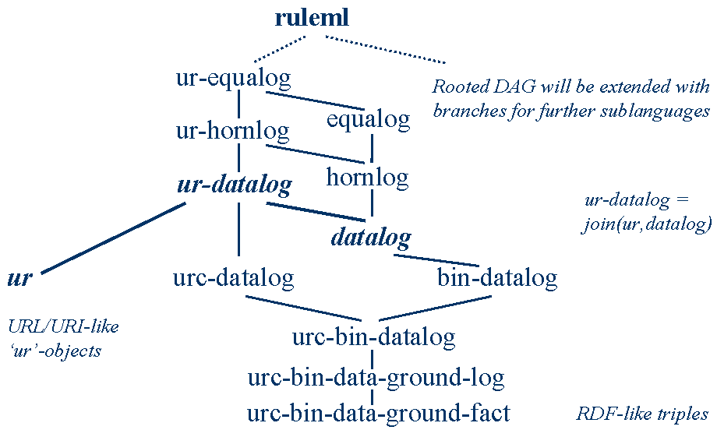
(version 0.8)
[www.ruleml.org/ruleml-krdtd/sld012.htm]

Slide 19
DTDs - Modularization
modules inherit from one another
  e.g.
however, v. 0.8 inheritance less than optimal
  counter-intuitive
  “inconsistent”
  inefficient
urc-bin-data-ground-fact
urc-bin-data-ground-log
+ imps
urc-bin-datalog
+ vars

Slide 20
DTDs - Inheritance Diagram (v. 0.8)
ruleml
ur-equalog
Rooted DAG will be extended with
branches for further sublanguages
ur-hornlog
equalog
ur-datalog
hornlog
ur-datalog = join(ur,datalog)
datalog
ur
urc-datalog
bin-datalog
URL/URI-like
‘ur’-objects
urc-bin-datalog
urc-bin-data-ground-log
urc-bin-data-ground-fact
RDF-like triples

Slide 21
DTDs - Remodularization (v. 0.85)
single root with two distinct branches (simplicity)
  far more intuitive
  simplified tree
  inverted
inheritance in one direction only (consistency)
  obvious super/subclass relationships
  each node inherits from node directly above it
non-redundant (efficiency)
  use of mods for changes affecting multiple DTDs

Slide 22
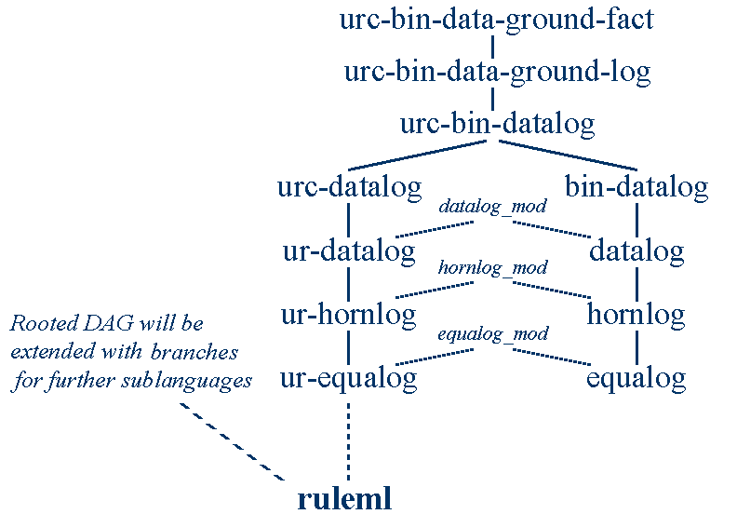
(version 0.85)
[www.ruleml.org/dtd/0.85/Inheritance_diagram.gif]

Slide 23
DTDs - Inheritance with Entities
DTDs have limited support for modularity
can still be accomplished with macro-like entities:
(note similarility to predefined ones in HTML)
  e.g. <!ENTITY copy “Copyright 2003. All rights reserved.”>
  <!-- using &copy; in document will print text -->
  usable only within DTD: parameter entities
  e.g. <!ENTITY % author “John Doe”>
  useful as a roundabout way to “inherit” the
  contents of another file
  e.g. <!ENTITY % datalog_include SYSTEM “datalog.dtd”>
%datalog_include;

Slide 24
DTDs - Overriding
inclusion of other documents isn’t enough
  what about overriding?
    version 0.8 used INCLUDE/IGNORE
    e.g. to change metarole _r
    from
    <!ELEMENT _r (ind)> (in urcbindataground fact)
    to
    <!ELEMENT _r (ind | var)> (in urcbindatalog),
    declaration of _r would be IGNOREd in
    datalog, then declared separately in hornlog
    version 0.85 uses content model-based approach

Slide 25
DTDs - Content Models
create a parameter entity for each element’s content model
  e.g. <!ENTITY % ind.content “(#PCDATA)”>
<!ELEMENT ind %ind.content;>
subclasses overwrite param. entity with new content model
  elements/attributes can’t overwrite one another (only entities can)
  analogous to re-assigning global variables
  e.g. <!-- in urcbindatagroundfact.dtd -->
<!ENTITY % _r.content “(ind)”>
<!ELEMENT _r %_r.content;>
<!-- in urcbindatalog.dtd -->
<!ENTITY % _r.content “(ind | var)”>

Slide 26
urc-bin-data-ground-fact
fact
…
opr, (_r)*, ind, ind, (_r)*
…
ind
#PCDATA
rulebase
atom
_r
ind
urc-bin-data-ground-log
fact | imp
head | body
rulebase
imp
urc-bin-datalog
opr, (_r)*, (ind|var), (ind|var), (_r)*
ind|var
#PCDATA
atom
_r
var

Slide 27
DTDs - Demo
DTD directory listing [www.ruleml.org/dtd/0.85/]
DTD example directory [www.ruleml.org/exa/0.85/]
Online validator [www.stg.brown.edu/service/xmlvalid/]

Slide 28
XML Schema Definition (XSD)
DTDs are limited
  not XML syntax
  no constraints on character data
  “brute force” inheritance
XML Schema is better ...
  XML syntax
  datatypes
  namespaces
… but not perfect
  modularity mechanisms are vague
  very complex and verbose

Slide 29
XSD - Content Models
content model-based approach also works with XSD
  instead of parameter entities, use groups
  e.g. <!ENTITY % _r.content “(ind)”>
<!ELEMENT _r %_r.content;>
  becomes
  <xs:attributeGroup name="_r.attlist“/>
  <xs:group name=“_r.content">
  <xs:sequence>
  <xs:element ref="ind"/>
  </xs:sequence>
  </xs:group>
  <xs:complexType name=“_r.type" mixed="true">
  <xs:group ref=“_r.content"/>
  <xs:attributeGroup ref=“_r.attlist"/>
  </xs:complexType>
  <xs:element name=“_r" type=“_r.type"/>

Slide 30
XSD - Inheritance
no need for workarounds in XSD
  <redefine> makes changes and includes everything else
  e.g. <!ENTITY % _r.content “(ind | var)”>
  <!ENTITY % include SYSTEM “urcbindatagroundlog.dtd”>
%include;
becomes
  <xs:redefine schemaLocation="urcbindatagroundlog.xsd">
  <xs:group name="_r.content">
  <xs:choice>
  <xs:group ref=“_r.content"/>
  <xs:element ref="var"/>
  </xs:choice>
  </xs:group>
  </xs:redefine>

Slide 31
XSD - Demo
XSD directory listing [www.ruleml.org/xsd/0.85/]
XSD example directory [www.ruleml.org/exa/0.85/]
Online validator [www.w3.org/2001/03/webdata/xsv]

Slide 32
Steering Committee
presented to RuleML Steering Committee during teleconference
  Wednesday, November 5th, 2003 2:00pm AST
Committee members:
  Harold Boley (CA)
  Mike Dean (USA)
  Andreas Eberhart (DE)
  Benjamin Grosof (USA)
  Duncan Johnston-Watt (UK)
  Steve Ross-Talbot (UK)
  Bruce Spencer (CA)
  Said Tabet (USA)
  Gerd Wagner (NL)
work was approved

Slide 33
Future Work
existing issues
  negation
    classical/strong
    as failure
  and/or nesting
  transformation rules, reaction rules
  guarded Horn Logic (suggested by Wolfgang Nejdl, U Hannover)
  abstract syntax
further suggestions from Benjamin Grosof
  SCLP (Situated Corteous Logic Programs)
These have since been implemented:
[www.ruleml.org/dtd/0.85/]
[www.ruleml.org/xsd/0.85/]

Slide 34
Questions/Comments?
Refences
  Modularization of XHTML (with DTDs) (W3C Rec.)
  [www.w3.org/TR/xhtml-modularization]
  Modularization of XHTML (with XSD) (W3C WD)
  [www.w3.org/TR/xhtml-m12n-schema]
  Rule Markup Initiative [www.ruleml.org]

