Slide 1

From RuleML 0.88 to 0.89
Sublanguages Beyond Horn Logic ― Validation and Translation
David Hirtle
Co-op student
NRC-IIT
April 21, 2005

Slide 2
Introduction
Family of sublanguages
  UML-like model
RuleML 0.88 (current release)
  Grammar-like “Content Models for RuleML”
  Compact and expanded forms (Normalizer)
  Backwards compatibility (Upgrader)
  Validation
RuleML 0.89 (pre-release)
Recent publication

Slide 3
Family of sublanguages
RuleML schemas are a modular “family”
  Inheritance between sublanguages
  Easier to maintain
Use a content model-based approach
  Pioneered by XHTML
UML-like model…

Slide 4
Family of sublanguages cont.
Graphical conventions:
  Rectangle - schema drivers (actual sublanguages)
  Oval - elementary modules
  UML-like aggregation arrows
    E.g.: datalog is part of hornlog
  UML-like inheritance arrows
    E.g.: bindatalog is a datalog
Element/attribute definitions grouped as modules
  Not intended to be directly validated against
  Allow others to “borrow” specific parts of RuleML
Top-down expressiveness ordering

Slide 5
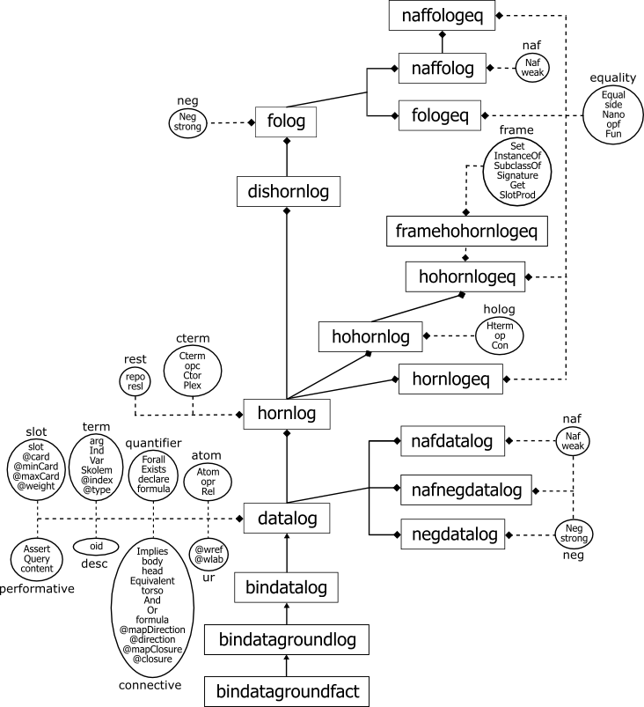
(0.89 uml model)
[http://www.ruleml.org/modularization/ruleml_m12n_089_uml_05-04-20.png]

Slide 6
RuleML 0.88
Motivated by First-Order Logic RuleML
Fully documented
  Full specification: http://www.ruleml.org/0.88
  Grammar only: Content Models for RuleML

Slide 7
RuleML 0.88 cont.
Compact and expanded forms
  User-friendly, yet maintains cross-compatibility
  XSLT Normalizer stylesheet: 088_normalizer.xslt
  Comparison: own_compact-diff.html
<Atom>
<Rel>sell</Rel>
<Ind>John</Ind>
<Ind>Mary</Ind>
<Ind>XMLBible</Ind>
</Atom>
role tags
<Atom>
<opr><Rel>sell</Rel></opr>
<arg index=“1”><Ind>John</Ind></arg>
<arg index=“2”><Ind>Mary</Ind></arg>
<arg index=“3”><Ind>XMLBible</Ind></arg>
</Atom>
type tags
(own_compact.ruleml)
(own_compact-normalized.ruleml)

Slide 8
RuleML 0.88 cont.
Backwards compatible (via XSLT conversion)
  Upgrader stylesheet: 087-to-088.xslt
  Comparison of input/output: own-diff.html
<Fact>
<head>
<Atom>
<opr><Rel>sell</Rel></opr>
<Ind>John</Ind>
<Ind>Mary</Ind>
<Ind>XMLBible</Ind>
</Atom>
</head>
</Fact>
<Atom>
<opr><Rel>sell</Rel></opr>
<Ind>John</Ind>
<Ind>Mary</Ind>
<Ind>XMLBible</Ind>
</Atom>
(own-087.ruleml)
(own-088.ruleml)

Slide 9
RuleML 0.88 cont.
Validation
  Modularity of RuleML serves as a benchmark
  Discussion on W3C XML Schema developers list
  Has helped others to identify issues…
    W3C's XML Schema Validator (XSV) (e.g. redefinition)
    Altova's XML Spy (e.g. self-references)
    …
Online demo: W3C XML Schema Validator
  Using classical own example

Slide 10
RuleML 0.89
Motivated by First-Order Logic RuleML and
the Semantic Web Services Language (SWSL)
Fully documented
  Full specification: http://www.ruleml.org/0.89
  Grammar only: Content Models for RuleML

Slide 11
RuleML 0.89
New sublanguages (expressiveness)
  folog (representing FOL RuleML)
  fologeq (adding equality)
  naffolog (adding negation as failure)
  naffologeq (adding equality and negation as failure)
  hohornlog (SWSL Hilog layer)
  hohornlogeq (adding equality)
  framehohornlogeq (adding SWSL Frames layer)
  ...

Slide 12
Recent Publication
Implementing RuleML Using Schemas,
Translators, and Bidirectional Interpreters
  Available online: implementing-ruleml-w3c-ws.html
Accepted for upcoming W3C Rules Workshop
  April 27-28 in Washington, D.C.

Slide 13
Conclusion
RuleML schemas are a modular “family”
  Each schema represents a specific sublanguage
  UML-like model
RuleML 0.88, motivated by FOL RuleML
  Syntax has 2 forms: compact and expanded (normalized)
  Backwards compatible with previous versions via XSLT
  Serves as benchmark for existing tools’ modularity support
RuleML 0.89
  Added expressiveness from new sublanguages

Slide 14
Questions?

