Slide 1

From RuleML 0.88 to 0.89
Sublanguages Beyond Horn Logic ― Validation and Translation
David Hirtle
NRC-IIT, UNB
April 21, 2005
Update: June 8, 2005

Slide 2
Overview
Introduction
Family of sublanguages
  RuleML 0.88 (current release)
  Grammar-like “Content Models for RuleML”
  Compact and expanded forms (Normalizer)
  Backward compatibility (Upgrader)
  Validation
RuleML 0.89 (pre-release)
Recent publication
Conclusion

Slide 3
Introduction
Rules are essential for the Semantic Web
  Derivation rules (implicational-inference)
  Reaction rules (event-condition-action)
  Transformation rules (functional-equational)
Rule interchange is important for e-Business
Goal is a canonical language (RuleML) for
interoperable rule markup
  XSLT translators to other SW languages, e.g. RDF
Collaborating with W3C, OMG, OASIS and other
standards bodies

Slide 4
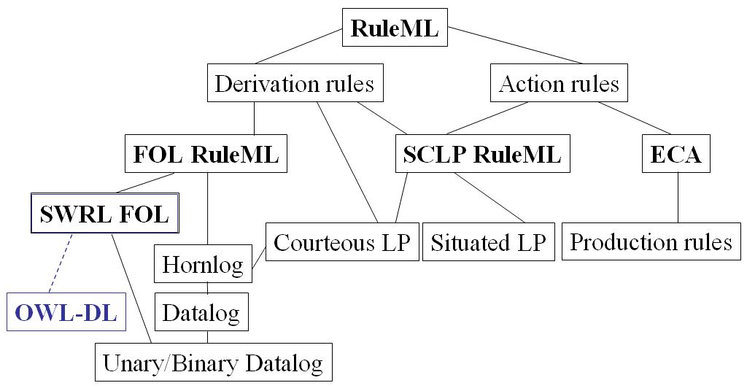

Slide 5
Family of sublanguages
RuleML schemas are a modular “family”
  Inheritance between sublanguages
  Easier to maintain
Use a content model-based approach
  Pioneered by XHTML
UML-like model…

Slide 6
Family of sublanguages cont.
Graphical conventions:
  Rectangle - actual sublanguages
  Oval - elementary modules
  UML-like aggregation arrows
    E.g.: datalog is part of hornlog
  UML-like inheritance arrows
    E.g.: bindatalog is a datalog
Element/attribute definitions grouped as modules
  Not intended to be directly validated against
  Allow others to “borrow” specific parts of RuleML
Top-down expressiveness ordering

Slide 7
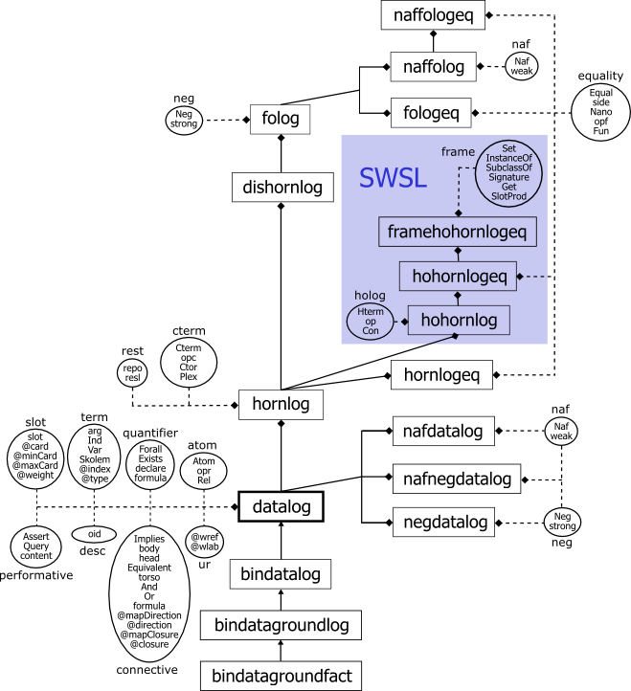
(0.89 uml model)
[http://www.ruleml.org/modularization/ruleml_m12n_089_uml_05-06-01.png]

Slide 8
RuleML 0.88
Motivated by First-Order Logic RuleML
(FOL RuleML)
Fully documented
  Full specification: http://www.ruleml.org/0.88
  Grammar only: Content Models for RuleML

Slide 9
RuleML 0.88 cont.
Compact and expanded forms
  User-friendly, yet maintains cross-compatibility
  XSLT Normalizer stylesheet: 088_normalizer.xslt
  Comparison: own_compact-diff.html
<Atom>
<Rel>sell</Rel>
<Ind>John</Ind>
<Ind>Mary</Ind>
<Ind>XMLBible</Ind>
</Atom>
role tags
<Atom>
<opr><Rel>sell</Rel></opr>
<arg index=“1”><Ind>John</Ind></arg>
<arg index=“2”><Ind>Mary</Ind></arg>
<arg index=“3”><Ind>XMLBible</Ind></arg>
</Atom>
type tags
(own_compact.ruleml)
(own_compact-normalized.ruleml)

Slide 10
RuleML 0.88 cont.
Backward compatible (via XSLT conversion)
  Upgrader stylesheet: 087-to-088.xslt
  Comparison of input/output: own-diff.html
<Fact>
<head>
<Atom>
<opr><Rel>sell</Rel></opr>
<Ind>John</Ind>
<Ind>Mary</Ind>
<Ind>XMLBible</Ind>
</Atom>
</head>
</Fact>
<Atom>
<opr><Rel>sell</Rel></opr>
<Ind>John</Ind>
<Ind>Mary</Ind>
<Ind>XMLBible</Ind>
</Atom>
(own-087.ruleml)
(own-088.ruleml)

Slide 11
RuleML 0.88 cont.
Validation
  Modularity of RuleML serves as a benchmark
  Discussion on W3C XML Schema developers list
  Has helped others to identify issues…
    W3C's XML Schema Validator (XSV) (e.g. redefinition)
    Altova's XML Spy (e.g. self-references)
    …
Online demo: W3C XML Schema Validator
  Using classical own example

Slide 12
RuleML 0.89
Motivated by FOL RuleML and the
Semantic Web Services Language (SWSL)
Fully documented
  Full specification: http://www.ruleml.org/0.89
  Grammar only: Content Models for RuleML

Slide 13
RuleML 0.89 cont.
New sublanguages (expressiveness)
  Modular spec of FOL RuleML as submitted to the W3C
    folog
    fologeq (adding equality)
    naffolog (adding negation as failure)
    naffologeq (adding equality and negation as failure)
  Providing the serialization of SWSL
    hohornlog (SWSL Hilog layer)
    hohornlogeq (adding equality)
    framehohornlogeq (adding SWSL Frames layer)

Slide 14
RuleML 0.89 cont.
New tag <Data>
  Optionally specify an XML Schema built-in datatype
    date
    integer
    string
    …
  Checked during validation
    E.g. <Data xsi:type=“xs:short”>10000000</Data> won’t
    validate because 10000000 > 32767 (=“short”)

Slide 15
Recent Publication
Implementing RuleML Using Schemas,
Translators, and Bidirectional Interpreters
  Available online: implementing-ruleml-w3c-ws.html
Accepted for W3C Rules Workshop
  April 27-28 in Washington, D.C.

Slide 16
Conclusion
RuleML schemas are a modular “family”
  Each schema represents a specific sublanguage
  UML-like model
RuleML 0.88, modular XSD spec of FOL RuleML
  Syntax has 2 forms: compact and expanded (normalized)
  Backwards compatible with previous versions via XSLT
  Serves as benchmark for existing tools’ modularity support
RuleML 0.89
  Added expressiveness from new sublanguages
  New tag <Data> which may specify a built-in datatype

Slide 17
Questions?

