Slide 1
People Friend Advisor
Based on interests and daily routines
By: Mehdi Rohaninezhad
National University of Malaysia(UKM)
Feb 10, 2012

Slide 2
Rule responder rule engines
Rule Engine
Prova: Uses Reaction RuleML to implement agent interaction (behavior), e.g. realizing Organizational Agent (OA)
OO jDREW: Uses Hornlog RuleML to implement reasoning (decisioning), e.g. realizing Personal Agent (PA)
DR-Device: Uses DR RuleML to implement defeasible logic

Slide 3
Person Profile
Each person is a part of society. In this project persons have two main property classes, interest and daily routines.
person’s profile:
Person(John^
name->John ;
knows->[Mary] ;
interest.no->4:Integer;
address->place[country ->Canada ; city->Vancouver] ;
phones->tel[cell->098 ; home->3435]).
person2
Interest
DailyRoutines
person3
Interest
DailyRoutines
person1
Interest
DailyRoutines
person4
Interest
DailyRoutines
person5
Interest
DailyRoutines

Slide 4
From Interests to Daily Routines and person profile
Interests
Daily Routines
HomeInterest
JobInterest
Leisure routine
Job routine
Person Profile

Slide 5
Related to: interests, daily routines and persons
Interest, dailyRoutines and person are three main predicates in this project. They play the role of ground facts.
relatedTo is a slotted term in interest predicates, which implies a kind of priority relation between person’s interests.
relatedTo is a slotted term in dailyRoutine predicates, which implies a kind of chronological order between person’s daily routines.
knows is a Plex term in person predicates, which implies a list of persons who are known directly.

Slide 6
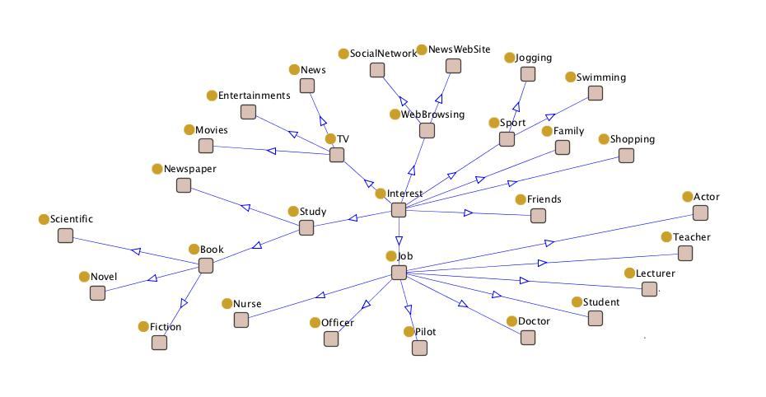
Interest taxonomy

Slide 7
Interest profile
Interests have RDF taxonomy. Person’s interests are related to each other in a priority order.
Here is an example of John’s interest profile
interest(JackJob^^Teacher^ person->Jack ; class->Teacher; job->JackJobRoutine ; degree-> 1^^Integer ; relatedTo->JackFacebook^^ SocialNetwork).
interest(JackFacebook^^ SocialNetwork^ person->Jack ; class->SocialNetwork ; degree-> 2^^Integer ; relatedTo->JackNovel^^Novel).
interest(JackNovel^^Novel^ person->Jack ; degree-> 3^^Integer ;class->Novel; relatedTo->JackJogging^^Jogging).
interest(JackJogging^^Jogging^ person->Jack ; class->Jogging ; degree-> 4^^Integer ).
Teacher
SocialNetwork
Novel
Jogging

Slide 8
Interest profile rules(1)
Rules for generating person interest lists
1-
getAllInterestCategories(?p , ?allInterestCategories , ?n^^Integer) :-
person(? ^ name->?p ; interest.no->?n^^Integer !?),
interestCategorylist(?p, [] , ?allInterestCategories, ?n^^Integer).
2-
interestCategorylist(?p, ?visited , [] , 0^^Integer).
interestCategorylist(?p, ?visited , [ ?c| ?rest], ?n^^Integer) :-
interest(?i^^Interest ^ person->?p ; class->?c ; degree->?dg !?),
greaterThan(?n^^Integer , 0^^Integer),
equal (?dg^^Integer ,?n^^Integer),
subtract(?n1^^Integer , ?n^^Integer ,1^^Integer),
notMember(?c , ?visited),
interestCategorylist(?p , [ ?c| ?visited] , ?rest , ?n1^^Integer).

Slide 9
Interest profile rules(2)
Query:
getAllInterestCategories(Jack , ?allInterestCategories , ?n^^Integer).
OO jDREW TD Result :
?allInterestCategories : [Jogging, Novel, SocialNetwork, Teacher]
?n: 4:Integer

Slide 10
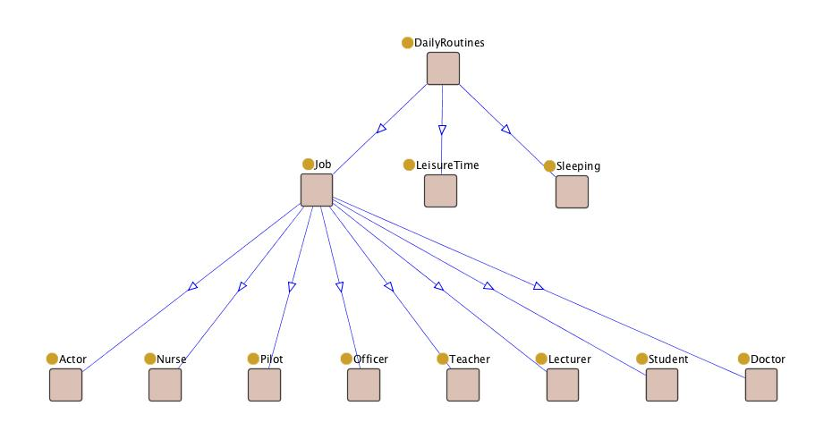
Daily Routine taxonomy

Slide 11
Daily Routine profile
Daily routines taxonomy is consisted of Job, Leisure activities and Sleeping. They are related with each other in chronological order.
Here is the Jack’s daily routines.
dailyRoutines(JackJobRoutine^^Teacher ^ person->Jack ; class->Teacher ;
duration->time[from->8.30^^Real ; to->16.30^^Real] ;
place->pl[UNB,Torento] ; relatedTo->JackLeisureTime^^LeisureTime).
%------------------------------------------------------------
dailyRoutines(JackLeisureTime^^LeisureTime ^ person->Jack ;
duration->time[from->18.30^^Real ; to->23.00^^Real];
place->pl[home , club] ; relatedTo->JackSleep^^Sleeping).
%------------------------------------------------------------
dailyRoutines(JackSleep^^Sleeping ^ person->Jack ;
duration->time[from->24.00^^Real ; to->7.00^^Real];
place->pl[home]).
Job
Leisure
Sleeping

Slide 12
Enjoy time(1)
Enjoy time is a time that a person spend on his/her interests. For a person who is interested in his job , the job time also should be considered. This predicate is implemented via NAF.
getEnjoyTime(?p,?time) :-
naf(getJobInterest(?p , ?i)),
getLeisureTime(?p , ?time).
%-----------OR
getEnjoyTime(?p,?time) :-
getJobInterest(?p , ?i),
getLeisureTime(?p , ?time1),
getJobTime(?p, ?time2),
add(?time^^Real, ?time1^^Real, ?time2^^Real)

Slide 13
Enjoy time(2)
Query:
getEnjoyTime(Mary,?time)
OO jDREW TD Result:
?time 13.7 : Real

Slide 14
Workmates(1)
Another helpful predicate is used for finding workmate list.
getWorkmateList(?job, ?visited , [] , 0^^Integer).
getWorkmateList(?job, ?visited , [?p|?rest] , ?n^^Integer) :-
greaterThan(?n^^Integer , 0^^Integer),
getJob(?job , ?p),
subtract(?n1^^Integer, ?n^^Integer ,1^^Integer),
notMember(?p , ?visited),
getWorkmateList(?job, [?p|?visited] , ?rest ,?n1^^Integer).

Slide 15
Workmates(2)
Query:
getWorkmateList(Teacher, [] , ?list , 2^^Integer).
OO jDREW TD Result :
?list [Harry, Jack]

Slide 16
Friend Advisor based on interests and leisure time interval(1)
People may be advised to make a friend based on common interests and leisure time interval. In this case their relation is not considered as an assumption. System offers a time interval for common leisure activities based on their leisure time intersection. System assign a grade for each friendship relation based on common interests(?grade).
friendAdviceBaseOnInterests(?p1 , ?p2, ?grade , [?lowerBound , ?upperBound]) :-
haveIntersectionLeisureTime(?p1,?p2, ?lowerBound , ?upperBound),
commonInterest(?p1 , ?p2 , ?grade).

Slide 17
Friend Advisor based on interests and leisure time interval(2)
Query:
friendAdviceBaseOnInterests(John ,
?p2, ?grade ,
[? lowerBound , ?upperBound]).
OO jDREW TD Result :
?p: Mary ?grade: 2 : Integer ?lowerBound: 21.00 : Real ?upperBound: 22.00 : Real | ?p: Jack ?grade: 3 : Integer ?lowerBound: 18:30 : Real ?upperBound: 22.00 : Real | ?p: Harry ?grade: 1 : Integer ?lowerBound: 18.30 : Real ?upperBound: 22.00 : Real

Slide 18
Knows and friendship
FOAF-like knows relation is defined to be symmetric here. If knows(?p1,?p2) Then knows(?p2,?p1).
directKnows(?p1,?p2) :-
person(?p1^ knows->?list !?),
member(?p2,?list).
%-----------OR
directKnows(?p1,?p2) :-
person(?p2^ knows->?list !?),
member(?p1,?list).
Person’s knows relation satisfies transitivity here as in FOAF. The relation is DIRECT if they know each other or INDIRECT if there is a person who knows them directly.
People may know each other but not necessarily have a friendship relation.
Mary
Harry
John
Jack
indirectKnows
directKnows
indirectKnows
directKnows
directKnows
indirectKnows

Slide 19
Friend advisor based on interests and knowing(1)
Two persons may know each other while they are not friends. So they may be advised to try to make friends based on their common activities. In this case person’s relation is considered as an assumption (directly OR indirectly). System assign a grade for any friendship relation based on common interests(?grade).
friendAdvice(?p1 , ?p2, ?grade) :-
indirectKnows(?p1,?p2),
commonInterest(?p1 , ?p2 , ?grade).
%-----------OR
friendAdvice(?p1 , ?p2, ?grade) :-
directKnows(?p1,?p2),
commonInterest(?p1 , ?p2 , ?grade).

Slide 20
Friend advisor based on interests and knowing(2)
Query:
friendAdvice(John , ?p2, ?grade).
OO jDREW TD Result :
?p2 Mary ?grade: 2
?p2 Jack ?grade: 3
?p2 Harry ?grade: 1

Slide 21
DEfeasible Reasoning(1)
One of other crucial reasoning technique is defeasible reasoning which is a reasoning for typical consideration.
POSL is extending towards d-POSL.
See also: Fall 2011 Project Team 1 (http://www.cs.unb.ca/~boley/cs6795swt/fall2011projects.html).
From POSL to d-POSL: Making the Positional-Slotted Language Defeasible: http://d-posl.wikispaces.com/
Because of the fact that typically we do not have common interests with the most of persons whom we know, project could be extended towards defeasible reasoning.
At the end of the day d-POSL extension of current POSL grammar is offered.

Slide 22
DEfeasible Reasoning(2)
Scenario: Between people of whom we know, only a small set we have common interests and activities. Most of them are our friends.
1- strict rule:
r1: friend(?x , ?y) :- knows(?x ,?y).
2- defeasible rules:
r2: knows(?x , ?y) := ~commonInterest(?x , ?y).
r3: friend(?x , ?y) := commonInterest(?x , ?y).
3- superiority relation: r3>r2

Slide 23
Changing d-posl grammer(1)
The grammar offered by Team1 only cover slotted terms and should be deployed for positional and positional-slotted predicates as well.
Some parts of DPosNew.g grammar’s rule is changed to accept positional-slotted atoms as well. Expr, slot rules are modified and pos is added:
expr:
( poses (SEMI slots)?
|
slots (SEMI poses)? (SEMI slots)?
)+
{System.out.println("Expression: " + $expr.text + "\n");}
;

Slide 24
Changing d-posl grammer(2)
slots:
slot (SEMI slot)*
;
slot:
(sname ARROW svalue)
| sname COLON sname ARROW svalue
| sname HAT sname COLON sname ARROW svalue
{System.out.println("Slot: " + $slot.text + "\n");}
;

Slide 25
Changing d-posl grammer(3)
poses:
pos (COMMA pos)*
;
pos:
svalue
| sname COLON svalue
| sname HAT sname COLON svalue
{System.out.println("Position: " + $pos.text + "\n");}
;

Slide 26
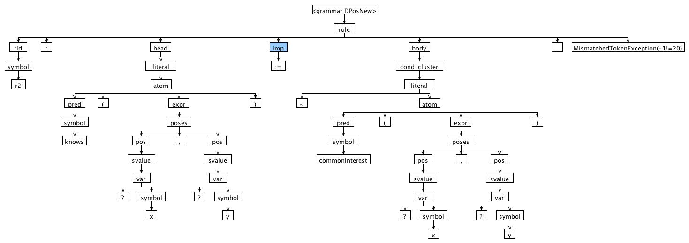
PARSE TREE OF SAMPLE INTERPRETATION

Slide 27
TEST RIG OF SAMPLE 1(Team1)
Rule ID: r1
SName apartment
Variable: ?x^^ACCOMMODATION
Expression: apartment->?x^^ACCOMMODATION
Atom: acceptable(apartment->?x^^ACCOMMODATION)
Literal: acceptable(apartment->?x^^ACCOMMODATION)
Literal: acceptable(apartment->?x^^ACCOMMODATION)
:
(
Predicate: carlo:apartment
^
:
SName apt845
SName carlo
SName age
)
Slot: apt845^carlo:age->12
Expression: apt845^carlo:age->12
.
Atom: carlo:apartment(apt845^carlo:age->12)
Literal: carlo:apartment(apt845^carlo:age->12)
Condition Cluster: carlo:apartment(apt845^carlo:age->12)
Body: carlo:apartment(apt845^carlo:age->12)

Slide 28
TEST RIG OF SAMPLE 2
Rule ID: r2
Expression: ?x,?y
Atom: knows(?x,?y)
Literal: knows(?x,?y)
Literal: knows(?x,?y)
(
line 1:47 mismatched input '<EOF>' expecting NEWLINE
?
,
?
)
Expression: ?x,?y
.
Atom: commonInterest(?x,?y)
Literal: ~commonInterest(?x,?y)
Condition Cluster: ~commonInterest(?x,?y)
Body: ~commonInterest(?x,?y)

Slide 29
conclusion
The idea of this project can be considered as a reasoning component for a PA in a virtual organization.
Defeasible reasoning extension of the sample helps PA to make difference between knowing and friendship concepts based on interest. Knowing concept might be considered as just a relation, but common interests, daily routines, gender and job prepare the ground for friendship.
Thanks to Harold Boley and RuleML colleagues for feedback on this project.

Slide 30
Thanks a lot for your attention

