Slide 1

Personal Agents in the
Rule Responder Architecture
Harold Boley
Benjamin Craig
Institute for Information Technology
National Research Council, Canada
Fredericton, NB, Canada
RuleML-2008
Orlando Florida
October 30-31, 2008

Slide 2
Outline
Rule Responder Overview
Agents
  Personal / Organizational / External
Infrastructure
  Reaction RuleML Messages
  Message Performatives
  Agent Communication Protocols
  Mule ESB (Communication Middleware)
Rule Engines (for Realizing Agents)
  Prova
  OO jDREW
Symposium Planner Use Case
  Query Delegation/Answering
  Shared Knowledge between Pas
  Ontology Description
Future Work and Conclusion

Slide 3
Overview of Rule Responder (I)
Rule Responder is an experimental
multi-agent system for collaborative teams and virtual communities on the Web
Supports rule-based collaboration between the distributed members of such a virtual organization
Members of each virtual organization are assisted by semi-automated rule-based agents, which use rules to describe the decision and behavioral logic
Notes:
Why rules are important -> to implement the decision logic

Slide 4
Overview of Rule Responder (II)
Uses languages and engines of the RuleML family for rule serialization, based on logic and XML:
  Hornlog RuleML: Reasoning
  Reaction RuleML: Interaction
Implemented on top of a Mule-based
Service Oriented Architecture (SOA)
Notes:
Why rules are important -> to implement the decision logic

Slide 5
Personal Agents
A personal agent assists a single person
of an organization, (semi-autonomously) acting on his/her behalf
It contains a FOAF*-like fact profile plus
FOAF-extending rules to encode selected knowledge of its human owner
* The Friend of a Friend (FOAF) project: http://www.foaf-project.org

Slide 6
Organizational Agents
An organizational agent represents goals and strategies shared by each member of the organization
It contains rule sets that describe the policies, regulations, opportunities, etc. of its organization

Slide 7
External Agents
External agents exchange messages with (the public interface of) organizational agents, asking queries, receiving answers, or interchanging complete rule sets
End users, as external agents, employ a Web (HTTP) interface of Rule Responder (currently an API-like browser interface)
Support for simultaneous external agents: Currently, end users (B2C)
Ultimately, other organizations (B2B)

Slide 8
Rule Responder as a
Multi-Agent Infrastructure
Realizes a System of OAs, PAs, and EAs
Built on the Mule ESB
The OAs and PAs are realized each with an instance of a Rule Engine
Combines the ideas of multi-agent systems, distributed rule management systems, as well as service-oriented and event-driven architectures

Slide 9
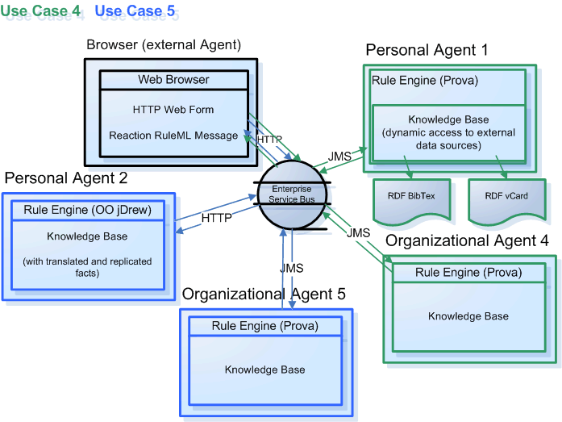
Infrastructure - Overview

Slide 10
Translation Between PAs' Native Languages and OA's Interchange Language
Each rule engine can use its own rule language
Agents require an interchange language so that they can understand each other
Rule Responder uses Reaction RuleML as its interchange language
Translation is done with an XSLT stylesheet

Slide 11
Reaction RuleML
Reaction RuleML is a branch of the RuleML family that supports actions and events
When two agents need to communicate, each others’ Reaction RuleML messages are sent through the ESB
Carries RuleML queries, answers, and rule bases to/from agents

Slide 12
Example Reaction RuleML Message
<RuleML xmlns="http://www.ruleml.org/0.91/xsd"
xmlns:xsi="http://www.w3.org/2001/XMLSchema-instance"
xsi:schemaLocation="http://www.ruleml.org/0.91/xsd
http://ibis.in.tum.de/research/ReactionRuleML/0.2/rr.xsd"
xmlns:ruleml2007="http://ibis.in.tum.de/projects/paw#">
<Message mode="outbound" directive="query-sync">
<oid> <Ind>RuleML-2008</Ind> </oid>
<protocol> <Ind>esb</Ind> </protocol>
<sender> <Ind>User</Ind> </sender>
<content>
<Atom>
<Rel>getContact</Rel>
<Ind>ruleml2008_PanelChair</Ind>
<Ind>update</Ind>
<Var>Contact</Var>
</Atom>
</content>
</Message>
</RuleML>

Slide 13
Message Performatives
The attribute directive="..." corresponds to the pragmatic performative
Specify message exchange/interaction protocols
Rule Responder Performatives
  In tradition of KQML and FIPA-ACL
  Currently implemented: Query and Answer
  Retract and Update in collaboration with RIF-PRD

Slide 14
Agent Communication Protocols
WSDL-like protocols
In-Only
  Message is sent to agent₁ from agent₂; then agent₁ executes performative
Request-Response
  Performs above in-only; then agent₁ sends response back to agent₂
Request-Response-Acknowledge
  Does Request-Response; then agent₂ sends a response back to agent₁
Workflows
  Generalizes the above protocols to allow arbitrary compositions of agent messages

Slide 15
Communication Middleware
Mule Enterprise Service Bus (ESB)
  Mule* is used to create communication end points at each personal and organizational agent of Rule Responder
  Mule supports various transport protocols
  (e.g. HTTP, JMS, SOAP)
  Rule Responder currently uses HTTP and JMS as transport protocols
  * Mule – The open source SOA infrastructure: http://mulesource.com

Slide 16
Rule Engines
Prova: Prolog + Java
OO jDREW: Object Oriented
java Deductive Reasoning Engine for the Web

Slide 17
Prova
Prova is mainly used to realize the organizational agents of Rule Responder
It implements Reaction RuleML for agent interaction (event-condition-action rules)

Slide 18
OO jDREW
OO jDREW is used to realize the
personal agents of Rule Responder
It implements Hornlog RuleML for agent reasoning (Horn logic rules)
Supports rules in two formats:
  POSL: Positional Slotted presentation syntax
  RuleML: XML interchange syntax
  (can be generated from POSL)

Slide 19
Use Case: Symposium Planner
RuleML-20xy Symposia
  An organizational agent acts as the single point of entry to assist with the symposium:
    Currently, query answering about the symposium
    Ultimately, preparing and running the symposium
  Personal agents have supported symposium chairs since 2007 (deployed as Q&A in 2008)
    General Chair, Program Chair, Panel Chair, Publicity Chair, etc.

Slide 20
Online Use Case Demo
Rule Responder:
http://responder.ruleml.org
RuleML-2007/RuleML-2008 Symposia:
http://ibis.in.tum.de/projects/paw/ruleml-2007
http://ibis.in.tum.de/projects/paw/ruleml-2008
Personal agents:
Supporting all Chairs
Organizational agent:
Supporting Symposium as a whole
Online

Slide 21
Query Delegation
Query delegation to personal agents is done by the organizational agent
Tasks for the symposium organization are managed via a role assignment matrix
Is defined here by an OWL Lite Ontology
(alternatives: RDFS, RuleML, ...)
Assigns (meta)topics to agents within the virtual organization: ... see next slide ...

Slide 22
Role Assignment Ontology
Topics
Metatopics
Agents
Sponsoring
.
.
.
General Chair
General Chair
Press Release
Challenge
Program Chair
Program Chair
.
.
.
Demos
Challenge Chair
Challenge Chair
.
Panel
.
.
.
.
.
.
.
.
.
.
.
.
.
.
.
.
.
Participants
Publicity Chair
Publicity Chair
Registration
.
.
Panel Chair
Panel Chair
.
Visa Letter
Responsible
Submissions
.
.
.
Accountable
Presentations

Slide 23
Multiple Query Answers by PAs
Some queries have more than one answer
The PA will send the answers one at a time to the OA (interleaved backtracking and transmission)
When no more answers are computed, an end-of-transmission message is sent back

Slide 24
Shared Knowledge Between Personal Agents
Rules can be shared among personal agents
Rules that apply to all PAs can be moved up to the OA level
... see next slide ...

Slide 25
Organizational Symposium
Agent Knowledge Base
% Sample Prova-like rule (in POSL syntax)
stored in the OA:
getContact(?topic, ?request, ?contact) :-
% Uses the topic and request to delegate the following query to appropriate PA
person(
?contact, ?role, ?title, ?email, ?telephone).
Notes:
Explain how the rules work

Slide 26
Personal Panel Chair Agent Knowledge Base
% Sample FOAF-like facts used by the OA rule:
% Example fact stored in the Panel Chair’s PA
person(John, PanelChair, PHD, john@email.com, 1-555-555-5555)
% Example fact stored in the Publicity Chair’s PA
person(Tracy, PublicityChair, PHD, tracy@email.com, 1-444-444-4444)
% Sample query in RuleML syntax:
... see next slide ...
Notes:
Explain how the rules work

Slide 27
Sample Message to Organizational Agent
<RuleML xmlns="http://www.ruleml.org/0.91/xsd"
xmlns:xsi="http://www.w3.org/2001/XMLSchema-instance"
xsi:schemaLocation="http://www.ruleml.org/0.91/xsd
http://ibis.in.tum.de/research/ReactionRuleML/0.2/rr.xsd"
xmlns:ruleml2007="http://ibis.in.tum.de/projects/paw#">
<Message mode="outbound" directive="query-sync">
<oid>
<Ind>RuleML-2008</Ind>
</oid>
<protocol>
<Ind>esb</Ind>
</protocol>
<sender>
<Ind>User</Ind>
</sender>
<content>
<Atom>
<Rel>getContact</Rel>
<Ind>ruleml2008_PanelChair</Ind>
<Ind>update</Ind>
<Var>Contact</Var>
</Atom>
</content>
</Message>
</RuleML>
Online
http://www.ruleml.org/RuleML-2008/RuleResponder
Query Selection: Panel Chair Contact
Notes:
Explain what the message means OID, protocol, sender

Slide 28
Architecture - Execution

Slide 29
Architecture - Execution

Slide 30
Architecture - Execution

Slide 31
Architecture - Execution

Slide 32
Architecture - Execution

Slide 33
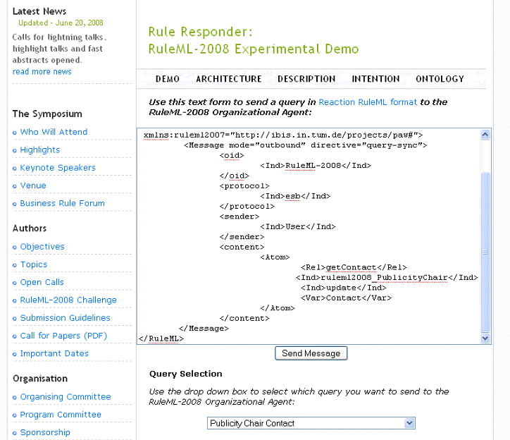

Slide 34
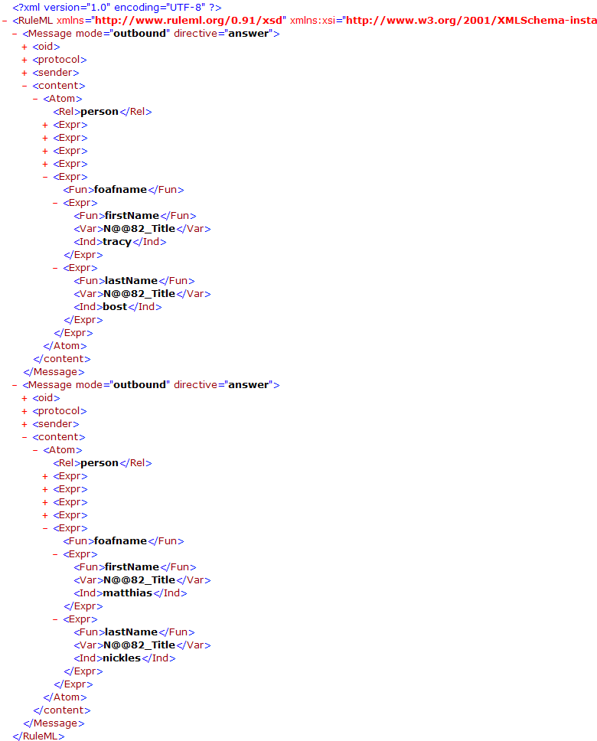
Notes:
Response

Slide 35
Sample Message to Publicity Chair Agent (I)
<content>
<Atom>
<Rel>sponsor</Rel>
<Expr>
<Fun>contact</Fun>
<Ind>Mark</Ind>
<Ind>JBoss</Ind>
</Expr>
<Ind type="integer">500</Ind>
<Expr>
<Fun>results</Fun>
<Var>Level</Var>
<Var>Benefits</Var>
<Var>DeadlineResults</Var>
</Expr>
<Expr>
<Fun>performative</Fun>
<Var>Action</Var>
</Expr>
</Atom>
</content>
Online
http://www.ruleml.org/RuleML-2008/RuleResponder
Query Selection: Publicity Chair Sponsoring
Notes:
Query

Slide 36
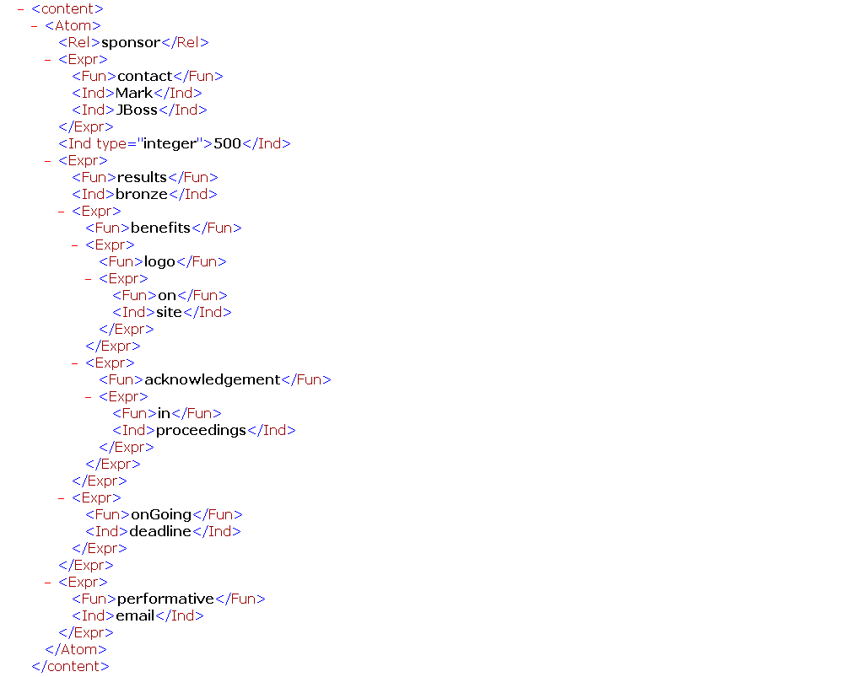
Notes:
Reponse

Slide 37
Sample Message to Publicity Chair Agent (II)
<content>
<Atom>
<Rel>sponsor</Rel>
<Expr>
<Fun>contact</Fun>
<Ind>Mary</Ind>
<Ind>Super</Ind>
</Expr>
<Ind type="integer">5000</Ind>
<Expr>
<Fun>results</Fun>
<Var>Level</Var>
<Var>Benefits</Var>
<Var>DeadlineResults</Var>
</Expr>
<Expr>
<Fun>performative</Fun>
<Var>Action</Var>
</Expr>
</Atom>
</content>
Online
http://www.ruleml.org/RuleML-2008/RuleResponder
Query Selection: Publicity Chair Sponsoring (edit)
Notes:
Query

Slide 38
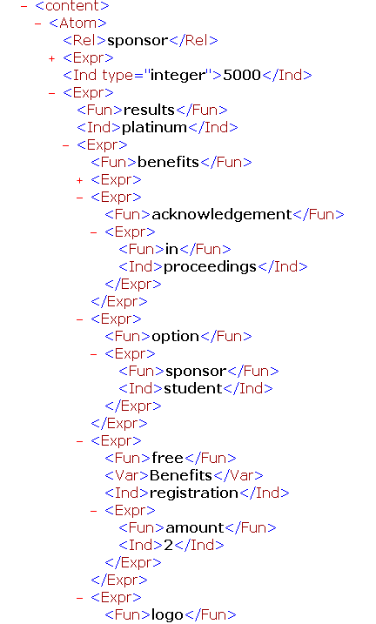
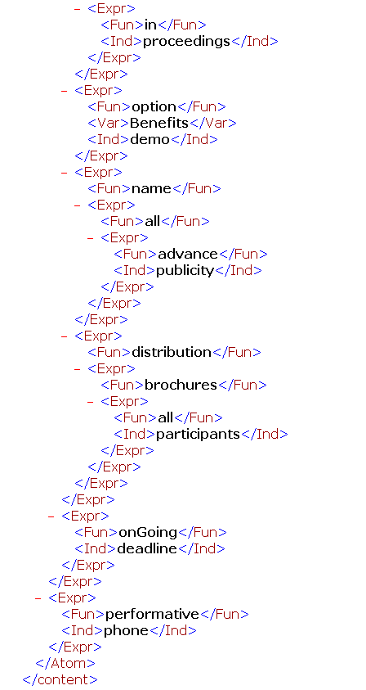

Slide 39
Conclusion (I)
Rule Responder was implemented & tested for various use cases (http://responder.ruleml.org) and deployed for RuleML-2008 Q&A
Its organizational agents delegate external queries to topic-assigned personal agents
It couples rule engines OO jDREW & Prova via Mule middleware and RuleML 0.91 XML interchange format

Slide 40
Conclusion (II)
Without a Reaction Rule Dialect, RIF could not be used for behavioral Responder logic
Current system is reusable on all levels:
Symposium Planner, Rule Responder, POSL, RuleML, OO jDREW, Prova, Mule
RuleML Techn. Group with Adrian Paschke, Alexander Kozlenkov and Nick Bassiliades:
Looking for more ‘partner engines’ (mainly Flora-2) for use case, e.g. on RuleML FOAF

Slide 41
Future Work (I)
Communication Between Personal Agent and Expert Owner
  The PA at some point may need to interact with its expert owner
  The formal interaction between PAs and their owners is email (SMTP)
  The interaction language of these emails is Reaction RuleML
Query Decomposition
  Each premise of a rule can be delegated to different PAs, followed by Integration

Slide 42
Future Work (II)
Centralized, Hierarchical (Distributed), and Networked (Distributed) Query Answering
Centralized and Distributed Knowledge Maintenance
  How to keep your rules updated
Distributed: Fault Tolerance
  Alternative agents when an agent stops working
Communication Overhead vs. Centralized Processing

